Slide 1
Software Engineering
at
Boeing

Slide 2

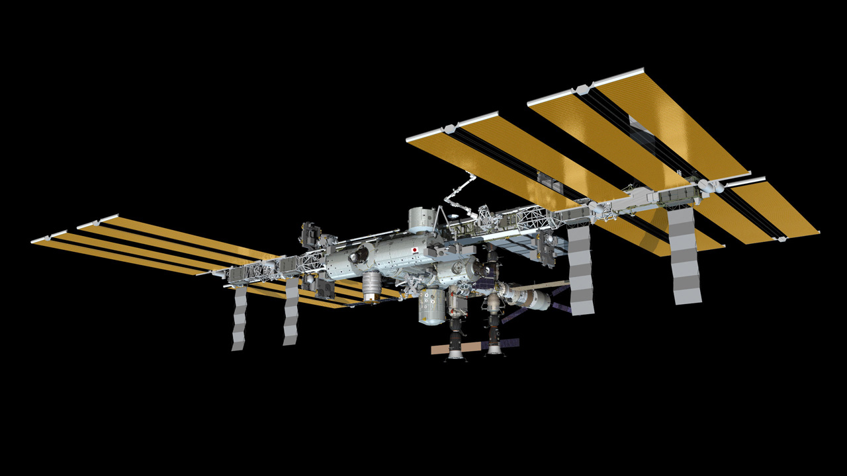






Boeing Products

Slide 3
Lots of Different Jobs
Engineering
  Aerospace
  Structures
  Electrical
  Software
  More!
Manufacturing
Business
Marketing
Testing
Sales
Training
Legal

Slide 4
Software Engineer?
Write “code”
Connect software
Requirements
Configuration
Quality

Slide 5
Where did I learn it?
College – Aerospace Engineering
On-the-job
Online Courses
Masters – Software Engineering

Slide 6
How fast are computers?
Sum the integers (natural numbers)
e.g. 1+2+3+4+5+…
1:1, 2:3, 3:6, 4:10, …
How fast can you get in 10 sec?
30 sec?

Slide 7
How about a computer?
Lets try!

Slide 8
Some Results
10 Sec
Simple python program: 70,000,000
Advance python program: 80,000,000
C++ Program:
1,000,000,000 in 0.6sec

Slide 9
Interactive Computing
Web Pages!
  Try one
Apps

Slide 10
Languages/Concepts
HTML - (HyperText Markup Language) the language that drives basic web pages.
Javascript - A language that web pages use if they want to interact with the user. This code can manipulate the HTML of the page.
Python - A simple to use language for making computers do things outside of the web.
Others: C, C++, PHP, Perl, Rust, Go, Ruby, D, R, FORTRAN, COBOL, and *many* more.

Slide 11
Places to Learn (free)
CodeAcademy - https://www.codecademy.com/ (HTML, Javascript, Python, and many more)
W3Schools - http://www.w3schools.com/ (HTML, Javascript and more)
Khan Academy - https://www.khanacademy.org/ (HTML, Javascript and more)
Learn Python - http://www.learnpython.org/ (Python)

Slide 12
Great free software
Firefox - Use it for browsing the web and working with HTML and Javascript. http://mozilla.org
Python - Easy to install python language. http://python.org
Libre Office - Like Microsoft Office, but free. http://libreoffice.org
Gimp - Edit photos (like Adobe Photoshop, but free). http://gimp.org
Inkscape - Professional graphics creation (like Adobe Illustrator, but free). http://inkscape.org
Audacity - Professional audio editor. http://audacityteam.org
VLC - Video player that will play almost any format. http://videolan.org
Git - Keep different versions of files (so you can go back), works with github.com. http://git-scm.com

