Slide 1
UFO SIGHTINGS ANALYSIS
The Martianas
File No. A-51
Angelica, Taryn & Tiffany
TOP SECRET
REPORT DATE: 4/18/2024
TRACK: Data Visualization
LOCATION: ASU- DATA ANALYTICS
MISSION: GRADUATE

Slide 2


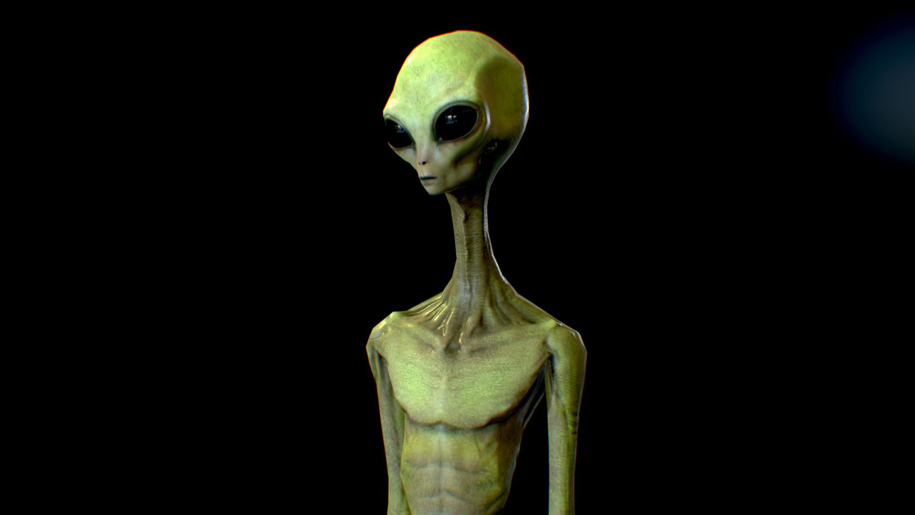
MISSION: PROJECT AND PURPOSE
The discussion surrounding UFOs, now referred to as UAPs, has persisted for centuries. Our team aims to delve into a dataset comprising information on UFO sightings and their locations, with the goal of identifying potential patterns in these sightings. We intend to present data and visualizations that address the following inquiries:
1. What are the top 5 and bottom 5 states in the USA for UFO sightings?
2. How do UFO sightings in the USA compare to those in other countries?
Which UFO shapes are most frequently sighted in the USA?
Additionally, we will examine which regions exhibit a higher concentration of reported sightings and at what times these sightings typically occur.

Slide 3
RESTRICTED: DATA
The dataset utilized for this analysis was obtained from the National UFO Reporting Center (NUFORC).
Our team opted for the "Highlighted Reports" dataset due to its ease of management and better data quality compared to the comprehensive "All Reports" dataset.
Per the website “NUFORC staff review each report, and highlight a small subset of what we feel to be the most credible or interesting cases. These tend to be reports from trained observers such as pilots, reports of anomalous structured craft seen at close distances, and reports with interesting and clear video or photographic evidence. To date, reports received since April 2023 have been reviewed for highlighting. We are working our way backwards through older reports to identify more such cases, and will be updating the online database periodically as they are marked.
https://nuforc.org/databank/

Slide 4
CAUTION: ISSUES
Flawed Data Entry (Human Error)
Limited Data Set (Highlighted Only)
There was some data with missing header but unable to drop due to amount of information that would be lost
Initially used the ‘All Data’ set, but was unable to obtain all data when parsing through each page (1488)
Issues with the interactive drop down (Flask, JavaScript,HTML)

Slide 5


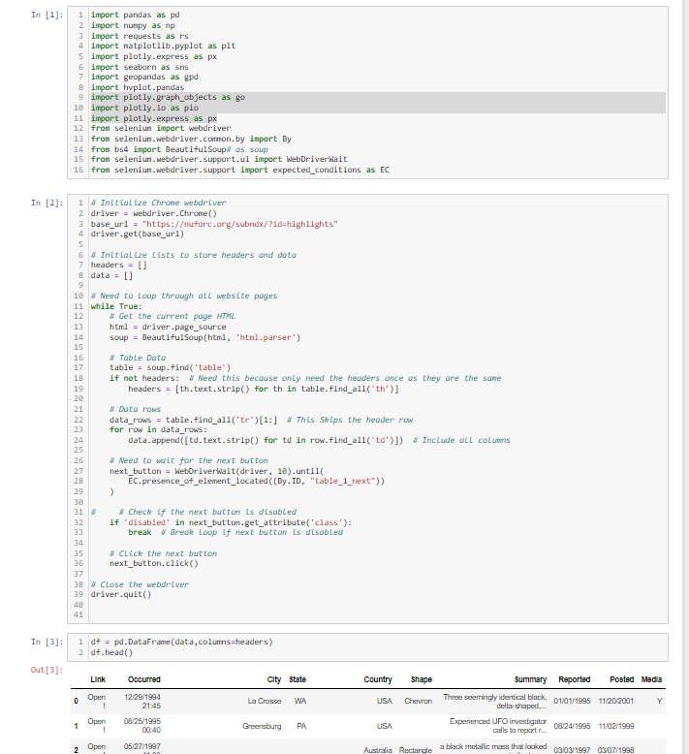
CLASSIFIED: Engineering

Slide 6
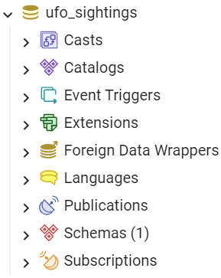
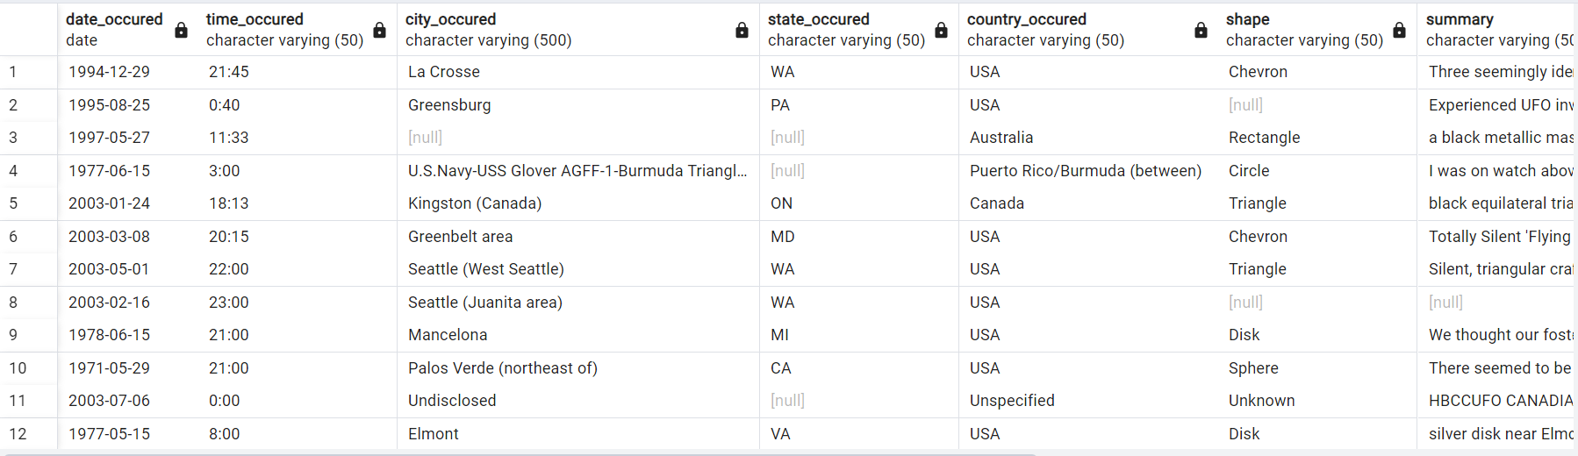
CLASSIFIED: Engineering (PostgreSQL)
Csv file created ‘highlighted_data.csv’

Slide 7
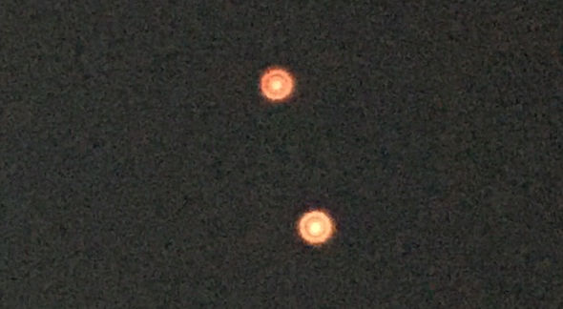
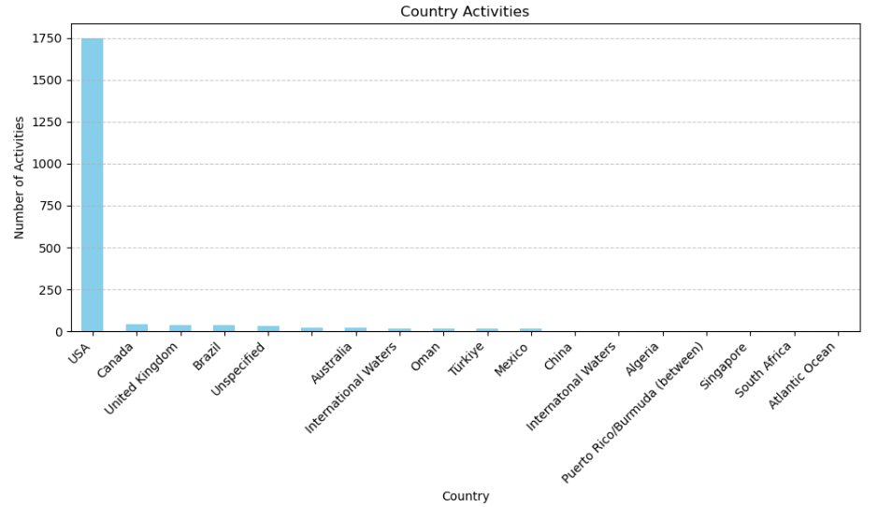
CLASSIFIED: Visualizations
REPORT: HOW DO UFO SIGHTINGS IN USA COMPARE TO OTHER COUNTRIES

Slide 8
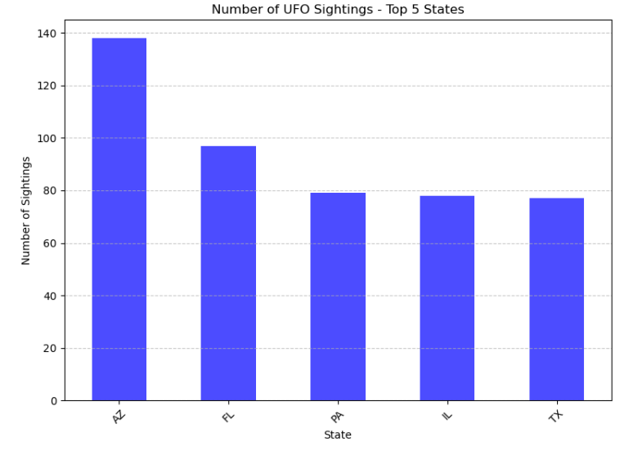
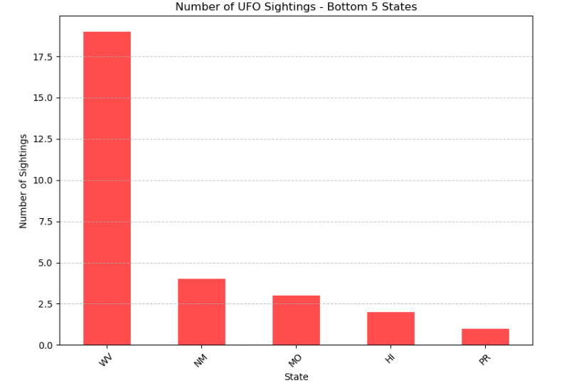
CLASSIFIED: Visualizations
REPORT: WHAT ARE THE TOP 5 AND BOTTOM 5 STATES IN THE USA FOR SIGHTINGS?
Top 5
Bottom 5

Slide 9
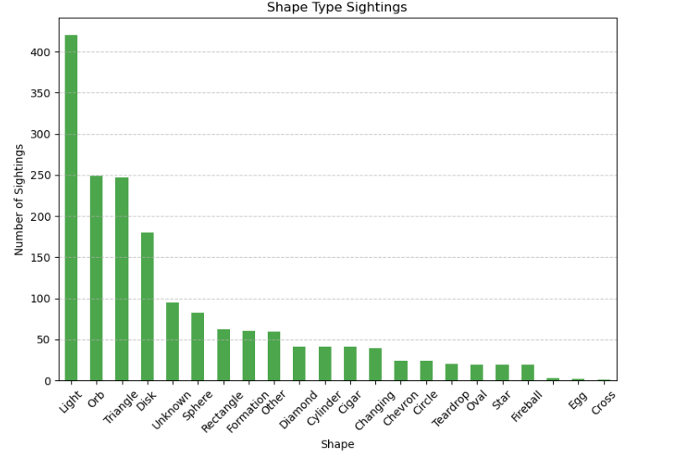
CLASSIFIED: Visualizations
REPORT: WHICH UFO SHAPES ARE MOST FREQUENTLY SIGHTED IN THE USA?

Slide 10
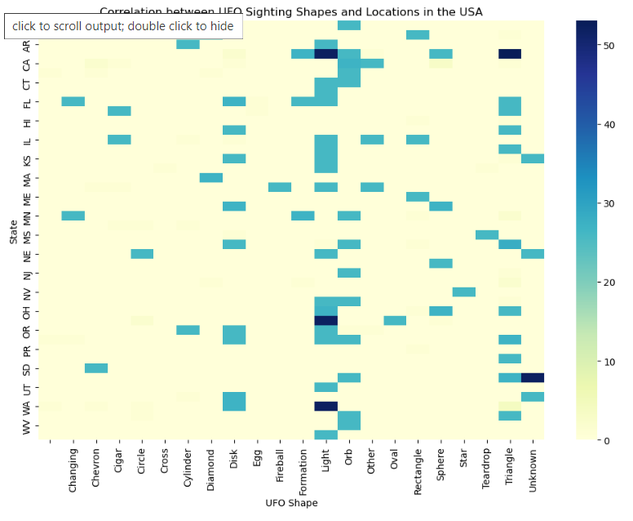
CLASSIFIED: Interactive Visualizations
REPORT: Heatmap showing # of UFO sightings by shape

Slide 11
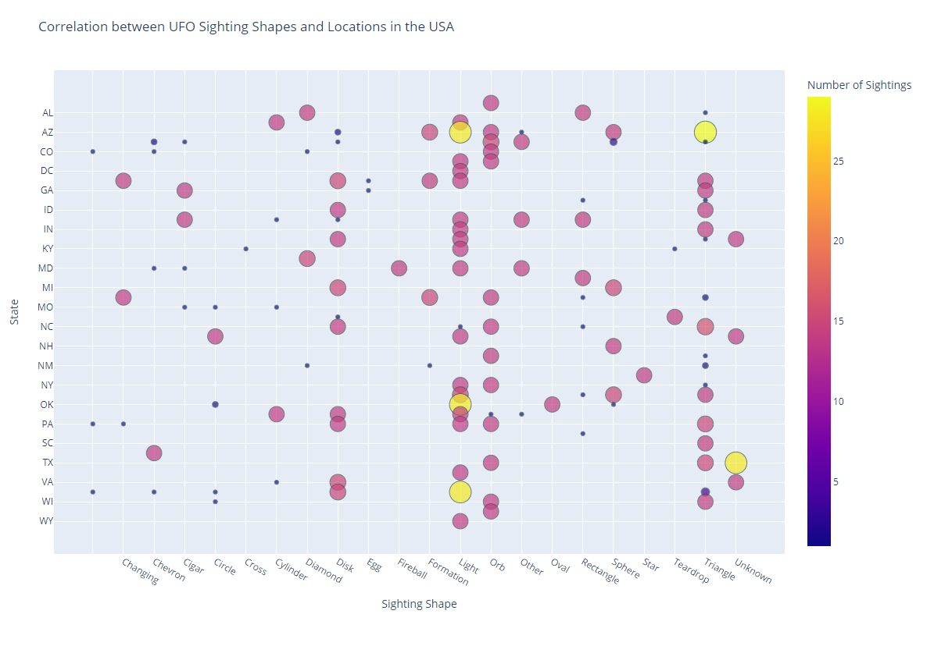
CLASSIFIED: Interactive Visualizations
REPORT: Another View showing Corr of Sightings by State

Slide 12
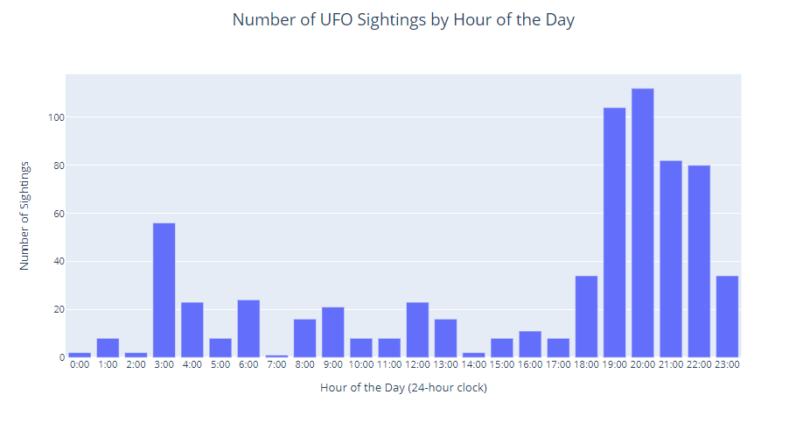
CLASSIFIED: Interactive Visualizations
REPORT: Times of UFO Sightings

Slide 13
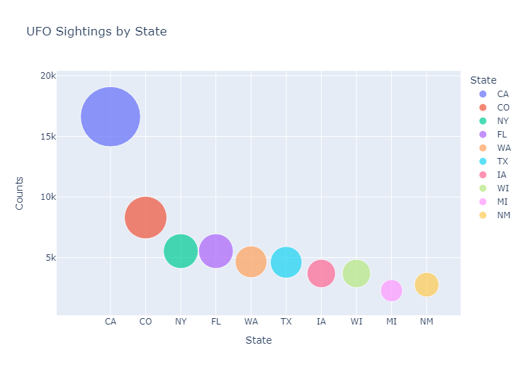
CLASSIFIED: Interactive Visualizations
REPORT: UFO Sightings by State Bubble Chart

Slide 14
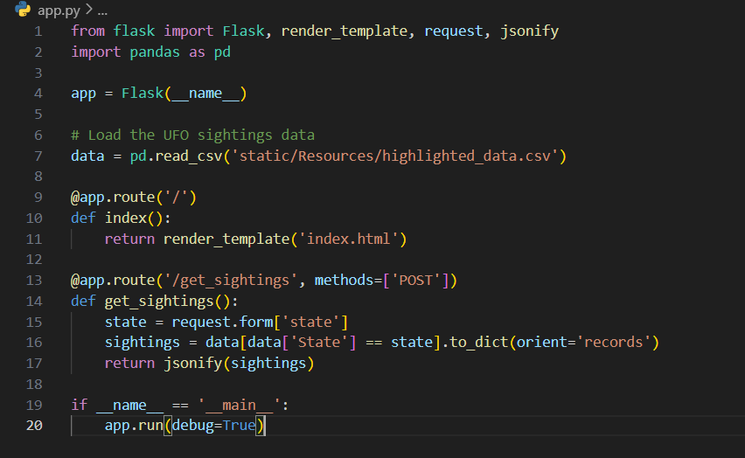
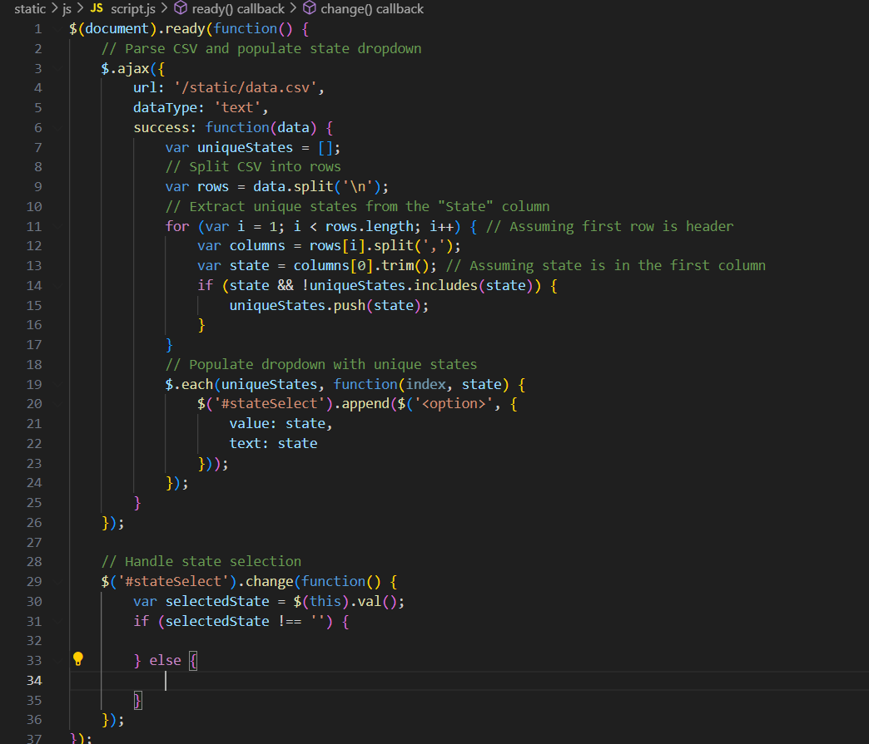
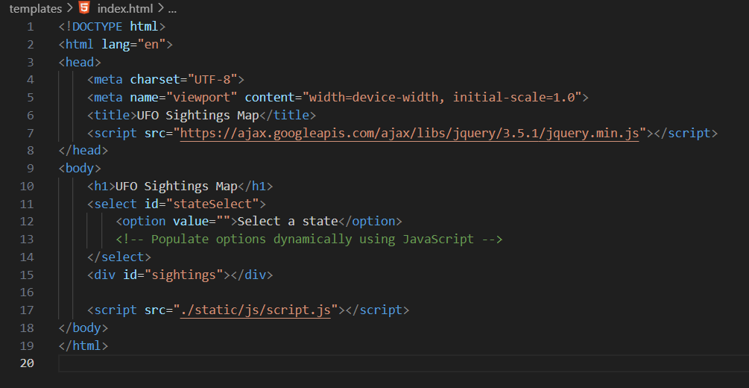
RED ZONE: Complications
REPORT: Flask (app.py), JavaScript (script.js), HTML (index.html)

Slide 15
Conclusion: Final Findings
In summary, our analysis of UFO sightings data from the National UFO Reporting Center (NUFORC) reveals significant findings. The top five states for sightings in the USA are Arizona, Florida, Pennsylvania, Illinois, and Texas, while the bottom five are West Virginia, New Mexico, Missouri, Hawaii, and Puerto Rico. Compared to other countries, the USA shows a notably higher frequency of sightings. Light-shaped objects are most commonly reported, followed by orbs. The west coast, particularly Washington, Oregon, and California, exhibits a higher concentration of sightings, with peak sightings occurring between 7 and 8 pm. These insights contribute to our understanding of UFO phenomena and may guide future research.

Slide 16
Conclusion: Final Findings
Given more time for project adjustments and with more experience, we would explore alternative methods to upload our data into a SQL database for easier access by others. We learned when sharing CSV files online , we encountered some security constraints that made direct access to the data on Postgresql difficult, and it required other users to adjust various options to gain access.
We would also consider utilizing JSON files or an API, potentially minimizing complications encountered when utilizing the d3 library for plotting purposes.

Slide 17

RESOURCES:
EdX/ASU Tutoring
Instructor
ChatGPT
How to Use Selenium to Web-Scrape with Example: https://towardsdatascience.com/how-to-use-selenium-to-web-scrape-with-example-80f9b23a843a
How to perform Web Scraping using Selenium and Python: https://www.browserstack.com/guide/web-scraping-using-selenium-python
Python Requests Module: https://www.w3schools.com/python/module_requests.asp
How to Scrape Multiple Pages of a Website Using Python?: https://www.geeksforgeeks.org/how-to-scrape-multiple-pages-of-a-website-using-python/#google_vignette
How to Scrape Multiple Web Pages Using Python: https://www.freecodecamp.org/news/how-to-scrape-multiple-web-pages-using-python/
Get the data type of column in Pandas – Python: https://www.geeksforgeeks.org/get-the-data-type-of-column-in-pandas-python/
Get a list of a particular column values of a Pandas DataFrame: https://www.geeksforgeeks.org/get-a-list-of-a-particular-column-values-of-a-pandas-dataframe/
https://www.naturalearthdata.com/downloads/10m-cultural-vectors/
https://hvplot.holoviz.org/getting_started/hvplot.html
https://www.linkedin.com/pulse/how-deploy-html-website-github-deekshith-h-r-gh9zc/
https://flask.palletsprojects.com/en/3.0.x/tutorial/
https://flask.palletsprojects.com/en/3.0.x/tutorial/templates/
https://plotly.com/python/
https://jupyter.org/widgets#:~:text=Notebooks%20come%20alive%20when%20interactive,a%20model%20impacts%20the%20results.
https://www.geeksforgeeks.org/interactive-graphs-in-jupyter-notebook/

Slide 19
UFO SIGHTINGS ANALYSIS
The Martianas
File No. A-51
CASE CLOSED

