Slide 1
Visualization and analysis of social media networks: an overview and use cases
Researcher Teemo Tebest
Hypermedialaboratory/TUT
11/11/11

Slide 2
Contents
What is a visualization?
...and what is social network analysis?
Where does the data come from?
How can we gather the data?
What kind of visualization tools can we use?
Use cases
Conclusions and next steps

Slide 3
(Information) visualization
Visualization is any technique for creating images, diagrams, or animations to communicate a message. (Wikipedia)
Visualizations purpose is to represent existing and available data in a more human-readable form.
Information visualization tries to give insight of the data that is being visualized.
Visualization can be static or dynamic.

Slide 4
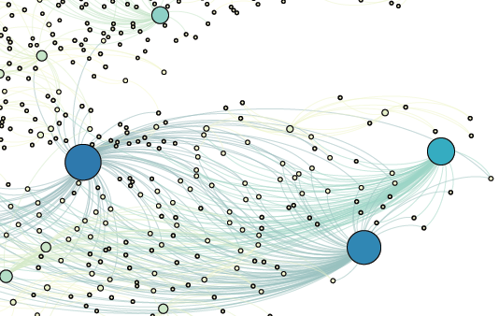
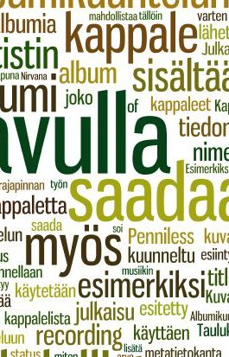

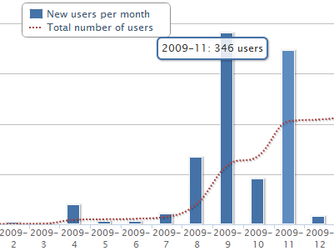
Visualizations

Slide 5
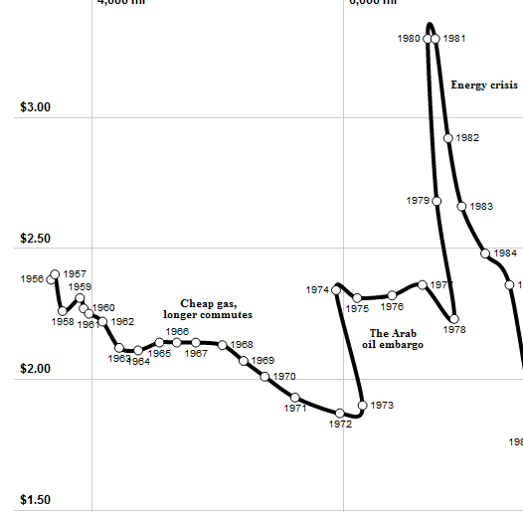
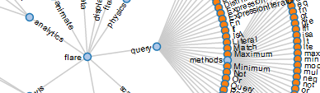
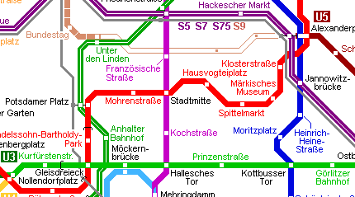
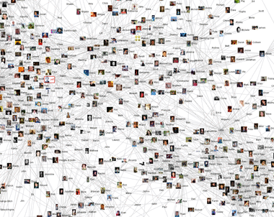

Visualizations

Slide 6
Social Network Analysis
Social network analysis (SNA) views social relationships in terms of network theory consisting of nodes and edges.
Nodes are the individual actors within the networks, and edges are the relationships between the actors.
In its simplest form, a social network is a map of specified edges, such as friendship, between the nodes being studied. (Wikipedia)

Slide 7
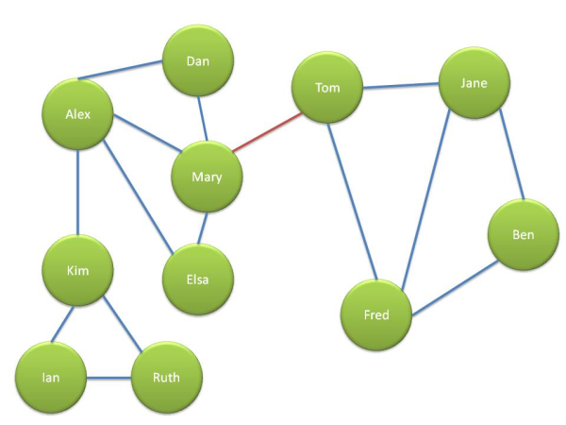
Social Network Analysis

Slide 8
Transmission
Well at least a short summary.
Now we know what I mean by visualization.
...and we know the definition of SNA.
Next we are looking on where does the data come from?

Slide 9
Data sources
(In Internet) data can be found in all kind of systems.
  Wikis, blogs, social media services, forums, databanks, logs, bonus card systems, bus route schedules, etc.
In social media the data is created by the users.
  Users interact within the system and the system used records user actions in some way (i.e. database).

Slide 10









Social Media Data Sources

Slide 11
Gathering data
How can we gather the data from the system.
There are two distinct ways to automatically gather data.
  Crawling from the frontend
  Saving in the backend

Slide 12
Gathering data
There are two distinct ways to automatically gather data.
  Crawling from the frontend
  Saving in the backend
It is crusial that all user actions are saved within the system.
  These include page views, page edits, logins, content contributions, etc.
  Some things are given but others must be considered while creating the system.

Slide 13
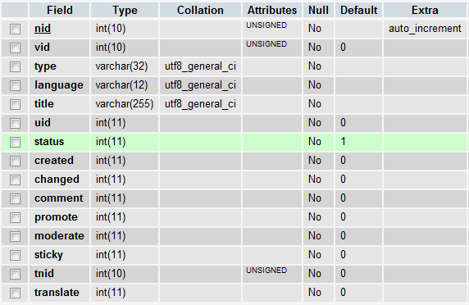
Gathering data to database
Mostly the data is saved into a database.
  MySQL, PostgreSQL, MongoDB, FS, etc.

Slide 14
Intermission
Now we have the data collected, but it is located in some database in some raw format.
This raw data gives very little insight on whats going on in the system.
There are various tools available for visualizing data.
  Commercial, free, open-source, etc.

Slide 15

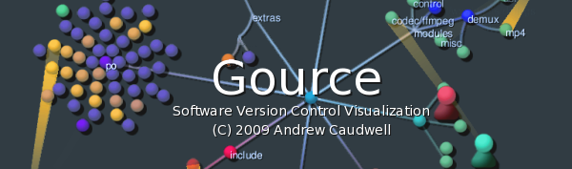

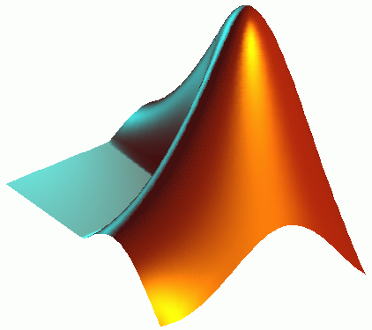




Visualization tools

Slide 16
Visualization tools
Gathered data must be often converted to the format that is used in the desired visualization tool.
Data formats include:
  CSV (Excelsheets)
  JSON
  XML (i.e. .gexf)
  Tailored arrays

Slide 17
A short overview of file formats
Script for converting data to desired file format.
.gexf – file format example.
.csv – file format example.
.gource custom file format example.

Slide 18
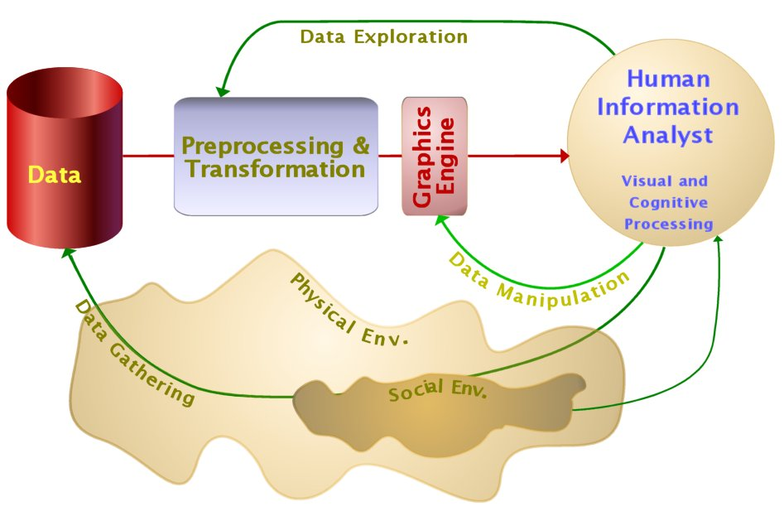
To summarize what we have gone through
We are talking about information visualization process (Ware, 2004)

Slide 19
Intermission
It's crusial to understand how information visualization (infovis) differs from scientific information visualization (scivis).
There is a need for both ad its wrong to assume that only scivis is meaningfull and infovis has no value.
Ok! Time to see some use cases.

Slide 20
Use cases
Courses:
  Developing an Online Publication 2011
  Programming Hypermedia 2011
  Usefulness of Web-Based Services 2011
Data journalism and open data:
  Tampere Data Journalism Day 29.9.2011
  Varsova Open Government Data Camp 2011

Slide 21
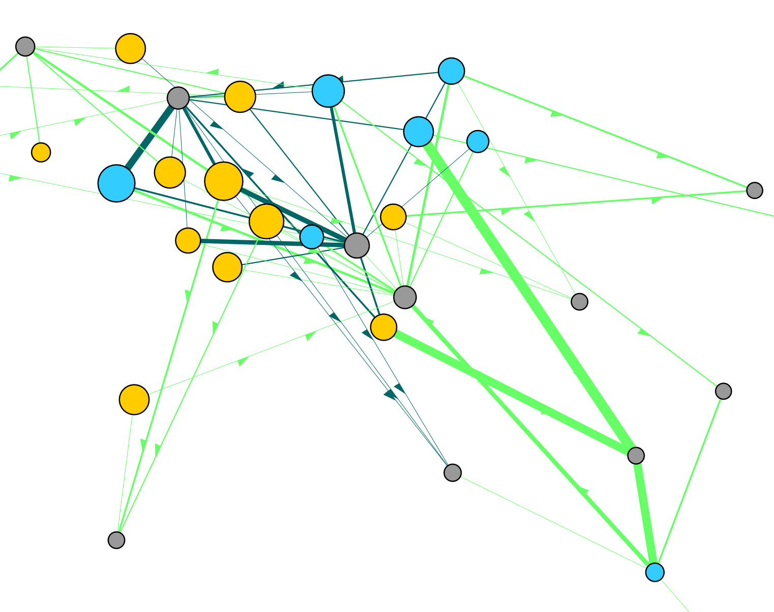
Developing an Online Publication
Academic tribes.
Yellow nodes are UTA students and cyan are TUT students. Grey nodes are wiki pages and edges represents edits.

Slide 22
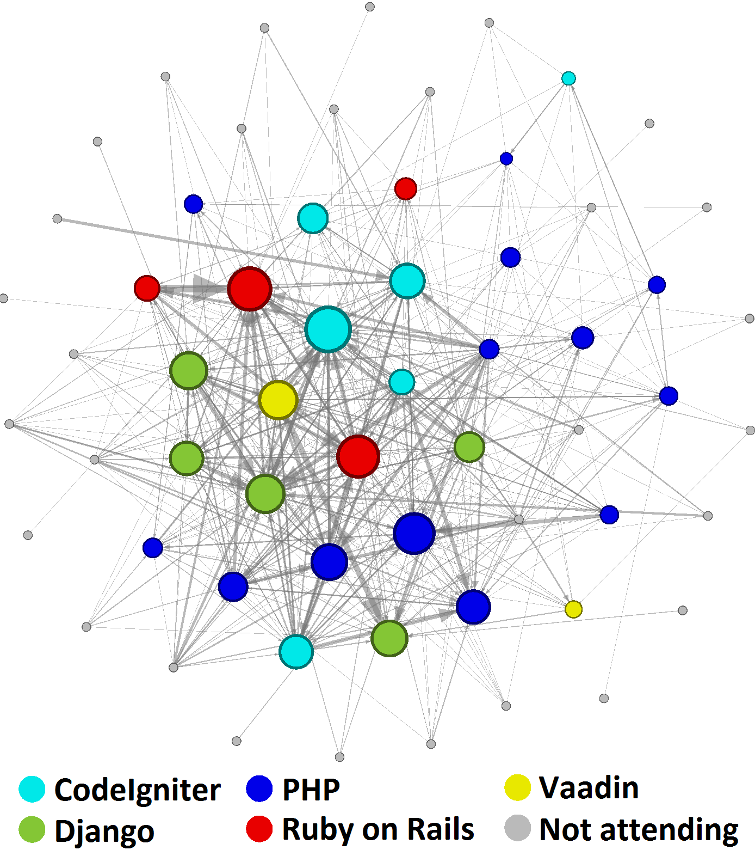
Programming Hypermedia
Peer-learning.
Nodes represent users reporting their work done in various different technologies and edges represent read counts.

Slide 23
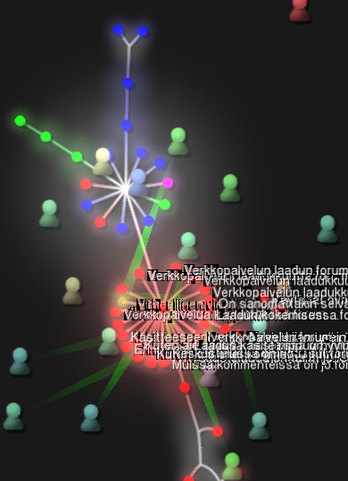
Usefulness of Web-Based Services
Bursts and deadline culture. (Barabasi, 2010)
The motivation to accomplish things increases towards the deadline.
Also very little voluntary contribution were seen.

Slide 24
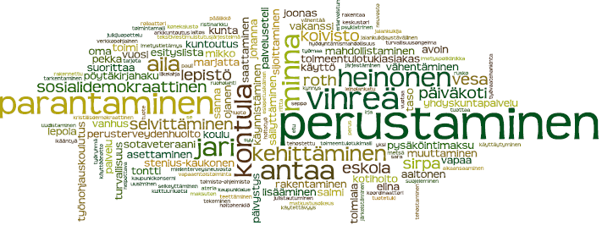
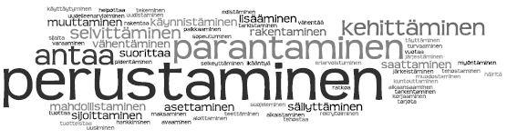
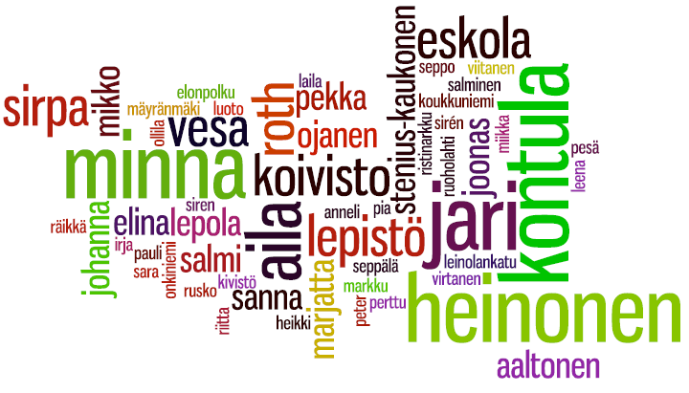
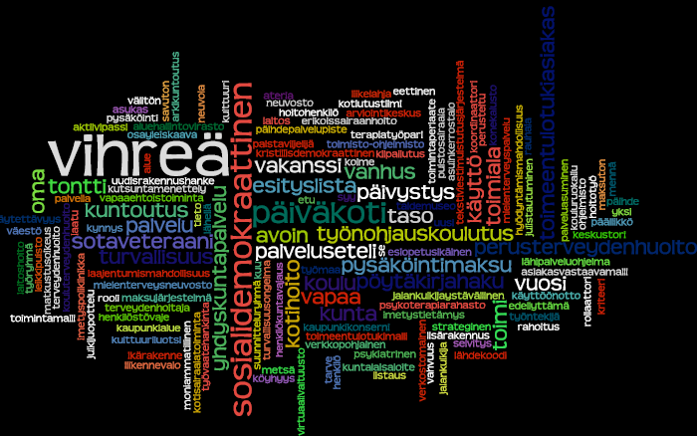
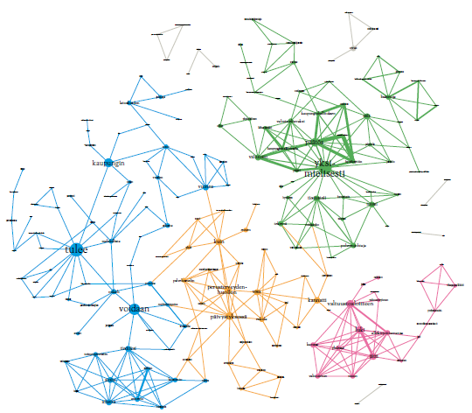
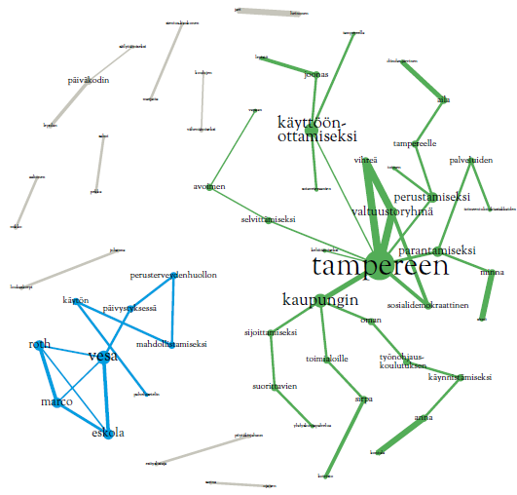
Tampere Data Journalism Day
Collaboration workshop with journalists, graphic designers and engineers.
Tampere city government decision- making data.
All was done in one day.

Slide 25
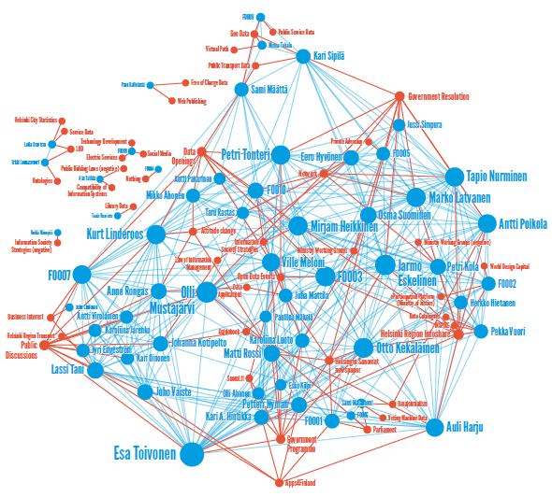
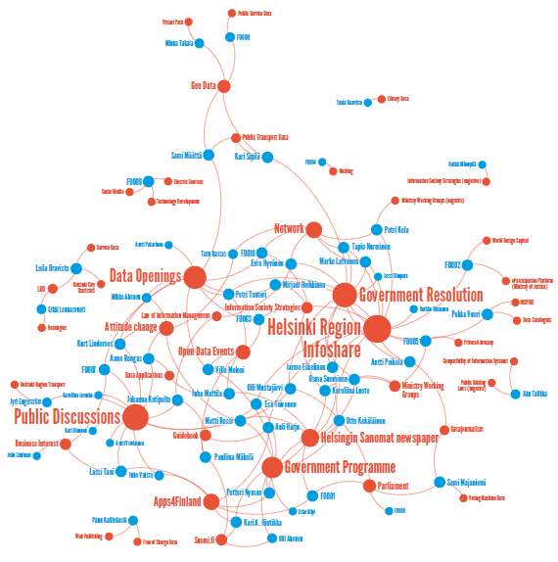
Varsova Open Government Data Camp
Finnish open-source actors and factors.
Web survey: ”Mention 3 things in the area of Finnish open-source”

Slide 26
Conclusions and Next Steps
Visualizations can reveal things that would otherwise remain hidden.
Visualizations can be informatic and/or impressive.
In the future visualizations should be more user-controlled (dynamic) and user-oriented.
Ideally anyone should be able to be an amateur social network analysist.

Slide 27
Thanks to
Jukka Huhtamäki, Kirsi Silius, Anne Tervakari, Meri Kailanto, Thumas Miilumäki and Jarno Marttila from Hypermedialaboratory/TUT.
Antti Syrjä, Johan Laitinen and Raimo Muurinen from Avanto Insight Oy.
Juuso Koponen from Informaatiomuotoilu.fi and Kirstu.
Antti Poikola from Otavan Opisto.

Slide 28
Thanks for your interest
Feel free to contact me!
https://twitter.com/teelmo
http://fi.linkedin.com/in/teelmo

Slide 29
Further readings
Barabasi A. L. (2010). Bursts: The Hidden Pattern Behind Everything We Do. Dutton Adult
Ware C. (2004). Information Visualization: Perception for Design. Morgan Kaufmann
Telea A. (2008). Data Visualization: Principles and Practice. AK Peters
Keim D., Kohlhammer J., Ellis G., Mansman F. (Eds.) (2010). Mastering the Information Age: Solving problems with visual analytics. Eurographics Association
Silius, K., Miilumäki, T., Huhtamäki, J., Tebest, T., Meriläinen, J., & Seppo, P. (2009, December). Social media enhanced studying and learning in higher education. IEEE EDUCON Education Engineering 2010 - The Future of Global Learning Engineering Education
Silius, K., Miilumäki, T., Huhtamäki, J., Tebest, T., Meriläinen, J., & Seppo, P. (2010, January). Students' motivations for social media enhanced studying and learning. Knowledge Management & E-Learning: An International Journal (KM&EL)

Slide 30
Further readings
Tebest, T. (2010, June). Web service monitoring and visualization of surveillance data [Master Thesis]. Tampere University of Technology
To be published in Bali 2011:
  Developing an Online Publication: Collaboration among Students in Different Disciplines
  Programming of Hypermedia: Course Implementation in Social Media
Web sites
  http://datajournalismi.fi/
  http://gephi.org/
  http://code.google.com/p/gource/
  http://hlab.ee.tut.fi/piiri/groups/hypermedian-ohjelmointi-2011
  http://hlab.ee.tut.fi/piiri/groups/vpkk-2011
  http://hlab.ee.tut.fi/piiri/groups/verkkojulkaisun-kehittaminen

