Slide 1

Investor Sentiment and Return Predictability
Of the Option to Stock Volume Ratio
周永昱 2020.06.09

Slide 2
目錄
CONTENTS
01
02
03
04
05
Introduction
Variables and
Summary Statistic
Empirical
Analysis
Additional
Analysis
Concluding
Remarks

Slide 3
Introduction
Variables and
Summary Statistic
Empirical
Analysis
Additional
Analysis
Concluding
Remarks
A
Investor sentiment & O/S-return
Investigate the effect of investor sentiment on the return predictive power of the option to stock volume ratio (O/S).
B
BW Investor Sentiment Index & other consumer sentiment indices
Concentrate on the aspects of Baker and Wurgler’s (2006) (BW hereafter) Investor Sentiment Index that differentiate it from other consumer sentiment indices.
Notes:
1.投資情緒對O/S預測力的影響
2.BW的投資情緒指標跟消費者情緒指數
放空限制直接影響OS預測力 JS:OS再投資人面對放空限制時跟return -相關

Slide 4
Introduction
Variables and
Summary Statistic
Empirical
Analysis
Additional
Analysis
Concluding
Remarks
Short sale constraints
O/S
Affect predictive power of O/S
Has an important impact on efficient investments in the option market
Makes options attractive
Negatively related to future stock returns when facing short sale constraints
Predictability increase when irrational demand in stocks.
Informed trading in the option market making O/S informative
High sentiment period
Consumer sentiment
O/S has stronger relation with future stock returns than low sentiment period
+ Short sale constraints
→ trade option
Alternative measure of investor sentiment
Survey-based that involves US households
May not have a direct connection with Investor Sentiment
Notes:
1.Short sale constraints + high sentiment period -> trade option
2.套利限制、irrational demand shocks-> misvaluation
-> CS 跟misvluation及IS可能沒直接關係

Slide 5
Introduction
Variables and
Summary Statistic
Empirical
Analysis
Additional
Analysis
Concluding
Remarks
Johnson and So (2012)
Focus on the effect of short sale constraints on the predictive power of O/S
Use a firm-specific measure of short sale constraints
→ Residual institutional ownership (RI): indirect measure of short sale constraints
JS Kim, DH Kim, and SW Seo (2017)
Investigates the effect of investor sentiment that reflects irrational demand and short sale constraints
→ Expect that the predictive power of O/S increase with irrational demand and short sale constraints
Also contains information on short sale constraints
→ BW Investor Sentiment Index
Notes:
Irr , short sale 影響O/S的預測力
而IS含有irr ss的資訊
Firm-specific: residual institutional ownership:RI has some limitations as a measure of short sale costs as it is an indirect measure of short sale constraints

Slide 6
Introduction
Variables and
Summary Statistic
Empirical
Analysis
Additional
Analysis
Concluding
Remarks
A
Investor sentiment & O/S-return
The return predictive power of the O/S is primarily driven by results derived during high investor sentiment periods.
B
BW Investor Sentiment Index & other consumer sentiment indices
The effect of the BW Investor Sentiment Index to be stronger than those of consumer sentiment indices.
Notes:
1.投資情緒對O/S預測力的影響
2.BW的投資情緒指標跟消費者情緒指數
放空限制直接影響OS預測力 JS:OS再投資人面對放空限制時跟return -相關

Slide 7
Introduction
Variables and
Summary Statistic
Empirical
Analysis
Additional
Analysis
Concluding
Remarks
A. Investor and Consumer Sentiment Measures
Investor Sentiment Index of BW
Consumer Sentiment Indices
Studies suggest various mispricing measures including trading volume, the premium for dividend paying stocks, the closed-end fund discount, the number of initial public offerings (IPOs), the mean first day IPO return, the equity share in new issues
BW adopt a principal component methodology to extract common variation among the six variables
Macroeconomic factors have noticeable impacts on investor sentiment suggesting that the result of raw investor sentiment are consistent with those of the residuals from the regression of such factor
MCSI & CB
Survey-based methodology among US households
The use of MCSI predates that of the CB Index
Lemmon and Portniaguina (2006) use CB Index as a measure of investor sentiment
MSCI captures changes in consumer sentiment sooner than the CB Index does
Notes:
六變數有跟IS無關的部分
MSCI: Michigan consumer sentiment index
CB: conference Board

Slide 8


Introduction
Variables and
Summary Statistic
Empirical
Analysis
Additional
Analysis
Concluding
Remarks
B. The Option to Stock Volume Ratio
Definition:
Parameter
$$O/{S_{i,w}}=\frac{OPVOL_{i,w}}{STVOL_{i,w}}$$
$OPVOL_{i,w}$ :
weekly sum of the total number of contracts traded across all options listed for stock i
$STVOL_{i,w}$ :
weekly sum of the total stock volume in units of 100 to make it more comparable with the quantity of stocks handled by option contracts as each option pertains to 100 shares of stock
Note :
Data sources:
Option : OptionMetrics
Stock : CRSP
Filter :
Options that expires between 5~30 days
Firm-week at least 25 call and 25 put contracts
Eliminate closed-end funds, real estate investment trusts, American depository receipts, and firms whose stock price are lower than $1
Notes:
1.Short sale constraints + high sentiment period -> trade option
2.套利限制、irrational demand shocks-> misvaluation
-> CS 跟misvluation及IS可能沒直接關係

Slide 9
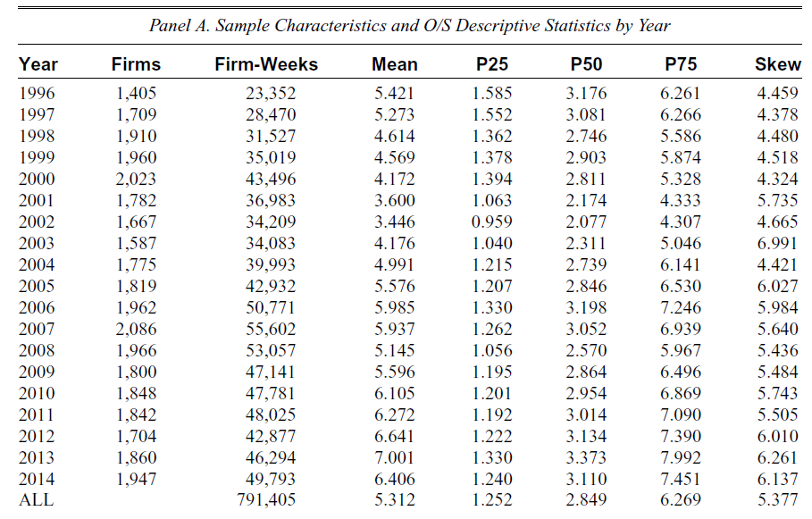
Introduction
Variables and
Summary Statistic
Empirical
Analysis
Additional
Analysis
Concluding
Remarks
C. Summary Statistics and Correlations
(%)
Notes:
1.Short sale constraints + high sentiment period -> trade option
2.套利限制、irrational demand shocks-> misvaluation
-> CS 跟misvluation及IS可能沒直接關係

Slide 10
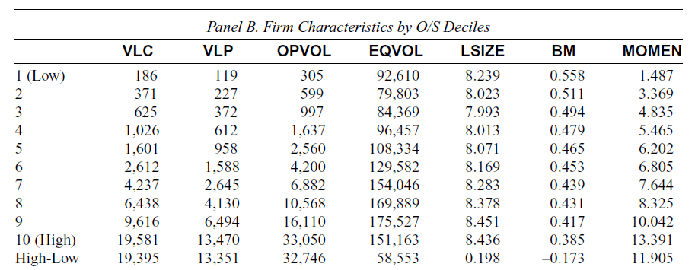
Introduction
Variables and
Summary Statistic
Empirical
Analysis
Additional
Analysis
Concluding
Remarks
C. Summary Statistics and Correlations
VLC (VLP):
Total call (put) options trading volume for the corresponding week in units of 100 share
OPVOL :
Total options trading volume
= VLC + VLP
EQVOL :
Total equity trading volume in unit of 100 shares
LSIZE :
Measure of firm size judged by the log of the market capitalization at each firm’s most recent quarterly earnings announcements in Compustat
BM :
Log of the book-to-market ratio
EQVOL :
The market-adjusted stock returns for the 6 previous month
Notes:
1.Short sale constraints + high sentiment period -> trade option
2.套利限制、irrational demand shocks-> misvaluation
-> CS 跟misvluation及IS可能沒直接關係

Slide 11
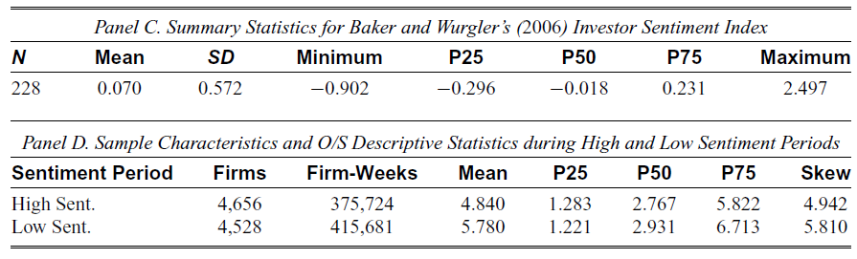
Introduction
Variables and
Summary Statistic
Empirical
Analysis
Additional
Analysis
Concluding
Remarks
C. Summary Statistics and Correlations
1
1
Investor sentiment has a negligible impact on the O/S
Notes:
1.Short sale constraints + high sentiment period -> trade option
2.套利限制、irrational demand shocks-> misvaluation
-> CS 跟misvluation及IS可能沒直接關係

Slide 12
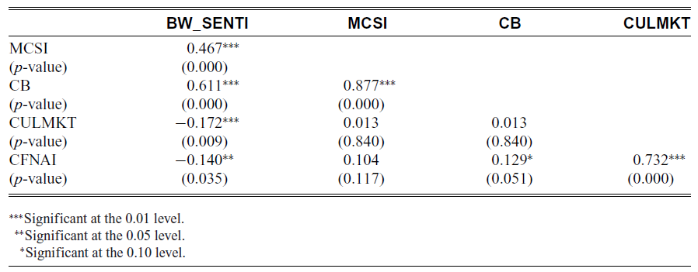
Introduction
Variables and
Summary Statistic
Empirical
Analysis
Additional
Analysis
Concluding
Remarks
C. Summary Statistics and Correlations
CULMKT :
The past market return over the 12 previous months
CFNAI :
Weighted average of 85 indicators of economic activity and inflationary pressure used as a measure of real economic activities taken from the Federal Reserve Bank of Chicago
1
2
1
Investor sentiment has an economically significant relation with consumer sentiment.
2
Indicative of the difference between the information contained in the investor and consumer
Sentiment indices.
Notes:
1.Short sale constraints + high sentiment period -> trade option
2.套利限制、irrational demand shocks-> misvaluation
-> CS 跟misvluation及IS可能沒直接關係

Slide 13
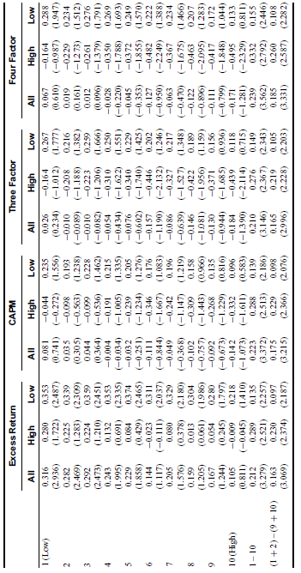
Introduction
Variables and
Summary Statistic
Empirical
Analysis
Additional
Analysis
Concluding
Remarks
A. Investor Sentiment and Profits in O/S Long-Short Strategy
Note :
High O/S portfolios underperform low O/S portfolios, especially during high sentiment periods.
Consistent with the results from Johnson and So (2012)
The return predictability of the O/S is more significant during high investor sentiment periods than low investor sentiment periods
The differences in the alphas of four-factor models among O/S portfolios during the whole sample period can be largely attributed to those during high sentiment periods
2
1
2
1
Notes:
1.Short sale constraints + high sentiment period -> trade option
2.套利限制、irrational demand shocks-> misvaluation
-> CS 跟misvluation及IS可能沒直接關係

Slide 14
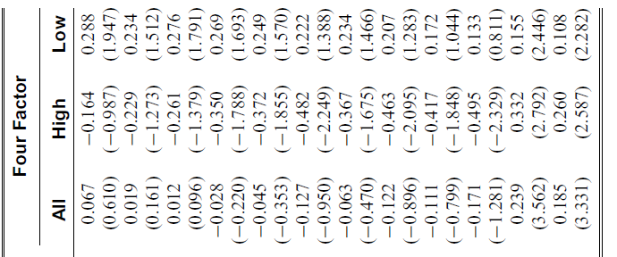
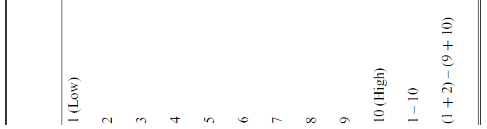
Introduction
Variables and
Summary Statistic
Empirical
Analysis
Additional
Analysis
Concluding
Remarks
A. Investor Sentiment and Profits in O/S Long-Short Strategy
Note :
This O/S-return relation becomes pronounced during high sentiment periods as short sale constraints bind more strongly during these periods than during other
The profits of short-leg positions generally drive the differences of a long-short strategy’s profits based on the O/S between high sentiment and low sentiment periods
During high sentiment periods, informed traders influence the profitability of short-legs more so than long legs
Notes:
1.Short sale constraints + high sentiment period -> trade option
2.套利限制、irrational demand shocks-> misvaluation
-> CS 跟misvluation及IS可能沒直接關係

Slide 15
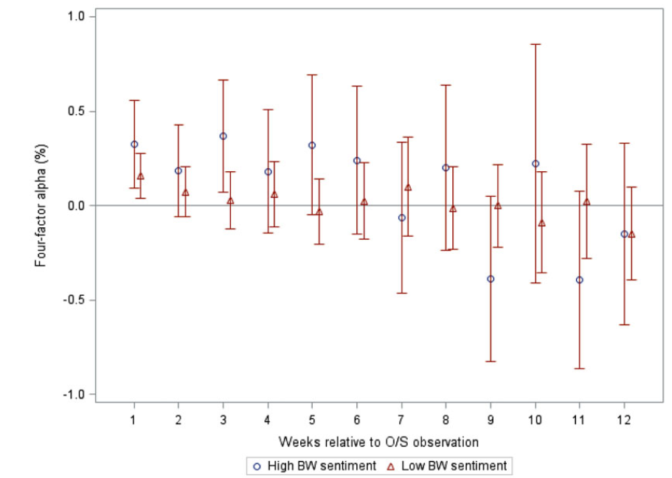
Introduction
Variables and
Summary Statistic
Empirical
Analysis
Additional
Analysis
Concluding
Remarks
A. Investor Sentiment and Profits in O/S Long-Short Strategy
Only first and third weeks significant
Check the persistence of the O/S-return relation during
high sentiment periods
Note :
The predictive power of the O/S for future stock returns during high sentiment periods is short-lived and quickly disappears within a few weeks
O/S-return relation during the entire sample period is largely determined by the O/S-return relation during high sentiment periods
Notes:
1.Short sale constraints + high sentiment period -> trade option
2.套利限制、irrational demand shocks-> misvaluation
-> CS 跟misvluation及IS可能沒直接關係

Slide 16
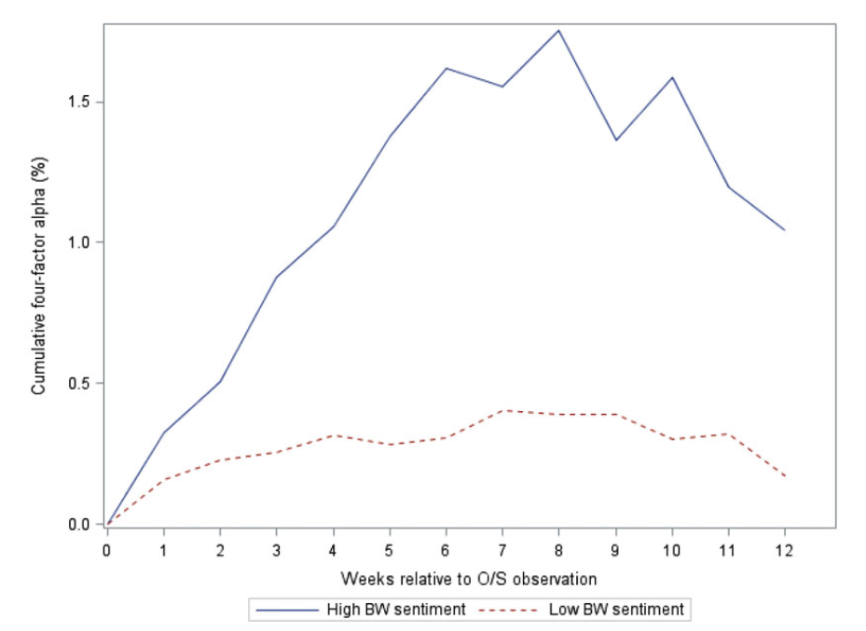
Introduction
Variables and
Summary Statistic
Empirical
Analysis
Additional
Analysis
Concluding
Remarks
A. Investor Sentiment and Profits in O/S Long-Short Strategy
Investor sentiment has a critical effect on the profits of an O/S long-short strategy
Notes:
1.Short sale constraints + high sentiment period -> trade option
2.套利限制、irrational demand shocks-> misvaluation
-> CS 跟misvluation及IS可能沒直接關係

Slide 17
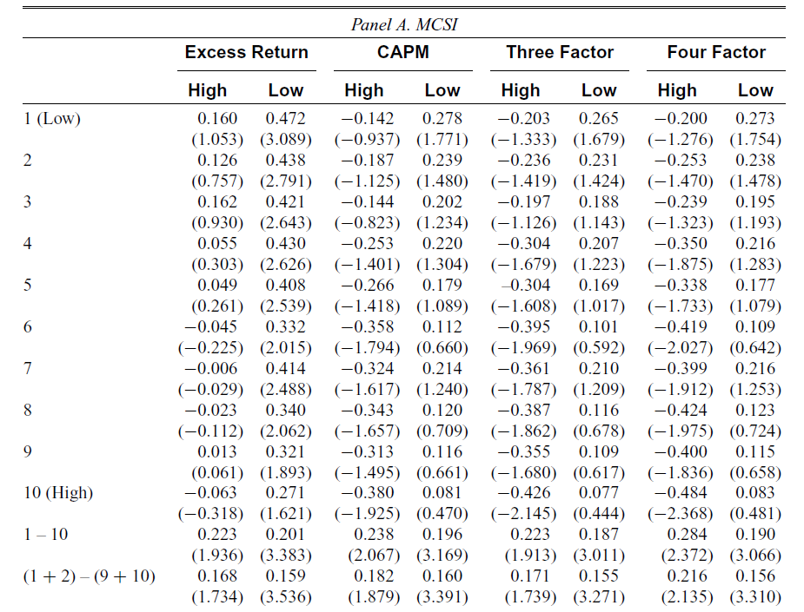
Introduction
Variables and
Summary Statistic
Empirical
Analysis
Additional
Analysis
Concluding
Remarks
B. Does the BW Investor Sentiment Index Contain Unique Information
Note :
During high consumer sentiment periods, the profits of an O/S long-short strategy are larger and more strongly significant thang those during low consumer sentiment periods.
Consistent with the empirical evidence in the literature that uses consumer sentiment indices as alternative measures of investor sentiment.

Slide 18
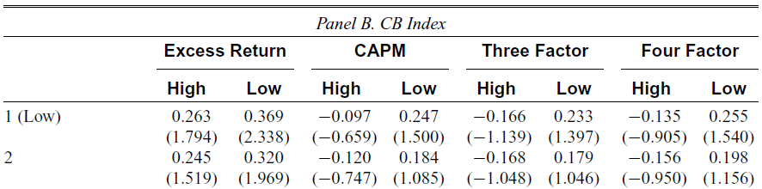
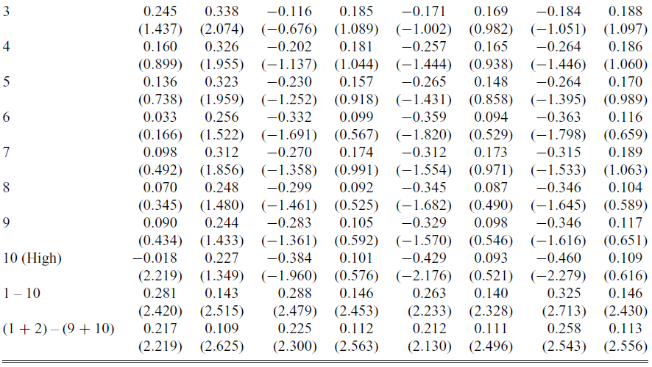
Introduction
Variables and
Summary Statistic
Empirical
Analysis
Additional
Analysis
Concluding
Remarks
B. Does the BW Investor Sentiment Index Contain Unique Information
Note :
the profits of an O/S long-short strategy with the MCSI and the CB Index during low consumer sentiment periods are larger and more strongly significant than those of the BW Investor Sentiment Index during low sentiment periods with the exception of the three-factor and four-factor models with the CB Index.
Larger than that of BW Investor Sentiment
Notes:
1.Short sale constraints + high sentiment period -> trade option
2.套利限制、irrational demand shocks-> misvaluation
-> CS 跟misvluation及IS可能沒直接關係

Slide 19
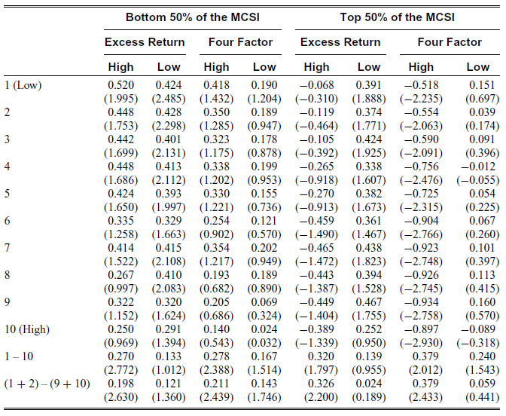
Introduction
Variables and
Summary Statistic
Empirical
Analysis
Additional
Analysis
Concluding
Remarks
B. Does the BW Investor Sentiment Index Contain Unique Information
Note :
MCSI cannot weaken the effect of the BW Investor Sentiment Index on the profitability of an O/S long-short strategy. The profits of an O/S long-short strategy during high and low MCSI periods still vary with the BW Investor Sentiment Index.
Notes:
1.Short sale constraints + high sentiment period -> trade option
2.套利限制、irrational demand shocks-> misvaluation
-> CS 跟misvluation及IS可能沒直接關係

Slide 20
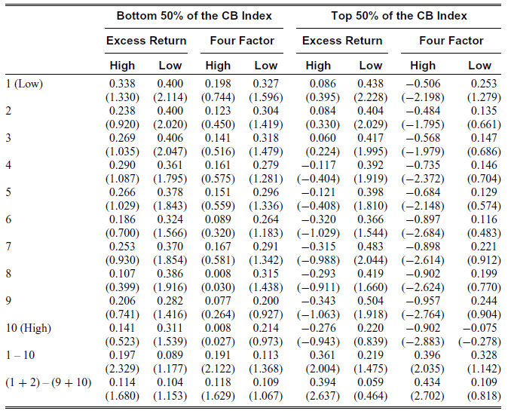
Introduction
Variables and
Summary Statistic
Empirical
Analysis
Additional
Analysis
Concluding
Remarks
B. Does the BW Investor Sentiment Index Contain Unique Information
Note :
Overall, the BW Investor Sentiment Index has a significant influence on the profitability of an O/S long-short strategy after considering the MCSI and the CB Index
Notes:
1.Short sale constraints + high sentiment period -> trade option
2.套利限制、irrational demand shocks-> misvaluation
-> CS 跟misvluation及IS可能沒直接關係

Slide 21
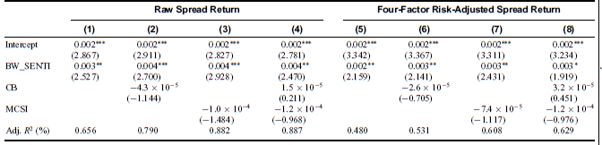

Introduction
Variables and
Summary Statistic
Empirical
Analysis
Additional
Analysis
Concluding
Remarks
B. Does the BW Investor Sentiment Index Contain Unique Information
Note :
The coefficient estimates for BW_SENTI are always positive and significant supporting our hypothesis that O/S return predictability becomes strong during high investor sentiment periods.
Tables V to VII present empirical evidence that confirms the superior informativeness of the BW Investor Sentiment Index with regard to the predictive power of O/S compared to the consumer sentiment indices.
Notes:
1.Short sale constraints + high sentiment period -> trade option
2.套利限制、irrational demand shocks-> misvaluation
-> CS 跟misvluation及IS可能沒直接關係

Slide 22
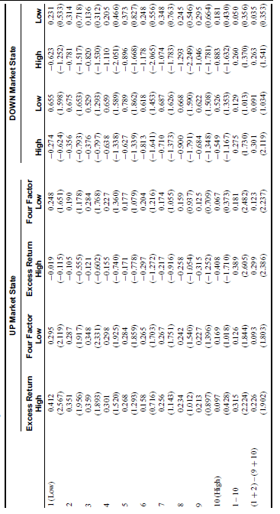
Introduction
Variables and
Summary Statistic
Empirical
Analysis
Additional
Analysis
Concluding
Remarks
UP market state
cumulative returns of the CRSP value-weighted index that includes dividends for the months t - k to t – 1 are nonnegative
The return predictive power of the O/S becomes strong during high sentiment periods compared to those during low sentiment periods after controlling for economic state variables
Notes:
1.Short sale constraints + high sentiment period -> trade option
2.套利限制、irrational demand shocks-> misvaluation
-> CS 跟misvluation及IS可能沒直接關係

Slide 23
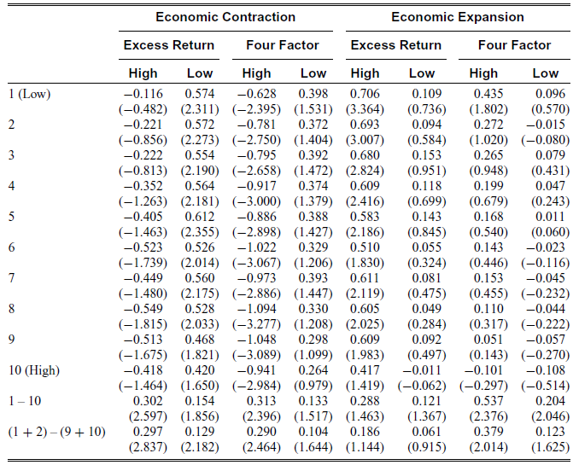
Introduction
Variables and
Summary Statistic
Empirical
Analysis
Additional
Analysis
Concluding
Remarks
Economic contraction
Negative values of CFNAI
Economic Expansion
Nonnegative values of CFNAI
The difference between the O/S profits in high and low sentiment periods cannot be explained by economic condition.
Notes:
1.Short sale constraints + high sentiment period -> trade option
2.套利限制、irrational demand shocks-> misvaluation
-> CS 跟misvluation及IS可能沒直接關係

Slide 24
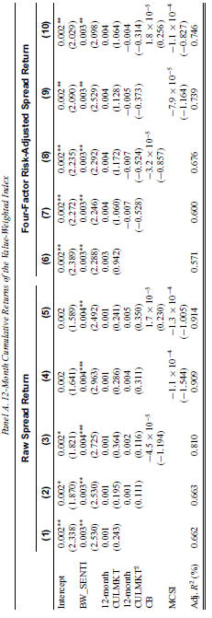
Introduction
Variables and
Summary Statistic
Empirical
Analysis
Additional
Analysis
Concluding
Remarks
Notes:
1.Short sale constraints + high sentiment period -> trade option
2.套利限制、irrational demand shocks-> misvaluation
-> CS 跟misvluation及IS可能沒直接關係

Slide 25
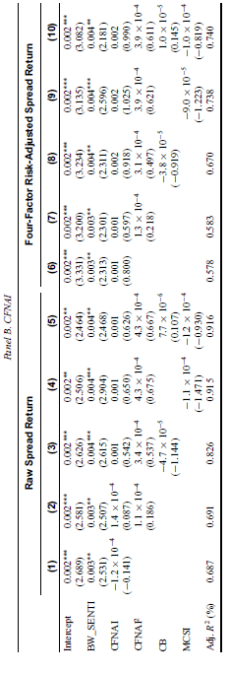
Introduction
Variables and
Summary Statistic
Empirical
Analysis
Additional
Analysis
Concluding
Remarks
After considering market states and consumer sentiment indices, the BW Investor Sentiment Index contains additional information that further explains the time series variation of the profits of an O/S long-short strategy.
Notes:
1.Short sale constraints + high sentiment period -> trade option
2.套利限制、irrational demand shocks-> misvaluation
-> CS 跟misvluation及IS可能沒直接關係

Slide 26
Introduction
Variables and
Summary Statistic
Empirical
Analysis
Additional
Analysis
Concluding
Remarks
O/S-return & investor sentiment
O/S-return relation becomes stronger during high investor sentiment period due to higher short sale constraints and irrational demand
Profitability last time
The profitability of an O/S long-short strategy during high investor sentiment periods last for only three weeks
Investor sentiment & consumer sentiment
BW Investor sentiment index has its own unique impact on future stock return, but that consumer sentiment & macroeconomic fundamentals do not
Investor sentiment & rational asset pricing models
Investor sentiment provides an important clue to the phenomenon unexplained by rational asset pricing models and economic theories
Notes:
Irrational investors have a significant effect on stock price prices and the trading strategy of rational investor

