Slide 1

Spin Echo EPI with Zig-Zag trajectory
Presented by: Teena Nandwani (23145534)
Supervisor: Prof. Dr. rer. nat. Moritz Zaiss

Slide 2
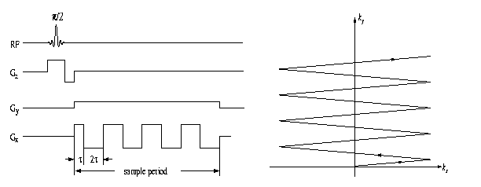
Zig-Zag Trajectory
Source: http://mri.beckman.illinois.edu/interactive/topics/contents/fast_imaging/figures/zig.shtml

Slide 3
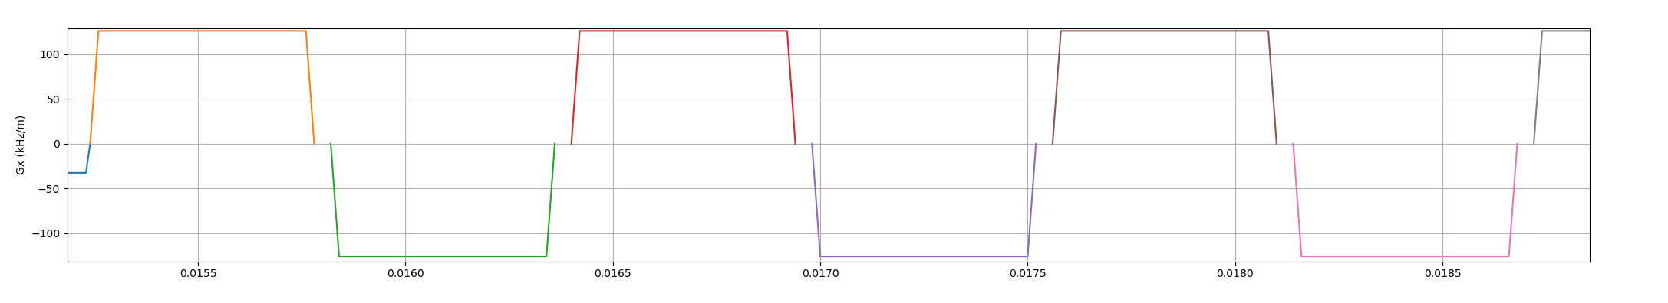
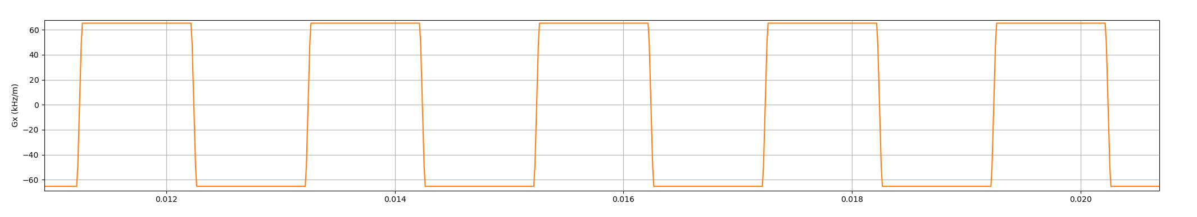
Extended Trapezoids
Reduces the time between each gradient
Resulting reduce in readout time - FASTER

Slide 4
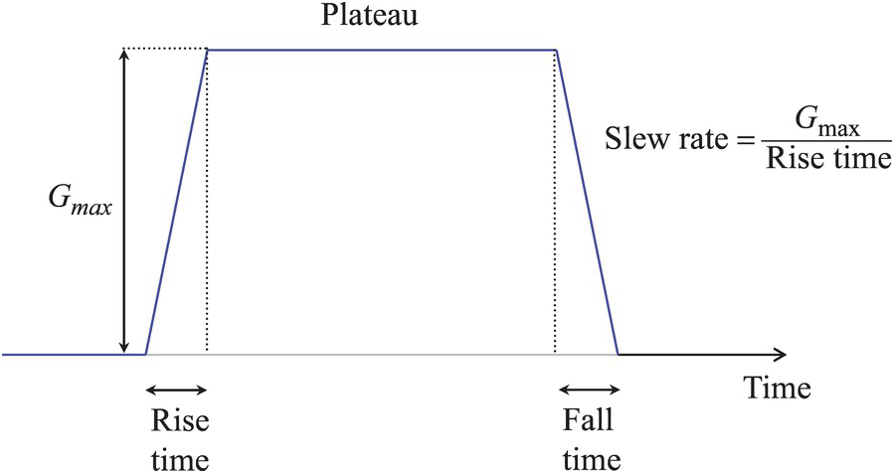
Extended Trapezoids
pp.make_extended_trapezoid(channel, amplitudes, system = system, times)

Slide 5
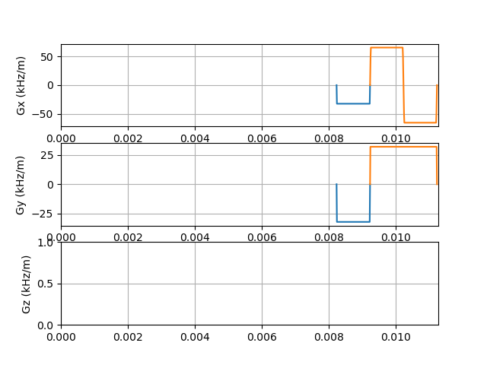
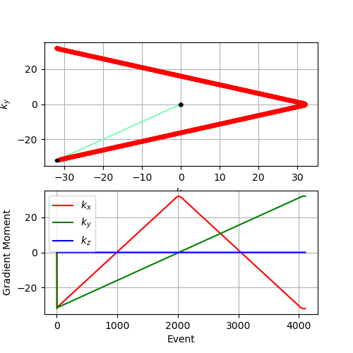
Extended Trapezoids & Zig Zag Trajectory

Slide 6
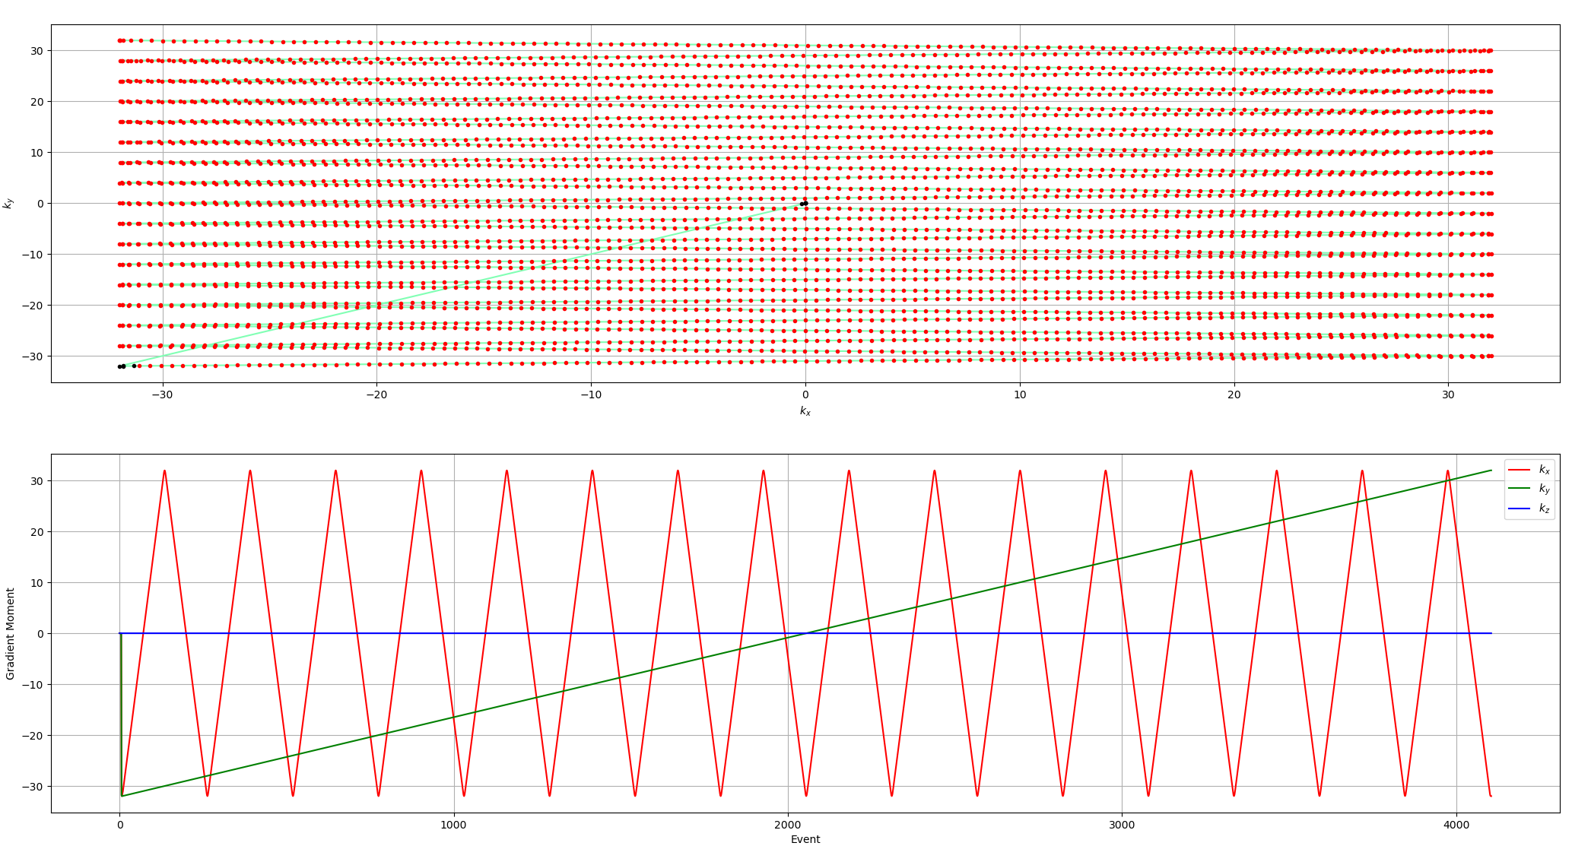
Extended Trapezoids & Zig Zag Trajectory
Less number of wiggles

Slide 7
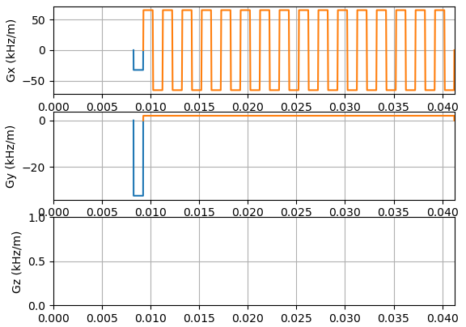
Extended Trapezoids & Zig Zag Trajectory
Less number of wiggles

Slide 8
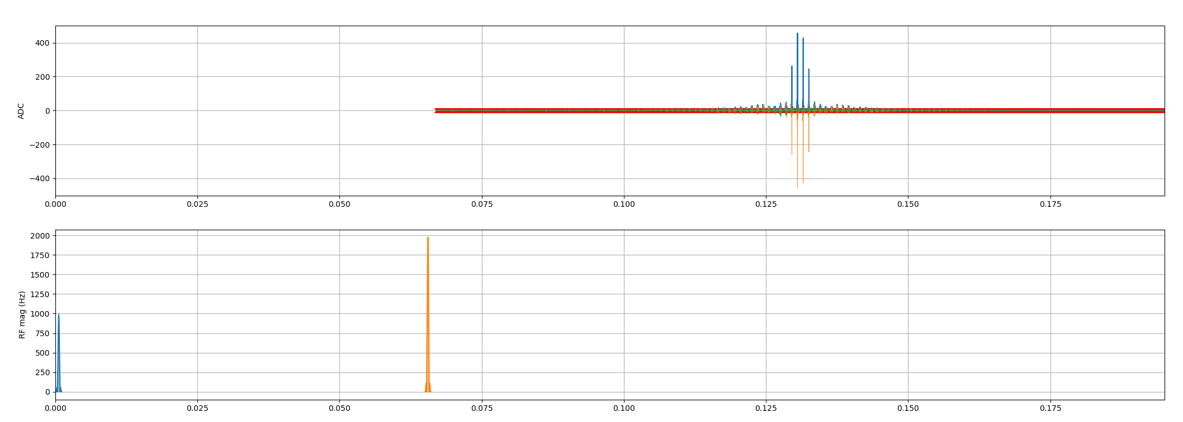
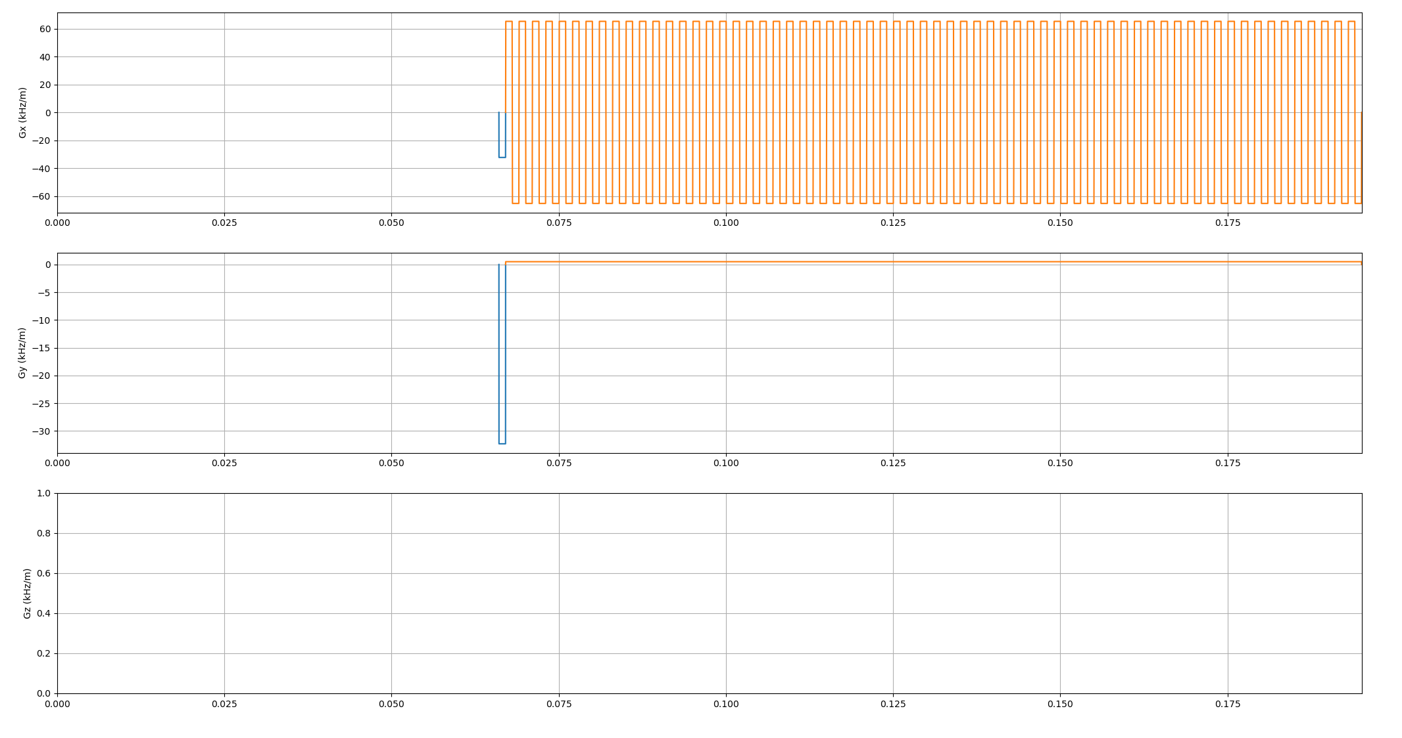
Pulse sequence

Slide 9
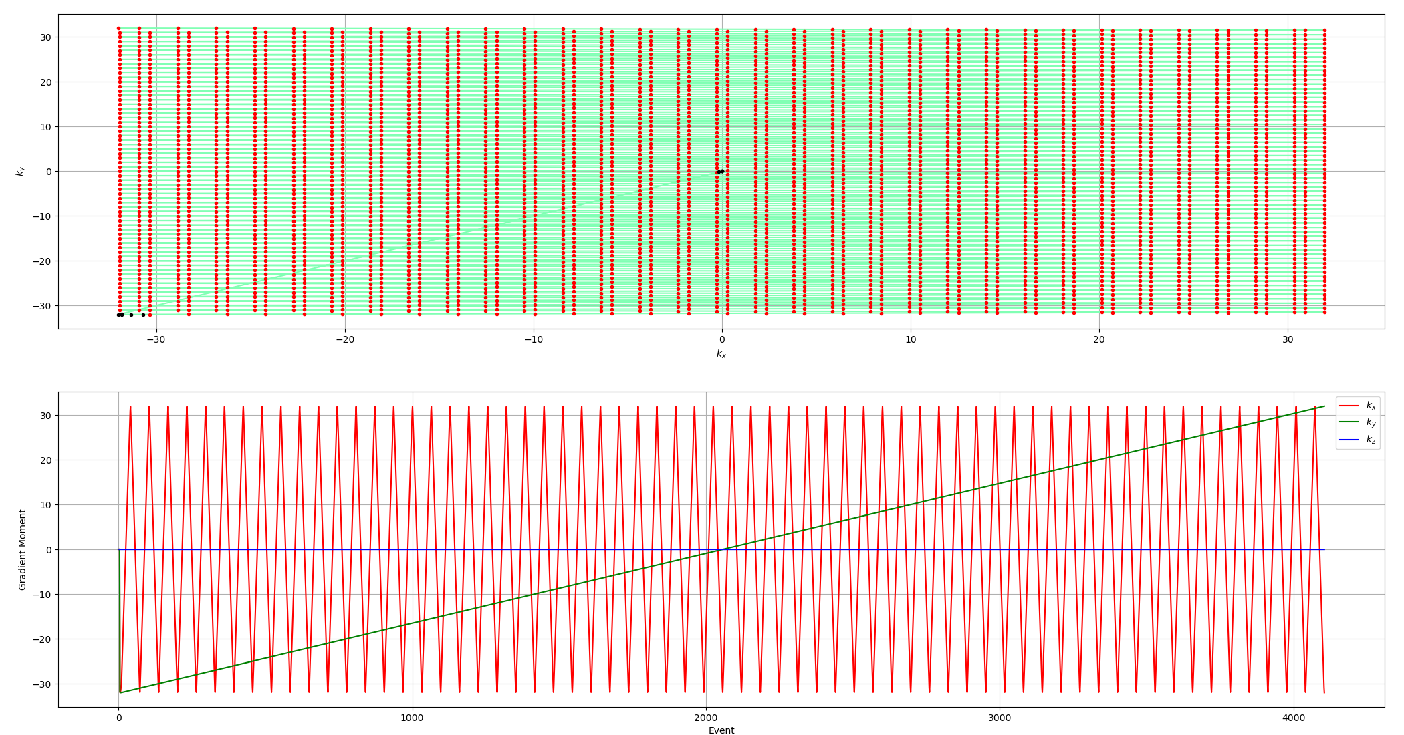
K-space trajectory

Slide 10
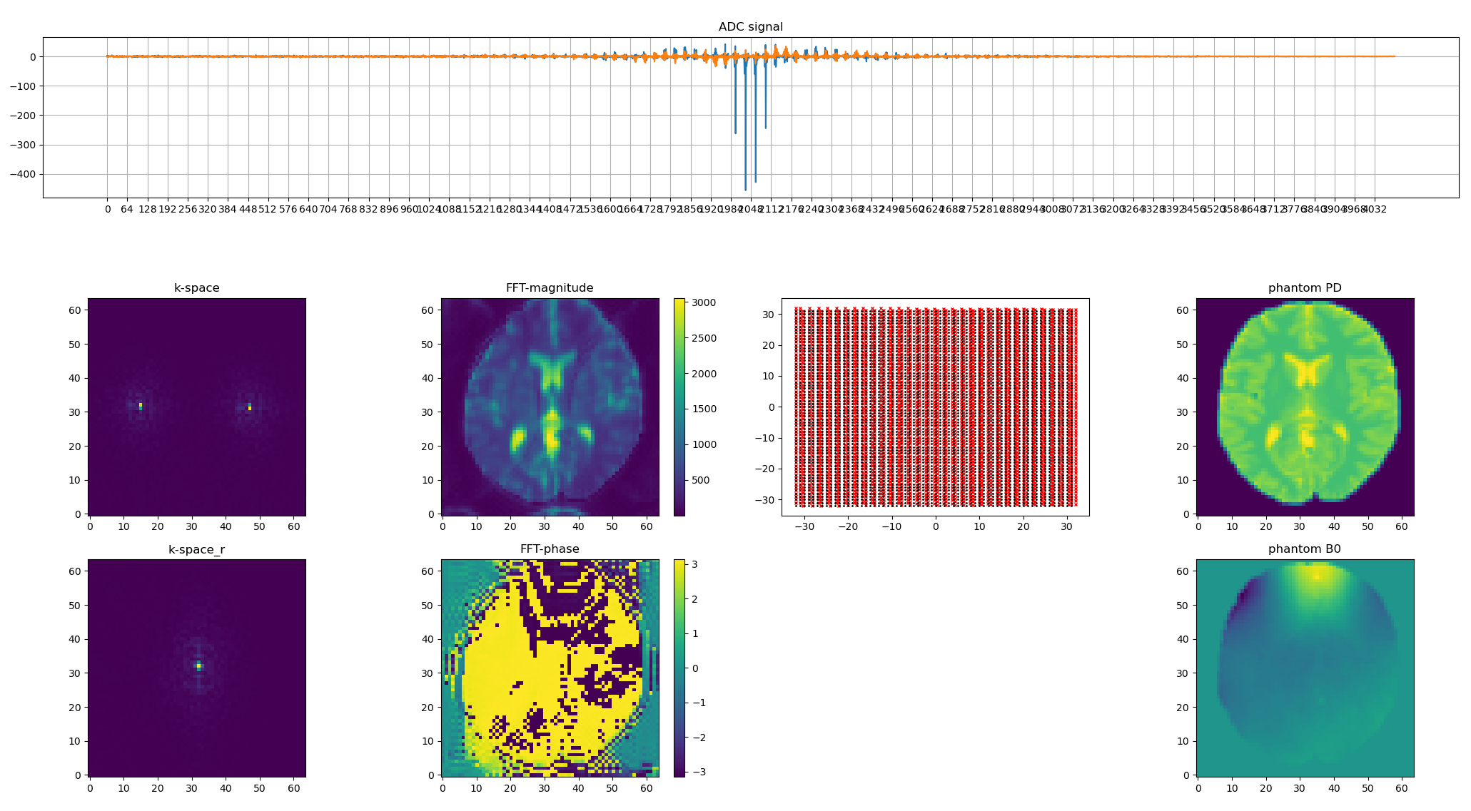
Phantom Plot

Slide 11
Thank you for your attention

