Slide 1
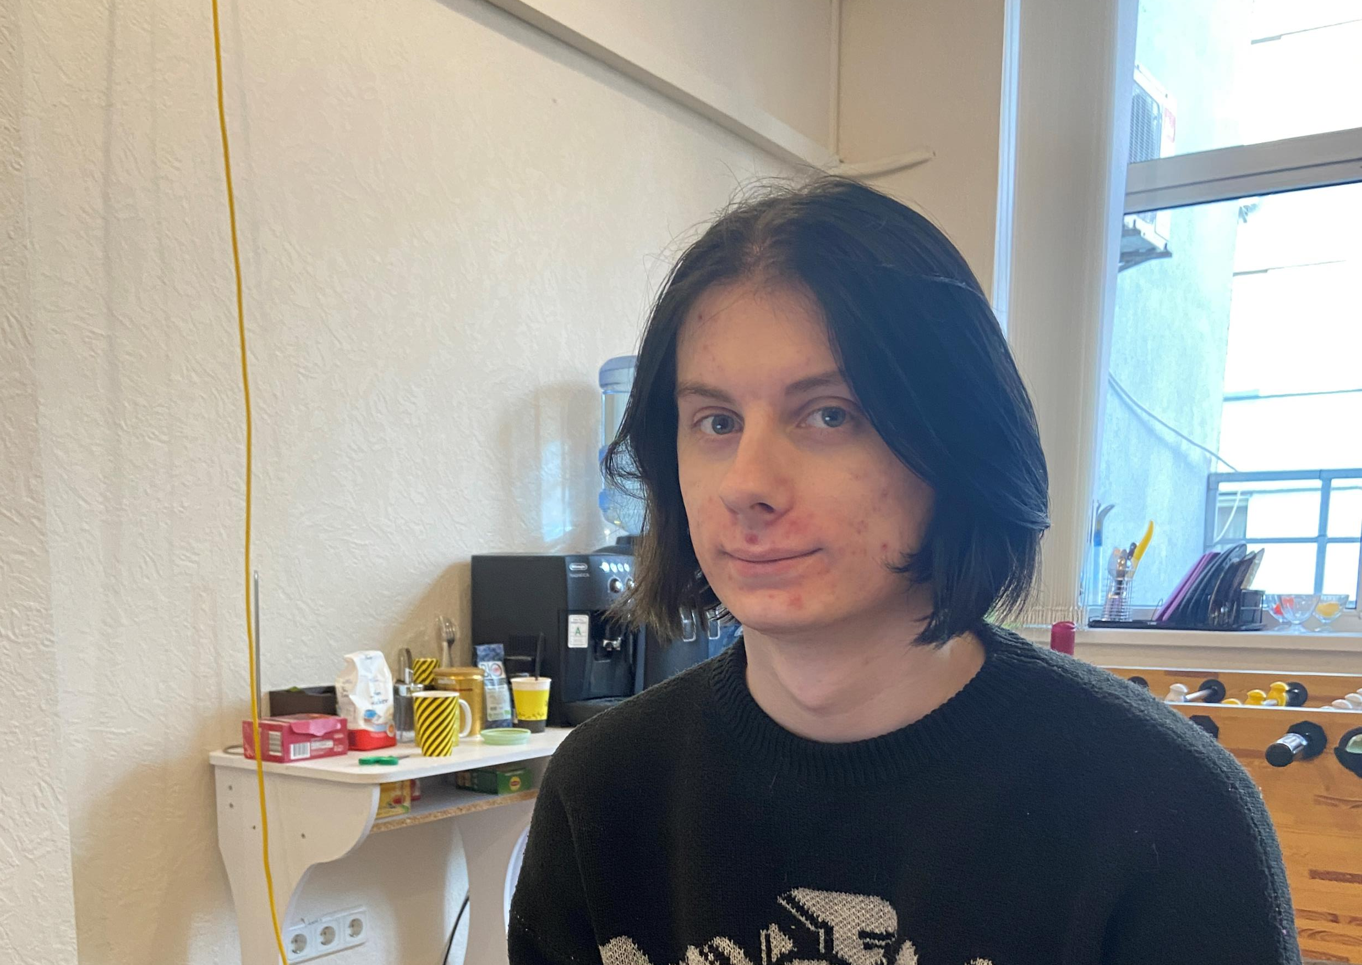
Artur Studnev
Orphan. 19 years. No father. Mother passed away. Currently, he lives with his grandmother in the Dniprovsky district of the city of Kyiv.
Studying at a vocational school in the 2nd year as a cashier.
He went to college just to get a scholarship. He says that he studies excellently, as this vocational school with a too easy curriculum.
He doesn't like to communicate with people and be in real space.
He likes to spend time at home and play computer games, watch videos and learn programming. He studies the culture of Japan, wants to move to a provincial town and live there.

Slide 2
Arthur dreams of being a programmer.
He has been studying at the IT Club for almost a year, studying web programming and can perform the tasks of a junior programmer. But in order to find a job it is necessary to have more knowledge than now, and to work well on the character and social relations. Now it's important to continue learning to program to improve and master new knowledge and skills.
Because of the trauma and the experience (loss of parents), there are anxiety and distrust of people. He needs a mentor and a circle of people, who can help overcome the crisis and help Arthur reach his full potential. This is a very typical situation with many older orphans in Ukraine who want to achieve something in life, but they need an exemplary adult.
I am Arthur's mentor and took him to practice at the IT Club as a programmer. We have six months ahead to improve IT skills and form the character. I hope that I will be a good mentor, Arthur and I will be able to achieve certain successes and victories for the better in his life.

