Slide 1
Number Guessing Game in Python
by: Teenu mary john
\

Slide 2
Problem Statement
Build a Python game where the user guesses a random number between 1–10.
Maximum 5 attempts allowed.
Provide hints (“Too High” / “Too Low”).
Show smiley image if success.
Show angry image if failure.

Slide 3
Requirements
Python programming language
Random module
Input/output handling
Pillow & Tkinter for images
Maximum 5 attempts logic

Slide 4
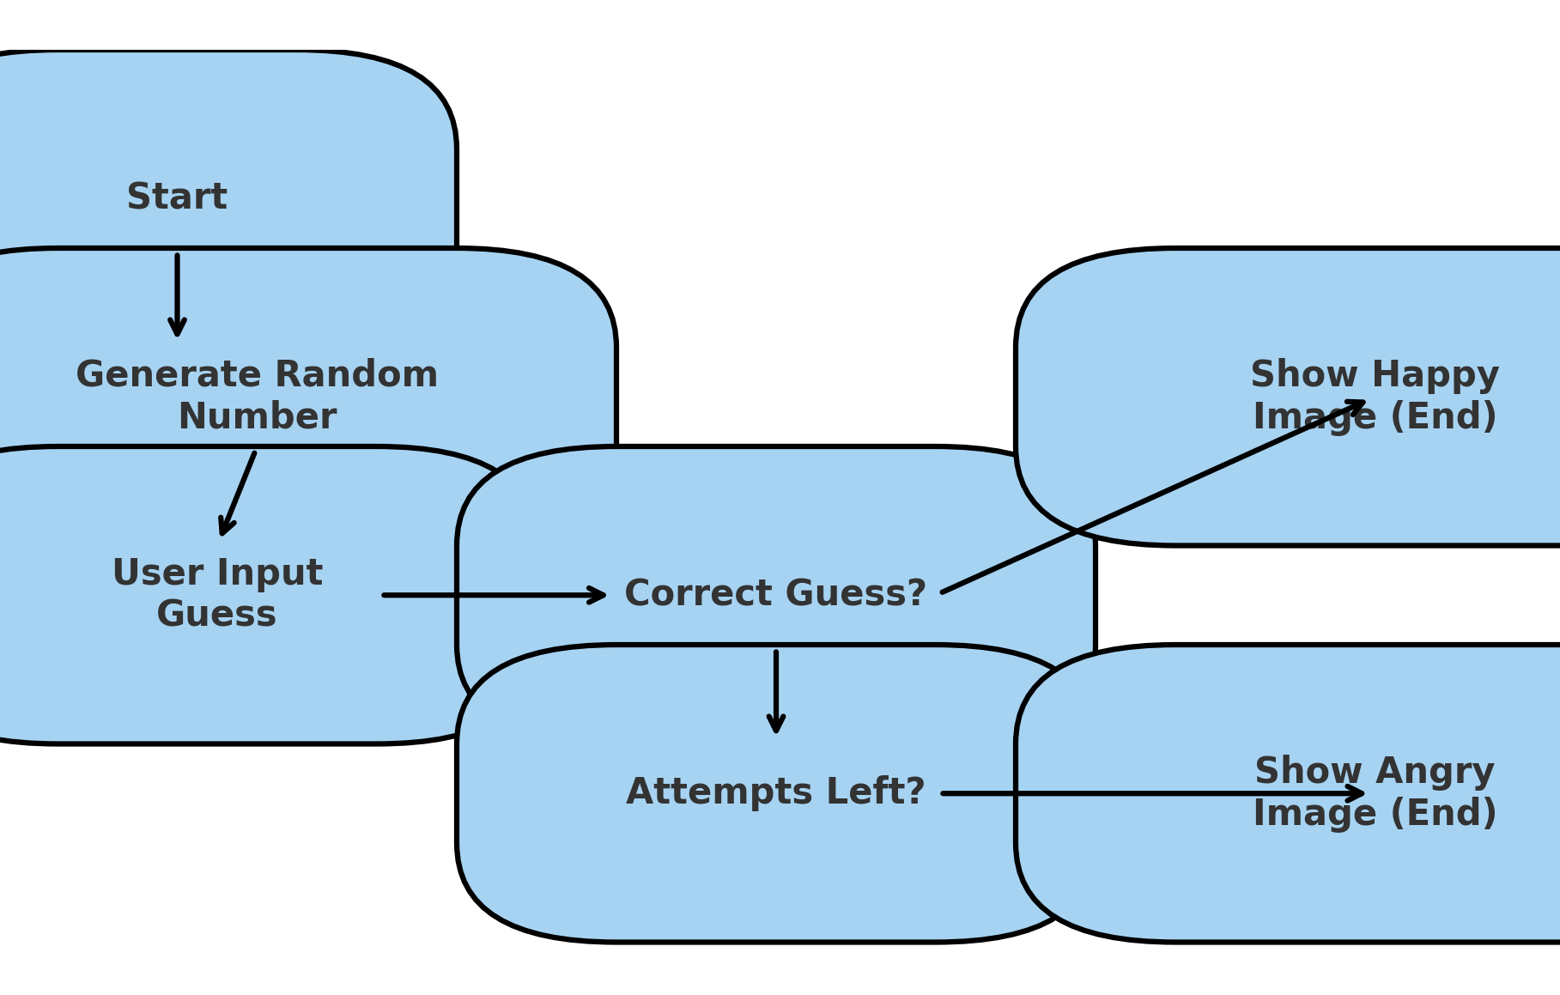
Design Flow Diagram

Slide 5
Logic Explanation
Random number generated using random.randint(1,10).
Loop runs maximum of 5 times.
If guess is correct → success message + image.
If guess is wrong → show hint + reduce attempts.
If all attempts used → failure message + image.

Slide 6
Implementation Steps
Import modules (random, tkinter, PIL).
Generate random number.
Take validated user input.
Compare input with random number.
Show success or failure image.

Slide 7
Test Cases & Results
Test Case ID | Input | Expected Output | Actual Output | Status
TC1 | Guess correct on 1st attempt | Show success message + happy.png image | Same | Pass
TC2 | Guess correct after multiple attempts | Show success message + happy.png image | Same | Pass
TC3 | Wrong guesses (5 times) | Show failure message + angry.png image | Same | Pass
TC4 | Input = 0 or 11 (out of range) | Show 'Please enter number between 1 and 10' | Same | Pass
TC5 | Input = 'abc' (not number) | Show 'Invalid input! Please enter integer' | Same | Pass

Slide 8
Conclusion & Future Enhancements
Developed a Python Number Guessing Game.
Demonstrated modular coding and GUI integration.
Successfully tested all functional scenarios.
Possible future improvements:
Increase range of numbers.
Add difficulty levels (Easy, Medium, Hard).
Include sound effects for win/loss.
Extend the game to multiplayer mode.

Slide 9
THANK YOU

