Slide 1
Listwise Explainer (LISTEN)
Faithfully Explaining Rankings in a News Recommender System [Link]

Slide 2
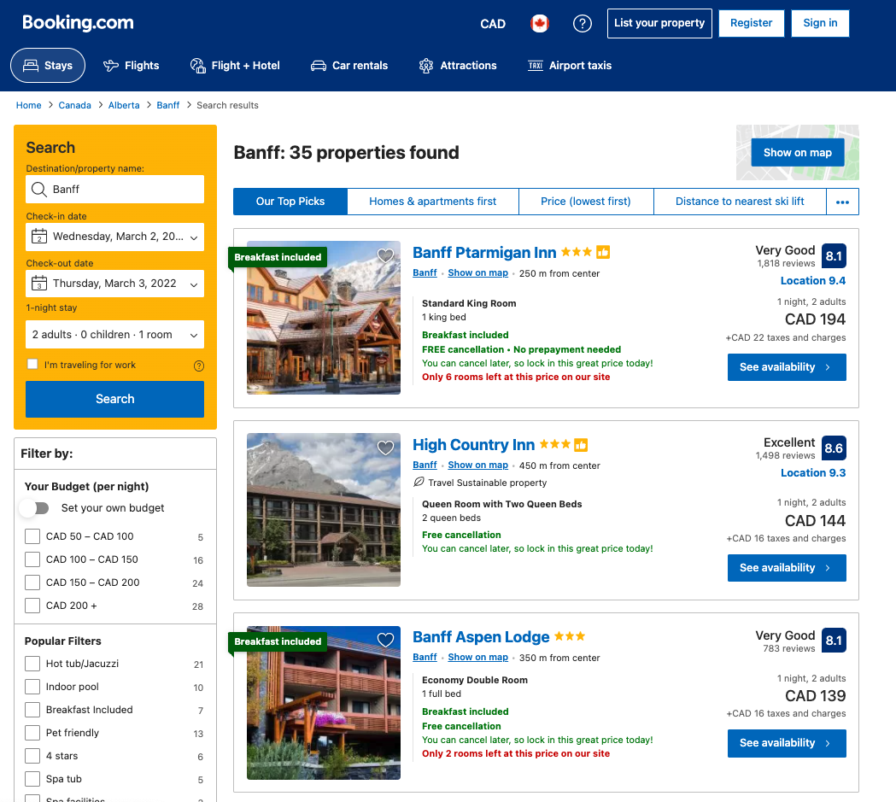
Why?

Slide 3
Why?
“Because this is the top choice hotel for family traveler”
“Because you booked similar hotels before for your trip last year”
“Because this is the best place to stay for the weekend”

Slide 4
Point-wise Ranking Model
x
F(x)
y
x (ranked)
a
b
c
d
f(
a
b
c
d
)
0.7
0.2
0.65
0.9
d
a
b
c
f(
)
f(
)
f(
)

Slide 5
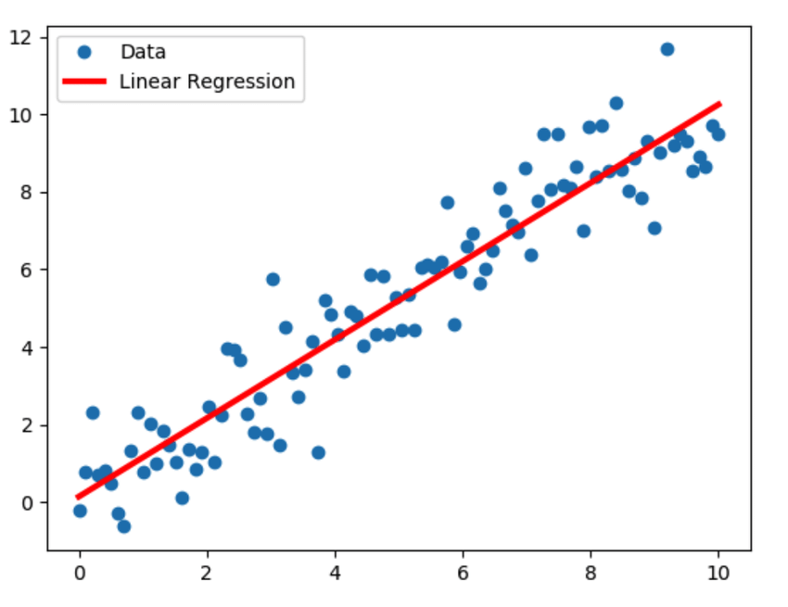
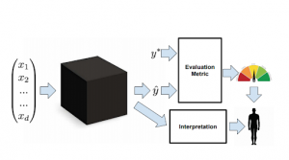
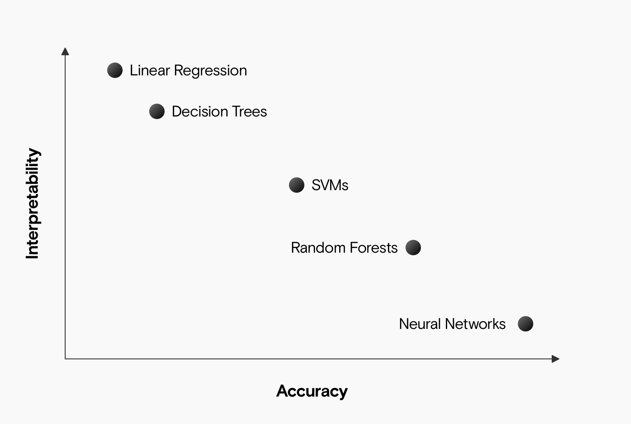
Interpretable ML
Interpretable Models
Model-agnostic
https://blog.ml.cmu.edu/2020/08/31/6-interpretability/

Slide 6
Interpretable ML
Interpretable Models
Model-agnostic
https://blog.ml.cmu.edu/2020/08/31/6-interpretability/

Slide 7
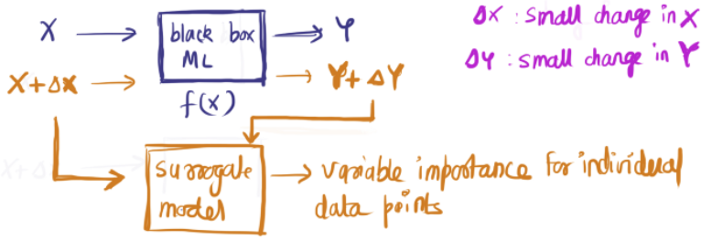
Surrogate Models
https://christophm.github.io/interpretable-ml-book/lime.html
https://towardsdatascience.com/idea-behind-lime-and-shap-b603d35d34eb
Notes:
“They tweak the input slightly (like we do in sensitivity tests) and test the changes in prediction.”

Slide 8
Surrogate Models
https://christophm.github.io/interpretable-ml-book/lime.html
https://towardsdatascience.com/idea-behind-lime-and-shap-b603d35d34eb
Notes:
“They tweak the input slightly (like we do in sensitivity tests) and test the changes in prediction.”

Slide 9
Delta X
H1
H2
H3
session_id | #adults | #children | #staying days
1234 | 2 | 1 | 3
Flat features
Sequential features
Notes:
“They tweak the input slightly (like we do in sensitivity tests) and test the changes in prediction.”

Slide 10
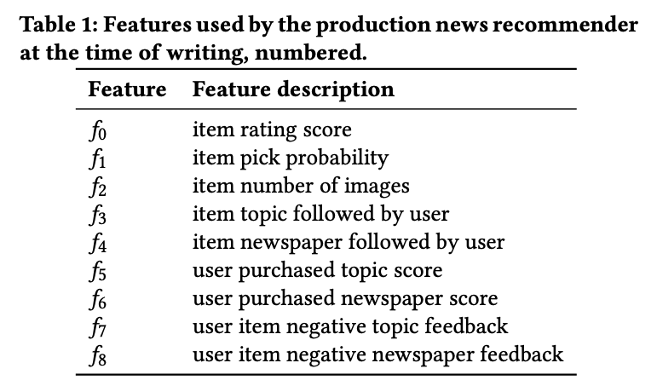

Slide 11
Delta X
H1
H2
H3
session_id | #adults | #children | #staying days
1234 | 2 | 1 | 3
1234 | 1 | 1 | 3
1234 | 2 | 0 | 3
1234 | 2 | 1 | 1
Flat features
Sequential features
Notes:
“They tweak the input slightly (like we do in sensitivity tests) and test the changes in prediction.”

Slide 12
Delta Y
x & x’
F(x & x’)
y & y’
a
a’
b
b’
f(
a
a’
b
b’
)
0.7
0.71
0.2
0.5
f(
)
f(
)
f(
)

Slide 13
Delta Y
x
F(x)
y
a
b
f(
a
b
)
0.7
0.2
f(
)
(no changes in ordering!)
x’
F(x)
y
a’
b’
f(
a’
b’
)
0.71
0.5
f(
)

Slide 14
Ranking Correlation Metric
Spearman Rank Correlation
Kendal Tau
AP Correlation

Slide 15
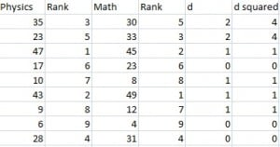

Spearman Rank Correlation
https://www.statisticshowto.com/probability-and-statistics/correlation-coefficient-formula/spearman-rank-correlation-definition-calculate/

Slide 16

Kendall’s Tau
Subject 1
Subject 2
Discordance+=1
Concordance+=1
C: Concordance
D: Discordance
https://www.ccs.neu.edu/home/jaa/tmp/RankCorrelation.pdf
Notes:
C be the total number of concordant pairs (pairs that are ranked in the same order in both rankings)
D the total number of discordant pairs (pairs that are ranked in opposite order in the two rankings)

Slide 17
A problem with the previous two metrics
1
2
3
4
1
2
4
3
1
2
3
4
2
1
3
4
Kendal(
)
=
Kendal(
,
)
,
(Insensitive to the location of the change)

Slide 18
Why?

Slide 19

AP Ranking Correlation
x
C(i) | i-1 | result
- | 0 | -
1 | 1 | 1/1
2 | 2 | 2/2
2 | 3 | 2/3
1
2
4
3
Notes:
AP ranking correlation coecient focusses on the top elements in the list.
changes in the higher regions of the list are more relevant than changes in the lower regions.

Slide 20
AP Ranking Correlation
x
C(i) | i-1 | result
- | 0 | -
1 | 1 | 1
2 | 2 | 1
2 | 3 | 0.66
1
2
4
3
AP: 2.66/3

Slide 21
AP Correlation
x
C(i) | i-1 | result
- | 0 | -
0 | 1 | 0
2 | 2 | 1
3 | 3 | 1
2
1
3
4
AP: 2/3

Slide 22
Combining it all
session_id | #adults | #children | #staying days | Δy
1234 | 2 | 1 | 3 | 0
1234 | 1 | 1 | 3 | 0.01
1234 | 2 | 0 | 3 | 0.75
1234 | 2 | 1 | 1 | 0.2

Slide 23
Combining it all
session_id | #adults | #children | #staying days | Δy
1234 | 2 | 1 | 3 | 0
1234 | 2 | 0 | 3 | 0.75
y
y’
5
1
…
7
8
9
1
2
…
5
8
0
Ranking result
with children = 1
Ranking result
with children = 0

Slide 24
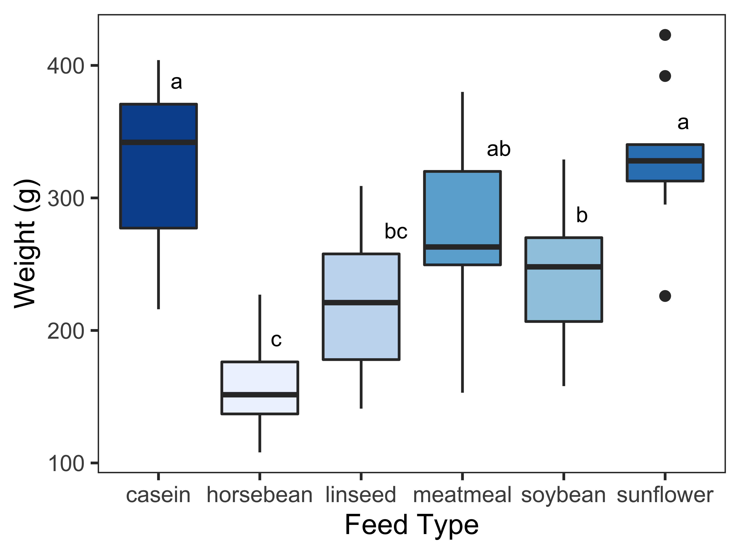
Global Explanation (kind of)
Aggregate the impact of each feature on each user request.
(fake plot)

