Slide 1
BATCH 2 OPERATIONS
Project Refinement —
Your Team Template
Complete the 5 core slides for your team’s Flow.
Use the optional appendices when needed.
Core template: slides 2–6. Optional appendices: slides 7–8.
Teams can duplicate and extend template slides No. 3 and No. 5 as needed.
01
Notes:
Complete the five core slides for your team’s Flow.
Use the optional appendices when needed.
Core template: slides 2–6. Optional appendices: slides 7–8.

Slide 2
TEAM TEMPLATE 1 / 5
Our Project & Team
One team, one main Flow. Short answers are enough. An unfinished Flow is welcome.
Project title / Flow name
Team / department and last updated
[Project title] / [Flow name or Not created yet]
[Team / department] [Date]
Members and roles
Member | Role (mark builder / contact) | Built or tested which part?
[Name] | [Role] | [Part]
[Name] | [Role] | [Part]
[Name] | [Role] | [Part]
Current status (replace with one choice below)
Main support need in one sentence
[Select one status]
[Type here]
Status choices: Not started / Design only / Partly built / Built but not tested /
Tested with issues / Tested successfully for stated cases
Use synthetic or approved information. Remove sensitive details and credentials. See Notes for completion guidance.
Project Refinement • Batch 2 Operations
02

Slide 3
TEAM TEMPLATE 2 / 5
The Problem & Expected Outcome
What work should this Flow improve, and what would a correct result look like?
Current task and people involved
Main pain point and reason for choosing it
[What happens today? Which roles take part?]
[What causes difficulty, and why does it matter?]
Flow boundary
Expected outcome
Starts when: [ ]
Ends when: [ ]
Work that stays manual: [ ]
[What output should the Flow create, and for which role?]
Success criteria (1–3 observable checks)
1. [Check]
2. [Check]
3. [Check, if needed]
Optional in Notes: task frequency and manual effort. Label numbers Observed, Estimated or Unknown, with their basis.
Project Refinement • Batch 2 Operations
03

Slide 4
TEAM TEMPLATE 3 / 5
How Our Flow Works (N)
Show the route from input to output. Mark steps Built, Planned or Blocked.
Flow diagram / readable screenshot
Apps / connectors
[Replace this text with a diagram, sanitised screenshot,
or numbered steps. Include the Trigger and branches.]
[Put long Flow details in Appendix B.]
[Exact names if known, or Name to confirm]
Input and source
[Relevant fields, column names and formats]
[Where does the input come from?]
Output and destination
[What is created, updated or sent?]
[Where does it go? Use role aliases.]
Human decisions or checks
[Who checks or decides what? Use None in this small Flow if appropriate.]
Trigger: show what starts the Flow. A hand-drawn plan is valid even if you have not built it yet.
Project Refinement • Batch 2 Operations
04

Slide 5
TEAM TEMPLATE 4 / 5
What We Built & Tested
Compare expected and actual results. A successful run can still produce the wrong output.
Built so far / incomplete / last tested
Built: [ ] Incomplete: [ ] Last tested: [date or Not yet tested]
Test / sample input | Expected result | Actual result | Run status / date | Evidence ref.
T01: [Input] | [Expected] | [Actual / Not yet tested] | [Status / date] | [E01 / None yet]
T02: [Input] | [Expected] | [Actual / Not yet tested] | [Status / date] | [E02 / None yet]
T03: [Optional] | [Expected] | [Actual / Not yet tested] | [Status / date] | [Reference]
What has not been tested yet?
[Branches, input formats or access conditions not checked yet. If no run exists, explain why.]
Add labelled screenshots or output excerpts in Appendix B. Unknown and No evidence yet are valid responses.
Project Refinement • Batch 2 Operations
05

Slide 6
TEAM TEMPLATE 5 / 5
Our Main Blocker (N)
Describe one issue. If there is no blocker, describe a limitation or desired improvement.
Blocker / improvement title
Exact location and impact
[Issue title or No current blocker]
[Step / Action / branch] [What cannot proceed?]
Reproduction steps and frequency
Expected versus actual
1. [Step and synthetic input]
2. [Step]
Frequency: [Every time / Sometimes / Once / Unknown]
[Related test ID] Expected: [ ] Actual: [ ]
Error text or symptom
[Relevant sanitised message, or describe the symptom]
Fixes attempted and results
Change tried | Result
[Change, or None yet] | [What happened?]
[Optional second attempt] | [Result]
Cannot start? Describe the first blocked step or access message. Put additional issues in Appendix A.
Project Refinement • Batch 2 Operations
06

Slide 7
OPTIONAL APPENDIX A
Additional Issue Detail
Optional Appendix A. Duplicate this slide once per additional issue.
Issue label, title and priority
Location, related test and impact
[ISSUE-02] [Title] [Priority]
[Step / branch] [Test ID] [Impact]
Reproduction steps and frequency
Expected versus actual / error or symptom
1. [Step / sample input]
2. [Step]
Frequency: [ ]
Expected: [ ]
Actual: [ ]
Error message or symptom: [ ]
Fixes attempted and results
Change tried | Result
[Change, or None yet] | [Result]
Question for the instructor / evidence reference
[Question] [Appendix B evidence label, if available]
Project Refinement • Batch 2 Operations
07

Slide 8
OPTIONAL APPENDIX B
Supporting Evidence
Optional Appendix B. Duplicate for each readable screenshot, diagram or sample.
Evidence label / related slide, test or issue / date
[E01] [Slide / test / issue] [Date]
Screenshot, diagram, sample data or text excerpt
What should the instructor notice?
[Replace with readable, sanitised evidence.]
[A text description is valid when a screenshot cannot be shared.]
[Explain the relevant detail]
Context / hidden or missing details
[Design / Configuration / Test run / Output]
[What is hidden or unavailable?]
Remove sensitive information. Do not include passwords, tokens, full run payloads or entire operational datasets.
Project Refinement • Batch 2 Operations
08

Slide 9
BATCH 2 OPERATIONS
Project Refinement —
Completed Example
09
Notes:
A fictional Training Request Router case to guide your answers.
All names, dates and results are invented and illustrative.
Slides 10–14 use the same fields, tables and answer areas as the template.

Slide 10
Fictional completed example 1 / 5
Our Project & Team
One team, one main Flow. Short answers are enough. An unfinished Flow is welcome.
Project title / Flow name
Team / department and last updated
Training Request Router / Training-Request-Router
Team A / Operations 10 November 2026
Members and roles
Member | Role (mark builder / contact) | Built or tested which part?
Member A | Builder / contact | Form, tracker and branches
Member B | Tester | Operations and Finance outputs
No additional member | Not applicable | Not applicable
Current status (replace with one choice below)
Main support need in one sentence
Tested with issues
Finance input receives an Operations-labelled email.
Status choices: Not started / Design only / Partly built / Built but not tested /
Tested with issues / Tested successfully for stated cases
Use synthetic or approved information. Remove sensitive details and credentials. See Notes for completion guidance.
Project Refinement • Batch 2 Operations
10

Slide 11
Fictional completed example 2 / 5
The Problem & Expected Outcome
What work should this Flow improve, and what would a correct result look like?
Current task and people involved
Main pain point and reason for choosing it
A coordinator copies requests into a tracker and emails the responsible team.
Manual copying and incorrect routing create extra checking.
Flow boundary
Expected outcome
Starts when: a training Form response arrives.
Ends when: one row and one email are created.
Manual: handling the request.
One accurate tracker row and a correctly labelled email to the approved test mailbox.
Success criteria (1–3 observable checks)
1. Operations input produces an Operations-labelled email.
2. Finance input produces a Finance-labelled email.
3. Each submission creates one row and one email.
Optional in Notes: task frequency and manual effort. Label numbers Observed, Estimated or Unknown, with their basis.
Project Refinement • Batch 2 Operations
11

Slide 12
Fictional completed example 3 / 5
How Our Flow Works
Show the route from input to output. Mark steps Built, Planned or Blocked.
Flow diagram / readable screenshot
Apps / connectors
When a new response is submitted
Built
Microsoft Forms, Excel Online (Business),
Office 365 Outlook
Get response details
Built
Input and source
Form fields: RequestTitle (Text), Category
(single choice: Operations or Finance).
Add a row into a table
Built
Category = Operations?
Built · routing unverified
Output and destination
Yes / Operations
No / Finance
One RequestsTable row and one email
to the approved test mailbox.
Send an email (V2)
Operations label · Built
Send an email (V2)
Finance label · Built
Human decisions or checks
Member B compares each row and email with its input. No approval step in this Flow.
Trigger: show what starts the Flow. A hand-drawn plan is valid even if you have not built it yet.
Project Refinement • Batch 2 Operations
12

Slide 13
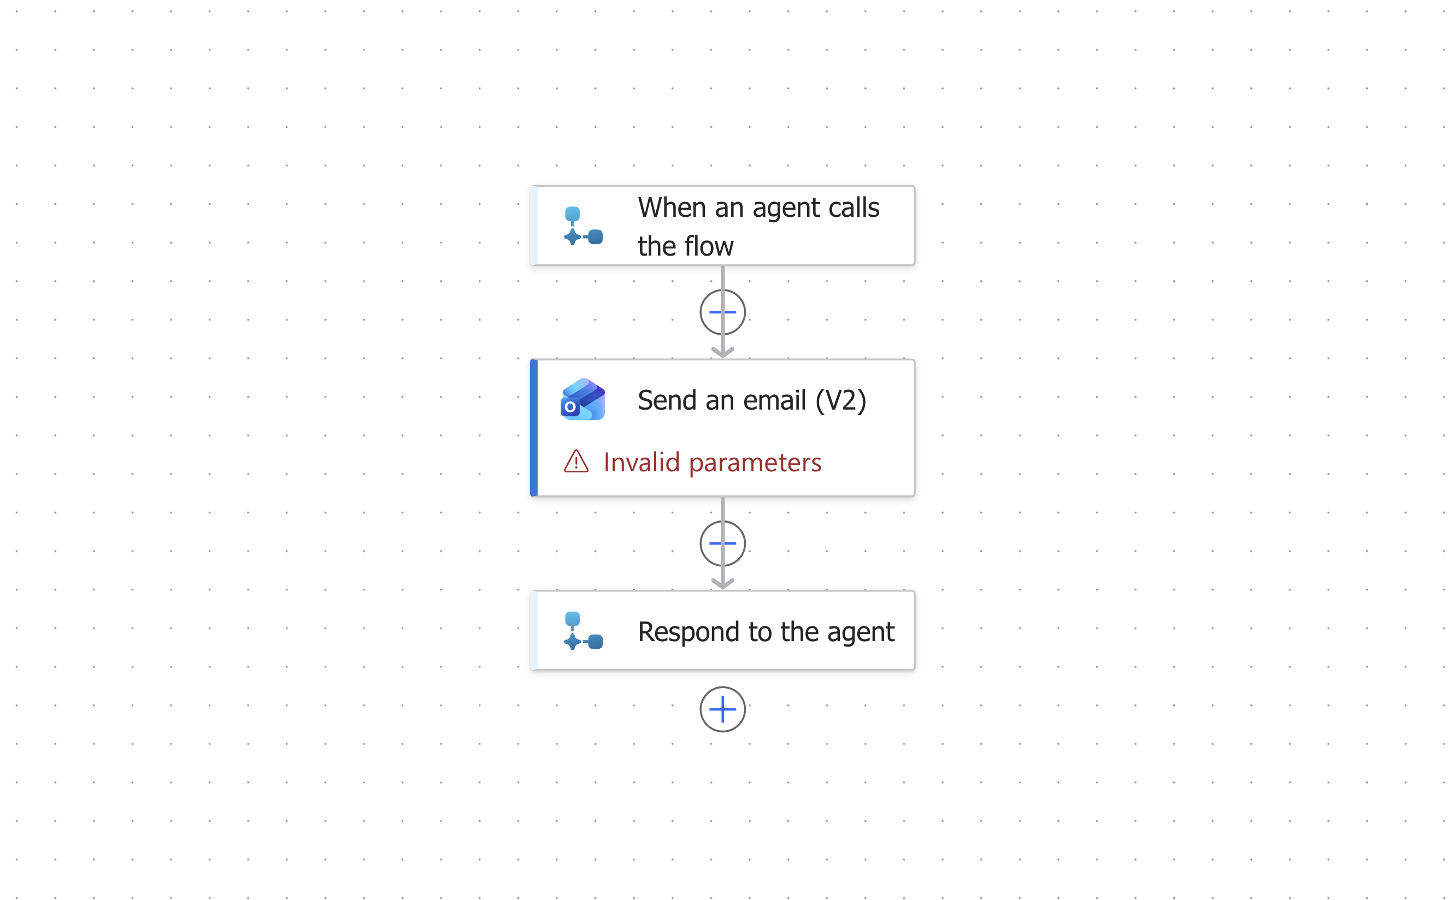
Fictional completed example 3 / 5
How Our Flow Works (another example)
Show the route from input to output. Mark steps Built, Planned or Blocked.
Flow diagram / readable screenshot
Apps / connectors
Input and source
Output and destination
Human decisions or checks
Trigger: show what starts the Flow. A hand-drawn plan is valid even if you have not built it yet.
Project Refinement • Batch 2 Operations
12

Slide 14
Fictional completed example 4 / 5
What We Built & Tested
Compare expected and actual results. A successful run can still produce the wrong output.
Built so far / incomplete / last tested
Built: all steps. Incomplete: routing verification. Last tested: 10 November 2026.
Test / sample input | Expected result | Actual result | Run status / date | Evidence ref.
T01: Training handout Category: Operations | 1 Operations row 1 Operations email | Expected row and email observed | ✅Succeeded 10 Nov 2026 | E01: illustrative text only
T02: Training budget Category: Finance | 1 Finance row 1 Finance email | Correct Finance row Operations email label | ✅Succeeded 10 Nov 2026 | E02: illustrative text only
T03: Repeat submission | Not defined yet | Not yet tested | 🟡Not run | No evidence yet
What has not been tested yet?
Repeat submissions, missing values and another authorised account. Retest after a verified correction.
Add labelled screenshots or output excerpts in Appendix B. Unknown and No evidence yet are valid responses.
Project Refinement • Batch 2 Operations
13

Slide 15
Fictional completed example 5 / 5
Our Main Blocker (1)
Describe one issue. If there is no blocker, describe a limitation or desired improvement.
Blocker / improvement title
Exact location and impact
Finance input receives an Operations email label
Condition / emails. Cause: Unknown. Routing untrusted.
Reproduction steps and frequency
Expected versus actual
1. Submit Training budget, Category = Finance.
2. Compare its tracker row and email label.
Observed: 1 of 1 Finance tests. Repeatability Unknown.
T02: expected Finance label, received Operations.
Error text or symptom
No error message. Run: Succeeded.
Finance tracker row is correct, but email label is wrong.
Fixes attempted and results
Change tried | Result
Reviewed the received email subject | Wrong label confirmed. Cause remains Unknown.
No further fix attempted | Not applicable
Cannot start? Describe the first blocked step or access message. Put additional issues in Appendix A.
Project Refinement • Batch 2 Operations
14

