Slide 1
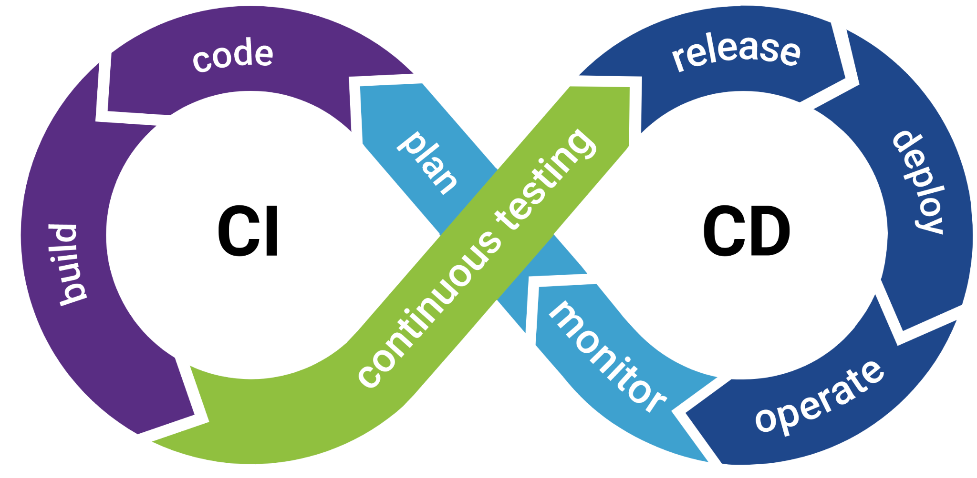
BUSINESS CASE FOR CI /CD

Slide 2
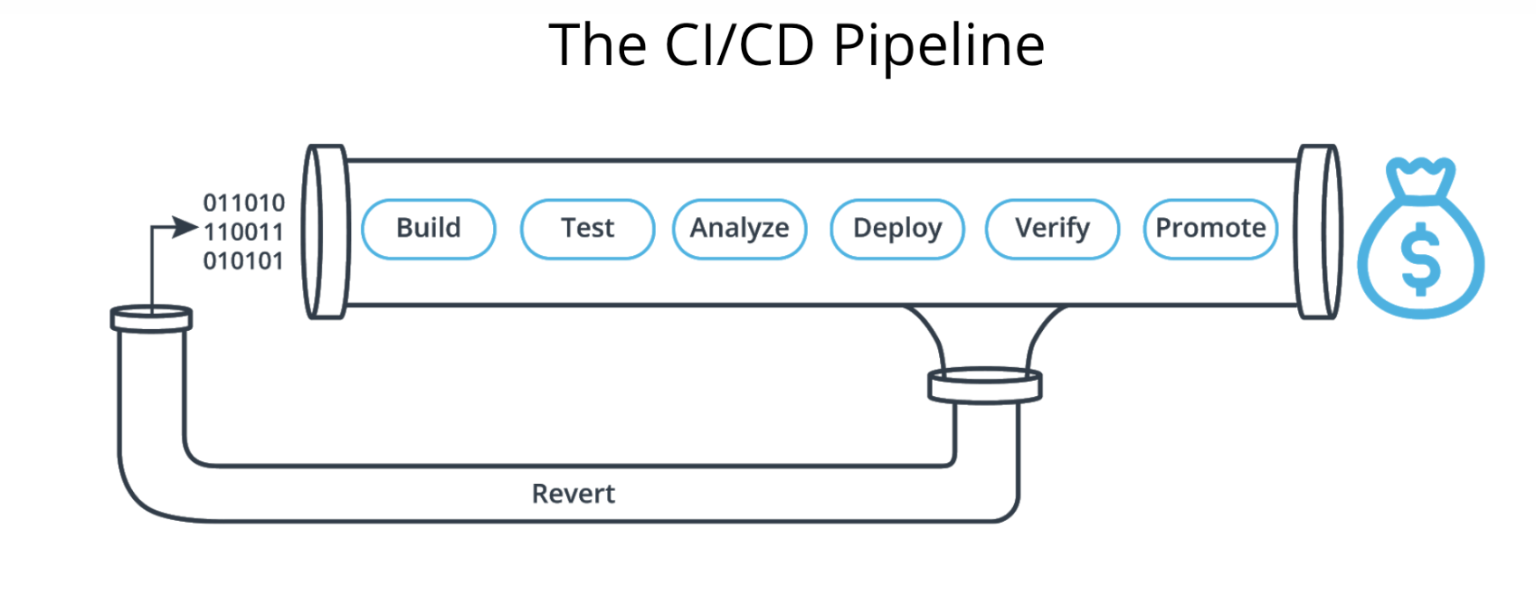
What is CI/CD ?
Continuous Integration
The practice of merging all developers' working copies to a shared mainline several times a day. It's the process of "Making"
Continuous Deployment
A software engineering approach in which the value is delivered frequently through automated deployments. Everything related to deploying the artifact fits here.

Slide 3
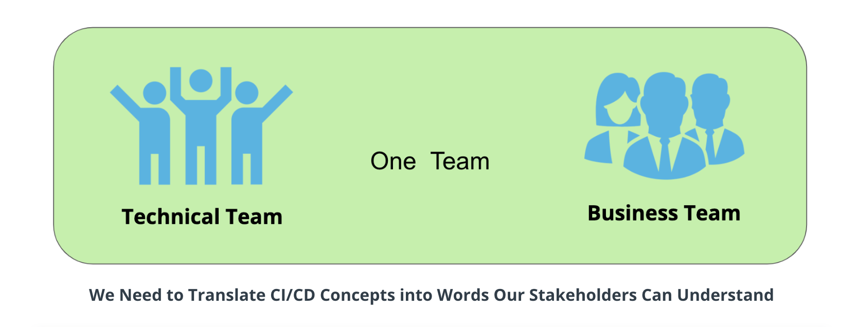
Why do we need CI/CD
CI/CD allows organizations to ship software quickly and efficiently.
Improve communications between technical team and Business team
CI/CD facilitates an effective process for getting products to market faster than ever before,
continuously delivering code into production.
Bug fixes via the most efficient delivery method.

Slide 4
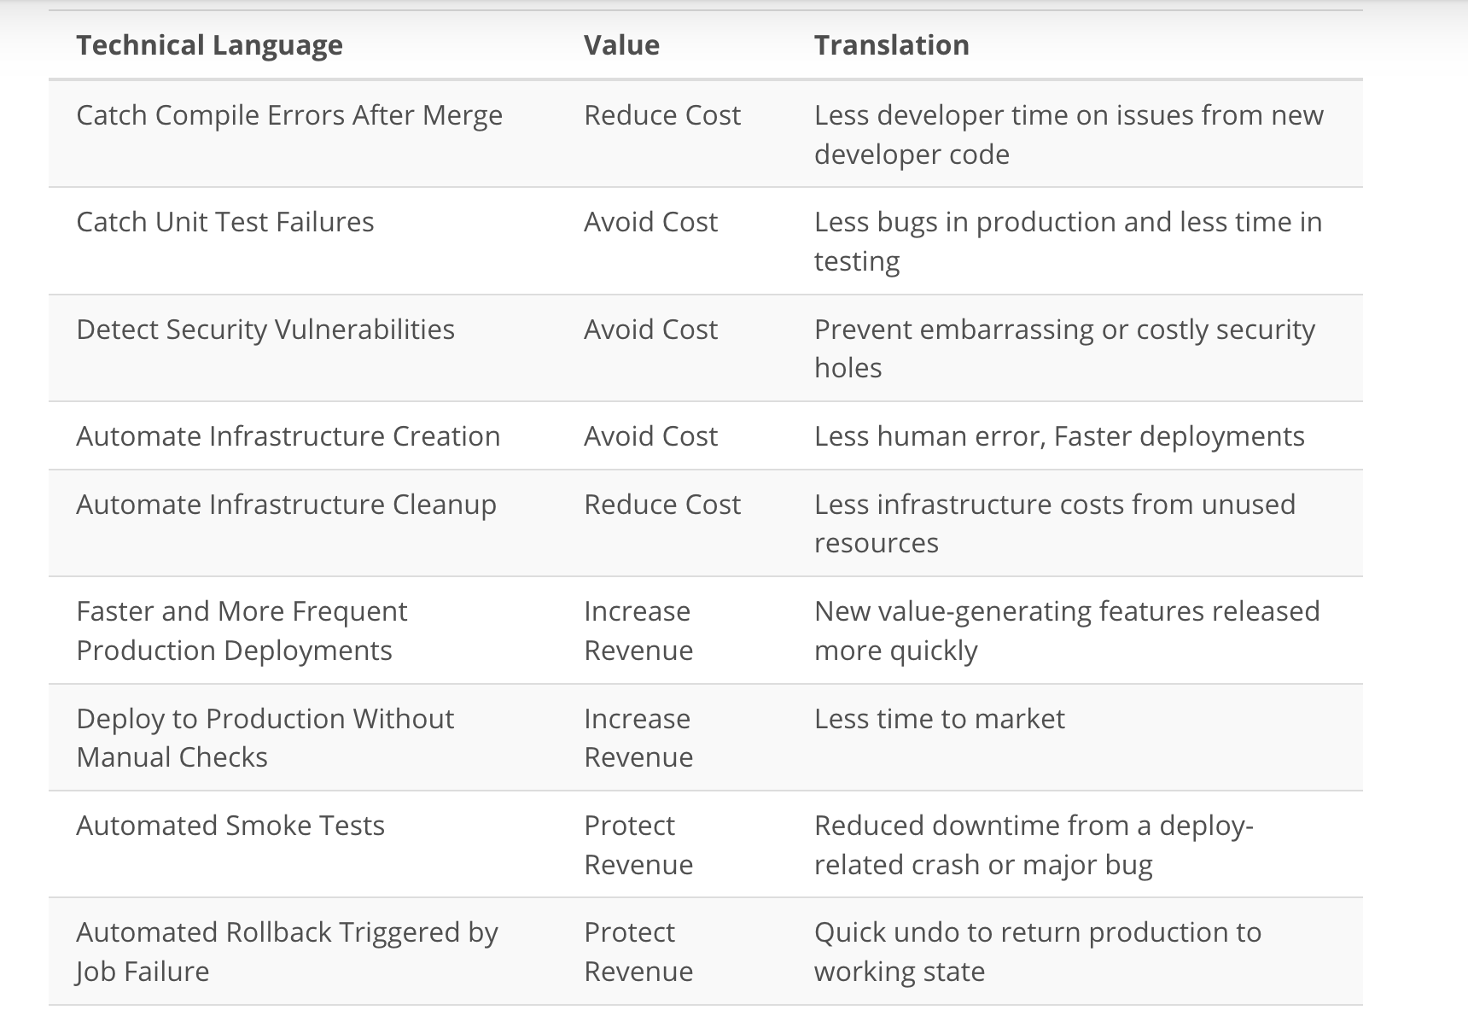
Benefits of CI/CD

Slide 5

THANK YOU

