Slide 1



Pension
View in Power BI
Last data refresh:
7/17/2019 1:57:01 PM Eastern Standard Time
Downloaded at:
8/26/2019 10:47:58 AM Eastern Standard Time

Slide 2
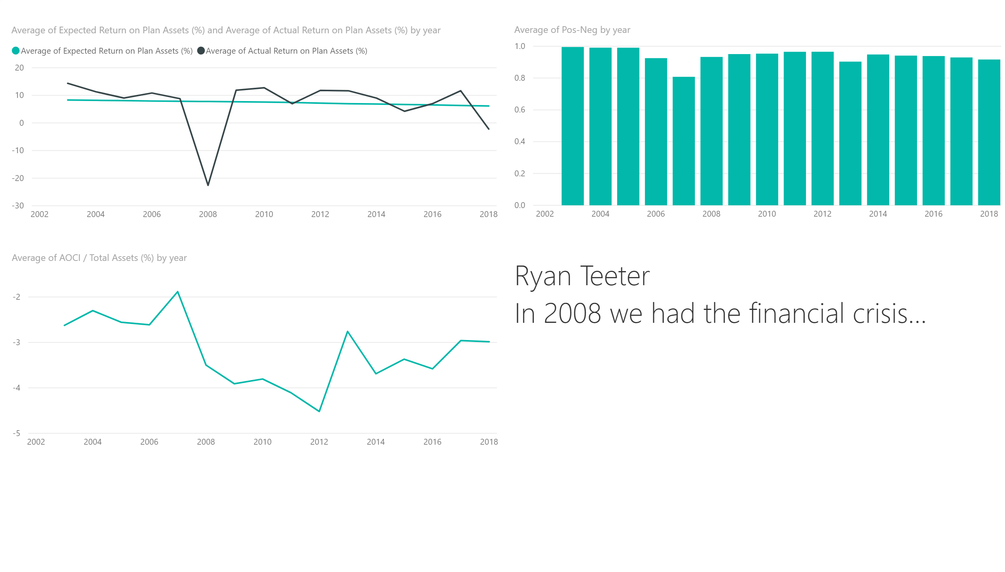

Slide 3


