Slide 1
Data Structures
Notes:
This first lecture is about the speed of a program. What is a data structure anyway? It is a data that stores other, usually more than one instance, of data). A data structure students are already familiar with is array, which can store a lot of data with the same data type.
But array is only one of many data structures. Each data structure has its own usage. In this course, we will be going through several data structures commonly known and used.

Slide 2
Introduction
Why study data structure?
Can understand more code.
Can choose a correct data structure for any task.
Notes:
Let us start with: Why do we have to study data structures?
The first reason is: if we know the basics, we can understand code written by other people faster. We can also use a well-known data structure suitable for a job without having to reinvent the wheel. In fact, many programming languages have data structure library for you to use.
The second reason is: we can choose a structure that gives us the best performance (speed) for a task.

Slide 3
Example, storing 5 numbers
Linked ist
P
1
2
3
4
5
P
Tree (Binary Search Tree)
2
1
4
3
5
Notes:
When choosing a data structure, sometimes it does not matter which data structure you choose. But one data structure may allow faster data retrieval than others, depending on how you use it.
Let’s store 5 integers. There are several data structures that can be used:
The first one is array.
The second possible choice is a linked list, which is a sequence of linked slots (a link between each slot is called a “pointer”). The upper picture shows an example linked list with its first pointer “p” (don’t worry too much about it, for now).
The third method is storing data in a tree structure (starting the search at p also, see the bottom half of the slide). The picture shows a binary search tree (don’t worry about the detail. We will cover this topic later).

Slide 4
Choosing the implementation
Heap
5
If we want to always retrieve a maximum value, heap is the best for that.
4
3
2
1
Copyright©Vishnu Kotrajaras, PhD.
Notes:
Another data structure called a heap can also be used. Here is a maxheap, which stores larger data at the top. Larger data is always nearer to its root.
Which one we choose depends on how we want to use the data. We normally want the data structure that gives us the fastest working time.
If our program makes use of the smallest data much more often than others, then the choice would be the linked list because the smallest data can be accessed directly from pointer “p”. An array, if sorted, can easily access the smallest data too, but if the smallest data is going to be deleted repeatedly, it will need a lot of time to shift other data to the left of the array.
In the example linked list, we would have to follow the pointer “p” for 5 steps.
For the example binary search tree (Figure 1‑2), we have to follow a right pointer from each node 3 times.
For our heap, it takes only 1 step since the data is directly pointed to by “p”.

Slide 5
Running time analysis (code speed estimation)
double average(int[] a)
{
int n = a.length;
double tempSum = 0;
for (int i=0;i<n;i++)
tempSum += a[i];
return tempSum/n;
}
Notes:
Let’s find out the runtime of this code.
We have 2 alternatives:

Slide 6
How?
Estimate run time of each code component and add them up.
Estimate the runtime of a representative statement only.
Notes:
Estimate the running time of each component of the code and add them all up. Or,
choose a representative statement of the code and estimate the running time of that statement only.

Slide 7
Estimate runtime of each code component
Total time = 4n+9
double average(int[] a)
{
int n = a.length;
double tempSum = 0;
for (int i=0;i<n;i++)
tempSum += a[i];
return tempSum/n;
}
Declaration = 1 unit time
Assignment = 1 unit time
Declaration = 1 unit time
Assignment = 1 unit time
Declare & initialize i = 2 unit
boolean test i = n+1 times
increment i = n times
n * (assign + increment)
Division = 1 unit time
Return = 1 unit time
Notes:
Line 3: Variable declaration and assignment. Assume a variable declaration and an assignment each consumes 1 unit of time. This line of code hence takes 2 units of time to run.
Line 4: the same as line 3. Therefore, it consumes 2 units of time.
Line 5: This involves a for loop:
- Declaration and initialization of variable “i”. Both of these are performed only once. So the time is 2 units (1 for declaration and the other unit is for initialization).
- Conditional testing of “i”. The first test takes place when the value of “i” is 0. The last test takes place when the value of “i” is equal to n. If we let each conditional testing consume 1 unit of time, this part of the program consumes n+1 units of time.
- Increment the value of “i” by 1. This part of the code is executed every time before starting the next iteration. The first time takes place when the value of “i” is 0. The last time this code gets executed is when the value of “i” is n-1. If an increment operation takes 1 unit of time, then all increments take n units of time.
The total time (our estimated unit time) for the execution of line 5 is 2+(n+1)+n, which is equal to 2n+3.
Line 6: contains an addition and an assignment (hence 2 unit of time), repeated inside a loop (iterates n times). Therefore, the total unit time is 2n.
Line 7: contains a division and a return statement (2 units of time together, assuming each takes 1 unit of time).
Adding everything, we get 2+2+(2n+3)+2n+2, which is 4n+9 units of time. But this is impractical. It has too much work.

Slide 8
Using Representative Statement
double average(int[] a)
{
int n = a.length;
double tempSum = 0;
for (int i=0;i<n;i++)
tempSum += a[i];
return tempSum/n;
}
Representative statement
Notes:
Now, let’s try the method that estimates the running time of a representative statement only.
Line 6 is the program’s representative since it runs in a loop and hence contributes more to the running time.
The runtime for this representative statement is 2n.

Slide 9
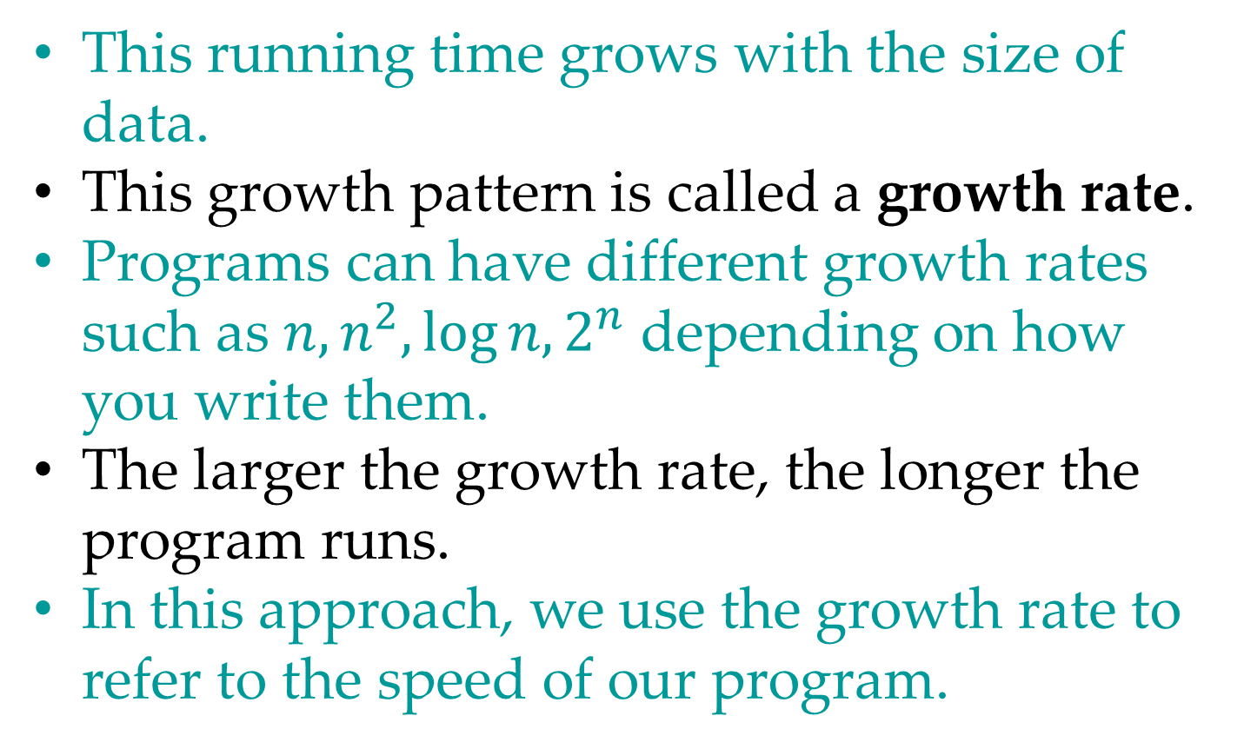
The growth of runtime
This running time grows with the size of data.
This growth pattern is called a growth rate.
Programs can have different growth rates such as $n, n^{2},\log{n, 2^{n}}$ depending on how you write them.
The larger the growth rate, the longer the program runs.
In this approach, we use the growth rate to refer to the speed of our program.

Slide 10
Let’s look at each growth rate
Notes:
Let us look at the running time of each growth rate, as the data size grows (Figure 1‑5). The x-axis indicates data size, while the y-axis indicates the running time.
The running time, according to the graph, can be compared as follows:
𝑙𝑜𝑔 𝑛 < 𝑛<𝑛^2<2^𝑛
Therefore, the programs’ growth rates can be used to compare their speed.

Slide 11
Comparing program speed using growth rate
Two programs might not have the same running time,
but if they have the same growth rate, their running time will not differ much for large n.
Thus we can regard their performance to be the same.

Slide 12
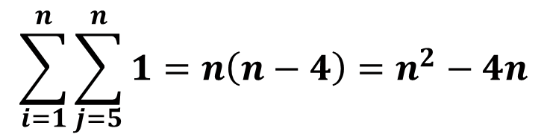
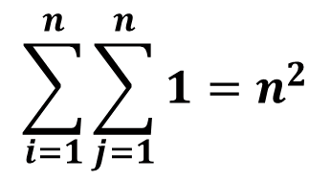
Comparing growth rate: example
for(int i=1; i<=n; i++){
for(int j=1; j<= n; j++){
x= x+1;
}
}
for(int i=1; i<=n; i++){
for(int j=5; j<= n; j++){
x= x+1;
}
}
Notes:
If we use the line that has x= x+1 as our code representative, code 1 will take
∑1_(𝒊=𝟏)^𝒏▒∑1_(𝒋=𝟏)^𝒏▒〖𝟏=𝒏^𝟐 〗 to run.
The other code will take ∑1_(𝒊=𝟏)^𝒏▒∑1_(𝒋=𝟓)^𝒏▒〖𝟏=𝒏(𝒏−𝟒)=𝒏^𝟐−𝟒𝒏〗 to run.

Slide 13
They have the same growth rate
Notes:
Their running time (y-axis) increase with the same rate (same growth rate). They remain relatively close to one another even for large n. Therefore, we can regard their performances to be equal.

Slide 14
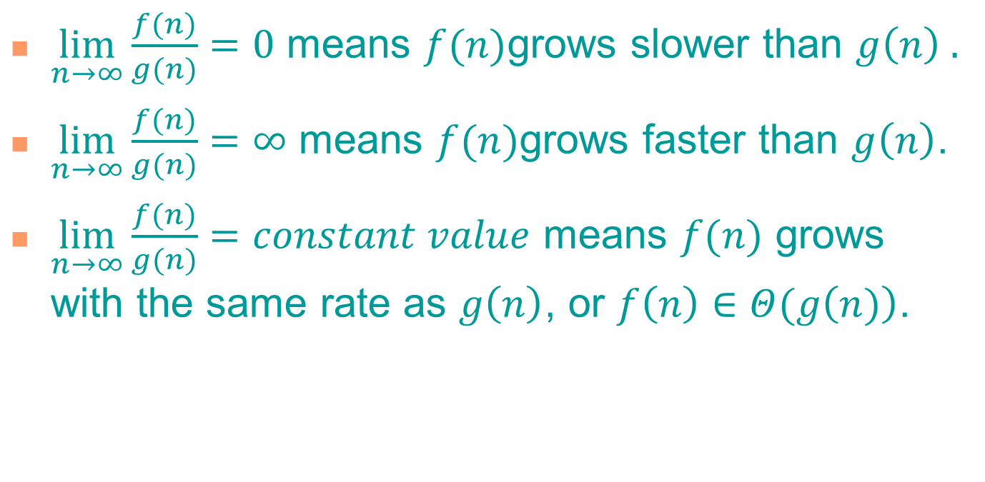
Comparing growth rate without drawing graph
Notes:
But it’s not very practical to draw graphs every time. Here is the definition you can use instead.

Slide 15
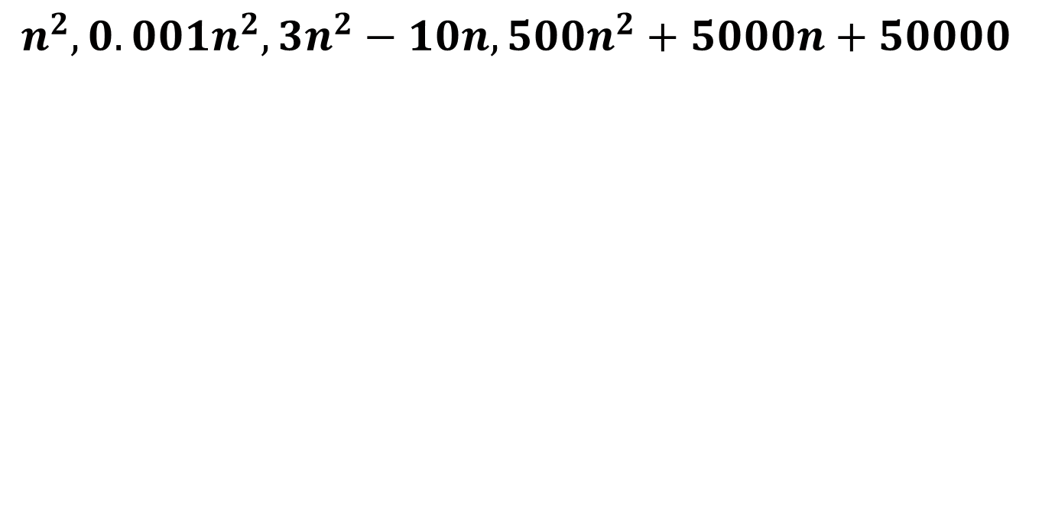
Example: same growth rate
Notes:
With this definition, here are the running time with the same growth rate (their most significant terms are the same)

Slide 16
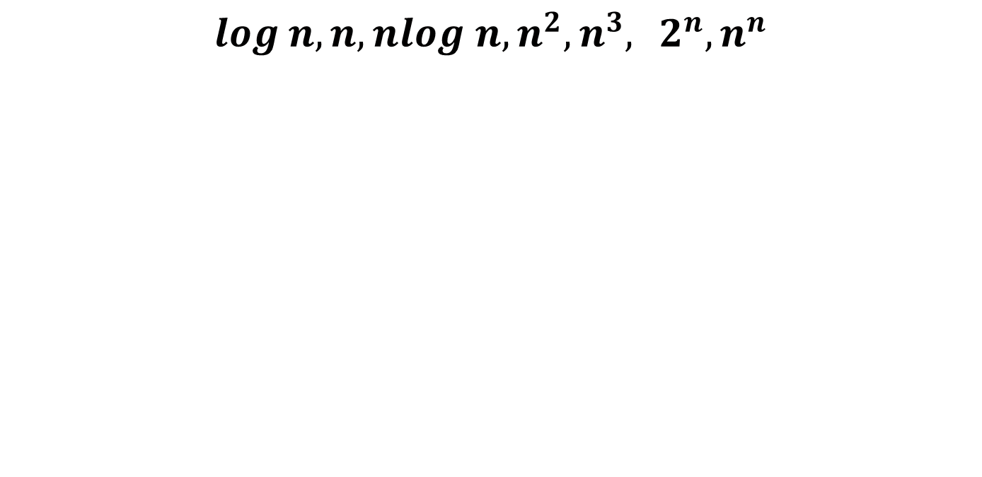
Example: growth rate from slow to fast

Slide 17
Notation for displaying growth rate
Big theta
Big O
Notes:
Notations for displaying growth rates are called asymptotic notations.

Slide 18
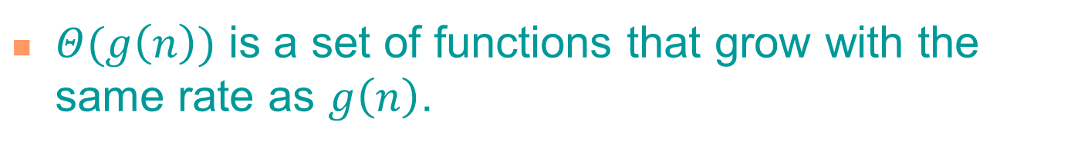
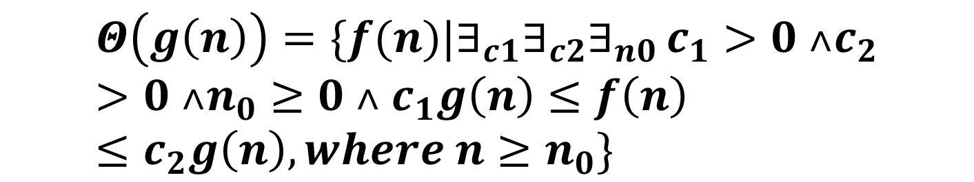
Big Theta
Notes:
So, $f(n)∈Θ(g\left(n\right))$ if and only if $f(n)$ is within the bound of $c_{1}g\left(n\right)$ and $c_{2}g\left(n\right)$ for all n greater than a certain value.

Slide 19
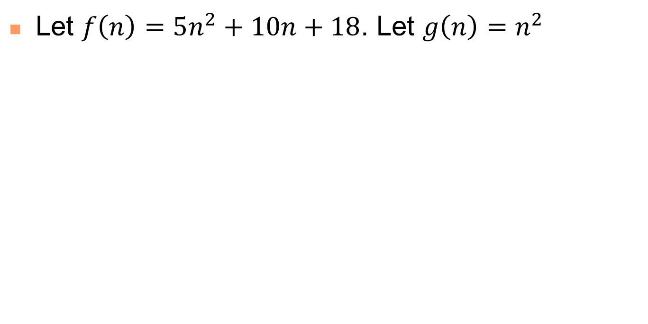
Big Theta: showing it with graph
Notes:
As an example, let our program’s running time be $f\left(n\right)=5n^{2}+10n+18$. Let $g\left(n\right)=n^{2}$. If we set $c_{1}$ to 1 and $c_{2}$to 8, the graph of their values is shown here.
The values of 𝑓(𝑛) eventually lie between 1∗𝑛^2 and 8∗𝑛^2. Therefore 𝑓(𝑛)∈𝛩(𝑛^2). There are many possible values for 𝑐_1and 𝑐_2 that make 𝑓(𝑛)∈𝛩(𝑛^2). Just finding one pair that works is enough.

Slide 20
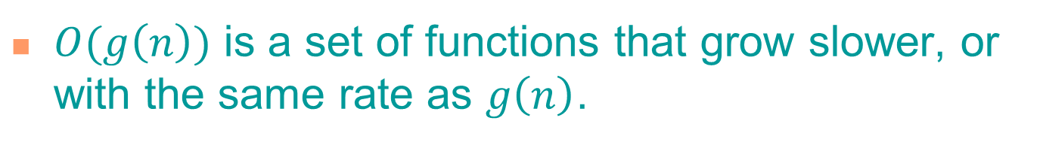
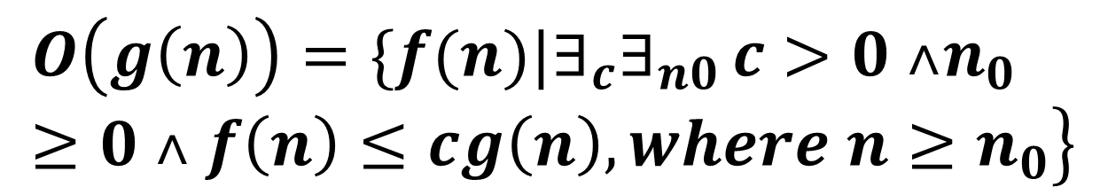
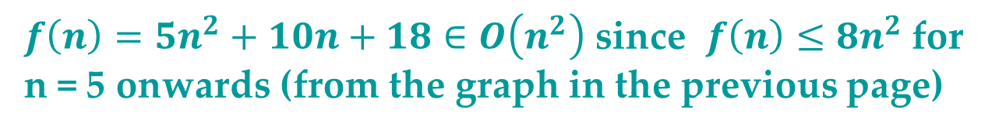
Big O

Slide 21
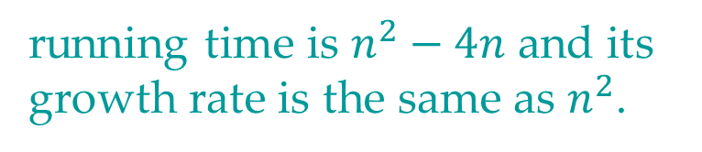
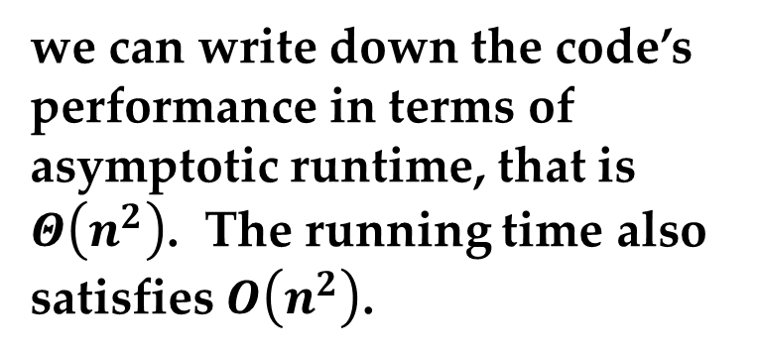
Writing down asymptotic term
for(int i=1; i<=n; i++){
for(int j=5; j<= n; j++){
x= x+1;
}
}
Notes:
That is, we can put our observed growth rate as asymptotic runtime. It is fast, convenient, and easily comparable with other programs.

Slide 22
Program with exit condition
for(int i=1; i<=n; i++){
for(int j=5; j<= n; j++){
if(f(i)) break;
x= x+1; // a representative statement
}
}

Slide 23
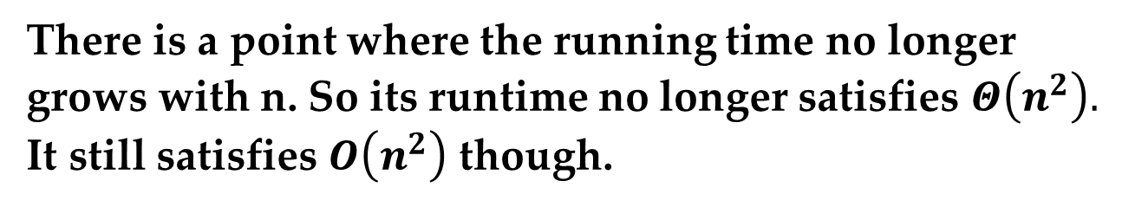
Notes:
Many programs have exit conditions like this and their runtime hence must be indicated using big-O rather than big-Theta.

Slide 24
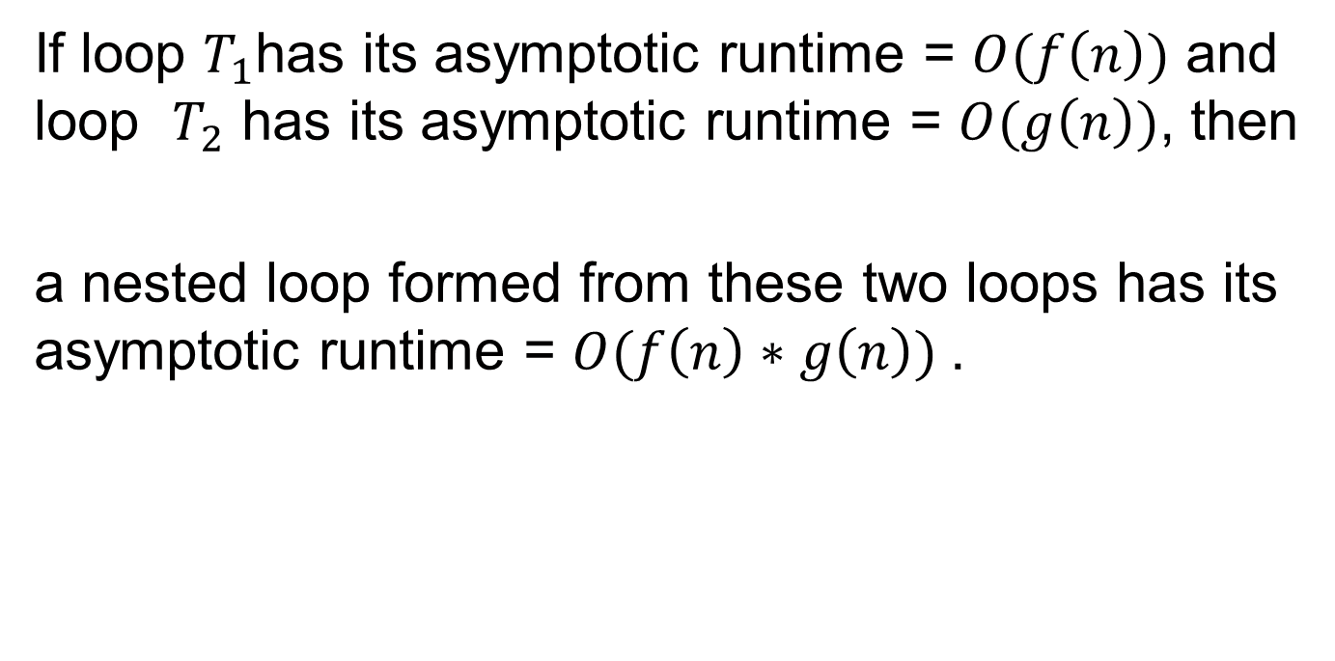
Asymptotic Notations and Nested Loop (formal definition)

Slide 25

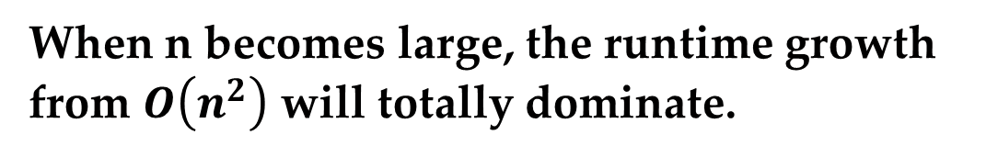

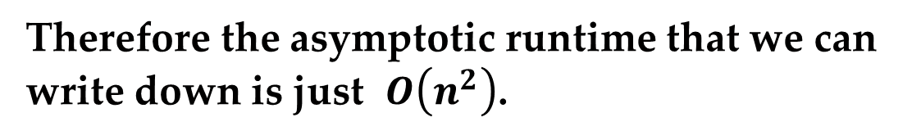
Asymptotic Runtime and Consecutive Operations
for(int i =1; i<=n; i++) //first loop
y = y*2;
}
for(int i=1; i<=n; i++){ //second loop
for(int j=5; j<= n; j++){
if(f(i)) break;
x= x+1;
}
}
Notes:
The total runtime is 𝛩(𝑛)+𝛰(𝑛^2 ). But when n becomes large, the runtime growth from 𝛰(𝑛^2 ) will totally dominate the runtime growth from 𝛩(𝑛). Therefore the asymptotic runtime that we can write down is just 𝛰(𝑛^2 ).

Slide 26
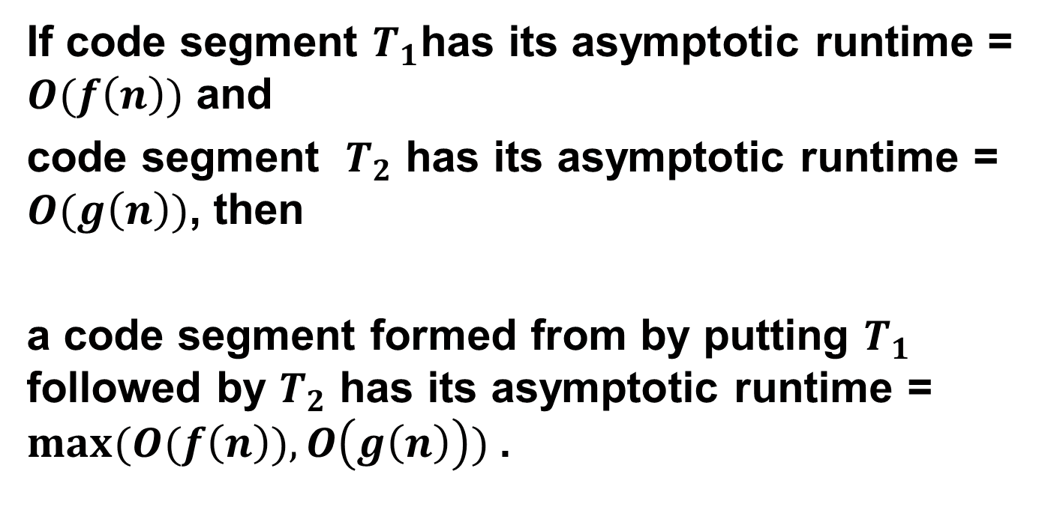
Asymptotic Runtime and Consecutive Operations (formal definition)

Slide 27
Asymptotic Runtime and Conditional Operations
if (condition)
Statement1
else
Statement2
The running time we should assume should be the worst case scenario, that is, the most time consuming statement.
This code either executes Statement 1 or Statement 2, never both.
Notes:
This code either executes Statement 1 or Statement 2, never both. Since we do not know which statement will get executed at runtime, the running time we should assume should be the worst case scenario, that is, the most time consuming statement.

Slide 28
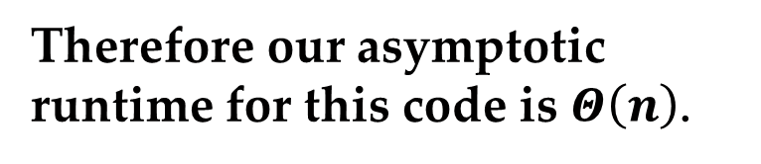
Asymptotic Runtime and Recursion
From the code, the input is originally n. It reduces by 1 each time mymethod is called. This is similar to executing a loop for about n times.
mymethod (int n) {
if (n == 1) {
return 1;
} else {
return 2*mymethod(n – 1) + 1;
}
}

Slide 29
Asymptotic Runtime in Logarithmic Form (binary search example)
index (0+7)/2
index (4+7)/2
index (6+7)/2
1 | 2 | 3 | 4 | 5 | 6 | 7 | 8
Notes:
Sometimes our programs run in logarithmic time. This usually happens when we can spend a constant time to divide a problem into equal parts (reading input data does not count because it is already 𝛩(𝑛)).
Let’s check out an example. Let’s say we have an array that stores n positive integers from index 0 to n-1, and the elements are sorted from small to large. We want to find an index of a given value, x. If x is not in the array, our algorithm should return -1.
To find the index, we could straightforwardly start searching from the first element of the array and stop when we find x. But x can be anywhere, from the first element to the last, even not in the array. Therefore the asymptotic runtime is 𝛰(𝑛).
But we know that the elements are sorted, so we can use a faster algorithm. This algorithm is called binary search. We start by looking at the middle element of the array. If it is less than x, it means x, if it is in the array at all, is on the right half of the array. On the other hand, if the middle value is more than x, we know that x, if it is in the array, is in the left half of the array. Once we know which half of the array to search, we can search that half of the array by starting with the middle element of that half, and so on.
Let’s find 7 in the array. The middle element we find is at index (0+7)/2, which is 3 (0 is the index of the first slot, while 7 is the index of the last slot.). The stored value at that array slot is 4.
We immediately know that the value 7 must be on the right half of the array. So we start searching by looking at the middle element of that half, which has index (4+7)/2, which is 5 (the first slot of the half has index value equals to 4). The stored value at that array slot is 6.
Again, 7 is on the right half of that array portion. So, we look at the middle element of the portion, which has index (6+7)/2, which is 6 (the first slot of this portion has index value equals to 6). This time, we find the value 7. Instead of looking at seven array slots , using linear search, we only need to look at three slots.

Slide 30
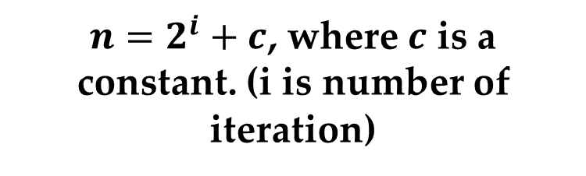
Binary search (code)
The longest time that the code runs is when we cannot find the required number in the array.
int binarySearch (int[] a, int x) {
int left = 0, right = a.length – 1;
while (left <=right) {
int mid = (left + right)/2;
if (a[mid] < x ) {
left = mid + 1;
} else if (a[mid] > x) {
right = mid – 1;
} else {
return mid;
}
}
return -1; // number not found
}
If the array size is n, the size of a portion that we need to investigate reduces by half each iteration.

Slide 31
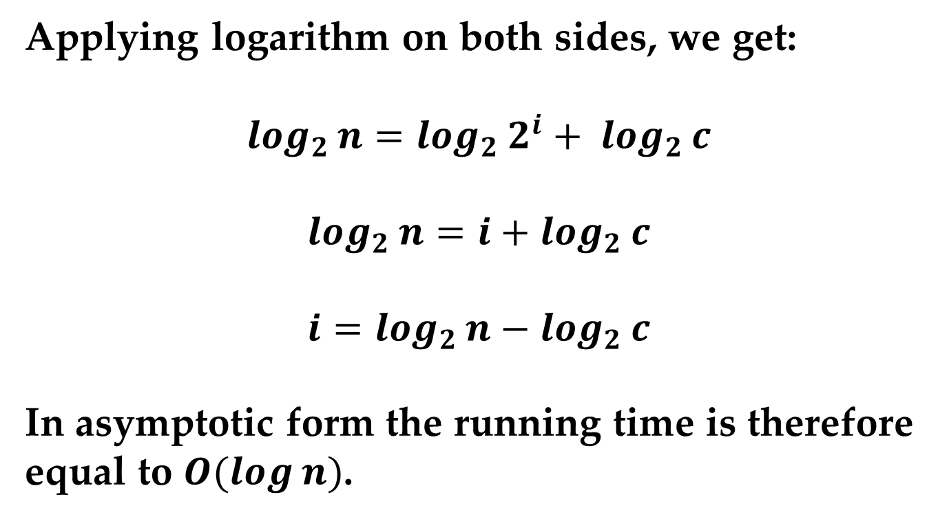
Notes:
(big-Theta is not used because the program can exit early if the required data is found).

Slide 32
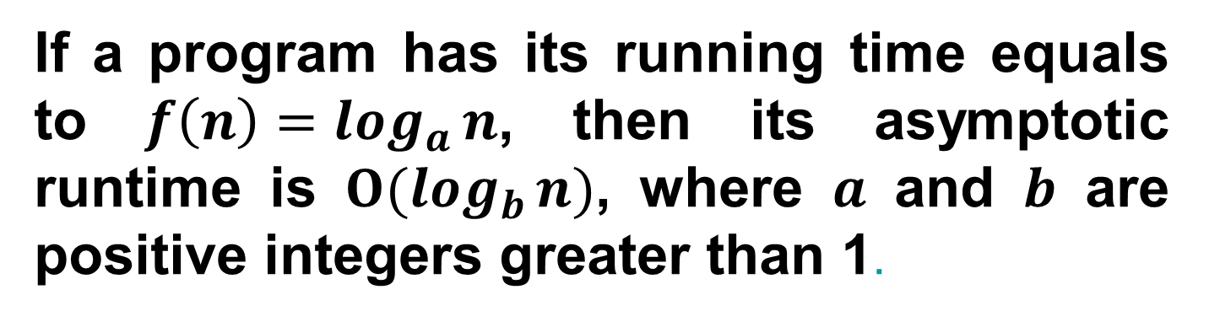
The base of the log is not important in its asymptotic form: let’s see the definition.

Slide 33
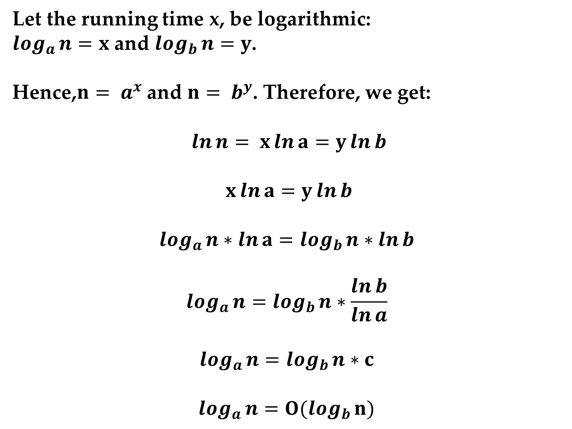
Notes:
Therefore the logarithmic asymptotic runtime can have so many possible bases, i.e. the bases do not matter.

Slide 34
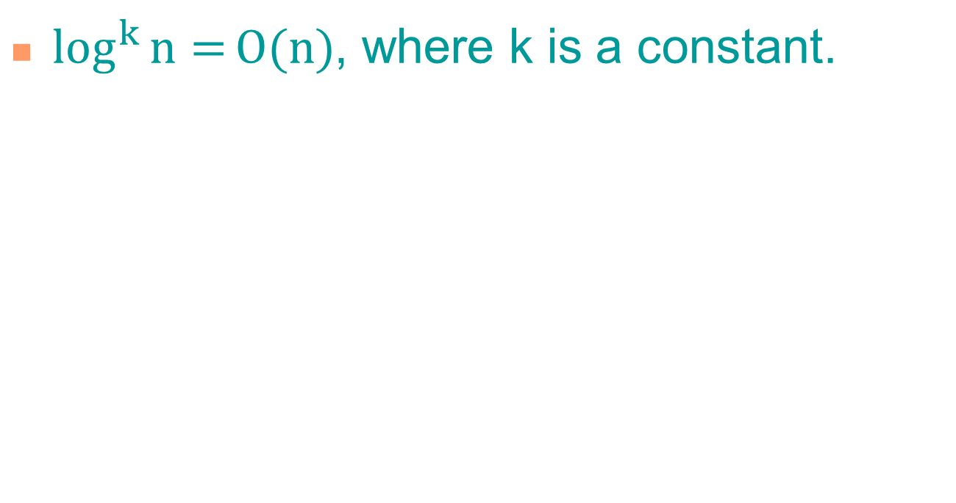
logarithmic runtime has a very low growth rate.

Slide 35
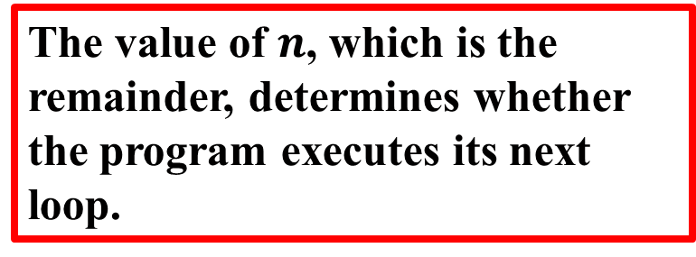
Another Logarithmic Runtime Example: Greatest Common Divisor
long gcd (long m , long n) {
while (n!=0) {
long rem = m%n;
m = n;
n = rem;
}
return m;
}

Slide 36
Let’s run gcd with m = 1974 and n = 1288
1st: rem = 1974 mod 1288 = 686
m = 1288, n=686
2nd: rem = 1288 mod 686 = 602
m = 686, n = 602
The value of n does decrease, but there seems to be no obvious pattern
3rd: rem = 686 mod 602 = 84
m = 602, n = 84
4th: rem = 602 mod 84 = 14
m = 84, n = 14
5th: rem = 84 mod 14 = 0
m = 14, n = 0
Notes:
This slide shows the value of rem, m, and n in each loop. To find the decrease pattern of n, we need to utilize the fact shown on the next page.

Slide 37
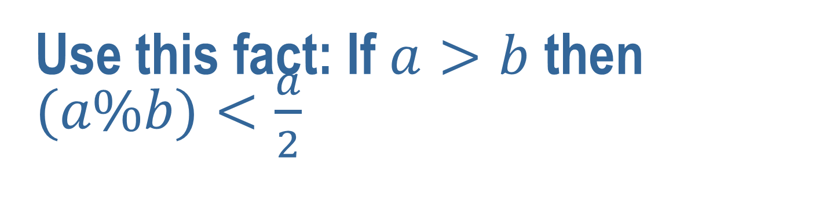

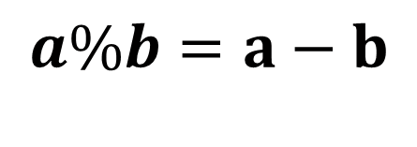
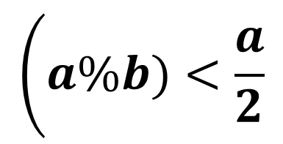
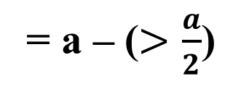
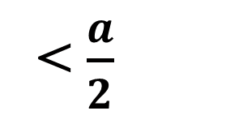
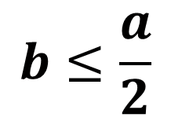
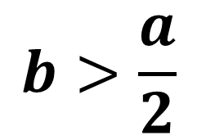
a
b
a
b
Notes:
If 𝑎>𝑏 then (𝑎%𝑏)<𝑎/2
This is always true:
If 𝑏≤𝑎/2 : since 𝑎%𝑏<𝑏, therefore (𝑎%𝑏)<𝑎/2 .
If 𝑏>𝑎/2 : 𝑎/𝑏 will result in 1 and its remainder, which is 𝑎−𝑏. Since we already know that 𝑏>𝑎/2, so the value of the remainder is 𝑎−(>𝑎/2), which is less than 𝑎/2 .

Slide 38

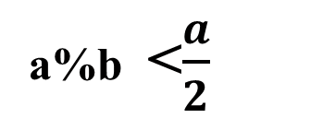
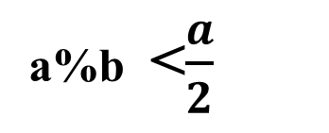
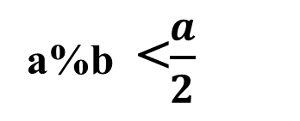
1st: rem = 1974 mod 1288 = 686
m = 1288, n=686
a
2nd: rem = 1288 mod 686 = 602
m = 686, n = 602
b
a
3rd: rem = 686 mod 602 = 84
m = 602, n = 84
b
a
4th: rem = 602 mod 84 = 14
m = 84, n = 14
b
5th: rem = 84 mod 14 = 0
m = 14, n = 0
Notes:
If we look at the value of each variable in each loop again, it can be seen that, starting from the 3rd loop, the value of n comes from the modulo between the values of n in the previous two loops. It means that the value of n reduces by at least half in every two iterations. This is similar to binary search but takes twice as long so the number of iterations is in terms of 2∗log_2⁡n. Thus its asymptotic runtime is also 𝛩(log⁡〖n)〗. (Please run animation)

Slide 39
Asymptotic Runtime and Its Application in Choosing Implementation
Different solutions for a problem often have different asymptotic runtime.
We can analyze the runtime of each solution and pick the most efficient solution.

Slide 40
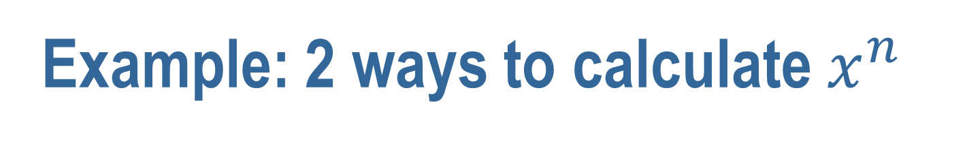
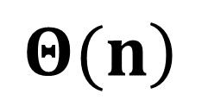
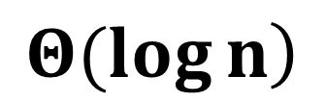
long power (long x, int n) {
long result =1;
for(int i=0;i<n;i++){
result = result * x;
}
Return result;
}
long power (long x, int n) {
if (n==0)
return 1;
if (isEven (n))
return power (x*x, n/2);
else
return power (x*x, n/2)*x;
}
Notes:
The program on the left runs in the loop n times. Thus having its asymptotic runtime = Θ(n).
The program on the right is based on a divide and conquer approach:
If n is even, 𝑥^𝑛comes from 〖(𝑥∗𝑥)〗^(𝑛/2).
If n is odd, 𝑥^𝑛 comes from 〖(𝑥∗𝑥)〗^(𝑛/2)∗𝑥, where 𝑛/2 uses integer division.
Each time the method power is called, n is reduced by half. This is very similar to the binary search problem. Until 𝑛 reaches zero, the number of times method power is called is proportional to log_2⁡𝑛. Therefore it has its asymptotic runtime equals to Θ(log⁡n).

Slide 41
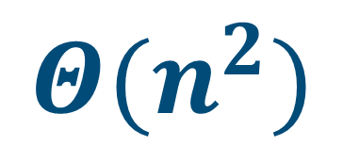
Example: largest gap between 2 values
int largestGap (int[] a) {
int largestGap = 0;
for (int i = 0; i < a.length; i++) {
for (int j = i+1; j < a.length; j++) {
int dif = Math.abs(a[i] - a[j]);
if (dif > largestGap) largestGap = dif;
}
}
return largestGap;
}
This version calculates the difference between every value pair
Notes:
Another example is a program that calculates the largest gap between two values in an array.
The version on this page calculates the difference between every value pair.
The outer loop obviously iterates for 𝑛 times. The running time of the inner loop varies according to the value of 𝑖. When i is 0, it runs n-1 times. When i is 1, it runs n-2 times, and so on. Therefore, the combined running time of both loops is (𝑛−1)+(𝑛−2)+(𝑛−3)+…+1+0= 𝛩(𝑛^2).

Slide 42
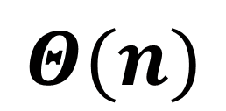
Alternative version
int largestGap (int[] a) {
int max = Integer.MIN_VALUE;
int min = Integer.MAX_VALUE;
for (int i = 0; i < a.length; i++) {
if (a[i] > max) max = a[i];
if (a[i] < min) min = a[i];
}
return max - min;
}
This version finds the maximum and the minimum value, and then subtracts them
Notes:
For this version, we only need one loop, running for n iterations, thus its asymptotic runtime is 𝛩(𝑛).

Slide 43
Example: Maximum Subsequence
Maximum Subsequence Sum is:
For integer A₁,A₂, …, A_{n}
Maximum Subsequence Sum is that gives the maximum value. It is a consecutive sequence that gives the highest added value.
Example: -2, 11, -6, 16, -5, 7
The sum of 11, -6, 16 is 21. But the max sequence is 11, -6, 16, -5, 7 -> the sum is 23.
23 is our answer.
consecutive
Notes:
Maximum subsequence sum is the maximum possible value of the sum of consecutive numbers in a sequence (can start and end anywhere).

Slide 44
Solving max sub sum: 1st method
1: int maxSubSum01 ( int [] a) {
2: int maxSum = 0;
3: for (int i = 0; i < a.length; i++) {
4: for (int j = i; j < a.length; j++) {
5: int theSum = 0;
6: for (int k = i; k <= j; k++) {
7: theSum += a[k];
8: }
9: if (theSum > maxSum) {
10: maxSum = theSum;
11: }
12: }
13: }
14: return maxSum;
15: }
First index
Last index
Sum from first to last.
Choose to store max value.
Notes:
Our first method uses the loop with k to calculates the sum from position i to j, where i is the first position of a sequence and j is the last position of that sequence.
Our program here calculates all possibilities. Variable maxSum stores the maximum sum so far.

Slide 45
Solving max sub sum: 1st method(cont.)
This first method has asymptotic runtime = 𝛩(n³).
Not good enough. Too many redundant calculations.
Example: If we have added elements from index 0 to 2, when we add elements from index 0 to 3, we should not start the addition from scratch. This is redundant calculation.
Notes:
Although the problem is solved, there are too many redundant calculations. Every time j is incremented by 1, the sum from values at position i to j is re-calculated from scratch. We can do much better storing partial sum from I to j and just add one more number to the partial solution when j is incremented.

Slide 46
Solving max sub sum: 2nd method
1: int maxSubSum02 (int [] a) {
2: int maxSum = 0;
3: for (int i = 0; i < a.length; i++) {
4: int theSum = 0;
5: for (int j = i; j < a.length; j++) {
6: theSum += a[j];
7: if (theSum > maxSum) {
8: maxSum = theSum;
9: }
10: }
11: }
12: return maxSum;
13: }
Starting position
Do the addition from the starting position and collect the result.
𝛩(n²)
Notes:
Using partial sum (as mentioned in the previous page), this second method gets rid of one of the loops. Thus asymptotic runtime is now 𝛩(n²).

Slide 47
Solving max sub sum: 2nd method(cont.)
-2
11
-6
4
when i=0, j=0: theSum = -2 maxSum = 0
when i=0, j=1: theSum = -2 + 11 = 9 maxSum becomes 9.
when i=0, j=2: theSum = 9 + (-6) = 3 maxSum is still 9.
when i=0, j=3: theSum = 3 + 4 maxSum is still 9.
Notes:
This example shows the working of this 2nd method. It can be seen that the value of theSum is kept for use in the next iteration of j, saving a lot of time compared to the first method.

Slide 48
Solving max sub sum: 3rd method
Use divide and conquer
The result sequence maybe in
The left half or the array, or
The right half, or
Lie between the left half and the right half. (its sequence contains the last element of the left half and the first element of the right half.)
Notes:
The third method uses divide and conquer: Divide a problem into multiple smaller problems (usually of equal size) until each problem size is small enough to solve with simple algorithm. Then the solutions to each simple problem are combined to form the answer of the original problem.
For the maximum subsequence sum problem, the idea is that, the subsequence that gives us the solution may situated:
-- entirely on the left half of the given sequence. Or
-- entirely on the right half of the given sequence. Or
-- in a region overlapping the left and the right half of the given sequence.

Slide 49
Solving max sub sum: 3rd method (cont.)
1 | -2 | 7 | -6 | 2 | 8 | -5 | 4
Max sub sum on this side is 7.
Max sub sum on this side is 10.
Max sub sum on the left with (-6) is 1.
Max sub sum on the right with (2) is 10.
Max sub sum that covers between the left side and the right side is therefore 1 +10 = 11 (this is the final answer).
Notes:
This example uses an array with 8 members.
-- maxSubSum on the left half is 7
-- maxSubSum on the right half is 10
-- for the maxSubSum that overlaps between 2 halves.
· maxSubSum on the left half that includes (-6) is 1
· maxSubSum on the right half that includes (2) is 10
So the total value = 10 + 1 = 11
Our answer is the maximum number of the three, which is 11.
Solving the problem only for the left half and on the right half therefore help solving the entire problem.

Slide 50
Solving max sub sum: 3rd method (cont 2.)
1:int maxSumDivideConquer (int [] array, int leftindex, int rightindex {
2: //assume that the array can be divided evenly.
3: if (leftindex == rightindex) { // Base Case
5: if (array[leftindex] > 0 )
6: return array[leftindex];
7: else
8: return 0; // min value of maxSubSum
9: }
10: int centerindex = (leftindex + rightindex)/2;
12: int maxsumleft = maxSumDivideConquer(array, leftindex, centerindex);
13: int maxsumright = maxSumDivideConquer ( array, centerindex + 1, right);
T(n)
T(n/2)
T(n/2)
Notes:
Base case (line 3-9) only deals with the case where we have only one array slot to look at. We either return the value in that slot or return 0. We do not want negative answers so the minimum is 0.
Line 12: Finding maximum subsequence sum from the left half of the array (using recursive call).
Line 13: Finding maximum subsequence sum from the right half of the array (using recursive call).
Let our method, maxSumDivideConquer, takes time T(n) to finish, where n is the number of consecutive array slots to consider.
Line 12 and 13 will take T(n/2) each.

Slide 51
Solving max sub sum: 3rd method (cont 3.)
14: int maxlefthalfSum = 0, lefthalfSum = 0;
15: //max sum – from the last element of the left
//side to the first element.
16: for (int i = centerindex; i >= leftindex; i--) {
17: lefthalfSum = lefthalfSum + array[i];
18: if (lefthalfSum > maxlefthalfSum) {
19: maxlefthalfSum = lefthalfSum;
20: }
21: }
𝛩(n)
Notes:
This page find the maximum sum of a sequence on the left half that must include the last data on the left half. The sum is stored in variable maxlefthalfSum.
If the number of data that we are working on is n, then this covers about n/2 data. The loop runs for around n/2 times. Thus the asymptotic runtime is 𝛩(n/2) -> 𝛩(n)

Slide 52
Solving max sub sum: 3rd method (cont 4.)
22: int maxrighthalfSum = 0, righthalfSum = 0;
23: // max sum – from the first element of the right
//side to the last element.
24: for (int i = centerindex + 1; i <= rightindex; i++) {
25: righthalfSum = righthalfSum + array [i];
26: if (righthalfSum > maxrighthalfSum) {
27: maxrighthalfSum = righthalfSum;
28: }
29: }
𝛩(n)
Notes:
This page find the maximum sum of a sequence on the right half that must include the first data on the right half. The sum is stored in variable maxrighthalfSum.
If the number of data that we are working on is n, then this covers about n/2 data. The loop runs for around n/2 times. Thus the asymptotic runtime is 𝛩(n/2) -> 𝛩(n)

Slide 53
Solving max sub sum: 3rd method (cont 5.)
30: //finally, find max of the three.
31: return max3 (maxsumleft, maxsumright, maxlefthalfSum + maxrighthalfSum)
}
Ignoring constant time, we have:
T(n) = 2T(n/2) + 2𝛩(n)
This part takes constant time. We can ignore.
Notes:
The running time on this page cannot yet be used because it still has T in its term. We need to get rid of T so that everything is in terms of n.

Slide 54
Solving max sub sum: 3rd method (cont 6.)
T(n) = 2T(n/2) + 2𝛩(n)
= 2T(n/2) + 𝛩(n)
= 2T(n/2) + cn
Divide everything by n, we get:
according to the definition
(1)

Slide 55
Solving max sub sum: 3rd method (cont 7.)
We can create a series of equations:
(2)
n = 2 multiplies y times
n = 2^{y}
(3)
(X)
Notes:
How many equations do we have?
Looking back from the last equation, since n in T(n) changes from 2 to 4 to … n/4, n/2 , n .
N is therefore = 2*2*2*2*… y times. Thus 𝑛=2^𝑦. Hence, 𝑦=log_2⁡𝑛.

Slide 56
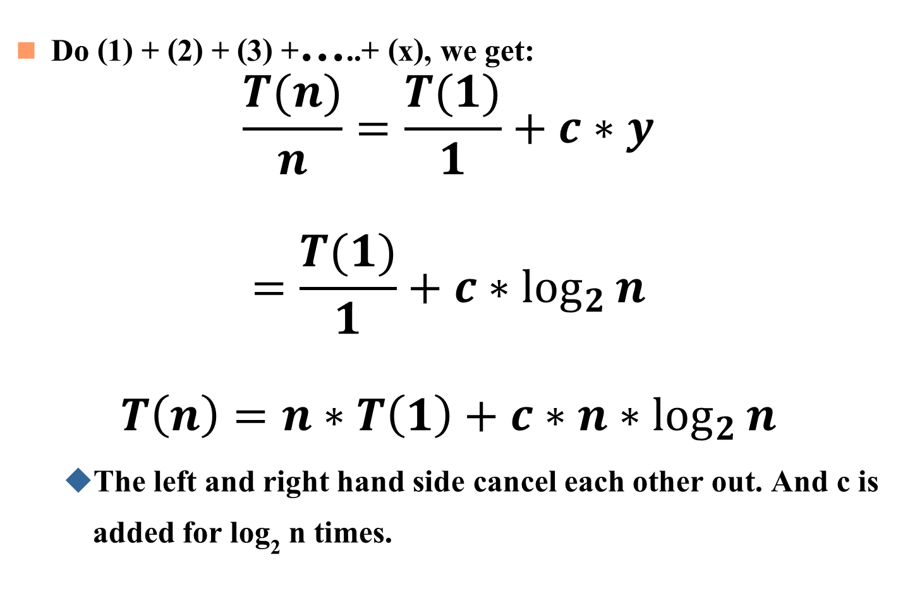
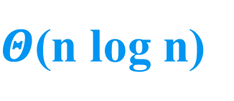
Solving max sub sum: 3rd method (cont 8.)
Notes:
When we add all equations together, almost all terms cancelled out. We are left with 𝑻(𝒏)=𝒏∗𝑻(𝟏)+𝒄∗𝒏∗log_𝟐⁡𝒏
The most dominating term is 𝒏∗log_𝟐⁡𝒏. Therefore the asymptotic runtime of this program is 𝜣(n log n) , better than the second method.

Slide 57
Solving max sub sum: 4th method
We improve on the 2nd method, with two points to note:
First, the first element of any maximum subsequence sum cannot be a negative value.
For example: 3, -5, 1, 4, 7, -4
-5 cannot be the first element of our result. It can only make the total smaller. Any single positive number gives a better result anyway.
Notes:
First point: the first element of any maximum subsequence sum cannot be a negative value.
- Yes. Beginning a sequence with a positive number is strictly better. (Our answer is 0 if all numbers are negative.)

Slide 58
Solving max sub sum: 4th method (cont.)
Second, any subsequence that is negative cannot begin max sub sum.
Let us be in a loop execution. Let i be the index of the first element of a subsequence an j be the index of the last element of that subsequence.
Let the last element, j, make this subsequence negative.
Let p be any index between i+1 and j.
3 | 4 | 1 | -3 | -9 | 1 | 5
i
p
j
Notes:
The sum from a[i] to a[j] is –11 ( from 4,1,-3,-9)
Continued next page!! Please refer to the picture on this page.

Slide 59
Solving max sub sum: 4th method (cont 2.)
The next step of the loop -> increment j by one.
If a[j] is negative, we will not get a better max sub sum. Max sub sum value will not change.
If a[j] is positive, a[i]+…+a[j] will be greater than a[i]+…+a[j-1]. However, because a[i]+…+a[j-1] is negative, the new sum is never more than a stored max sub sum. The new sum cannot even match a[j] alone.
Therefore if we have a negative subsequence, we should not move j. We should move i instead.

Slide 60
Solving max sub sum: 4th method (cont 3.)
Should we only increment i by one or more?
From our assumption, we know that a[j] makes a[i]+…+a[j] negative. Therefore, incrementing i by one within the range between i and p will only make a[i]+…+ a[p] smaller. (p is any index between i and j). Hence a[i]+…+a[j] will be smaller.
If we want to get a larger max sub sum, we must start our subsequence from position j+1. Therefore i should be incremented to j+1.
3 | 4 | 1 | -3 | -9 | 1 | 5
i
p
j

Slide 61
Solving max sub sum: 4th method (cont 4.)
1: int maxsubsumOptimum (int[] array) {
2: int maxSum = 0, theSum = 0;
3: for (int j = 0; j < a.length; j++) {
4: theSum = theSum + array [j];
5: if ( theSum > maxSum) {
6: maxSum = theSum;
7: } else if (theSum < 0) { // if a[j] makes the
8: //sequence negative,
9: theSum = 0; // start again from
10: // position j+1.
11: }
12: }
13: return maxSum;
14: }
Notes:
This 4th method actually runs only one loop. It resets theSum to 0 whenever theSum (added so far from position i) becomes negative (position j). Then theSum starts from adding numbers from position j+1 onwards.
This actually follows from the concept discussed in the last few pages.

Slide 62
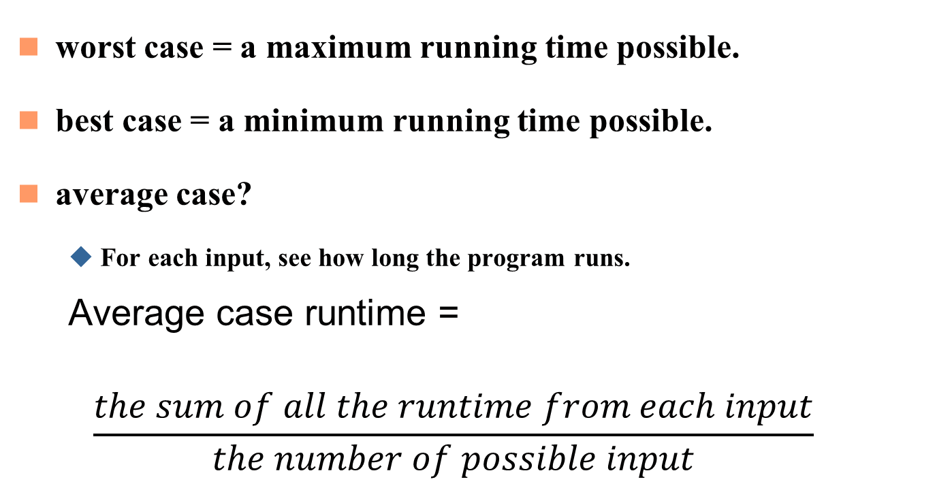
Best case, Worst case, Average case
Notes:
Best case runtime is the fastest possible runtime for a program. It has the lowest possible growth rate. Worst case runtime is its opposite (we usually use the worst case runtime as the upper bound for our asymptotic runtime).
Average case runtime =
(𝑡ℎ𝑒 𝑠𝑢𝑚 𝑜𝑓 𝑎𝑙𝑙 𝑡ℎ𝑒 𝑟𝑢𝑛𝑡𝑖𝑚𝑒 𝑓𝑟𝑜𝑚 𝑒𝑎𝑐ℎ 𝑖𝑛𝑝𝑢𝑡)/(𝑡ℎ𝑒 𝑛𝑢𝑚𝑏𝑒𝑟 𝑜𝑓 𝑝𝑜𝑠𝑠𝑖𝑏𝑙𝑒 𝑖𝑛𝑝𝑢𝑡)

Slide 63
Average case
The average case definition is based on an assumption that:
Each input has equal chance of occurrence.
If we do not want the assumption,
We must take a probability of each input into account.
Average case = (prob. of input_{i} * runtime when use input_{i} )
Notes:
Each probability value must be between (inclusive) 0 and 1. All probability values must add up to 1.

Slide 64
Example: Finding x in array
Let’s say we want to find x in an array of size n.
int find (int x, int[] a) {
for (int i = 0; i < a.length; i++) {
if (a[i] == x) return i;
}
return -1;
}

Slide 65
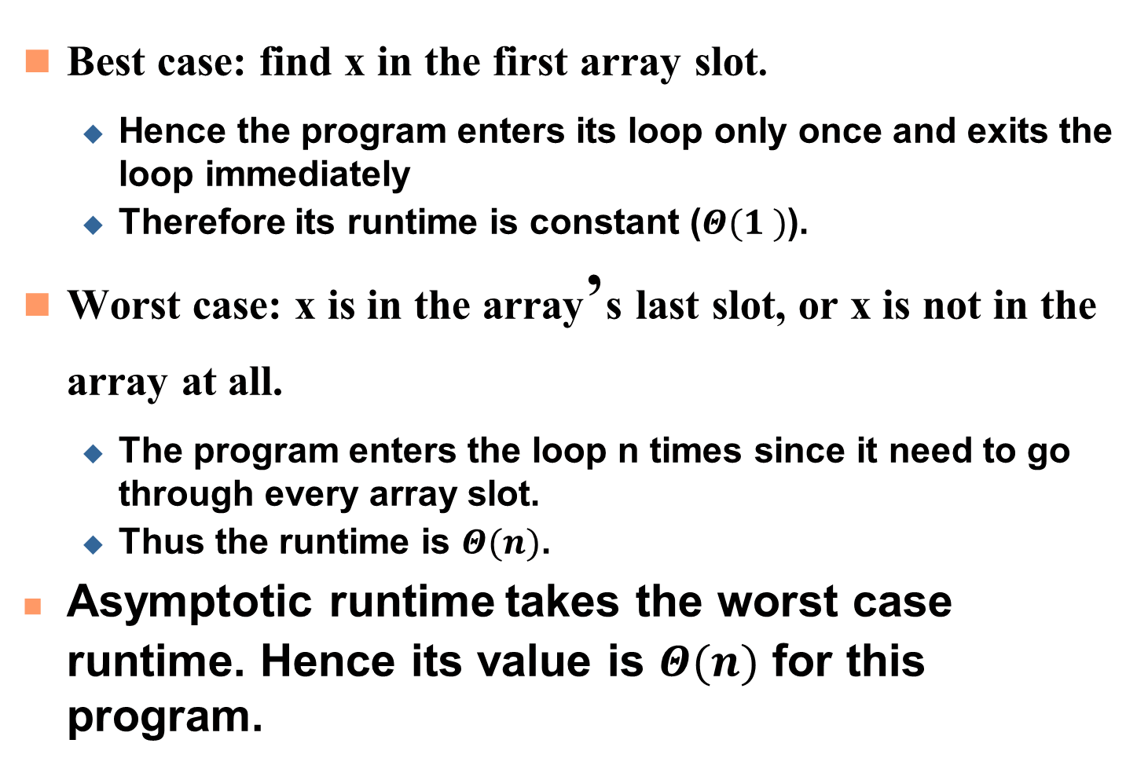

Slide 66
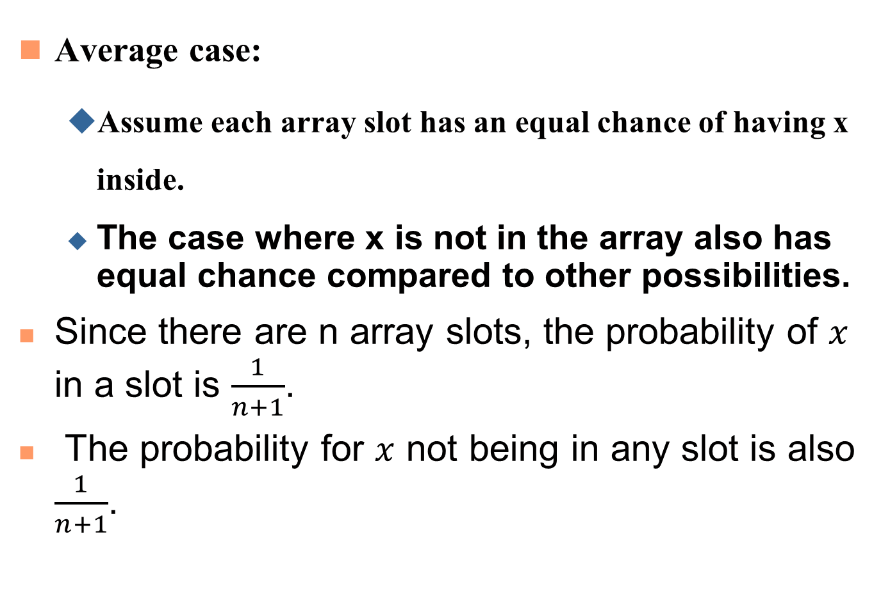

Slide 67
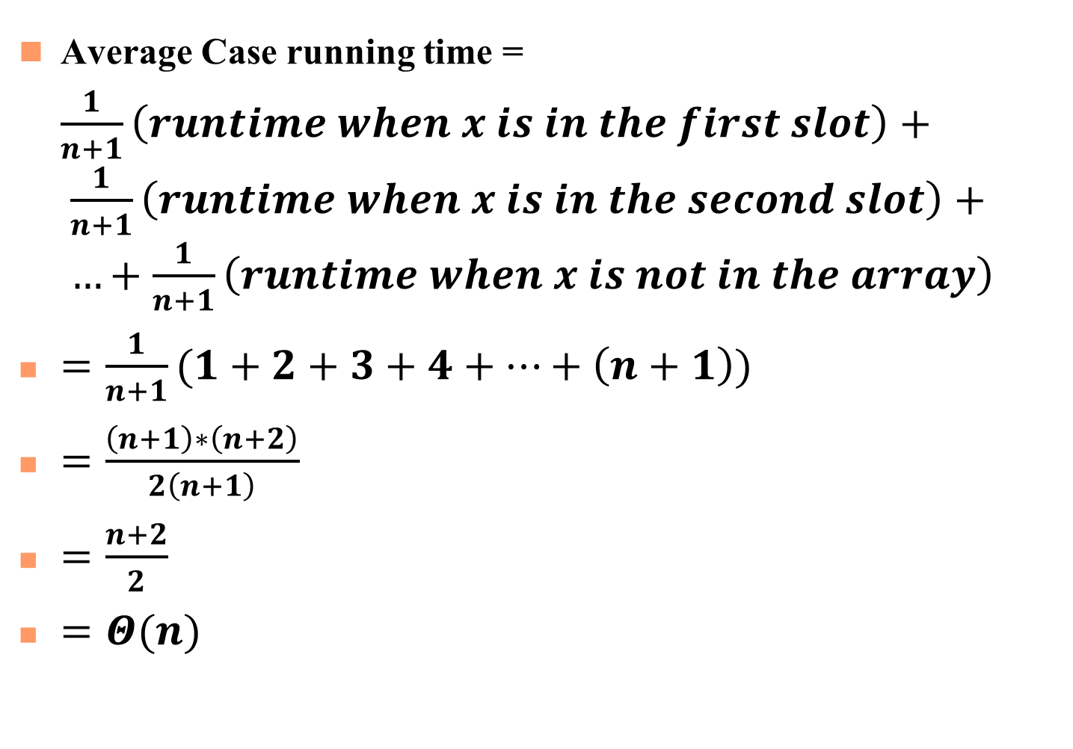

Slide 68
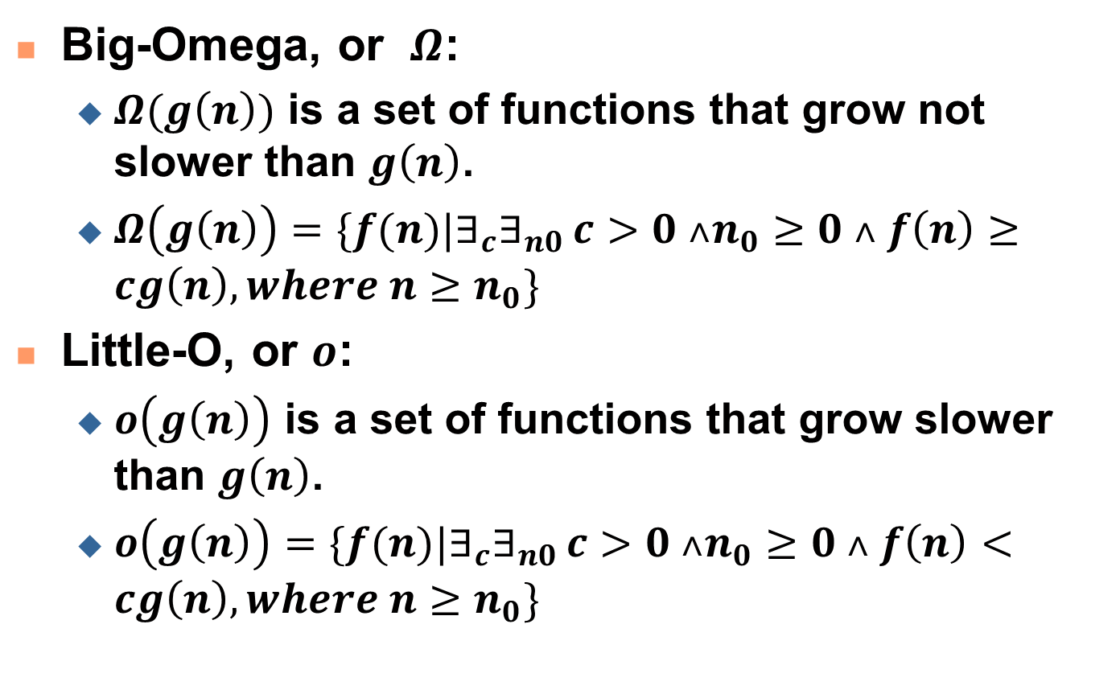
Other asymptotic definitions

Slide 69
