Slide 1
Hash table

Slide 2
Hash table is an array (with quick way to search for a data)
To find a data X:
Use part of X as a “key”.
Use the “key” as an input for our hash function.
A hash function takes a key as its input, and return the array index, i, of a position that X should be in.
Look at the array at position i.
If X is stored in that position, we have found it.
If X is not stored in that position and the position is empty, it means X does not exist in the array.
If there is another data in that position, we have to search for X using patterned move.

Slide 3
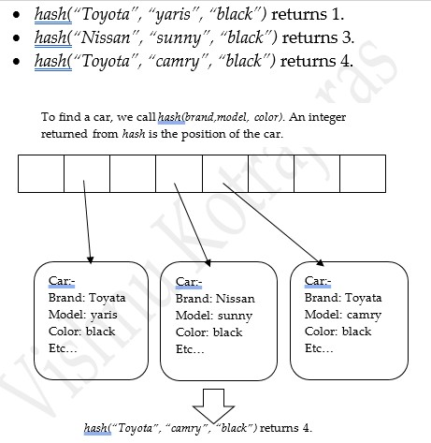

Slide 4
Everything depends on our hash function. A hash function should:
be fast to calculate. The runtime of a hash function directly dictates the speed that our data can be found.
be appropriate for a given type of data (if calculated from data). Each type of data will certainly give us different keys.
returns different values when supplied with different keys.

Slide 5
Designing A Hash Function
When designing a hash function, we try to make our hash function distribute its data all over the array. We generally use the following steps:
Transform our key into an integer.
Make our integer more widely distributed with some rules of transformation.
Transform the number we got in step 2 into array index.

Slide 6
Transforming our key
To transform our key into an integer, we can:
convert it to integer using available methods.
convert true to 1, false to 0.
convert a string or strings to its ASCII values.
combine integer conversions of various pieces of data into one integer.

Slide 7
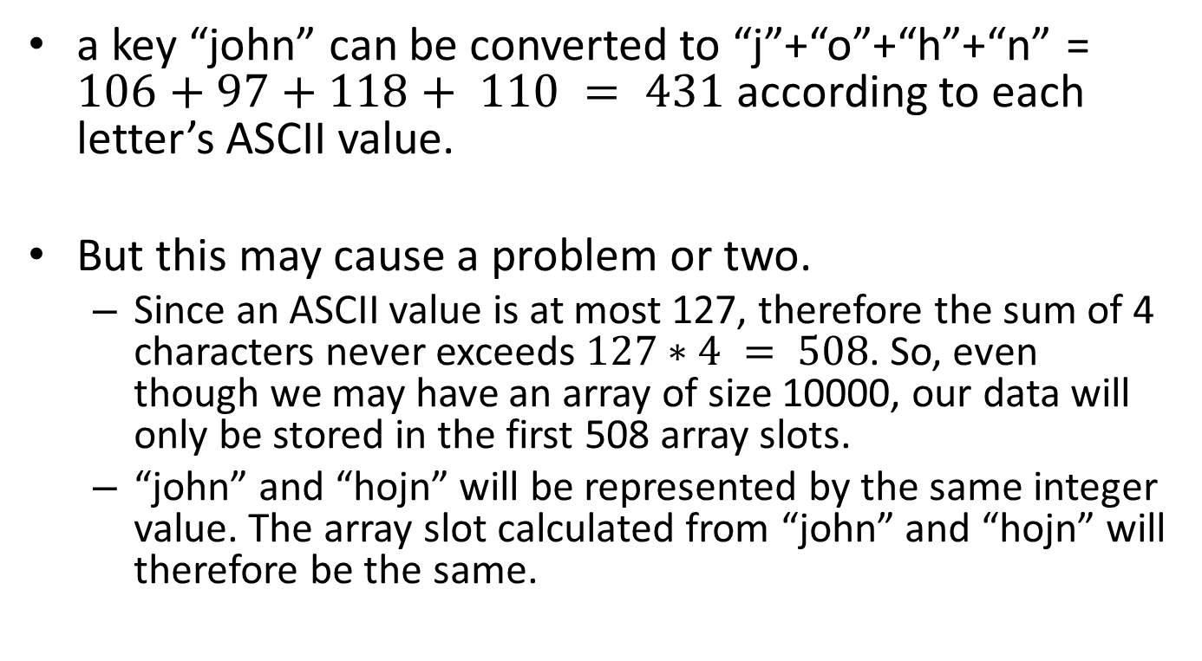
a key “john” can be converted to “j”+“o”+“h”+“n” = $106+97+118+ 110 = 431$according to each letter’s ASCII value.
But this may cause a problem or two.
Since an ASCII value is at most 127, therefore the sum of 4 characters never exceeds $127∗4 = 508$. So, even though we may have an array of size 10000, our data will only be stored in the first 508 array slots.
“john” and “hojn” will be represented by the same integer value. The array slot calculated from “john” and “hojn” will therefore be the same.

Slide 8
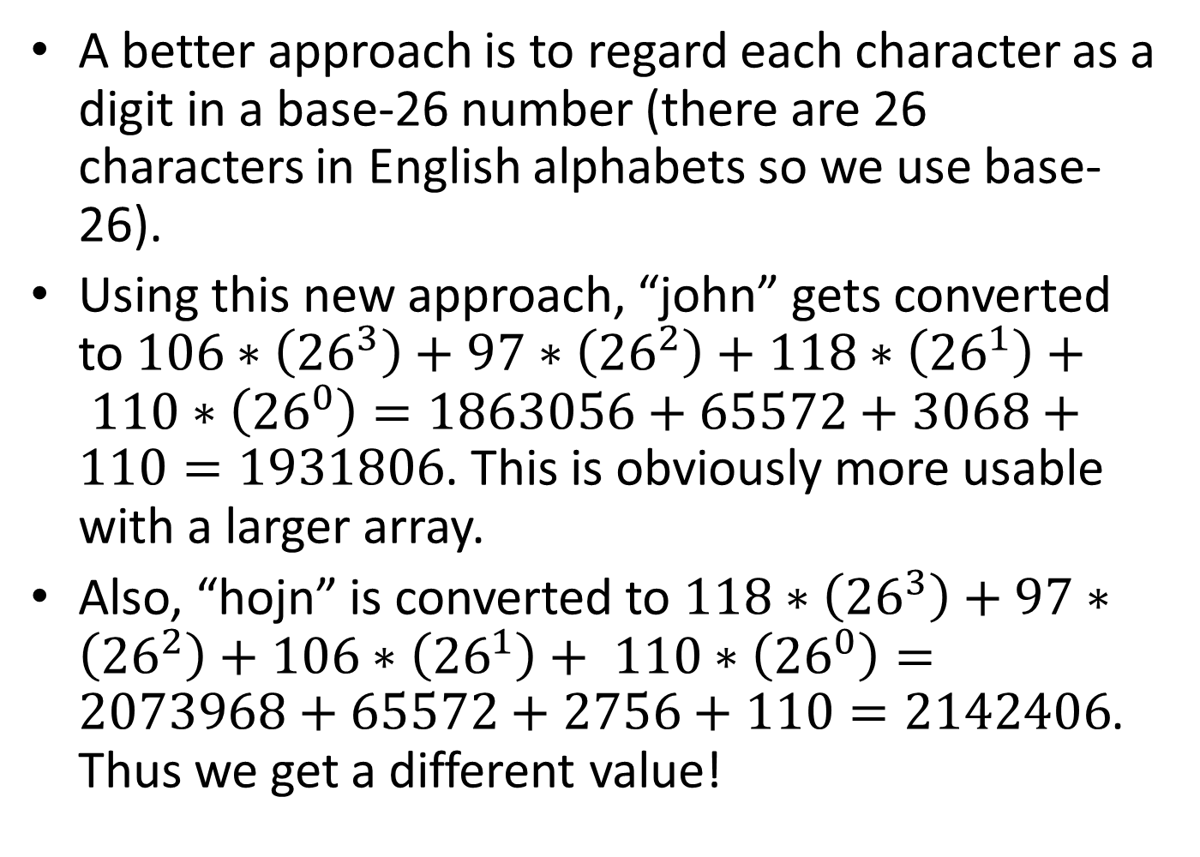
A better approach is to regard each character as a digit in a base-26 number (there are 26 characters in English alphabets so we use base-26).
Using this new approach, “john” gets converted to $106∗\left({26}^{3}\right)+97∗\left({26}^{2}\right)+118∗\left({26}^{1}\right)+ 110∗\left({26}^{0}\right)=1863056+65572+3068+110=1931806$. This is obviously more usable with a larger array.
Also, “hojn” is converted to $118∗\left({26}^{3}\right)+97∗\left({26}^{2}\right)+106∗\left({26}^{1}\right)+ 110∗\left({26}^{0}\right)=2073968+65572+2756+110=2142406$. Thus we get a different value!

Slide 9
public static int f(String key) {
int val =0;
for(int i=0; i<key.length();i++)
val = 26*val+key.charAt(i);
return val;
}

Slide 10
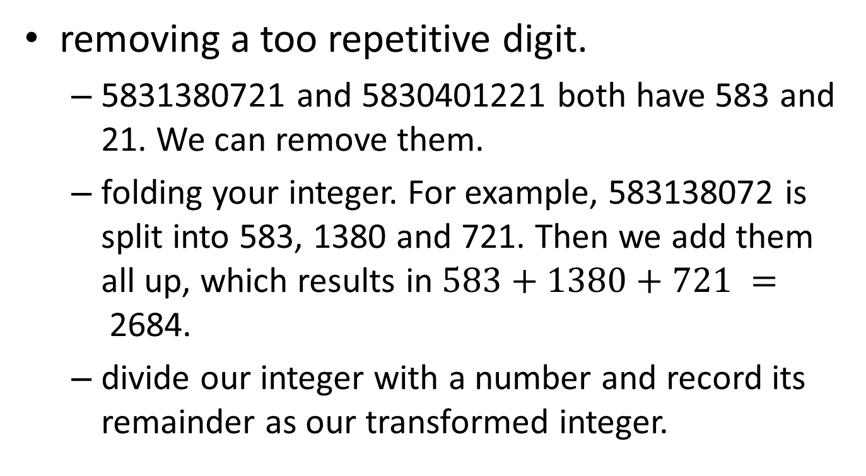
Making our integer more widely distributed
removing a too repetitive digit.
5831380721 and 5830401221 both have 583 and 21. We can remove them.
folding your integer. For example, 583138072 is split into 583, 1380 and 721. Then we add them all up, which results in $583+1380+721 =$2684.
divide our integer with a number and record its remainder as our transformed integer.

Slide 11
Transforming our value into array index
divide each integer with the array size and use the remainder as its corresponding array index value.
a prime number is often used as the array size

Slide 12
Collision
Some data will end up being assigned to the same array position (this is called “collision”).
When this happens, we have to organize these data in a systematic way to be able to store all of them in the array and be able to quickly find them later.
There are two implementation ideas of a hash table that can deal with collision:
Separate chaining
Open addressing

Slide 14
Separate Chaining Hash Table
Each of our array slots, instead of storing one data, stores a linked list of data instead.
All data that have the same value from our hash function go into the same linked list.
To find a data, use a hash function to find a linked list that stores the data, then search the data sequentially in that linked list.

Slide 15
To add a new data, use a hash function to find a linked list that will (or already) store that data. Then search the list for that data.
If the list already has the data, we do nothing. There is no point for adding a duplicated data. A hash table has no use for duplicated copies of data, since it is only used to check whether a data is available.
If the list does not store the data, we add the data in front of the list. Statistically, a new data is more likely to be accessed than older data. That is why we put it in front of the list.

Slide 16
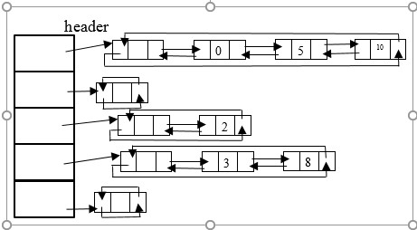

Slide 17
Implementation of Separate Chaining Hash Table
public class SepChaining{
private static int DEFAULT_SIZE = 101;
private static int MAXLOAD = 2;
private CDLinkedList[] lists;
private int currentSize =0;
public SepChaining(){
this(DEFAULT_SIZE);
}
public SepChaining(int size){
int nextPrimeSize = nextPrime(size);
lists = new CDLinkedList[nextPrimeSize];
for(int i=0; i<lists.length; i++){
lists[i] = new CDLinkedList();
}
}

Slide 18
DEFAULT_SIZE: a default value for the number of array slots. This must be a prime number to avoid the small common factor problem.
MAXLOAD: a maximum number of data that we want to store per list, on average.
We do not want the average number of data (per list) to be long. This is because a list is searched sequentially. Longer list means longer search time. So, we need to check our current average number of data against MAXLOAD.
If our value exceeds MAXLOAD, it means our lists are too long, we should make a larger array and redistribute our data into the new array (this is called rehash) so that lists within the new array are shorter.
lists: an array that stores linked lists. This is our main data storage of our hash table.
Our linked lists are circular doubly-link lists from chapter 3 (class CDLinkedList), but the code for class CDLinkedList and DListIterator has to be modified so that our list can store Objects, instead of integers.
currentSize: a total number of data stored in our hash table.

Slide 19
private static boolean isPrime(int n){
if(n == 2 || n == 3)
return true;
if(n == 1 || n % 2 == 0)
return false;
for(int i = 3; i*i <= n; i+= 2)
if(n%i == 0)
return false;
return true;
}
private static int nextPrime(int n){
if(n % 2 == 0)
n++;
for( ; !isPrime(n); n += 2 ){}
return n;
}
Prime n or just greater than n

Slide 20
public int hash(Object data){
int hashValue = data.hashCode();
int abs = Math.abs(hashValue);
return abs%lists.length;
}

Slide 21

public int find(Object data) throws Exception{
int pos = hash(data);
CDLinkedList theList = lists[pos];
return theList.find(data);
}
find returns -1 if a given data is not stored in our hash table. Otherwise, it returns a non-negative value.
This non-negative value is a position within a linked list that the data is stored

Slide 22
public void add(Object data) throws Exception {
int pos = hash(data);
CDLinkedList theList = lists[pos];
if(theList.find(data) == -1){ // not found
DListIterator itr =
new DListIterator(lists[pos].header);
lists[pos].insert(data, itr);
currentSize++;
}
if(currentSize/lists.length >= MAXLOAD){
rehash();
}
}
identifies a linked list
adds the data in front of the list
create a larger array (and new linked lists within the new array) and put all existing data from our array inside the new array

Slide 23
public void rehash() throws Exception {
CDLinkedList[] oldLists = lists;
int newLength = nextPrime(2*lists.length);
lists = new CDLinkedList[newLength];
for(int i=0; i<lists.length; i++){
lists[i] = new CDLinkedList();
}
for(int i=0; i<oldLists.length; i++){
DListIterator itr;
itr = new DListIterator(oldLists[i].header);
while(itr.currentNode.nextNode !=
oldLists[i].header){
add(itr.next());
}
}
}
We need to add new data using method add. We cannot simply copy data into new lists because a value returned from hashing each data is now different due to the array changing its size.

Slide 24
Find the list that may have data
public void remove(Object data) throws Exception{
int pos = hash(data);
CDLinkedList theList = lists[pos];
if(theList.find(data) != -1){ //data found
theList.remove(data);
currentSize--;
}
}
If the data is in the list, we call method remove of CDLinkedList
If the data is not in the list, we do nothing.

Slide 25

For a separate chaining hash table, a load factor (or lambda) is therefore an average length of each linked list.

Slide 26
Searching time
Seach time = time to do hashing + time to search a list
= very small value + time to search a list
≅ time to searh a list
If the data that we want to find is not in our hash table at all,
our search time is approximately equal to the time to search an entire list.
This is directly proportional to an average list length, which is our load factor.
If our data is in one of the lists,
on average, we will have to search half of that list.
Assume that our hash function can distribute data evenly, each linked list in our hash table should be of equal size.
The average search time is therefore directly proportional to half an average list length, which is half our load factor.
In both cases, the time for searching a data depends on the value of the load factor.

Slide 27
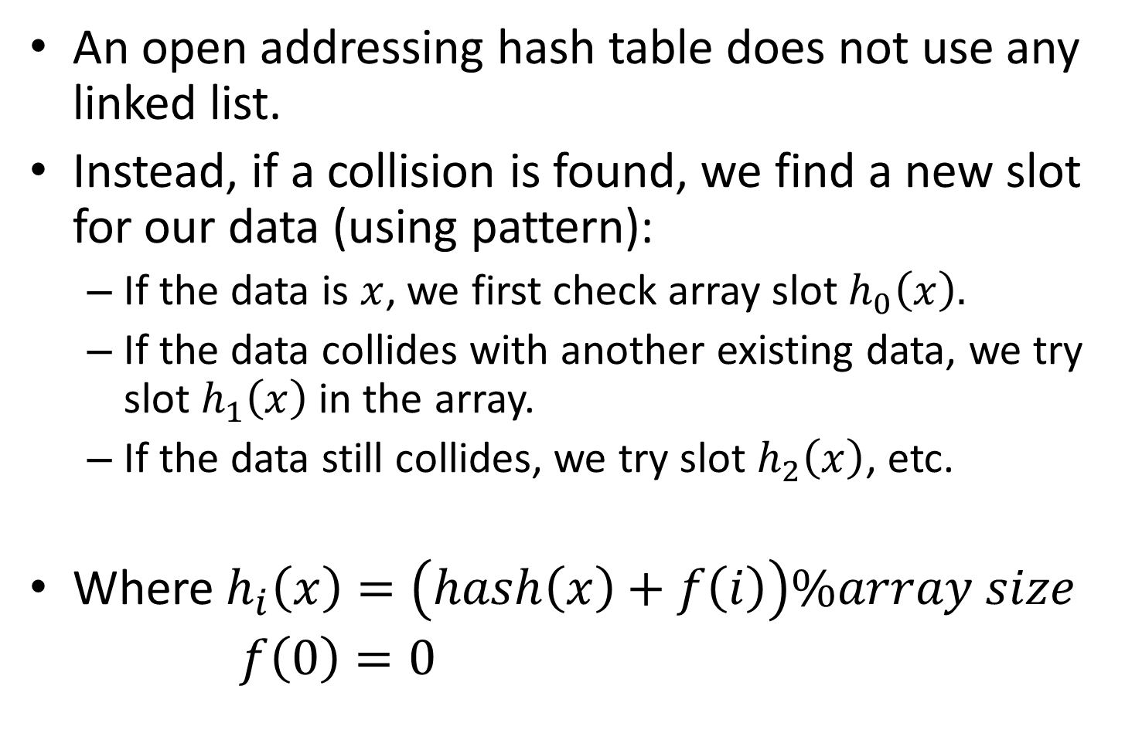
Open Addressing Hash Table
An open addressing hash table does not use any linked list.
Instead, if a collision is found, we find a new slot for our data (using pattern):
If the data is $x$, we first check array slot $h_{0}\left(x\right).$
If the data collides with another existing data, we try slot $h_{1}\left(x\right)$ in the array.
If the data still collides, we try slot $h_{2}\left(x\right)$, etc.
Where $h_{i}\left(x\right)=\left(hash\left(x\right)+f\left(i\right)\right)\%array size$
$f\left(0\right)=0$

Slide 28
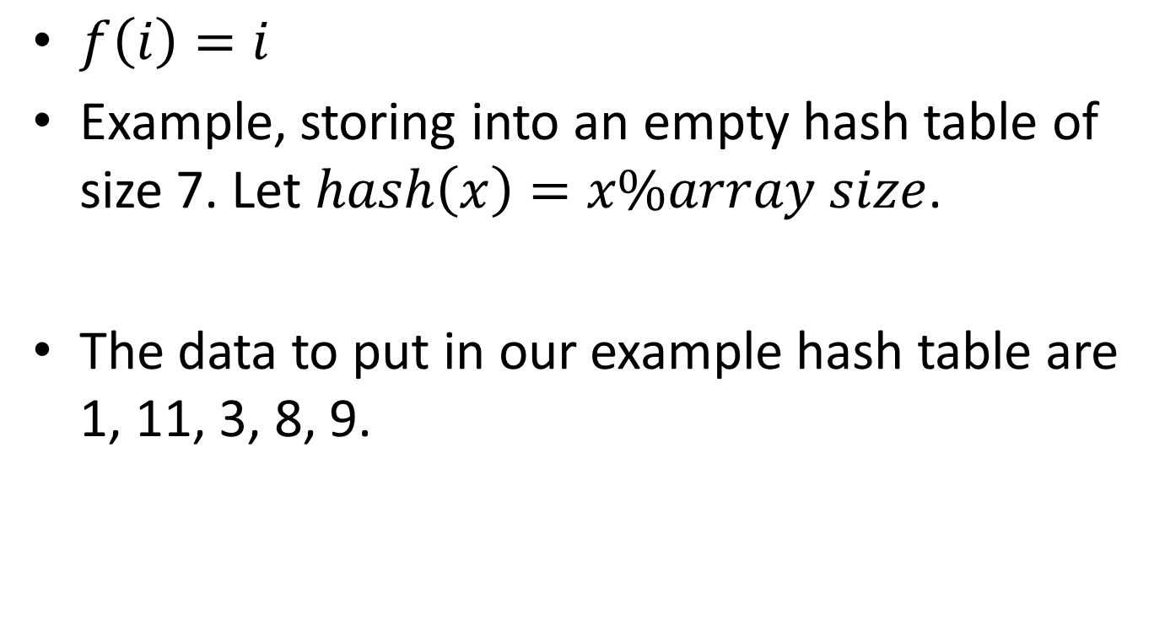
Linear Probing
$f\left(i\right)=i$
Example, storing into an empty hash table of size 7. Let $hash\left(x\right)=x\%array size$.
The data to put in our example hash table are 1, 11, 3, 8, 9.

Slide 29
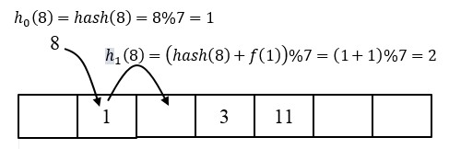
1, 11, 3 are inserted normally but

Slide 30
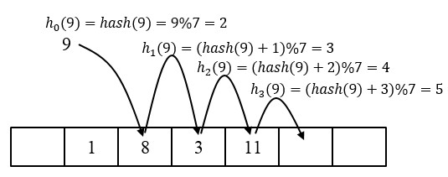
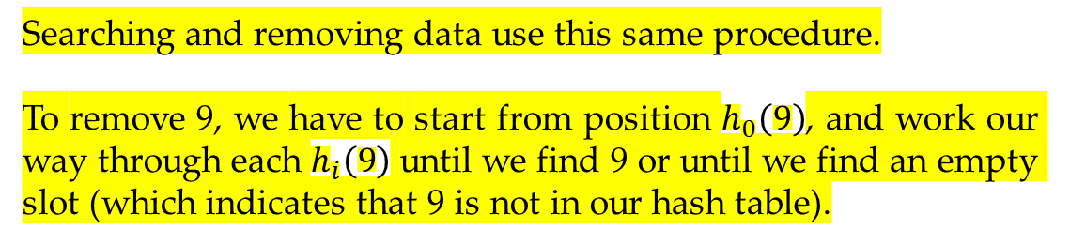
Searching and removing data use this same procedure.
To remove 9, we have to start from position $h_{0}\left(9\right)$, and work our way through each $h_{i}\left(9\right)$ until we find 9 or until we find an empty slot (which indicates that 9 is not in our hash table).

Slide 31
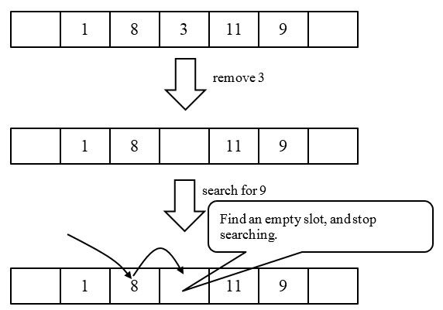
Removing data can cause a problem

Slide 32
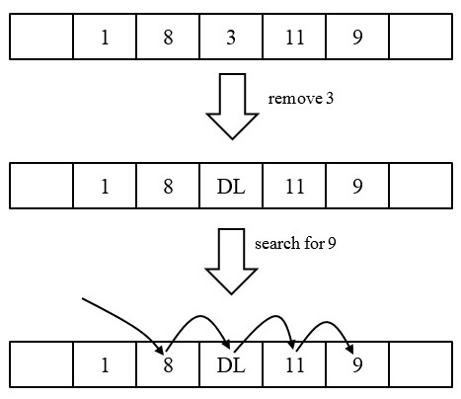
Fixing delete issue with Lazy Deletion

Slide 33
Linear Probing Problem
Primary clustering
when collisions take place near to one another, several consecutive array slots are very likely to be occupied.
This can cause a problem when another collision takes place in one of these occupied slots.
Because linear probing just search one slot away each time, it can take a long time to find an empty array slot.

Slide 34

Quadratic Probing

Slide 35
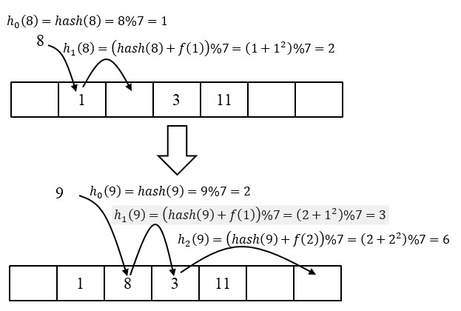

Let $hash\left(x\right)=x\%array size$ and let the hash table originally store 1, 3, and 11.

Slide 36
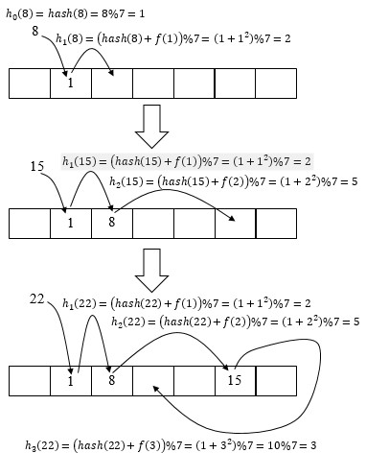
Another example
The more data that collide at the same slot, the longer it takes to search our hash table.
This problem is called secondary clustering.

Slide 37
Another problem with quadratic probing hash table is that we may not be able to put our data into our array even though there are still some empty slots.
Therefore a quadratic probing hash table needs to be larger than other types of hash tables in order to store the same amount of data.

Slide 38
Fact
if a quadratic probing hash table is not yet half full and the table size is prime, then we can always find a slot for a new data.
Proof is in the textbook.

Slide 39

Double Hashing
Each data is likely to have a different pattern when avoiding collisions. Therefore we can prevent both primary and secondary clusterings.

Slide 40
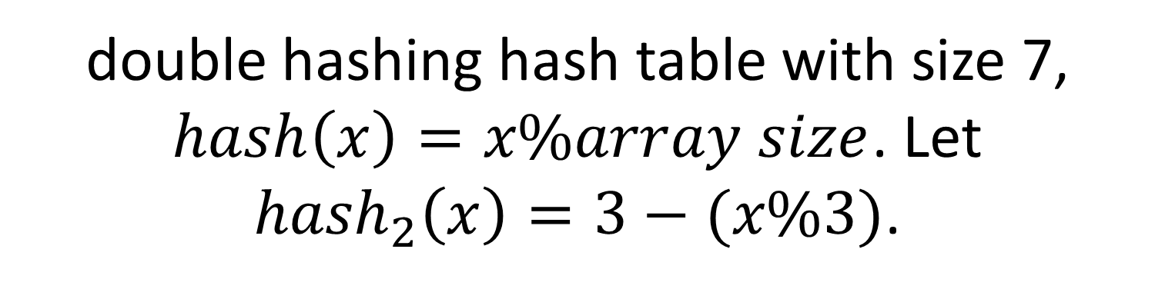
double hashing hash table with size 7, $hash\left(x\right)=x\%array size$. Let ${hash}_{2}\left(x\right)=3−(x\%3)$.
Add 8, 15, 22 to the table (the table already stores 1).

Slide 41
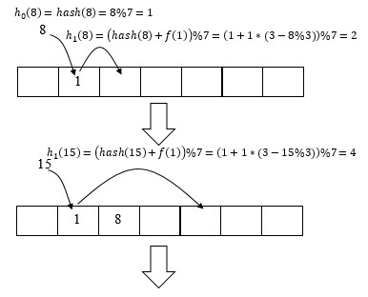

Slide 42
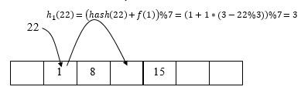

Slide 43
Implementing Open Addressing Hash Table (double hashing in this case)
public class OpenAddressing{
private static int DEFAULT_SIZE = 101;
Private static final Object DELETED = new
Object();
private static int MAXFACTOR = 0.5;
private int currentSize =0;
private Object[] array;
public OpenAddressing(){
this(DEFAULT_SIZE);
}
public OpenAddressing(int size){
int nextPrimeSize = nextPrime(size);
array = new Object[nextPrimeSize];
}

Slide 44
DEFAULT_SIZE: a default hash table size, which is prime.
DELETED: a placeholder data to replace a deleted data. This is how we mark an array slot as deleted.
MAXFACTOR: a default load factor that this table can tolerate. If a load factor exceeds this value, we need to do a rehash.
currentSize: a number of data stored in our array.
array: the array that stores our data.

Slide 45
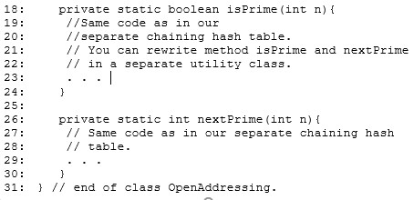

Slide 46
A double hashing hash table is defined by extending from OpenAddressing.
Their codes are similar to a double hashing hash table except their function hi.

Slide 47
class DoubleHashing extends OpenAddressing
private static int MAXFACTOR = 0.75;
private int occupiedSlots = 0;
public DoubleHashing(){
this(DEFAULT_SIZE);
}
public DoubleHashing(int size){
super(size);
}
public int hash(Object data){
int hashValue = data.hashCode();
int abs = Math.abs(hashValue);
return abs%array.length;
}
public int hash2(Object data){
return //any unique number function different
//from hash.
}
has its own MAXFACTOR
the number of slots that store data or DELETED object. We use this field to determine whether to rehash
we do not want data that collide in the same array slot to use the same collision avoidance pattern.

Slide 48
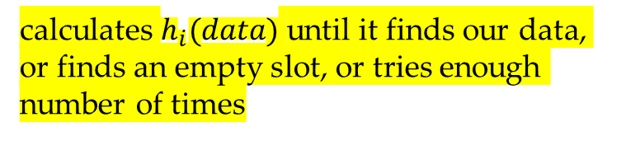
public int find(Object data){
final int smallNum =5;
int h = hash(data);
int hash2Result = hash2(data);
for(int i=0; i<currentSize + smallNum; i++){
if(array[h] == null || array[h].equals(data))
return h;
h = (h + hash2Result)%array.length;
}
return -1;
}
calculates $h_{i}(data)$ until it finds our data, or finds an empty slot, or tries enough number of times
the code on line 8 should be changed to
h = (h + 1)%array.length for linear probing, and
h = (h+2*i-1)%array.length for quadratic probing
Method find returns the position of our data (or the position of the empty slot) if the data (or the empty slot) is found. Otherwise, it returns -1.

Slide 49
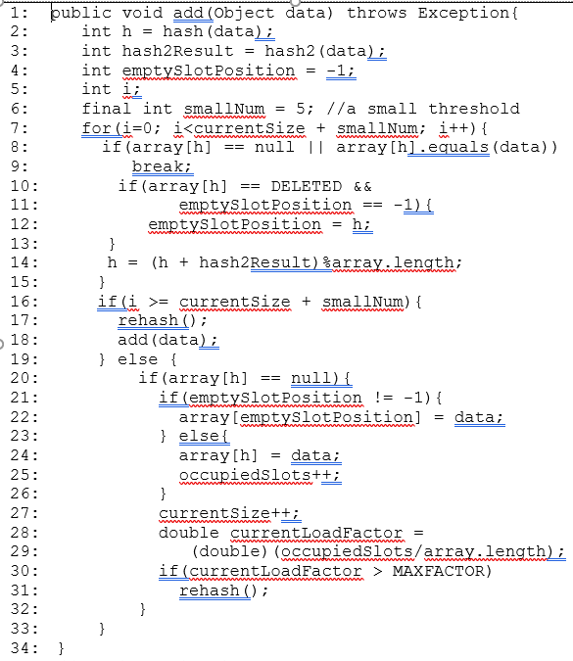

if our search encounters a slot that is marked deleted, we record this slot position. This slot position will be the position we add our new data
If our loop does not find the data (too many collisions), we have to rehash and then attempt to add the data again
if the empty slot is found, we add the data to the array (add to the DELETED slot if its position was recorded earlier)
call method rehash if the current load factor exceeds our specified value

Slide 50
public void rehash(){
Object[] oldArray = array;
array = new Object[nextPrime(array.length*2)];
currentSize = 0;
occupiedSlots = 0;
for(int i=0; i<oldArray.length; i++){
if(oldArray[i] != null &&
oldArray[i]!=DELETED)
add(oldArray[i]);
}
}
adds all data (DELETED objects are not true data so they are not added) from our original array into the new array.

Slide 51
public void remove(Object data){
int index = find(data);
if(index != -1 && array[index]!=null){
array[index] = DELETED;
currentSize--;
}
}
Method remove first attempts to find our data. If the data is found, we replace it with a DELETED object.

Slide 52
Separate Chaining VS Open Addressing
Separate Chaining | Open Addressing
Simple add and remove. | More complicated add and remove.
A lot of space required to store references. | Less space required, even though the load factor is small.
Collisions only affect data in the same linked list. | Collisions may affect an entire table.

