Slide 1
Tree (2)
Vishnu Kotrajaras, PhD.

Slide 2
remove
public void remove(int v) {
BSTNode parent = null;
BSTNode n = root;
TreeIterator i = (TreeIterator) find(v);
if (i == null) {
// not found, we can not remove it
return;
}
n = i.currentNode;
parent = n.parent;

Slide 3
size--;
if (n.left == null && n.right == null) {
//both subtrees are empty
if (parent == null) {
root = null;
} else if (parent.left == n) {
parent.left = null;
n.parent = null;
} else {
parent.right = null;
n.parent = null;
}
}
root
n
root
n
v
v
disconnect
parent
parent
n
n
v
v
disconnect

Slide 4
else if (n.left == null && n.right != null) {// only right child
if (parent == null) { //the node to remove is a root
root = n.right;
root.parent = null;
n.right = null;
} else if (parent.right == n) {
BSTNode q = n.right;
q.parent = parent;
parent.right = q;
n.parent = null;
n.right = null;
} else {// parent.left == n
BSTNode q = n.right;
q.parent = parent;
parent.left = q;
n.parent = null;
n.right = null;
}
}
root
root
n
n
v
v
x
x
parent
parent
m
m
n
n
v
v
x
x

Slide 5
else if (n.right == null && n.left != null) {
if (parent == null) {
root = n.left;
root.parent = null;
n.left = null;
} else if (parent.right == n) {//a mirror image of the last case in
//the previous page
BSTNode q = n.left;
q.parent = parent;
parent.right = q;
n.parent = null;
n.left = null;
} else { // a mirror image of the second case in the previous page
BSTNode q = n.left;
q.parent = parent;
parent.left = q;
n.parent = null;
n.left = null;
}
}

Slide 6
else {// n has two subtrees
BSTNode q = n.right;
TreeIterator itr = findMin(q);
BSTNode minInSubtree = itr.currentNode;
n.data = minInSubtree.data;
BSTNode parentOfMin = minInSubtree.parent;
if(parentOfMin.left == minInSubtree){
parentOfMin.left = minInSubtree.right;
}else{ //min is the only node in the subtree
parentOfMin.right = minInSubtree.right;
}
if(minInSubtree.right != null){
minInSubtree.right.parent=parentOfMin;
minInSubTree.right = null;
}
minInSubTree.parent = null;
}
}
n
n
v
Replace
j
x
z
x
z
i
Smallest value in tree that has n.right as its root.
i
jm
jm
k
k
n
n
j
j
x
z
x
z
i
i
jm
jm
Now, remove this one instead.
k
k

Slide 7
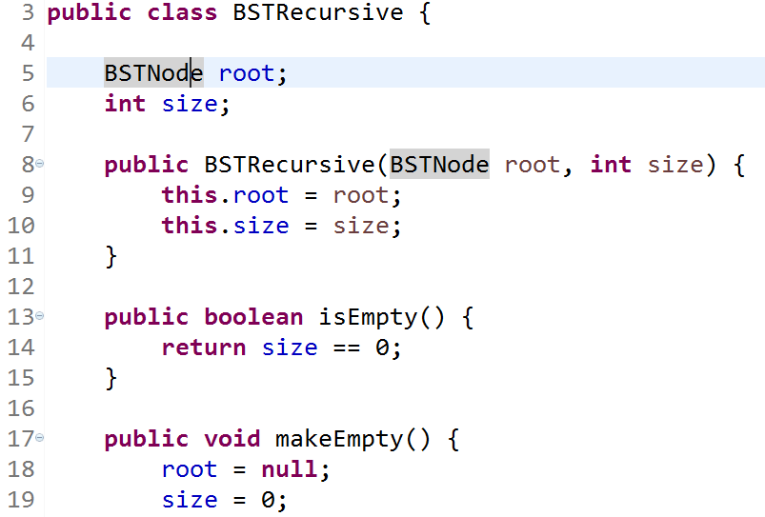
Recursive approach

Slide 8
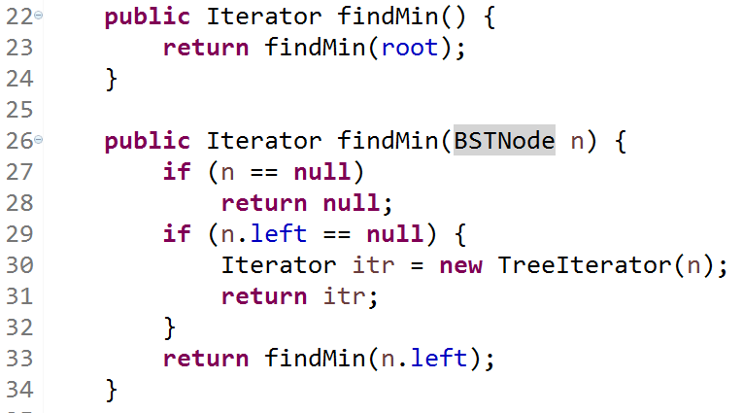

Slide 9
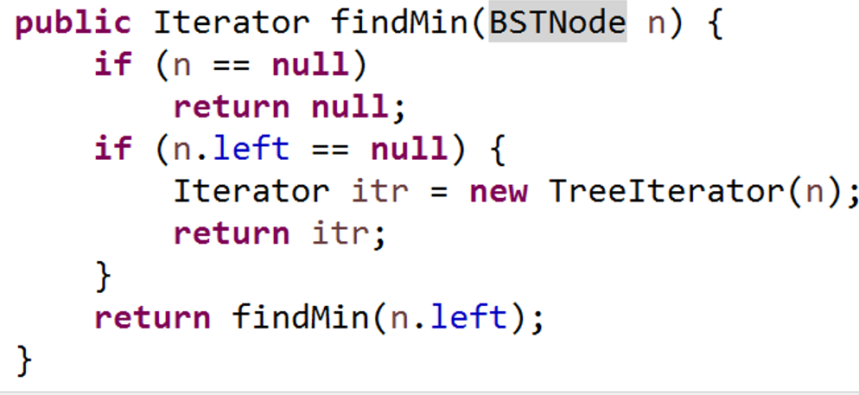

Slide 10
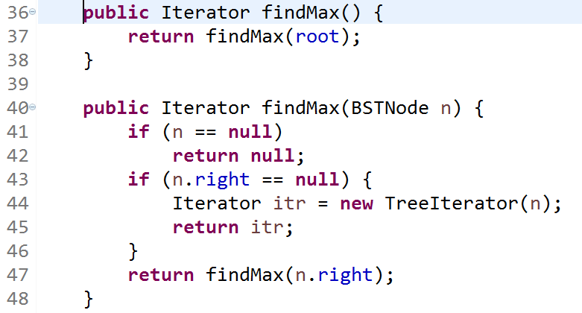

Slide 11
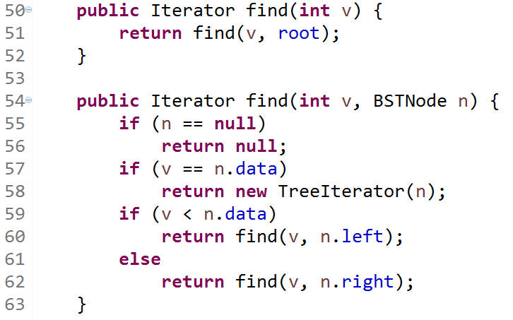

Slide 12
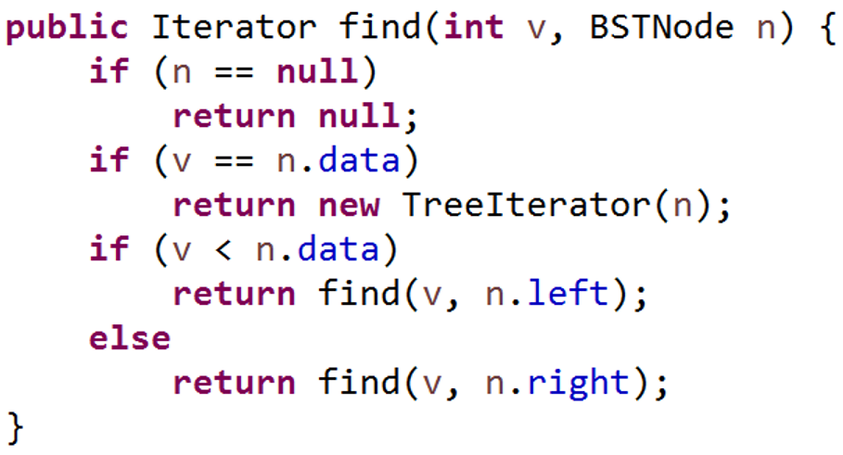



Slide 13
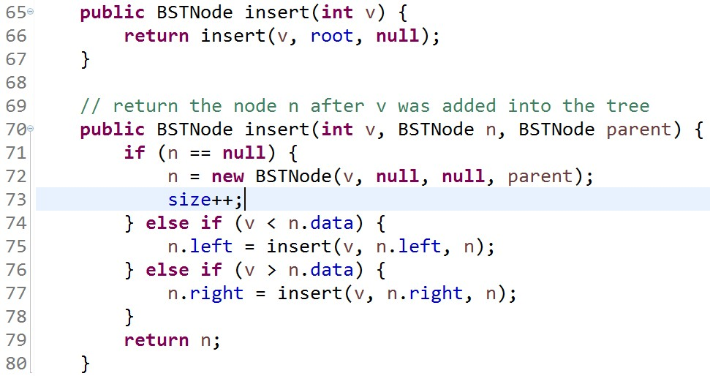




root =
return root;
Must have, or the tree won’t change!! See what is going on next page!!

Slide 14
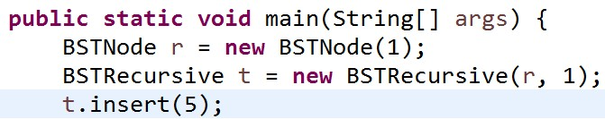
Before insert
Doing insert(v,n,parent), v==5, n == root, parent == null
t.root
t.root
n
v > n.data , therefore
t.insert(5) or t.insert(5,root,null)
insert(v, n.right, n); //(5, null, n)
1
1
Instance of insert(v, n.right, n) is insert(v,n,parent), v==5, n == null, parent == original n will cause the following:
Original n
Running the instance of the method will give us the new node, but it only connects to our existing tree through its parent node. So the new node is not included in the tree if we look from root. Therefore “n.right =“ is necessary to set a link from the parent of our new node.
t.root
n (for this run instance)
1
parent
5

Slide 15
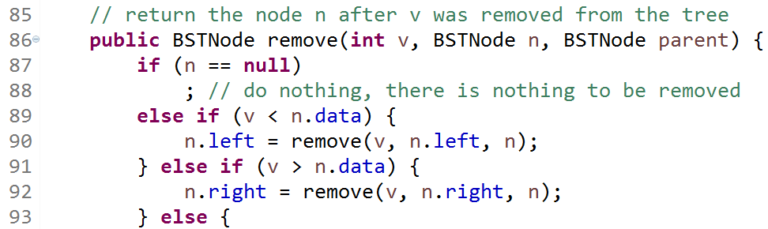
Must have, or the tree won’t change!! See what is going on next pages!!

Slide 16
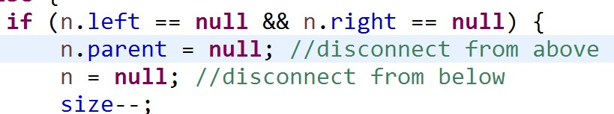
This is the method’s returned value
Original tree
p
p
1
1
n
The real tree won’t change unless we move the pointer of the original node!! (in this case “p.right = remove(4,n,p);
For other cases, we need “t.left = “ or “t.right = “ )
n
remove(4,n,p)
4
4

Slide 17
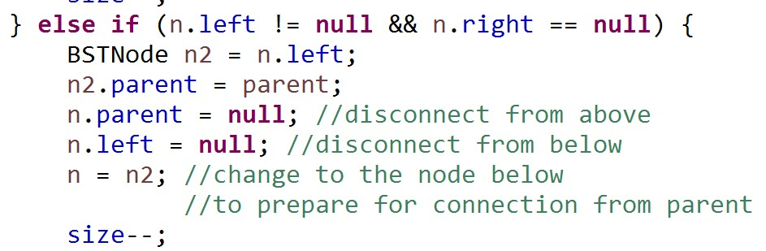
Original tree
t.root
t.root
parent
The real tree will still have 6 in it like this unless we change the pointer from the parent of node that contains 6 (the red pointer) to point to n. Therefore “n.right= “ and “n.left = “ in the code are needed to change the pointer from parent.
4
4
2
6
2
6
5
n2
5
n

Slide 18
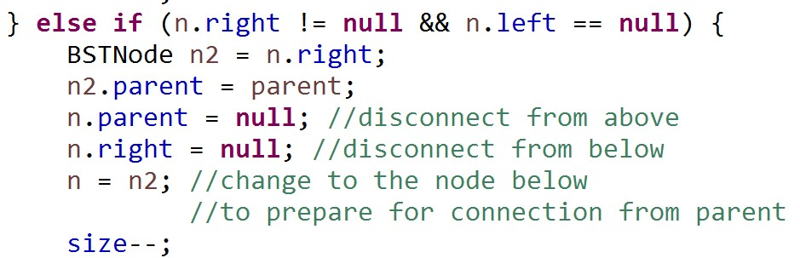
This is a mirror image of the previous page!

Slide 19
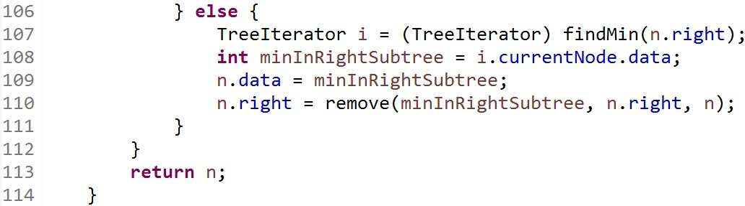
Red pointer in the picture won’t change if this “n.right” does not exist.
t.root = remove(6) = remove(6,t.root,null) -> t.root.right = remove(6,t.root.right,t.root)
v==6, n==t.root.right, parent ==t.root
t.root
t.root
parent
t.root
parent
4
4
4
n
n
i
2
6
2
6
2
8
5
8
5
8
5
8

Slide 20
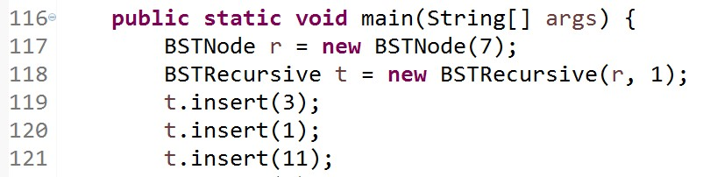
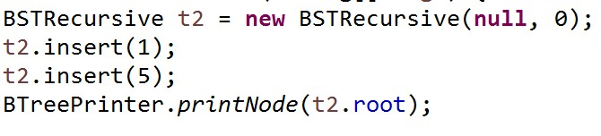
Usage (same usage for BST and BSTRecursive)
When root points to a node at the start, the code always works regardless of us having set “root =“ or not inside the method.
The tree can be printed from root.
If we did not set “root=“ inside method insert, this code does not work when the root is originally null!! Tree won’t print!! (see the reason next page)

Slide 21
t2.root
Insert(1), which is insert(1,null,null) is called
t2.root
The new node is not connected to the original tree. Thus any attempt to print the tree from the root downwards will fail. This is why we need “root =“ in our insert(int value) , so that we can set the root to point to where n points to.
n
1
t2.root
n
1

Slide 22
Recursive Tree Traversal
preorder
Root, left subtree, right subtree
Within subtree, pick its root first, and so on….
6
6, left subtree of 6, right subtree of 6
6, (1, left subtree of 1, right subtree of 1), (8, left subtree of 8, right subtree of 8)
6, (1, null, (3, left subtree of 3, right subtree of 3))(8, (7, left subtree of 7, right subtree of 7), (10, left subtree of 10, right subtree of 10))
6, (1, null, (3, null, null))(8, (7, null, null), (10, null, null))
6, 1, 3, 8, 7, 10
1
8
3
7
10
Notes:
เก็บไว้ตอน traversal

Slide 23
postorder
Left subtree, right subtree, then the root.
Inside each subtree, use postorder too.
Left subtree of 6, right subtree of 6, 6
(left subtree of 1, right subtree of 1, 1), (left subtree of 8, right subtree of 8, 8), 6
(null, (left subtree of 3, right subtree of 3, 3), 1), ((left subtree of 7, right subtree of 7, 7), (left subtree of 10, right subtree of 10, 10), 8), 6
(null, (null, null, 3), 1), ((null, null, 7), (null, null, 10), 8), 6
3, 1, 7, 10, 8, 6
6
1
8
3
7
10
Notes:
เก็บไว้ตอน traversal

Slide 24
inorder
Left subtree comes first, then root, then right subtree.
Inside each subtree, use inorder too.
Our iterator will be based on this type of traversal
Left subtree of 6, 6, right subtree of 6
(left subtree of 1, 1, right subtree of 1), 6, (left subtree of 8, 8, right subtree of 8)
(null, 1, (left subtree of 3, 3, right subtree of 3)), 6, ((left subtree of 7, 7, right subtree of 7) , 8, (left subtree of 10, 10, right subtree of 10))
(null, 1, (null, 3, null)), 6, ((null, 7, null) , 8, (null, 10, null))
1, 3, 6, 7, 8, 10
6
1
8
3
7
10
Notes:
เก็บไว้ตอน traversal

Slide 25
inorder(BSTNode n){
if(n == null){
return;
}
inorder(n.left);
print(n.data);
inorder(n.right);
}

Slide 26
breadth-first traversal
The first 3 methods we have seen are tree-searching using depth-first search
When looking at each subtree, we must finish with the whole of that subtree before we can carry on.
breadth-first inspects a tree level by level, starting from root.
Notes:
เก็บไว้ตอน traversal

Slide 27
breadth-first implementation
When we look at a node, we record the children of that node into a queue created for storing next level nodes (next level queue).
Example: if we have
9
3
13
6
11
18
5
7
15
8
Notes:
เก็บไว้ตอน traversal

Slide 28
thisLevel
9
9
9
3
13
nextLevel
11
3
13
3
13
6
18
5
7
15
8
Value visited
Notes:
เก็บไว้ตอน traversal

Slide 29
thisLevel
9
3
13
3
13
nextLevel
11
6
11
18
6
18
5
7
15
8
Value visited
9
Notes:
เก็บไว้ตอน traversal

Slide 30
thisLevel
9
6
11
18
3
13
nextLevel
5
7
15
6
11
18
5
7
15
8
Value visited
9
3
13
And so on .. .. .
Notes:
เก็บไว้ตอน traversal

