Slide 1
Sorting Algorithm

Slide 2
Bubble Sort(small-large)
Compare the first two value. If the second value is smaller, swap them.
5
2
4
3
1
Then, compare the next pair (its first value may have come from the first swap). Swap the two values if the second value is smaller.
2
5
4
3
1
We repeat until we reach the final pair. Then start again, and so on.

Slide 3
Running time of Bubble Sort
The number of swap must be enough for moving:
the largest value from left most to right most.
The smallest value from right most to left most.
n values
5
2
4
3
1
𝛩(n²)
the first n-1 swaps are needed in order to move the value from the left most slot to the right most slot. However, the value in the right most slot can only move left one slot.
Therefore we need to do the swaps for n-1 rounds.
Notes:
When the array size is n. The first n-1 swaps are enough to move a value from the leftmost position to the rightmost position. But the value in the rightmost position can only move 1 position to the left. If you want to move it all the way to the leftmost position, you need to repeat this move n-1 times. -> (n-1)*(n-1) , 𝛩(n²).

Slide 4
1: public static void bubblesort(int[] array){
2: for (int pass = 1; pass<=array.length-1; pass++)
3: for(int element=0; element<= array.length –2; element++)
4: if(array[element] > array[element+1])
5: swap(array, element, element +1);
6: }
Compare and swap 1 pair
}
1: public static void swap(int[] array, int a, int b){
2: int temp = array[a];
3: array[a]= array[b];
4: array[b]= temp;
5: }
Notes:
This page shows the code for bubblesort.

Slide 5
Worst case for Bubble Sort (initially from large->small value)
5
4
3
2
1
4
3
2
1
5
4
5
3
2
1
3
4
2
1
5
4
3
5
2
1
3
2
4
1
5
No need
to swap
4
3
2
5
1
3
2
1
4
5
1st loop: n-1 comparisons and n-1 swaps.
2nd loop: n-1 comparisons, but n-2 swaps.
Notes:
Worst case running time for Bubblesort takes place when the array is sorted from large to small.
The slide shows the first two iterations of bubble sort.

Slide 6
Worst case for Bubble Sort (2)
Each loop: n-1 comparisons. We have n-1 loops in total.
Therefore we have (n-1)² comparisons.
The number of swaps is (n-1) + (n-2) + (n-3) +…+ 1 = n(n-1)/2
bubble sort (worst case)
= (n-1)² + n(n-1)/2 * (unit time of a swap)
= (n-1)² + n(n-1)/2 * 3
= (5n² – 7n +2) /2
Notes:
In each loop, there are n-1 comparisons. And we have (n-1) loops so there are (n-1)² comparisons.
The number of swaps are
(n-1) + (n-2) + (n-3) +…+ 1 = n(n-1)/2
bubble sort (worst case) = (n-1)² + n(n-1)/2 * unit time of a swap
= (n-1)² + n(n-1)/2 * 3
= (5n² – 7n +2) /2
(we calculate unit time so that we can compare it with selection sort, etc.)

Slide 7
Selection Sort
Store the index of the first array element in variable maxindex.
Check each array member one by one. If a member value is greater than a[maxindex], change maxindex to store the index of that member. Continue until all members are checked.
Swap the last array member with a[maxindex] (no swapping needed if both are the same member) -> maximum value is put into the right most slot.
Repeat 1 – 3 again for the remaining n-1 array member.

Slide 9
Selection Sort Example
maxindex =0
5
4
3
1
2
n-1 comparisons, 1 swap.
maxindex is still 0. Now, swap a[maxindex] and a[4]
Restart:
maxindex =0
2
4
3
1
5
n-2 comparisons, 1 swap.
maxindex is now 1. We then swap a[maxindex] and a[3]

Slide 10
Selection Sort (Code)
𝛩(n²)
public static void selectionSort(int[] a){
int maxindex; //index of the largest value
for(int unsorted= a.length; unsorted > 1; unsorted--){
maxindex = 0;
for(int index= 1; index < unsorted; index++){
if(a[maxindex] < a[index])
maxindex = index;
}
if(a[maxindex] != a[unsorted -1])
swap(a, maxindex, unsorted -1);
}
}
Reduce the array size.
Check the array 1 round and updating maxindex.
Swap if not the same.
Notes:
For each round of array comparisons, there is only 1 swap. So it is supposed to be faster than Bubblesort. But its asymptotic runtime is the same as bubble sort.

Slide 11
Selection Sort (worst case)
Time that we count:
Comparisons
Assignments
Worst case is when each loop has a swap. This happens when the data is almost sorted except the smallest value which is at the right most slot.
example: 2,3,4,5,1
Counting
Comparisons: (n-1) + (n-2) + … + 1 times.
Comparisons for the swapping: (n-1) times.
Swaps: n-1 times.
Notes:
worst case running time (number of comparisons and number of data assignments) takes place when there is a swap for every round of comparisons, which happens when the data are almost sorted but the smallest value is the last data.
Example: 2,3,4,5,1
Number of comparisons = (n-1) + (n-2) + … + 1
Number of comparisons for swapping = (n-1)
Number of swaps = n-1
Unit runtime = n(n-1)/2 + (n-1) + (n-1)(unit time of a swap)
= n(n-1)/2 + (n-1) + 3(n-1)
= (n² + 7n -8) /2
Now we compare this runtime with the worst case unit runtime of bubblesort. Assuming that bubblesort is slower, we get:
(5n2 - 7n +2) /2 > (n2 + 7n -8) /2
4n2 - 14n +10 > 0
2n2 - 7n +5 > 0
(2n-5)(n-1) > 0
n must be >= 3 for the above inequality to be true. Thus, selection sort is faster when n is 3 and above.
But the fact remains that their asymptotic runtime are equal.

Slide 12
Insertion Sort
Split the array into 2 sides, left and right. The left side is consider sorted. Therefore, at the beginning, there is only one member in the left side.
Check each member on the right side one by one.
If a member is found to be of smaller value than the last member of the left side, put that member in its correct place on the left side.
Repeat the whole steps again. Each time, the left side will grow by 1. repeat until all members are moved to the left side.

Slide 14
Insertion Sort Example
The left side is considered sorted.
6
5
3
7
4
Must bring 5 to the front (or slide 6 to the right and put 5 in its place).
5
6
3
7
4
Slide 5 and 6 one slot each. Then put 3in the first slot.

Slide 15
Insertion Sort Example(2)
3
5
6
7
4
Do not need to move since 7 is in its correct position.
3
5
6
7
4
Slide 5,6,7 and put 4 next to 3.

Slide 16
𝛩(n²)
public static void insertionSort(int[] a){
int index;
for(int numSorted = 1; numSorted < a.length; numSorted++){
int temp = a[numSorted];
for(index = numSorted; index >0; index--){
if(temp< a[index-1]){
a[index] = a[index –1];
} else{
break;
}
}
a[index] = temp;
}
}
This will be put in the left side.
5
6
3
7
4
Compare with 6 and then 5. 6 is moved 1 position to the right. And so is 5.
When no move is possible, put 3 where 5 used to be.

Slide 17
Insertion Sort (worst case)
Worst case takes place when there are maximum number of sliding.
The array is initially sorted from large to small.
In each round, all members on the left side must move.

Slide 18
Insertion Sort (worst case cont)
unit time of worst case insertion sort
=(1+2+..+n-1)*2 + n-1
= n(n-1) + n-1
= (n+1)(n-1) = n² –1
Notes:
unit time of worst case insertion sort
=(1+2+..+n-1)*2 + n-1
= n(n-1) + n-1
= (n+1)(n-1) = n² –1
Assume that selection sort is slower, we get:
(n² + 7n -8) /2 > n² –1
0 > n² -7n +6
0 > (n-6)(n-1)
This is true only when n is between 1 and 6. Thus selection sort is faster generally for the worst case.
Similar comparisons reveal that insertion sort is faster than bubblesort when n is 2 or more.

Slide 19
Merge Sort
Split the array into two portions. Then go sort each portion.
(Each portion can be divided. Hence we have a recursion here.)
Then combine all sorted portion.

Slide 20
8 | 2 | 6 | 3
8 | 2
6 | 3
8
2
6
3
2 | 8

Slide 21
8 | 6 | 3
8 | 6
3
8
6
6 | 8

Slide 22
Combining array in merge sort (step 1)
Let us combine a (1,5,8,9) and b (2,4,6,7)
Let’s have counters at the first index of both arrays. Then we create a new array for collecting our result. Let’s call this new array -> c.
a
b
c
1
5
8
9
2
4
6
7
indexA
indexB
indexC

Slide 23
Combining array in merge sort (step 2)
Compare a[indexA] and b[indexB]. Put a smaller value into c[indexC], then move the counters that point to that value.
a
b
c
1
5
8
9
2
4
6
7
1
indexA
indexB
indexC

Slide 24
Combining array in merge sort (step 3)
Continue comparing a[indexA] and b[indexB] and keep updating c until one array is spent.
a
b
c
1
5
8
9
2
4
6
7
1
2
4
5
6
7
indexA
indexB
indexC
Then we copy the rest into c. Finish.

Slide 25
Worst case of array combination
Takes place when comparisons are needed until the last elements of both arrays.
n-1 comparisons in total (n is the size of the resulting array)
Therefore, the time for array combination is O(n).

Slide 26
Code for array combination
public static int[] merge(int[] a, int[] b){
int aIndex = 0; int bIndex = 0; int cIndex = 0;
int aLength = a.length; int bLength = b.length;
int cLength = aLength + bLength;
int[] c = new int[cLength];
//compare a and b then move a value into c until one array is spent.
while((aIndex < aLength) && (bIndex < bLength){
if(a[aIndex]<=b[bIndex]){
c[cIndex] = a[aIndex];
aIndex++;
}else{
c[cIndex] = b[bIndex];
bIndex++;
}
cIndex++;
}
Continue next page

Slide 27
Code for array combination(cont.)
//copy the remaining elements into c
if(aIndex == aLength){ //if a is spent.
while(bIndex<bLength){
c[cIndex] = b[bIndex];
bIndex++;
cIndex++;
}
}else{ //if b is spent.
while(aIndex<aLength){
c[cIndex] = a[aIndex];
aIndex++;
cIndex++;
}
}
return c;
}

Slide 28
Array splitting
We do not have to do any real sorting, because
When we keep dividing array, we will eventually have arrays with one element. Combining arrays with one element is an automatic sort.
Hence, combining bigger arrays will also have sorted result.

Slide 29
Code for array splitting
1: public static int[] mergeSort(int[] unsort, int left, int right){
2: if(left == right){//if there’s nothing left to sort, answer with
// an array of size 1.
3: int[] x = new int[1];
4: x[0] = unsort[left];
5: return x;
6: }
7: else if(left<right){ //if it is sortable, keep splitting the array.
8: int center = (left+right)/2;
9: int[] result1 = mergeSort(unsort,left,center);
10: int[] result2 = mergeSort(unsort,center+1,right);
11: return merge(result1,result2);
12: }
13: }
Notes:
Left is the leftmost position of our portion of array that we want to sort.
Right is the rightmost position of our portion of array that we want to sort.
left == right means our portion only contains one data, thus no sorting is needed.
Otherwise, we need to work on left half and right half of the array separately, then combine their results.

Slide 30
Running time of merge sort
If there is only one member, the time is constant. We can have it equal to 1.
When there is more than one member, the time used is the total time for the left portion, right portion, and the combination of the two. -> O(n)
Notes:
Running time with input size n = T(n)

Slide 31
Running time of merge sort( cont.)
Divide by n through out. We will get.
(1)
We keep changing n. We get a set of equations in the next page.

Slide 32
Running time of merge sort( cont.)
(2)
(3)
(x)

Slide 33
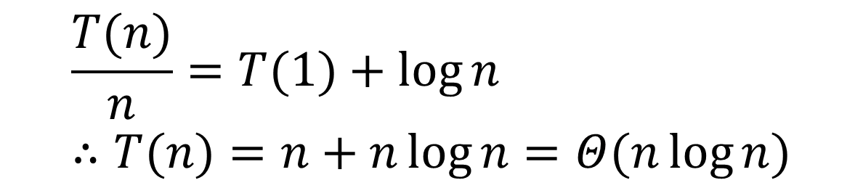
Running time of merge sort( cont.)
add (1) upto (x), we will get:
$$\frac{T(n)}{n}=T(1)+\log{n} \\ ∴T(n)=n+n\log{n}=Θ(n\log{n})$$
It can be seen that merge sort is faster than any other previous methods.
Its limitation is – it requires space for the resulting array.

Slide 34
Quick Sort
1. If there is one member or less in an array, that array is our answer.
2. Choose a value in the array. That value will be our pivot.
3. Move all values that are less than pivot to the left of pivot. Move all values that are greater than pivot to the right of pivot. (For values equal to pivot, we can deal with them in many ways. The best way is to distribute them evenly on both sides of pivot.) This step is called -> partition.
4. Now, pivot is in the right place. We then do quick sort on both sides of the original array.
5. our answer is the concatanation of
quicksort(left) ++ pivot ++ quicksort(right)
Notes:
Very similar to merge sort, but operate on the original array to save space.

Slide 35
quick sort concept
3
5
6
1
4
pivot
Split side
3
1
4
5
6
quick sort
quick sort
Concat.
Notes:
First, select pivot.
Then put larger values than pivot to its right and smaller value to the pivot to its left.
Call quicksort on both sides.
Concatenate the results.

Slide 36
step 1: when array is small
If there is one member or less in an array, that array is our answer.
For small size array (such as <20), insertion sort is faster because we don’t waste time dividing portion. So for small array, we use another sorting method.

Slide 37
step 2: choosing pivot
You should not use the array’s first element as pivot.
Because if that array is already sorted, one side of the portion will always be empty.

Slide 38
bad pivot (choosing first member)
pivot
5
4
3
2
1
4
3
2
1
5
No right portion
We cannot reduce problem size by half any more.

Slide 39
Good pivot
random number usually gives even partition.
But random number is slow to generate.
Median of the first, middle, and last array slot.
The best pivot should be the median of all array elements. But we cannot do that because it takes too much time.
This median of 3 method performs well in general experiments.

Slide 40
median of 3 – the code
1: private static int pivotIndex(int[] a, int l, int r){
2: int c = (l+r)/2;
3: if((a[l]<=a[r] && a[l]>=a[c]) ||
4: (a[l]>=a[r] && a[l]<=a[c]))
5: return l;
6: if((a[c]<=a[l] && a[c]>=a[r]) ||
7: (a[c]>=a[l] && a[c]<=a[r])
8: return c;
9: return r;
10: }
Notes:
This is one of the approach you can use to find a pivot. It chooses the median of the first, last, and middle value. ( median of 3).

Slide 41
Step 3: partitioning
Get pivot out of the way by swapping it with the last element.
Let i be the index of the first position and j be the index of the before-last position (Pivot is in the last position).
Keep incrementing i until a[i] >= pivot value.
Keep decrementing j until a[j] <= pivot value.

Slide 42
If i is on the left of j, swap a[i] and a[j]. This is an attempt to move smaller value to the left and larger value to the right. If i is not on the left of j, go to step 8.
Increment i by 1 and decrement j by 1. This is just avoiding the slots that we just swap their values.
Start with step 3 again.
Swap a[i] with pivot. We will get the array with pivot in its correct position. To its left are the smaller values and to its right are the larger values.

Slide 43
Partition example
pivot
7
2
5
1
0
4
9
6
3
8
swap pivot with the last member.
7
2
5
1
0
8
9
6
3
4
i
j
Try to increment i and decrement j.
7
2
5
1
0
8
9
6
3
4
Cont.
i
j
Cannot move both. Must swap a[i] and a[j].
Notes:
In this particular example, when we first try to move i and j, both cannot be moved. So we swap a[i] and a[j] right away and increment i, decrement j.

Slide 44
Partition example(cont.)
3
2
5
1
0
8
9
6
7
4
i
j
Try to increment i and decrement j.
3
2
5
1
0
8
9
6
7
4
i
j
swap a[i] and a[j].
3
2
0
1
5
8
9
6
7
4
Cont.
i,j
Notes:
Then
a[i] stops at 5 (> pivot, 4)
a[j] stops at 0 (<pivot)

Slide 45
Partition example(cont.)
3
2
0
1
5
8
9
6
7
4
i,j
Try to increment i and decrement j.
3
2
0
1
5
8
9
6
7
4
j
i
Now i is not smaller than j. we swap a[i] and pivot.
3
2
0
1
4
8
9
6
7
5
Less than 4
Greater than 4
Notes:
a[i] stops at 5 (> pivot)
a[j] cannot move
Now we are done with the partition, but we need to move pivot to its correct position first.

Slide 46
Partititioning value that is equal to: 1st method
i stop but j does not stop: not good because the values will be on one side only.
pivot
7
4
2
4
0
8
9
6
4
4
i
j
Try to increment i and decrement j.
7
4
2
4
0
8
9
6
4
4
i
j
swap a[i] and a[j].
Cont.
0
4
2
4
7
8
9
6
4
4
i
j
Notes:
What do we do if our data has equal value to the pivot?
Let’s try -> stop i but do not stop j.
-> j will stop when it finds 0, where i does not move.

Slide 47
Partititioning value that is equal to: 1st method (cont.)
0
4
2
4
7
8
9
6
4
4
i
j
Try to increment i and decrement j.
0
4
2
4
7
8
9
6
4
4
i
j
swap a[i] and a[j].
0
2
4
4
7
8
9
6
4
4
j
i
Pivot will be swapped here.
Notes:
All 4s will be on one side (unfair distribution)
Same thing happens if we stop j but does not stop i.

Slide 48
Partititioning value that is equal to: 2nd method
i and j MOVE PAST ALL pivot values.
Still not good enough because if we have the following:
1
1
1
1
1
1
1
1
1
1
i
j
i and j are at array’s end. Pivot will be at array’s end too. Not balance.
Notes:
Now let’s try I and j jumping over all values equal to the pivot (there must be code that stops i and j from going out of array bound).
If there are lots of duplicated data, this strategy will result in uneven partition because i will be at the very end of the portion.

Slide 49
Partititioning value that is equal to: 3rd method
i and j both stop when encountering a pivot value.
Unnecessary swap will take place.
Last page, swapping at all steps.
Good points: even array portions.
Faster in a long term.
Notes:
Try stopping both i and j:
This approach gives us even portions.

Slide 50
quick sort: code
private static void quicksort(int[] a,int l, int r){
if(l+CUTOFF<=r)
{
//find pivot
int pIndex = pivotIndex(a,l,r);
//get pivot out of the way.
swap(a,pIndex,r);
int pivot = a[r];
Notes:
input are
->the array we want to sort
->index of the leftmost position of the data portion that we want to sort (l).
->index of the rightmost position of the data portion that we want to sort (r).
CUTOFF is used to determine when we use other sorting algorithm (when the array portion is small enough).

Slide 51
//start partitioning
int i=l, j=r-1;
for( ; ; )
{
while(i<r && a[i]<pivot)i++;
while(j>l && a[j]>pivot)j--;
if(i<j){
swap(a,i,j);
i++;
j--;
}else //if I exceeds j, we cannot swap them. We must get //out of the loop.
break;
}
Do not let index go beyond the array’s edge.
swap

Slide 52
//swap pivot into its correct position
swap(a,i,r);
//quick sort on subarrays
quicksort(a,l,i-1);
quicksort(a,i+1,r);
}
else
insertionSort(a,l,r);
}

Slide 53
quick sort running time
For easy calculation, let’s assume we use a random pivot and do not use insertion sort when the array is small.
Let T(n) = running time when working with an array of size n.
Let T(0)=1, T(1)=1.
For other T(n), the running time is the sum of:
Time for choosing pivot: -> constant. (negligible)
Time for partitioning:-> depends on array size. Let it be c*n.
Time for quick sort on left and right subarray.

Slide 54
quick sort running time(cont.)
Let the left subarray has size i.

Slide 55
Worst case
Takes place when pivot is always a smallest value. In such situation, the array size is only reduced by 1 each time.
Cont.

Slide 56
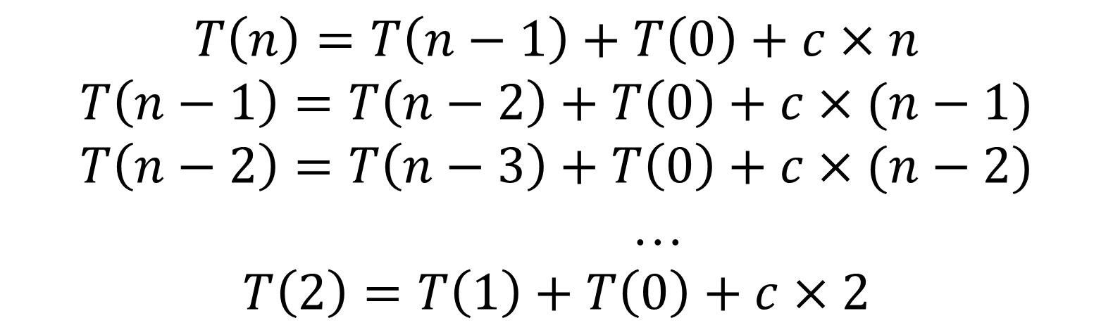
Worst case (cont.)
Cont.
Add them all up.

Slide 57
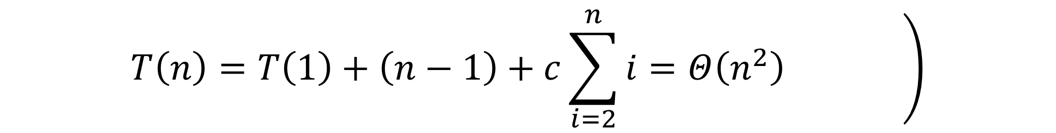
Worst case (cont 2.)
To sum up, worst case running time is similar to other sorting methods.

Slide 58
Best case
Takes place when the array can always be divided evenly.
The calculation here is similar to merge sort.
The equation will become:
Cont.

Slide 59
Best case (cont.)
Add them.
Cont.

Slide 60
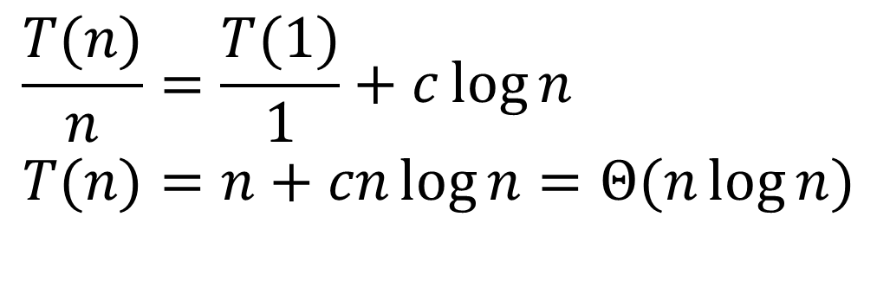
Best case (cont 2.)
$$\frac{T(n)}{n}=\frac{T(1)}{1}+c\log{n} \\ T(n)=n+cn\log{n}=Θ(n\log{n})$$
The same level as merge sort.

Slide 61
Average case
Each subarray size can be from 0 to n-1.
Subarray cannot have size == n because we do not count our pivot.
For every size to have equal chance of happening, each size has a probability of = 1/n.
So our equation becomes:
Cont.

Slide 62
Average case (cont.)
Multiply by n, we get:
(avg1)
Change n to n-1, we get:
(avg2)
Cont.

Slide 63
Average case (cont 2.)
Do (avg1)-(avg2), we get:
We can ignore c. Then divide by n(n+1), we get:
Cont.

Slide 64
Average case (cont 3.)
We can then form a set of equations:
Add them all.
( the last page
too)
Cont.

Slide 65
Average case (cont 4.)
We get:
(avg3)
The sum is a harmonic number, with the following formula:
Cont.

Slide 66
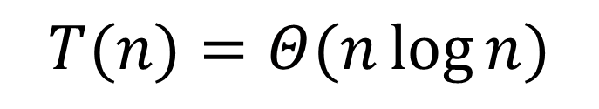
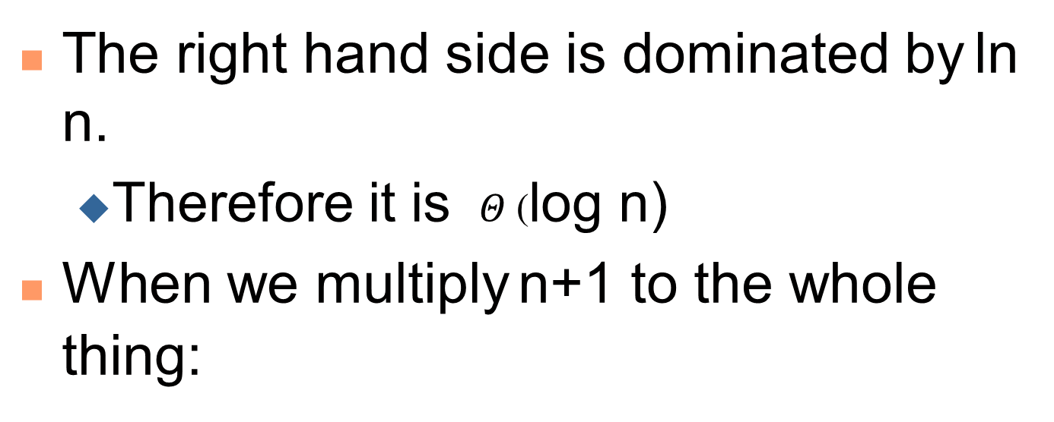
Average case (cont 5.)
use harmonic number in avg3:
The right hand side is dominated by ln n.
Therefore it is $Θ$(log n)
When we multiply n+1 to the whole thing:
$$T(n)=Θ(n\log{n})$$

Slide 67
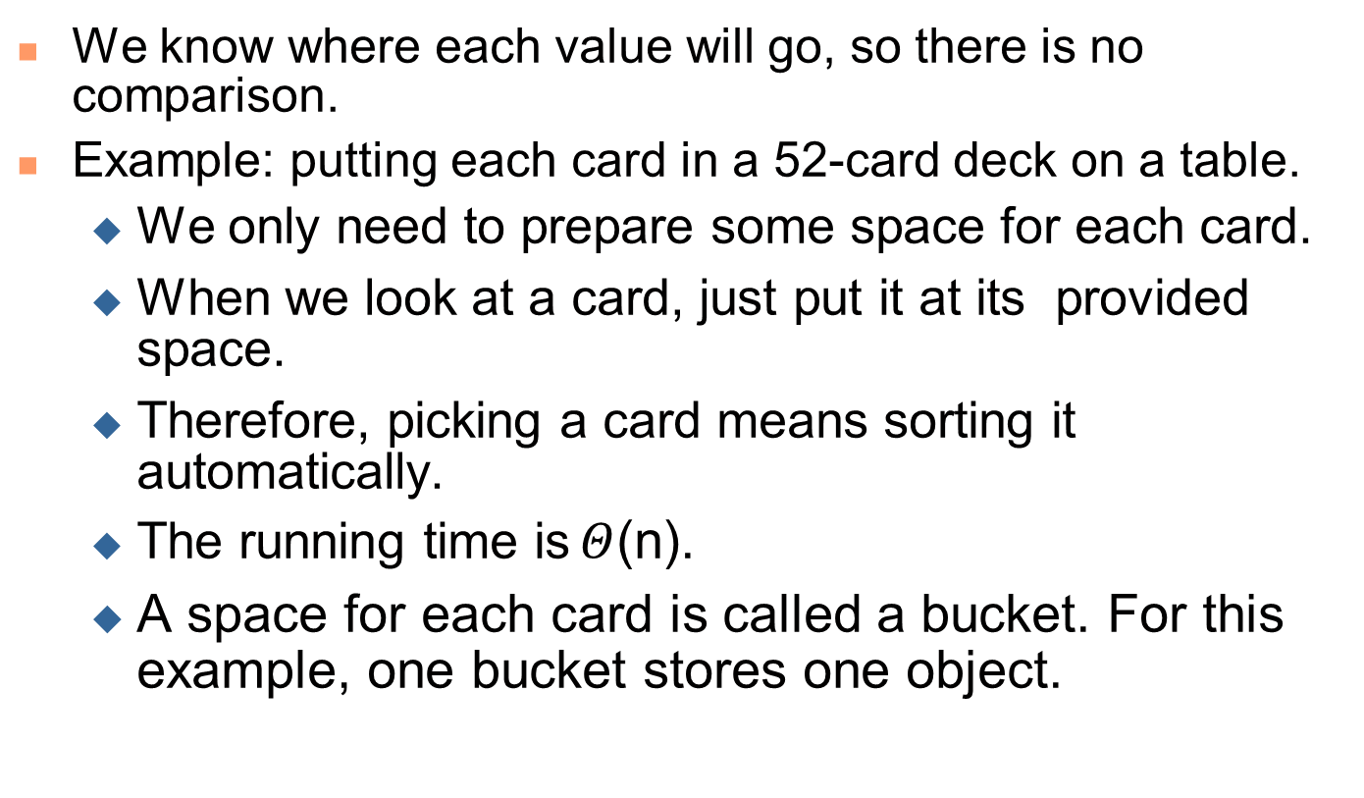
Bucket sort
We know where each value will go, so there is no comparison.
Example: putting each card in a 52-card deck on a table.
We only need to prepare some space for each card.
When we look at a card, just put it at its provided space.
Therefore, picking a card means sorting it automatically.
The running time is $Θ$(n).
A space for each card is called a bucket. For this example, one bucket stores one object.

Slide 68
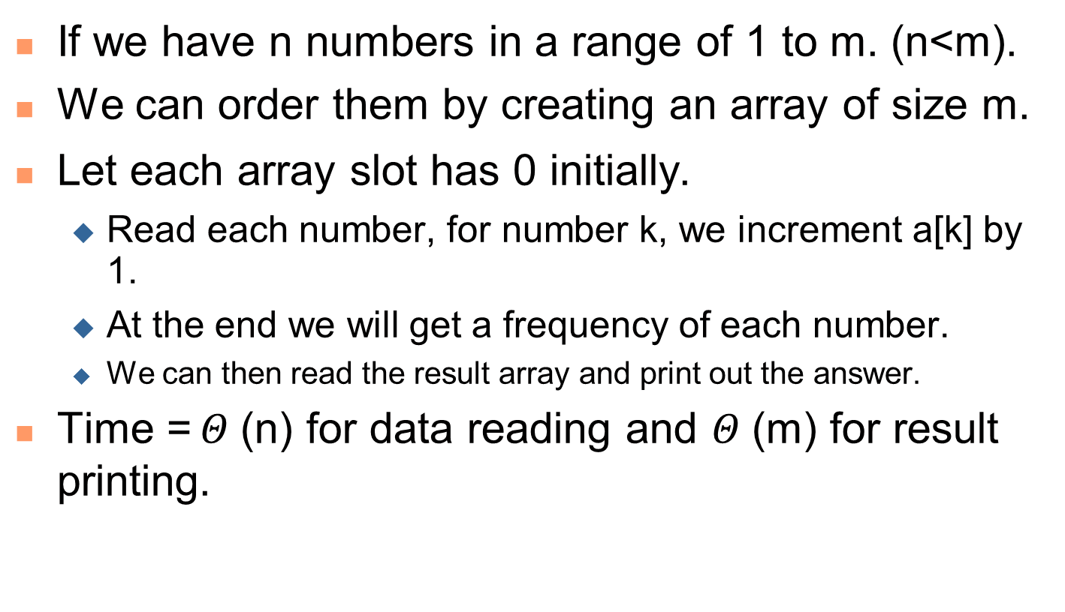
Bucket sort (cont.)
If we have n numbers in a range of 1 to m. (n<m).
We can order them by creating an array of size m.
Let each array slot has 0 initially.
Read each number, for number k, we increment a[k] by 1.
At the end we will get a frequency of each number.
We can then read the result array and print out the answer.
Time = $Θ$(n) for data reading and $Θ$(m) for result printing.

Slide 69
Bucket sort (cont 2.)
a bucket may store more than one distinct objects.
Example: sorting exam papers from 49 students:
At collection time, an examiner can divide students into 5 groups (1-9,10-19,…,40-49).
Within a group, we can use a sorting method such as insertion sort.
After sorting within a group, simply put all groups in sequence.
The running time depends on the method used to sort within buckets.

