Slide 1
Priority Queue

Slide 2
What is it?
It is a queue that access elements according to their importance value.
Eg. A person with broken back should be treated before a person with minor wounds, even though he arrives later.

Slide 3
Priority
In this class, small value is regarded as more important.
If two items have equal priority, we may regard the item that exists longer in the queue to be more important.
To compare elements, we can use Comparable interface or Comparator Interface.

Slide 4
Comparator Interface
Has method: compare(Object o1, Object o2)
Has to be the same class or one is the subclass of the other.
Return negative value if o1 is less than o2, positive value if o1 is more than o2, and 0 otherwise.

Slide 5
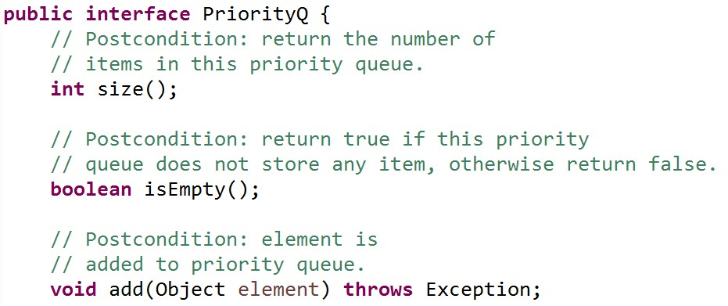
The interface for Priority Queue

Slide 6
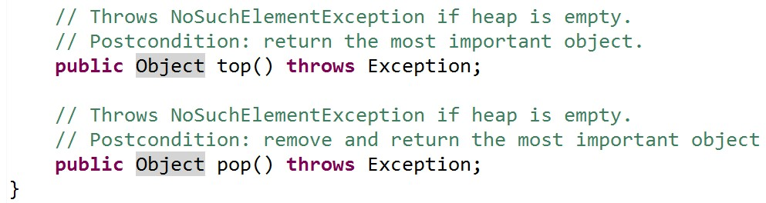

Slide 7
Many implementation choices exist
Normal queue: no priority then?
Array of queue (each queue for each priority): too much space to prepare if there are lots of possible priority.
We fix it with a linked list of queues!
But add() needs a search (no instant access like array). O(priority)+ O(list size).
If every data has different priority, the time is O(n).
pop(), top() take 𝛩(1), since first data in the first queue is accessed.

Slide 8
Use ArrayList
Easy to put members in sorted order.
Takes time to find a position to add though (O(log n) if use binary search).
After addition, many array elements have to be shifted after insertion (O(n)).
add() therefore takes O(n). -> not very good
top() is 𝛩(1) because we can return the first array element right away.
pop() takes 𝛩(n) because we need to shift all array data after removing the first.
Linked list of queues seems to be better.

Slide 9
Use LinkedList
top() and pop() take 𝛩(1) because we can return the front of the list right away and removing data in a Linked list does not require shifting other data.
add() takes O(log n) for binary search, it still needs to search the position to add, but does not need element shifting.
The performance is about equal to using linked list of queues.
Queue implementation may produce some additional time.
Seems to have the best time (so far).

Slide 10
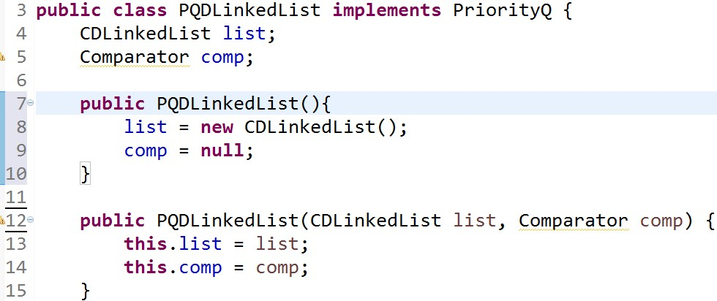
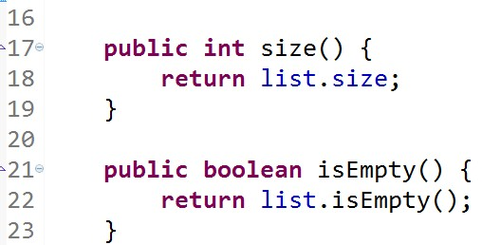
Linked List priority queue

Slide 11
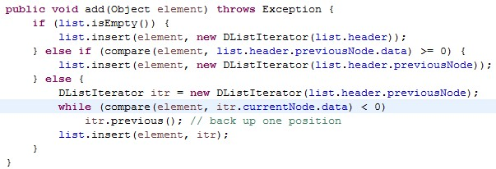
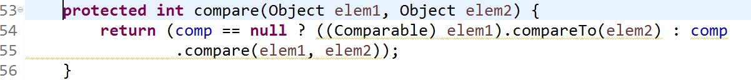
Just find the right position to insert data.

Slide 12
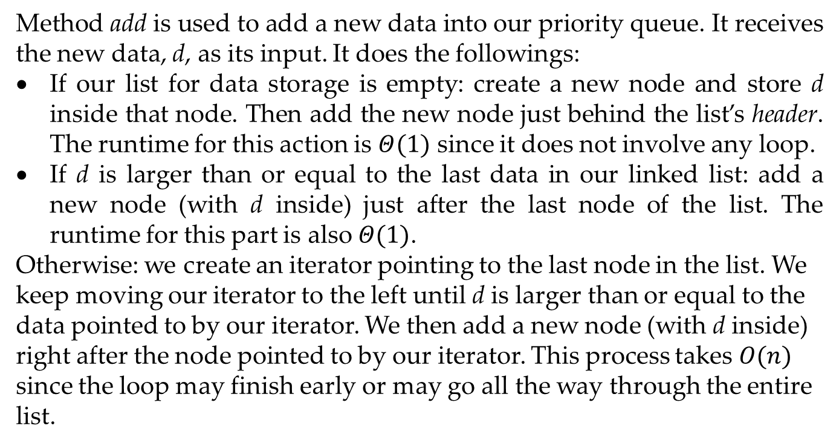
Method add is used to add a new data into our priority queue. It receives the new data, d, as its input. It does the followings:
If our list for data storage is empty: create a new node and store d inside that node. Then add the new node just behind the list’s header. The runtime for this action is $Θ(1)$ since it does not involve any loop.
If d is larger than or equal to the last data in our linked list: add a new node (with d inside) just after the last node of the list. The runtime for this part is also $Θ(1)$.
Otherwise: we create an iterator pointing to the last node in the list. We keep moving our iterator to the left until d is larger than or equal to the data pointed to by our iterator. We then add a new node (with d inside) right after the node pointed to by our iterator. This process takes $Ο(n)$ since the loop may finish early or may go all the way through the entire list.

Slide 13
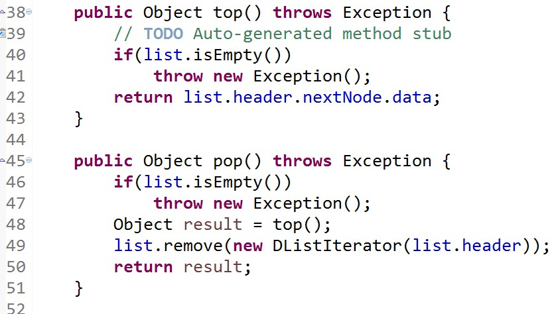
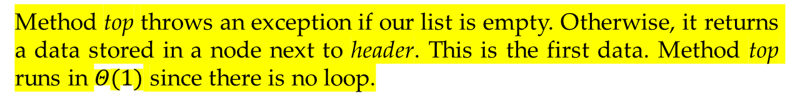
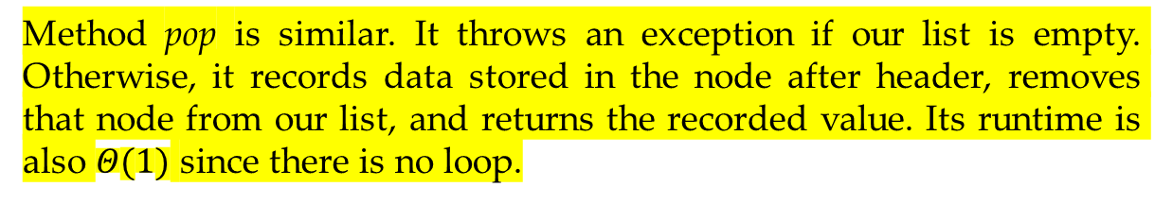
Method top throws an exception if our list is empty. Otherwise, it returns a data stored in a node next to header. This is the first data. Method top runs in $Θ(1)$ since there is no loop.
Method pop is similar. It throws an exception if our list is empty. Otherwise, it records data stored in the node after header, removes that node from our list, and returns the recorded value. Its runtime is also $Θ(1)$ since there is no loop.

Slide 14
Implement using real Heap
public class Heap implements PriorityQ {

Slide 15
Complete Binary tree
Notes:
Complete binary tree is a tree full at every level except the last level, where it is filled only from left to right. No hole.

Slide 16
Heap is a complete binary tree
It is either an empty tree, or
A tree that has its minimum value in its root. (this kind of heap is called minHeap)
Left and right subtree have to be heaps too.
Heap is not a binary search tree!

Slide 17
Smallest value is at the root for every subtree.

Slide 18
Complete binary tree can be put into array
26 40 31 48 50 85 36 107 48 55 57 88
It is easy to find child, parent.
This represents the tree from the previous page.

Slide 19
First, how to use Heap (smallest GPA is most important.)
Notes:
This example shows heap of student data. You can look at the underlined variable to see how heap is used.

Slide 20
Notes:
This page only contains constructor.

Slide 21
Notes:
This program adds one student “s” into heap if s is not a sentinel (the value that tells us that we should stop getting input).
We use method add.
If a sentinel is read, we clear heap and output heap contents onto the screen. We use loop with pop().

Slide 22
// constructor receives string as input. toString should be implemented.
// Postcondition: return integer that < 0, = 0, or > 0, depending on student’s GPA.

Slide 23
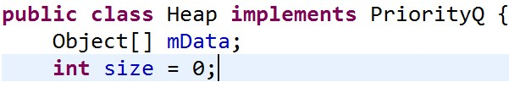
Let us see the class for heap.
Actual implementation is array.

Slide 24
Index of a node’s child

Slide 25
Index of a node’s parent

Slide 26
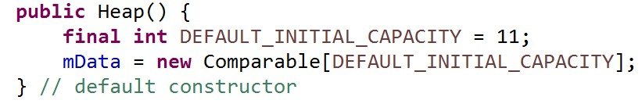
Method of a Heap

Slide 27
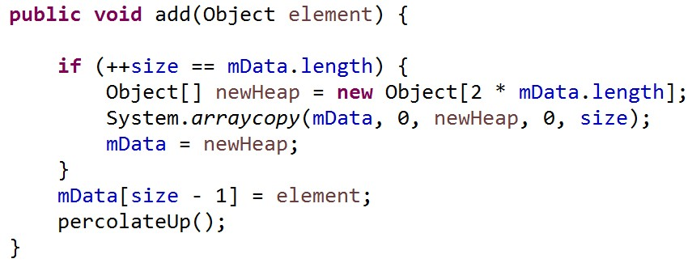
// Postcondition: element is added to the heap.
// worst case time = O(n)
// average time = constant
Depends on avarage time of percolateUp
Resize array, this is O(n)
The real operation.

Slide 28
Let us add 30
26 | 32 | 31 | 48 | 50 | 85 | 36 | 107 | 30
30

Slide 29
Percolate up is
Swapping 30 with its parent until parent has less value.
We will get a heap when we finish.

Slide 30
Let us follow the movement.
26 | 32 | 31 | 30 | 50 | 85 | 36 | 107 | 48

Slide 31
We finally get a heap at the end of all swaps.
26 | 30 | 31 | 32 | 50 | 85 | 36 | 107 | 48

Slide 32
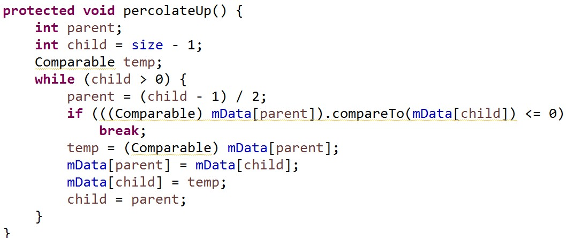
// Postcondition: move the last element up the tree. The worst time is O(log n). The average time is constant.
Depend on the height of the tree. Worst case happens when we need to swap up to the root.

Slide 33
Average time -percolateUp
Let the new value be around the middle of existing values.
Half array elements have greater value.
This is a complete binary tree, therefore this half are leaves.
Therefore we need to swap only once (or at most twice) to get our value to the right place.
This is why it is said to take a constant time.

Slide 34
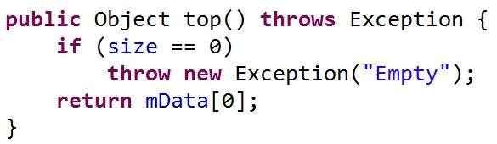

Slide 35
pop() – Be careful!
4
4
8
5
8
5
6
6
The tree may no longer be a complete binary tree. So we cannot remove node!!

Slide 36
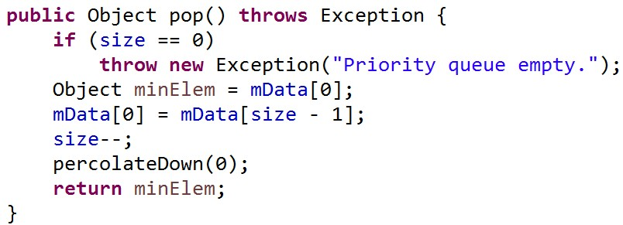
// Precondition: must not be an empty queue or it throws NoSuchElementException.
// Postcondition: remove the most important value from this queue. This object is returned as pur answer.
// worst time = O(log n).
//put the last element into the root.
reduce size to prevent access of the array’s back

Slide 37
26
107 48
when pop( ) is called, 48 will swap place with 26. Size will be reduced by 1. after that, percolateDown will be called.
30 31
32 50 85 36
26 | 30 | 31 | 32 | 50 | 85 | 36 | 107 | 48

Slide 38
PercolateDown is
Swapping 48 with its smallest child. We do it until no more swap can be done. We will get a legal heap in the end.

Slide 39
48 | 30 | 31 | 32 | 50 | 85 | 36 | 107 | 48

Slide 40
30 | 48 | 31 | 32 | 50 | 85 | 36 | 107 | 48

Slide 41
30 | 32 | 31 | 48 | 50 | 85 | 36 | 107 | 48
Now we finally get our heap.

Slide 42
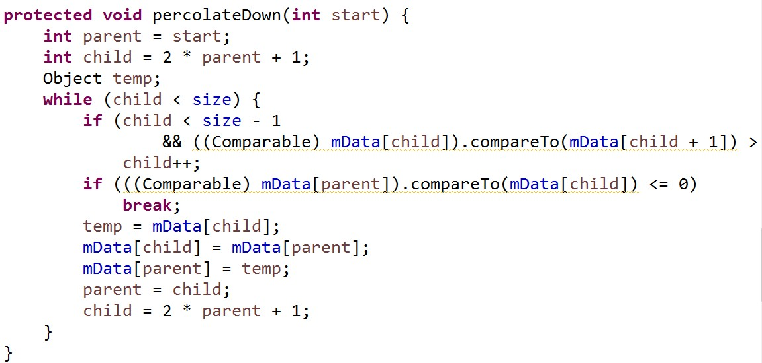
// Postcondition: heap arranged by moving the top element down the tree. Worst and average time is O(log n).
Initially, let “child” be the left child.
Child can’t be the last element because there will be no right child to compare.
If right child is smaller, change our “child”.
Notes:
It uses the same principle as percolateUp. That is, swapping child and its parent until no more swapping can be done. But the child used must be the smallest (most important).
Worst case running time is when the swap has to be done until we reach a leaf. Therefore the time is log n .
Average case:
Let us assume that the newly inserted element has value in the middle of all existing values. That means, half of tree’s elements have greater values. But because this is a complete binary tree, this half must be at its leaves. PercolateDown will have to move the inserted element down to the level before last. So it is almost like a worst case.

Slide 43
Try this and print the heap content. See if it is what you expected.

Slide 44
Application of heap
Huffman Code

Slide 45
Let’s look
Let’s say we want to compress file without losing any information
Let M be the data that we want to compress. Let its size be 100000 characters. M contains only character a to character e.
Let E be M after compression.

Slide 46
Normally, 1 character needs 16 bit to store.
100000 character needs 100000x16 bits.
It is useful to know how to reduce the number of bits while maintaining the same information.

Slide 47
Try this
The number of bits reduce to 300,000
Notes:
Because we know that there are few characters, we can encode them the way we want.

Slide 48
Can it be reduced even more?
The number of bits now <=300,000
But 001010 can mean either
Aababa or cbda. Rather ambiguous.
Notes:
This way we can compress more, but we can’t get the original message back because the resulting number is ambiguous.

Slide 49
How do we prevent ambiguity
use prefix-free encoding.
By creating a binary tree
Left branch is 0.
Right branch is 1.
Character is at the leaves.

Slide 50
Therefore, there is no two characters on the same path (from root)
a = 010
b = 11
c = 00
d = 10
e = 011

Slide 51
alternatives?
Which scheme is best?
Ans: frequently appear character
should have small number of bits.
Notes:
This is a legal tree too. But which tree is better?
If a character is in our message frequently, we want that character to be represented by as few bits as possible.

Slide 52
Create Huffman tree
This is a binary tree of codes. but it is built using the frequency of characters in the message.
Characters with high frequency will take less bits.

Slide 53
let us use the following example.
A has 5000
B has 10000
c has 20000
d has 31000
e has 34000

Slide 54
Put pair (character, frequency) into Priority Q
Priority Q that we use, we will have the lowest frequency as most important!
Each node of our priority Q has left, right, parent of its own.
In our example, the initial queue is ordered such that -> (a:5000) (b: 10000) (c: 20000) (d: 31000) (e: 34000)
Now let us build Huffman tree.

Slide 55
Remove the two items with smallest frequency from the queue. The first one becomes the left branch, the second one becomes the right branch.
The sum of their frequency is stored in the new root.
15000
0
1
a
b
Then we put the result back into the priority queue. The queue will now be ( :15000) (c: 20000) (d: 31000) (e: 34000)
A tree here

Slide 56
Remove the first two elements and do the same again.
35000
0
1
15000
c
0
1
a
b
When we put this tree back into the queue, we get ->
(d: 31000) (e: 34000) ( : 35000)

Slide 57
Remove the two front elements and do the same again.
65000
0
1
d
e
This becomes a new tree.
When we put this tree back into the queue, we get ->
( : 35000) ( : 65000)

Slide 58
We do the same again.
100000
0
1
65000
35000
0
1
0
1
15000
c
d
e
0
1
priority Q will become (: 100000)
a
b
Notes:
Now we get the huffman tree.

Slide 59
Try creating a tree with this example.

