Slide 1
AVL Tree

Slide 2
Ordinary Binary Search Tree
Searching time is O(height)
⎣log₂ n⎦ ≤ height ≤ n – 1
Speed of search depends on the shape of the tree.
1
6
6
2
1
9
2
8
6
2
8
1
7
9
9
7
8
Best time
7
Better time
Like a Linked List

Slide 3
AVL Tree : Adelson-Velskii and Landis
AVL = Binary Search Tress + Rule on height
e
For each and every node, e
h_{L}
h_{R}

Slide 4
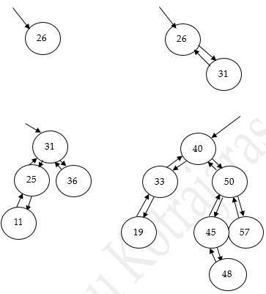
AVL Tree examples
Null tree has height = -1

Slide 5
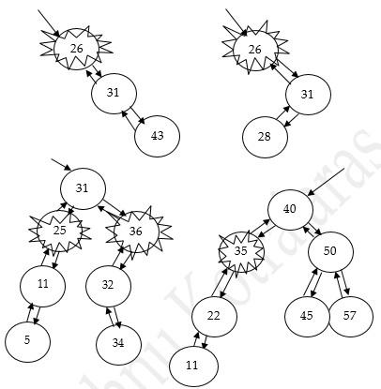
Non AVL Tree examples

Slide 6
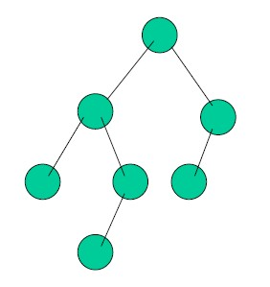
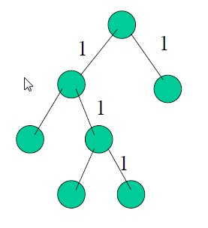
Are these AVL??????
AVL
Non-AVL

Slide 7
Maintaining the property of AVL
Add and remove just like BST.
But adding or removing can cause the tree to lose its AVL property.
We need to rearrange the tree then.

Slide 8
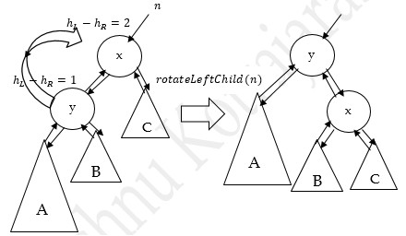
Rebalance: 1st case

Slide 9
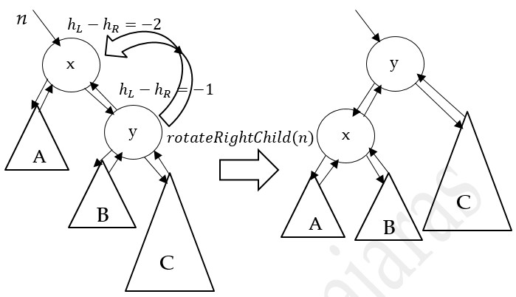
Rebalance: 2nd Case

Slide 10
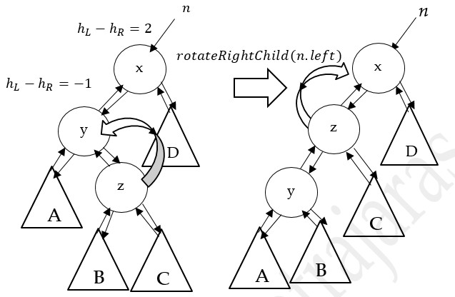
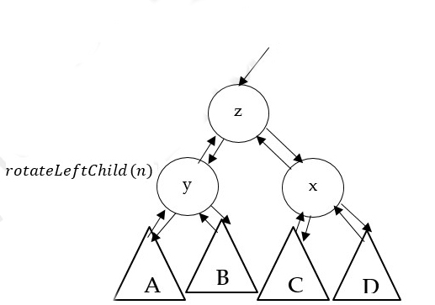
Rebalance: 3rd Case

Slide 11
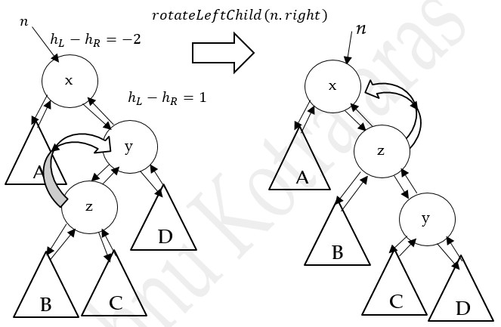
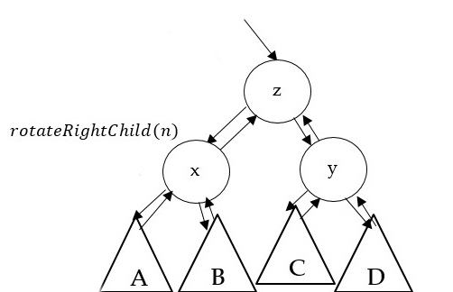
Rebalance: 4th case

Slide 12
AVL Node
public class AVLNode {
// cannot extend from BSTNode because left, right, parent will then be
// BSTNode!!
int data;
AVLNode left, right, parent;
int height;
public AVLNode(int data) {
this.data = data;
left = null;
right = null;
parent = null;
height = 0;
}
NEW

Slide 13
public AVLNode(int data, AVLNode left, AVLNode right, AVLNode parent,
int height) {
this.data = data;
this.left = left;
this.right = right;
this.parent = parent;
this.height = height;
}
public static int getHeight(AVLNode n) {
// Need this to be static method because null
// does not have height to be checked!
return (n == null ? -1 : n.height);
}
reading the value of variable height

Slide 14
// Assume that left and right child have correct height,
// we update the height value of n
public static void updateHeight(AVLNode n) {
if (n == null)
return;
int leftHeight = getHeight(n.left);
int rightHeight = getHeight(n.right);
n.height = 1 +
(leftHeight < rightHeight ? rightHeight : leftHeight);
}
recalculates the height of n, and set the value of height, assuming that n.left and n.right have correct height

Slide 15
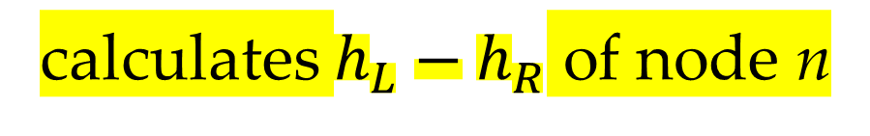
// Assume that left and right subtree have correct // height. Find which way the tree is more loaded.
public static int tiltDegree(AVLNode n) {
if (n == null)
return 0;
return getHeight(n.left) - getHeight(n.right);
}
calculates $h_{L}−h_{R}$ of node n

Slide 16
Iterator
the implementation is the same except all BSTNode get replaced by AVLNode. We call the class for this iterator AVLTreeIterator.
Implementation not shown here since it is similar to our normal iterator.

Slide 17
Methods for rotation
public AVLNode rotateLeftChild(AVLNode n) {
AVLNode l = n.left;
AVLNode lr = n.left.right; // can be null
n.left = lr;
if (lr != null) {
lr.parent = n;
} l.right = n;
l.parent = n.parent;
n.parent = l;
AVLNode.updateHeight(n);
AVLNode.updateHeight(l);
return l;
}
Θ(1)

Slide 18





$$n$$
$$n$$
x
n.left = lr;
if (lr != null) {
lr.parent = n;
}
x
$$l$$
y
C
y
$l$r
C
$l$r
B
B
A
A

Slide 19



l.right = n;
l.parent = n.parent;
x
point to n.parent
$$l$$
n.parent = l;
y
$$l$$
C
y
$$n$$
B
A
A
x
B
C

Slide 20
public AVLNode rotateRightChild(AVLNode n) {
AVLNode r = n.right;
AVLNode rl = n.right.left; // can be null
n.right = rl;
if (rl != null) {
rl.parent = n;
}
r.left = n;
r.parent = n.parent;
n.parent = r;
AVLNode.updateHeight(n);
AVLNode.updateHeight(r);
return r;
}
Θ(1)

Slide 21
public AVLNode rebalance(AVLNode n) {
if (n == null)
return n;
int balance = AVLNode.tiltDegree(n);
if (balance == -2) {
if (AVLNode.tiltDegree(n.right) == 1)
n.right = rotateLeftChild(n.right);
n = rotateRightChild(n);
} else if (balance == 2) {
if (AVLNode.tiltDegree(n.left) == -1)
n.left = rotateRightChild(n.left);
n = rotateLeftChild(n);
}
AVLNode.updateHeight(n);
return n;
}

Slide 22
insert and remove use rebalance
public class AVLTree {
AVLNode root;
int size;
public AVLTree(){
root = null;
size = 0;
}
All methods other than insert and remove are the same as BST , except
we need to change BSTNode to AVLNode

Slide 23
// return the node n after v was added into the tree
public AVLNode insert(int v, AVLNode n, AVLNode parent){
if (n == null){
n = new AVLNode(v, null, null, parent, 0); size++;
} else if (v < n.data) {
n.left = insert(v, n.left, n);
} else if (v > n.data) {
n.right = insert(v, n.right, n);
}
n = rebalance(n);
return n;
}

Slide 24
// return the node n after v was removed from the tree
public AVLNode remove(int v, AVLNode n, AVLNode parent) {
if (n == null)
; // do nothing, there is nothing to be removed
else if (v < n.data) {
n.left = remove(v, n.left, n);
} else if (v > n.data) {
n.right = remove(v, n.right, n);
} else {
if (n.left == null && n.right == null) {
n = null; size--;
} else if (n.left != null && n.right == null) {
n.left.parent = parent;
n = n.left; size--;
}

Slide 25
else if (n.right != null && n.left == null) {
n.right.parent = parent;
n = n.right; size--;
} else {
TreeIterator i = (TreeIterator) findMin(n.right);
int minInRightSubtree = i.currentNode.data;
n.data = minInRightSubtree;
n.right = remove(minInRightSubtree, n.right, n);
}
}
n = rebalance(n);
return n;
}
Notes:
Only the code in circle has changed from its BST counterpart.

Slide 26
Conclusion
AVL tree is a Binary Search Tree with height constraint.
Each node stores its height.
Insert/remove, then do the rebalance
Rebalance = rotation
Add, remove, search take O(log n)

