Slide 1
Crime Patterns
in the Capital
Exploring Crime Patterns Across Washington D.C. in 2025
Temiloluwa Owoade
MATH 014 — Introduction to Data Science
Spring 2026 | Howard University

Slide 2
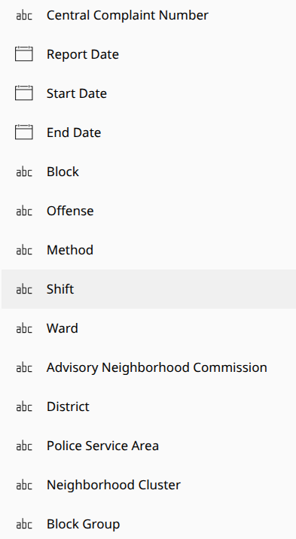
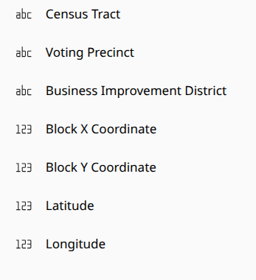

02 | Dataset Overview
What
Variables
Why It Matters
Reported crime incidents across Washington D.C. for the full year 2025, sourced from DC Open Data.
Offense type, date & time, geographic coordinates, ward, police district, PSA, neighborhood cluster, shift, and reporting lag.
Crime data captures spatial, temporal, and categorical dimensions simultaneously; making it analytically rich and socially relevant.
Analyzing the data can give us a clearer iunderstanding on what aspects need more government and enforcment support.
We can identify trends to pre-emtively prevent crimes.
24,151
25
8
3
Incidents
Variables
Wards
Shifts

Slide 3
03 | Research Objective
What drives crime patterns across Washington D.C.?
Where?
What?
Which wards and neighborhood clusters concentrate the most incidents?
Which offense types dominate, and do they vary by location and time?
When?
How Long?
Do crime rates follow seasonal, monthly, or shift-based patterns?
Is there a meaningful gap between when crimes occur and when they are reported?

Slide 4
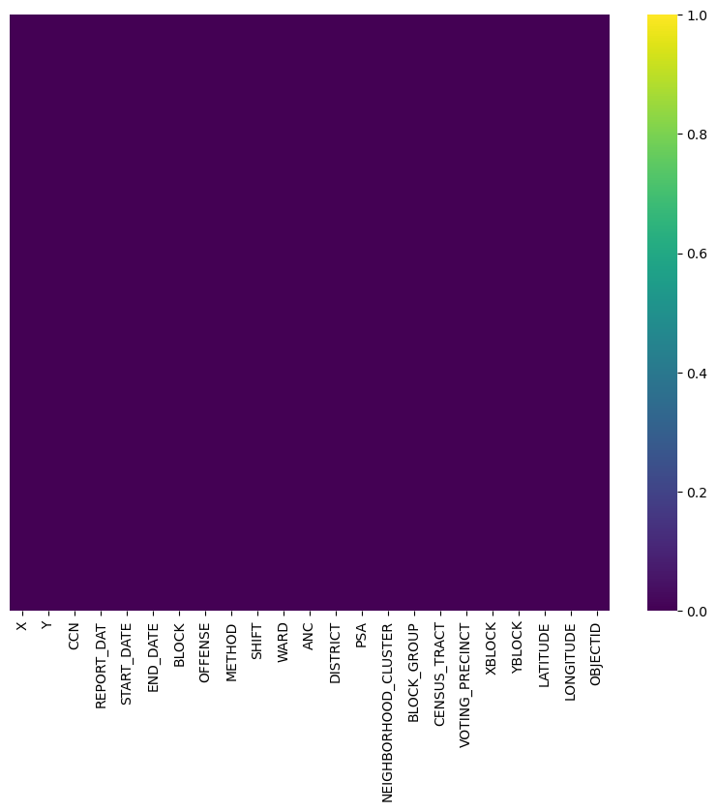
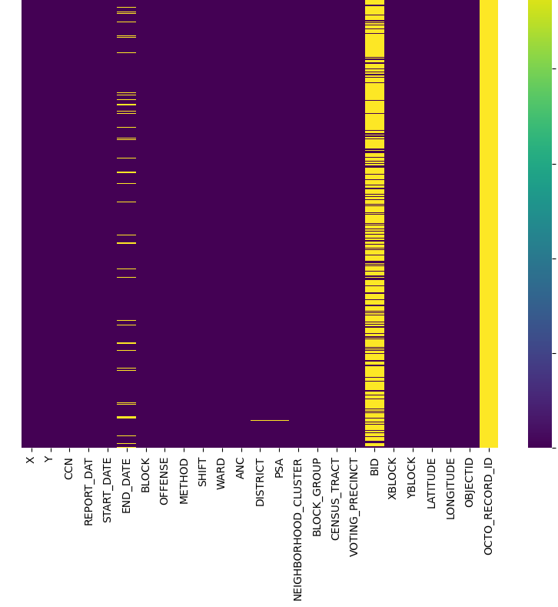
04 | Data Cleaning & Preparation
01
Null value removal & Gap closure
02
End Dates where modified
Ongoing cases where stated as 1st January 2026
The null values were removed.
OCTO_RECORD_ID column and BID was removed
DISTRICT and PSA was closed (using data form the DC public data set).

Slide 5
05 | Key Analysis Questions
Q1
Which offense types are most frequently reported across Washington D.C. in 2025?
Q2
How is crime distributed across the city's eight wards — and which wards bear the greatest burden?
Q3
Does the type of offense vary significantly by ward, or is the composition relatively uniform citywide?
Q4
Are certain crimes more likely to occur during specific shifts (day, evening, midnight)?
Q5
Do crime rates follow a seasonal pattern across months of the year?

Slide 6
06 | Visualizations — At a Glance
Univariate
Multivariate
Offense Distribution (countplot)
Offense × Ward Heatmap
Which crimes are most common?
Where do specific crimes concentrate?
Univariate
Multivariate
Crime by Ward (countplot)
Offense × Shift Grouped Bar
Which wards have the most incidents?
Crime type × time of day
Univariate
Interactive
Crime by Shift (countplot)
Top 5 Offenses Over Time (Plotly)
When do most crimes occur?
Monthly trends for top crimes
Bivariate
Interactive
Avg Reporting Lag by Offense
Arson vs Homicide (Plotly bar)
Which crimes take longest to report?
Rare offense monthly breakdown
Bivariate
Surprise
Monthly Crime Trend (line)
Geospatial Crime Map (Mapbox)
Are there seasonal patterns?
Every incident plotted on DC map

Slide 7
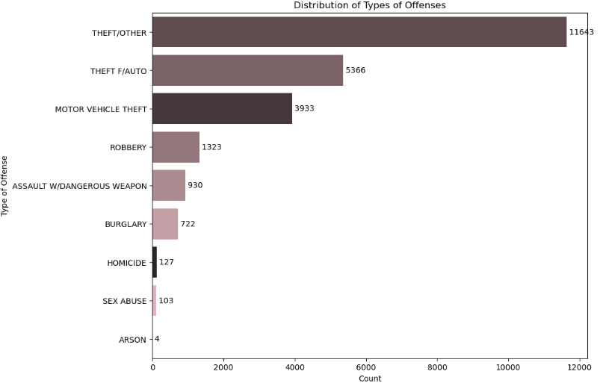
Univariate | Offense Distribution
What it shows
Frequency of each crime type, ranked from most to least common.
Why it matters
Establishes the baseline crime composition of D.C. before exploring relationships.
Key Insight
Theft and motor vehicle theft dominate — violent crimes like homicide and arson are rare by comparison.

Slide 8
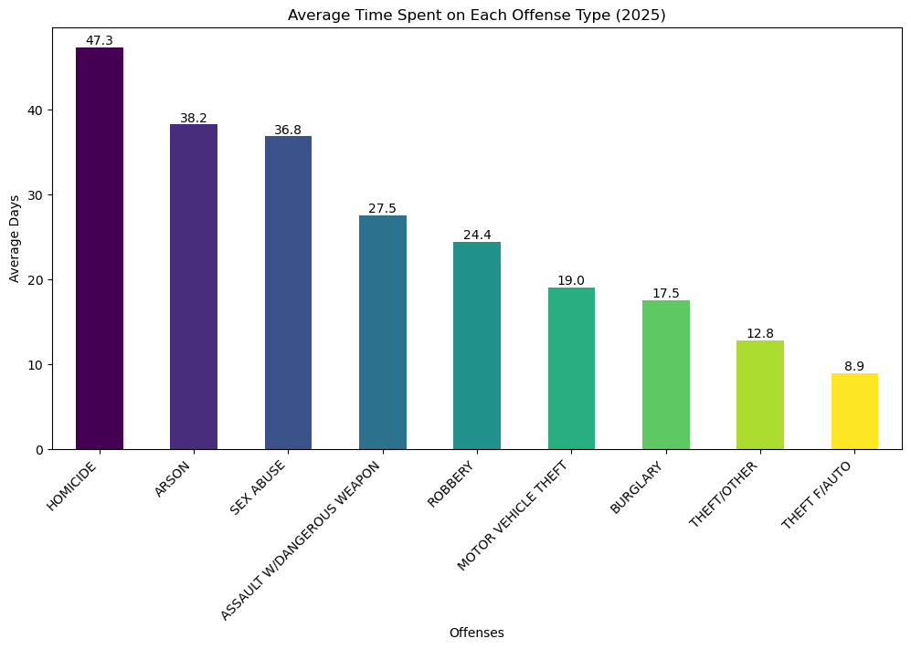
Bivariate | Average Time Spent on Each Offense Type
[Insert Offense Countplot Here]
What it shows
Frequency of each crime type, ranked by how quickly the cases are closed.
Why it matters
Helps us outline which crimes may need more attention based on how much time it takes to resolve
Key Insight
Crimes relating to physical harm/assult tend to take more time

Slide 9
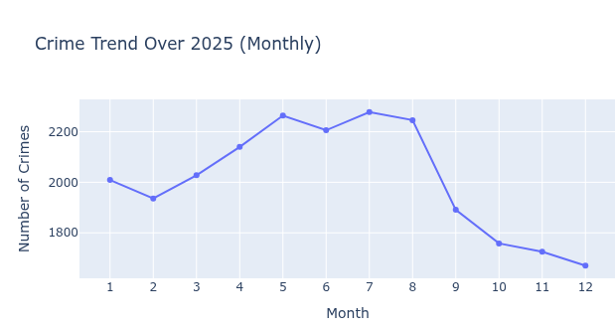
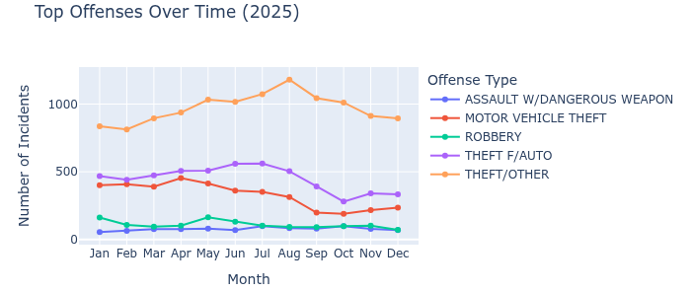
Bivariate | Crime Trend Over 2025
[Insert Plotly Mapbox Scatter Here]
What it shows & why it matters
These line plots show the rates of crimes monthly throughout the year.
It can help us preemptively mitigate crimes at peak times
What it reveals
During the warmer months, crime rates spike (theft specifically). In october, there is a noticeable dip in October in most offense types

Slide 10
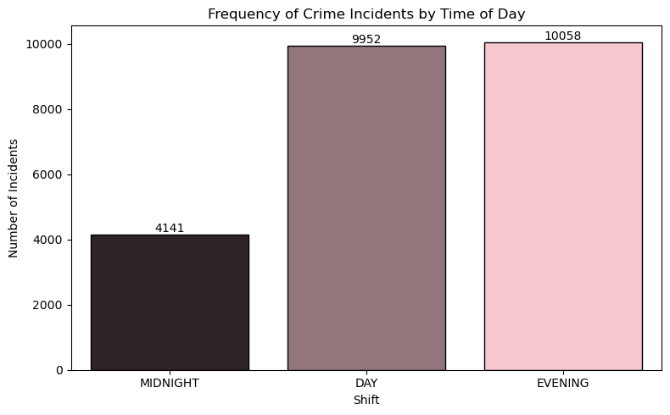
Univariate | Frequency of Crime Incidents by Time of Day
Why this is the Surprise plot
Every other plot aggregates. This one preserves full spatial granularity — every single incident plotted at its exact coordinates.
Midnight = 10pm to 8am
Evening = 2pm to 12am
Morning = 6am to 4pm
What it reveals
Most reports are made in the evening and in the day shift

Slide 11
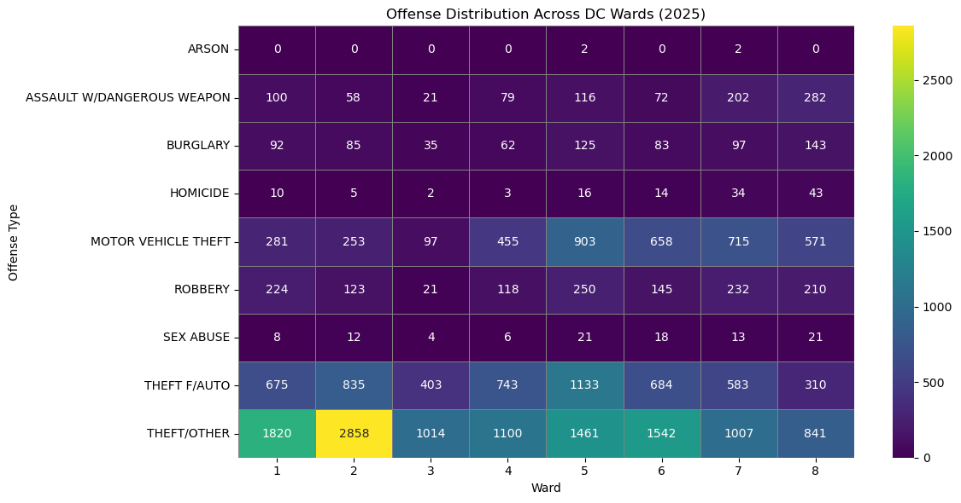
Multivariate | Offense × Ward Heatmap
What it shows
Incident counts for each offense type across all 8 wards simultaneously.
Why it matters
Reveals geographic concentration of specific crime types that a simple frequency chart cannot show.
Key Insight
Certain wards show disproportionate concentrations of specific offenses, suggesting structural or environmental factors at play.

Slide 12
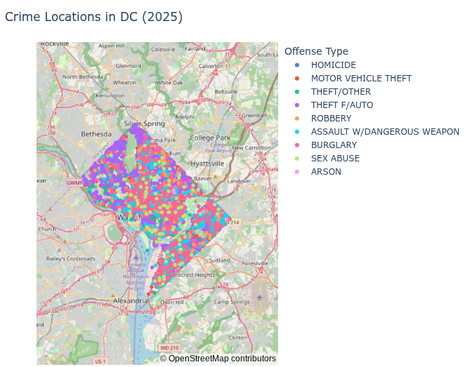
Surprise | Crime Locations Across D.C.
[Insert Plotly Mapbox Scatter Here]
Why this is the Surprise plot
Every other plot aggregates. This one preserves full spatial granularity — every single incident plotted at its exact coordinates.
What it reveals
Geographic hotspots, spatial clustering of specific offense types, and the physical shape of crime across the city — insights no chart can provide.

Slide 13
07 | Key Findings
Theft Dominates
Ward-Level Disparity
Property crimes, especially theft and motor vehicle theft, account for the largest share of all reported incidents citywide.
Crime is not evenly distributed. Certain wards consistently report higher volumes and different offense compositions than others.
Shift Patterns
Seasonal Trends
Incidents are not uniformly distributed across shifts — evening and day shifts show elevated counts of reporting for specific offense types.
Warmer Months tend to have higher reported incidents
Reporting Lag
Spatial Hotspots
A meaningful gap exists between incident occurrence and report filing — and it varies significantly by offense type.
The geospatial map reveals clear geographic clustering, with certain neighborhoods concentrating disproportionate incident density.

Slide 14
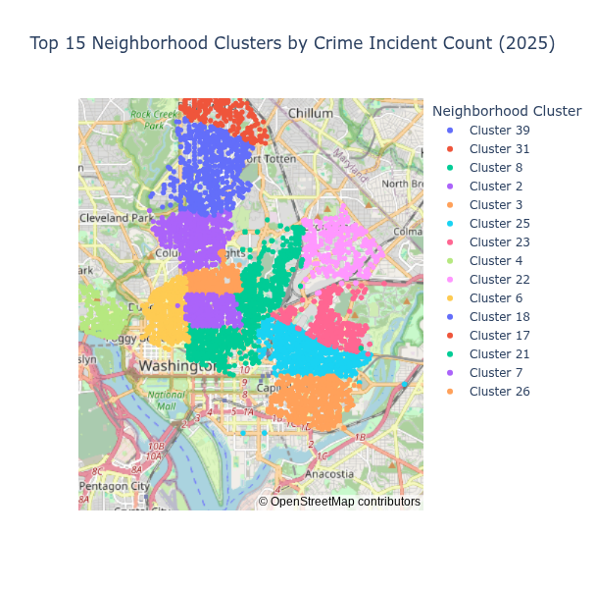
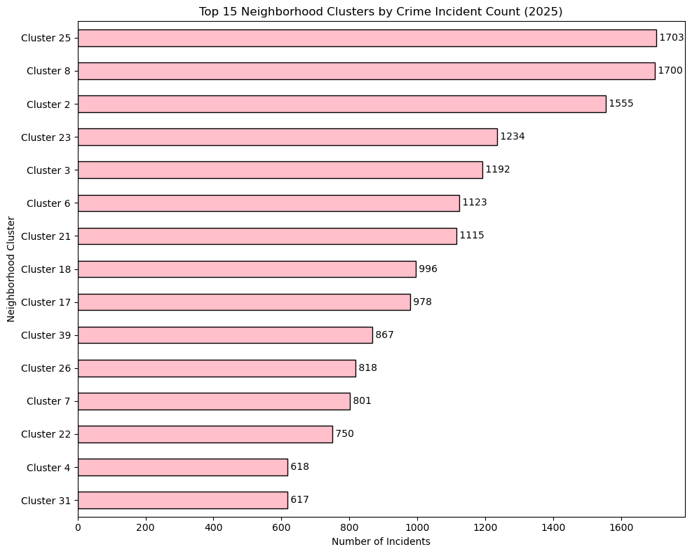
Additional Analysis / Findings
Top 15 Neighborhood Clusters
Howard University
Motivation: Wards are large units that can mask hyper-local disparities. Drilling to neighborhood clusters — and mapping them — reveals whether high-crime areas are contiguous hotspot corridors or scattered pockets, with direct implications for resource allocation.

Slide 15
08 | Conclusion
Crime in D.C. is not random —
it is structured.
This dataset reveals that where, when, and what type of crime occurs are deeply interconnected. Property crimes dominate but concentrate spatially. Reporting lag exposes a hidden behavioral dimension. And the geospatial map makes visible what no aggregate chart can, the physical texture of urban crime across a living city.
Understanding these patterns is not just an analytical exercise — it is a step toward more equitable, evidence-based public safety.
Temiloluwa Owoade | MATH 014 | Howard University | Spring 2026

