Slide 1


Sportify
Cloud-Native Multi-Sport Club Management System (MSCMS)
Sportify unifies every operation of a modern multi-sport club — squads, live matches, medical, plan-driven training, real competitions and analytics — into one secure, role-aware platform built on a microservices back-end, a Next.js front-end and a Python ML engine.

Slide 2

🧭 Index
A guided tour through the whole platform
01
🧩
Problem Definition
02
🎯
Goals
03
⚙️
Solutions
04
🔐
Roles & Access
05
🏗️
System Architecture
06
🧱
Technology Stack
07
⭐
Features (one by one)
08
👁️
Role Views
09
🎬
Live Demo
10
🚀
Future Work
11
✅
Conclusion
12
👥
Team
Sportify · MSCMS
2

Slide 3
🧩 Problem Definition
Where fragmented club operations break down
🗂️
Scattered Tooling
✍️
Manual Match Ops
Splinters club operations across spreadsheets, WhatsApp threads and paper forms, with no shared system.
Forces staff to log line-ups, events and scores by hand, inviting delays and human error.
🩹
Blind Injury Tracking
📊
No Single Truth
Records injuries in isolation, with no link to player availability or selection decisions.
Leaves standings, squads and fixtures duplicated and contradictory across teams and sports.
Sportify · MSCMS
3

Slide 4
🧩 Problem Definition
More gaps a unified platform has to close
🔓
Role-Blind Access
🔮
Zero Analytics
Exposes sensitive data through shared logins, with no per-role permissions or audit trail.
Offers no performance insights or match-outcome predictions to guide tactical choices.
🏋️
Unplanned Training
🐌
Slow Deal Flow
Schedules sessions ad hoc, with no attendance, drill rating or training-load tracking.
Drags scouting reports and sponsor negotiations through disconnected emails and back-and-forth.
Sportify · MSCMS
4

Slide 5
🎯 Project Goals
What Sportify set out to achieve
🧩
Unify Club Operations: Consolidates matches, medical, training, scouting, messaging and finance into one role-aware platform.
⚽
Run Matches Live: Streams each fixture in real time with an accurate, minute-by-minute event timeline and live clock.
🏥
Drive Injury Recovery: Guides every injury from diagnosis through rehab to a final passing fitness test before return-to-play.
🗄️
Anchor a Single Source of Truth: Makes the Spring Boot back-end the authoritative store for real fixtures, results and league standings.
🔐
Enforce Secure Access: Applies Keycloak-backed role-based access control across every service, route and action.
📊
Surface Predictive Insights: Delivers performance analytics and ML-driven predictions to inform line-up, scouting and tactics.
Sportify · MSCMS
5

Slide 6
⚙️ Solutions: Traditional vs. Technological
How Sportify replaces the old club playbook with a cloud-native one
☁️
Spreadsheets → Cloud Platform
🩺
Paper Files → Digital Journey
📺
No Live Ops → Match Engine
Replaces scattered, siloed spreadsheets with one unified cloud-native platform that centralizes every workflow.
Turns loose paper medical records into a staged digital injury lifecycle tied to each player's profile.
Upgrades silent match days into a broadcast-style live engine streaming events, line-ups and a running clock.
📊
Manual Standings → Real Data
🔐
Open Access → RBAC
🤖
Gut Feel → Analytics & ML
Swaps hand-typed tables for live standings and fixtures ingested automatically from the football-data.org API.
Ends 'everyone sees everything' by enforcing Keycloak role-based access across players, staff and managers.
Replaces instinct with data dashboards and a Python ML service that predicts outcomes and player insights.
Sportify · MSCMS
6

Slide 7
🔐 Roles & Access
How each role sees a tailored, secure surface
👑
Administrator
🏢
Sport Manager
Key Access: every dashboard route, including admin-only User Management. • Primary Functions: manages all accounts and roles and oversees the platform with unrestricted access.
Key Access: Club Hub, Teams, Staff, Players, Matches, Scouting, Contracts and Sponsors. • Primary Functions: runs a sport end-to-end, from squad and staff to transfers and sponsor deals.
📋
Team Manager
🎯
Head Coach
Key Access: Club Hub, Teams, Staff, Players, Training, Matches, Contracts, Reports. • Primary Functions: coordinates a team's roster, training schedule, fixtures and contract logistics.
Key Access: Players, Teams, Training, Matches, Medical, Analytics, Reports, Alerts. • Primary Functions: leads coaching, sets up training and line-ups, and reviews performance and fitness.
Sportify · MSCMS
7

Slide 8
🔐 Roles & Access
From analysts and scouts to read-only players & fans
🩺
Doctor / Physiotherapist
📊
Performance Analyst
Key Access: Medical, Players and Training (doctor also gets Alerts). • Primary Functions: manages medical profiles and the injury lifecycle, monitoring availability for training.
Key Access: Analytics, Training Analytics, Reports, Matches, Players and the ML Predictor & Rating tools. • Primary Functions: analyzes match and training data and runs AI predictions and ratings.
🔍
Scout
👤
Player / Fan
Key Access: Scouting & Scouting Ops, Players, Matches, Competitions, Head-to-Head, Reports. • Primary Functions: tracks and evaluates prospects, logging scouting reports against players and fixtures.
Key Access: read-only Club Hub, Players, Matches, Competitions and Head-to-Head (players also see Training and Medical). • Primary Functions: browses club info and follows matches in a view-only UI.
Sportify · MSCMS
8

Slide 9
🏗️ System Architecture
A cloud-native Spring Cloud microservice mesh behind one JWT-secured gateway
🖥️
Next.js Front-End
🚪
Spring Cloud Gateway
🧩
Six Domain Services
🧭
Eureka + Config
Serves the React dashboard and talks to the platform through a single API Gateway origin.
Verifies Keycloak JWTs and load-balances every request to the right service on port 8080.
Splits into user (8081), player (8084), training-match (8087), medical (8086), reports (8083) and notification (8085), each with a private database.
Registers services in Eureka (8761) and feeds them centralized settings from the Config Server (8082).
🔐
Keycloak Identity
📨
Kafka Event Backbone
🤖
FastAPI ML Engine
🌐
football-data.org Feed
Issues and signs OAuth2 tokens for the mscms realm that every service validates as a resource server.
Streams domain events asynchronously via an outbox publisher so notifications and analytics never block.
Exposes Python match-prediction and player-rating models that the gateway routes to under /ml.
Pulls real La Liga and Champions League fixtures and standings on a scheduled sync into the match service.
Sportify · MSCMS
9

Slide 10
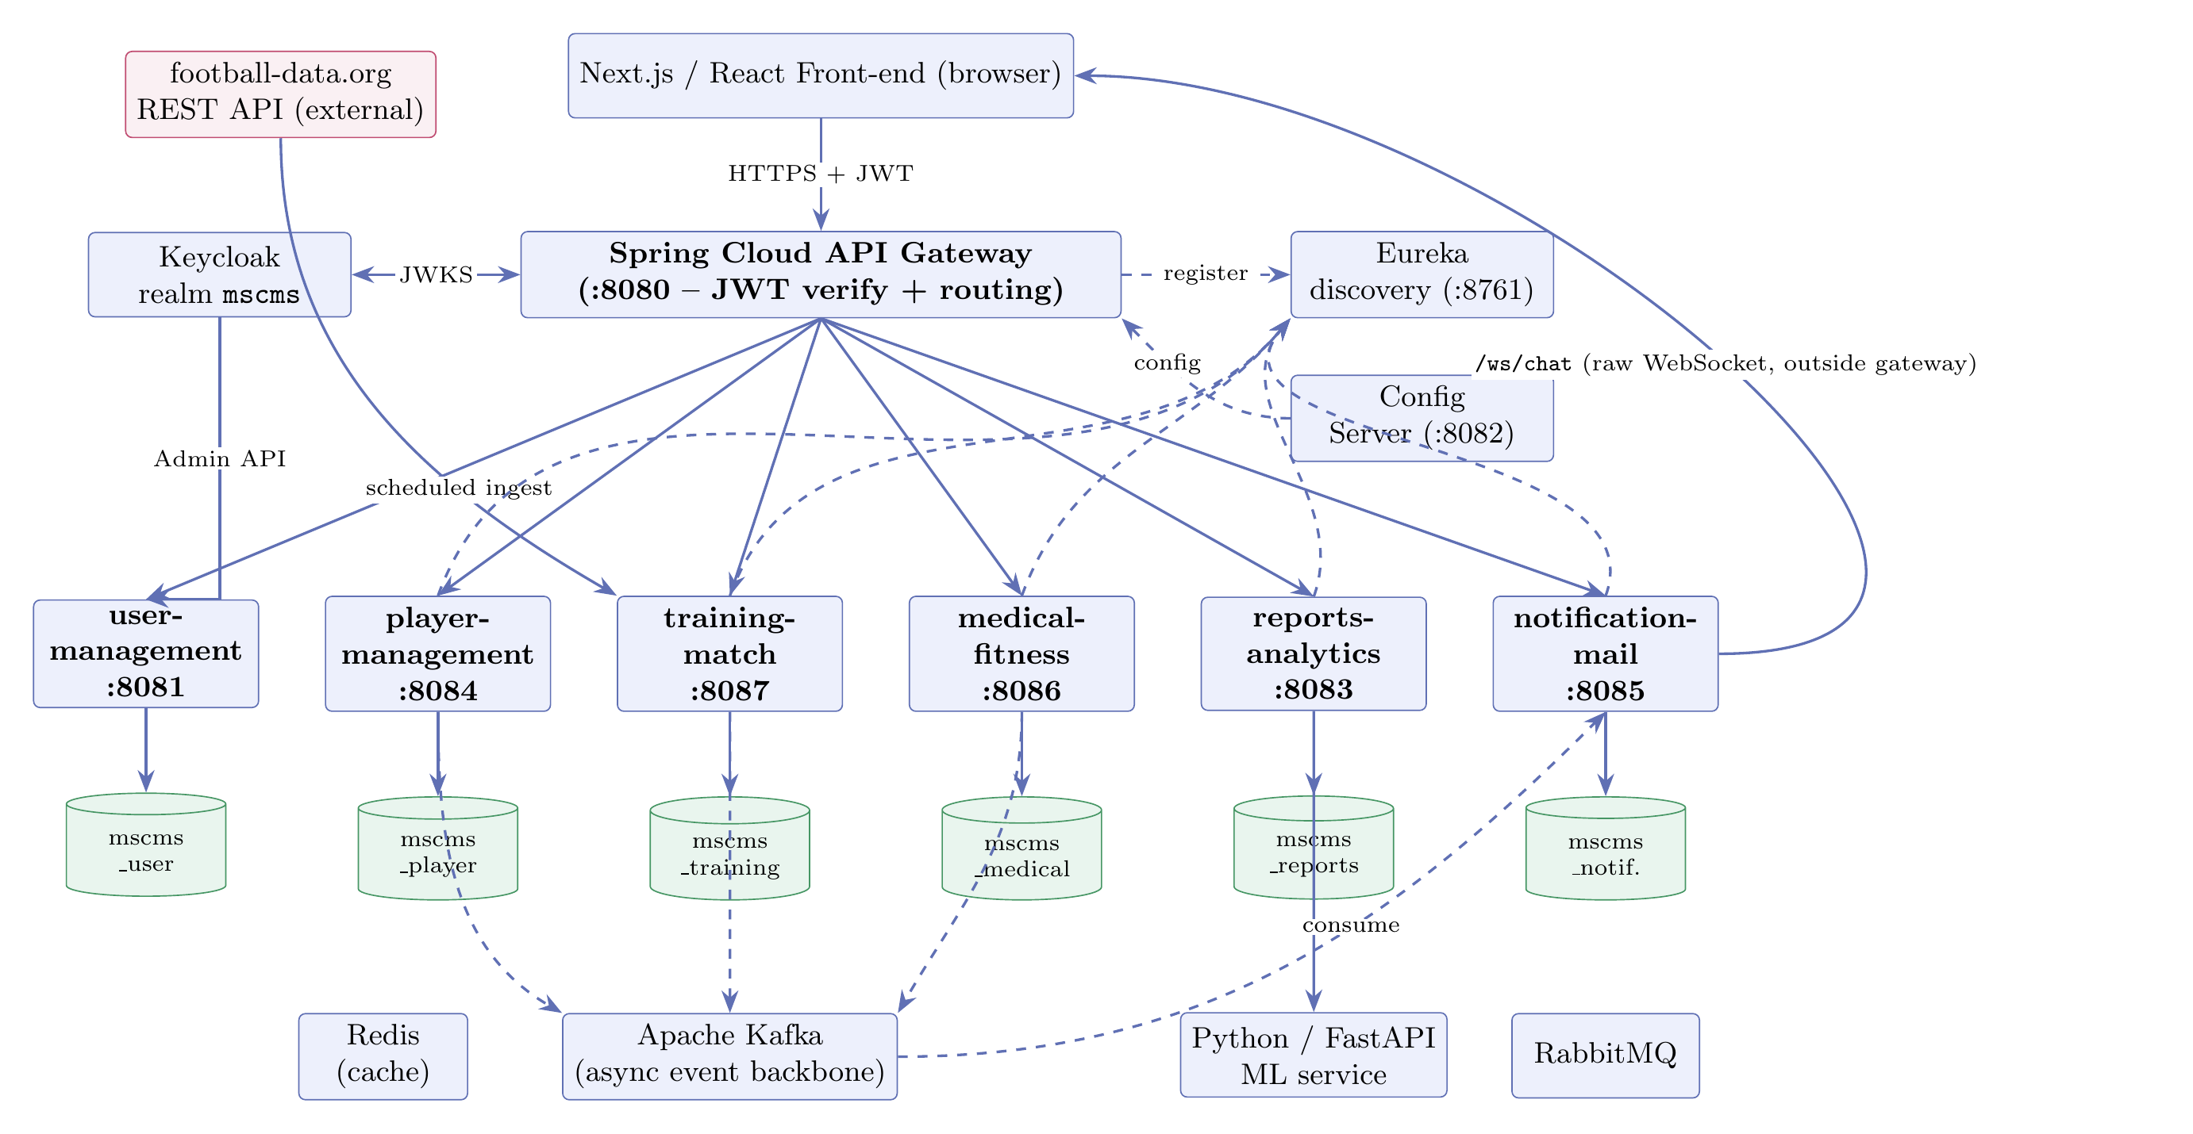
🗺️ Architecture at a Glance
One gateway, six domain services, an event backbone and an ML engine
Sportify · MSCMS
10

Slide 11
🧱 Enterprise-Grade Tech Stack
Proven, production-grade technology at every layer
☕
⚛️
🐳
Back-End
Front-End
Infrastructure
Java 21 / Spring Boot 3.5
Spring Cloud Gateway + Eureka
PostgreSQL 14 (DB per service)
Next.js 16 (App Router)
React 19 & Tailwind v4
WebSockets for real-time
Keycloak 26 (Identity / JWT)
Apache Kafka (Eventing)
Docker · Python/FastAPI ML
Sportify · MSCMS
11

Slide 12
⭐
Key Features
Each capability, one at a time — with a real screen of it in action.
Sportify · MSCMS
12

Slide 13
🛡️ Role-Aware Dashboards
One adaptive surface per role — from administrator to fan.
🎛️
Adaptive surface — Every menu, page and action is tailored to the signed-in role.
🔐
Enforced twice — A shared permissions map gates the sidebar and the server-side route guard.
👥
Fourteen roles — From administrator to fan, each account sees only what it should.
Sportify · MSCMS
13

Slide 14
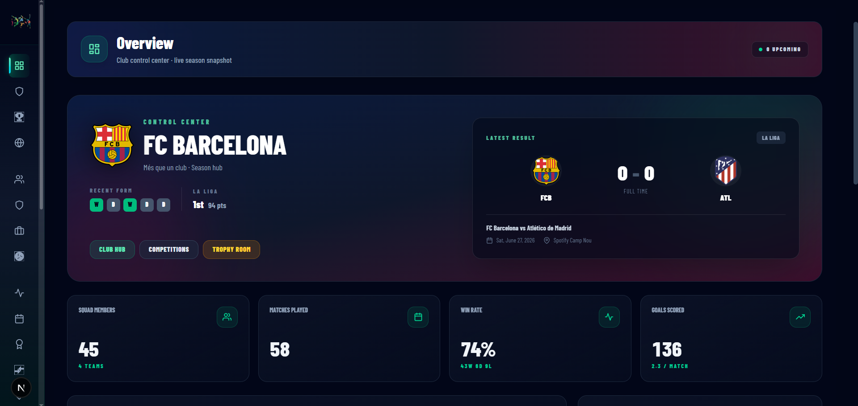
📷 Role-Aware Dashboards
fig-dashboard.png
Sportify · MSCMS
14

Slide 15
🏟️ Multi-Sport & Multi-Team
Sports, teams, rosters, contracts and transfers in one place.
⚽
Many sports — Football, basketball, handball, swimming and more, all in one system.
🧑‍🤝‍🧑
First & reserve squads — Each sport runs a senior team plus a reserve / academy team.
📇
Full squad data — Players, staff, contracts and transfers managed per team.
Sportify · MSCMS
15

Slide 16
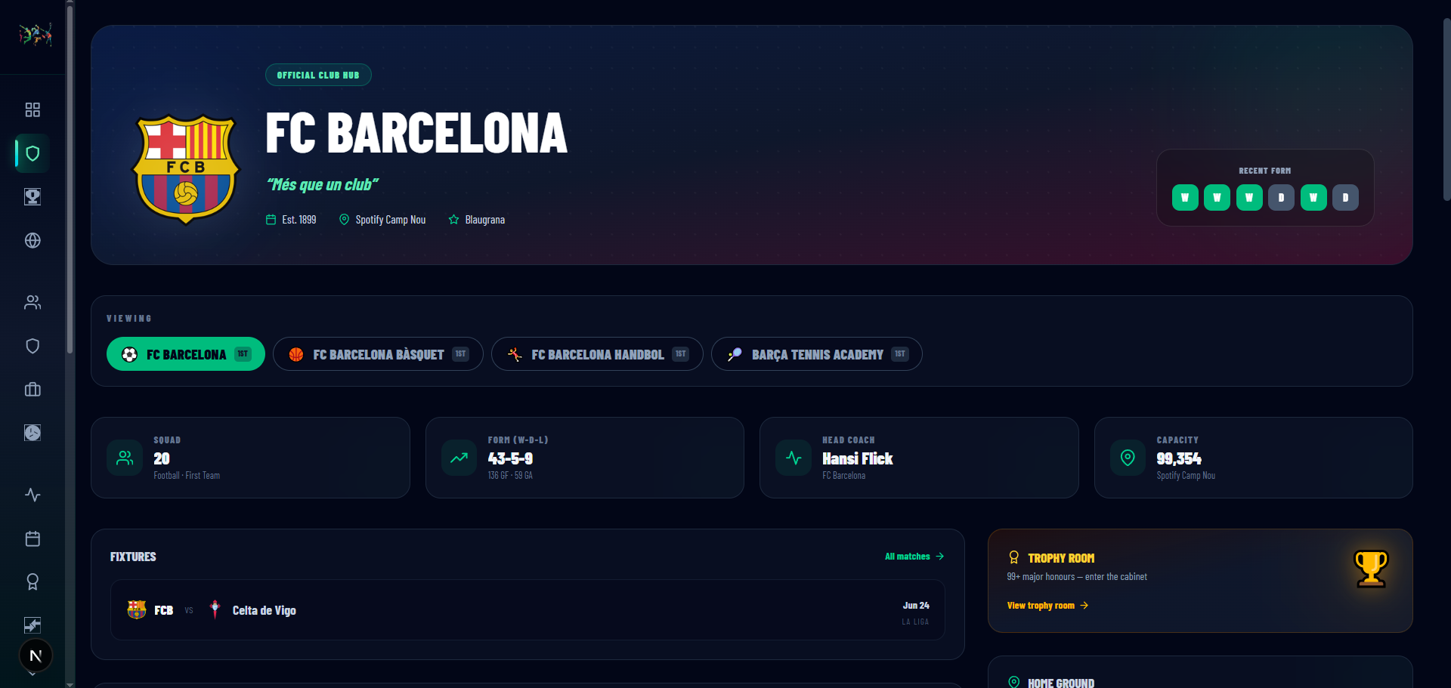
📷 Multi-Sport & Multi-Team
fig-club-hub.png
Sportify · MSCMS
16

Slide 17
🏆 Real Competitions
Live La Liga and the new-format UEFA Champions League.
🇪🇸
La Liga Live — Shows live La Liga standings and fixtures, with results that update automatically as matches are played.
⭐
New-Format Champions League — Renders the redesigned UCL as one 36-team league-phase table with qualification zones, then unlocks the knockout bracket.
🌎
World Cup 2026 — Presents the 48-team World Cup across 12 group tables and a knockout bracket, seeding the qualified teams into the Round of 32 when the draw is TBD.
⚔️
Head-to-Head — Builds FC Barcelona's all-time win-draw-loss record, goals and win-rate against every opponent from finished matches.
Sportify · MSCMS
17

Slide 18
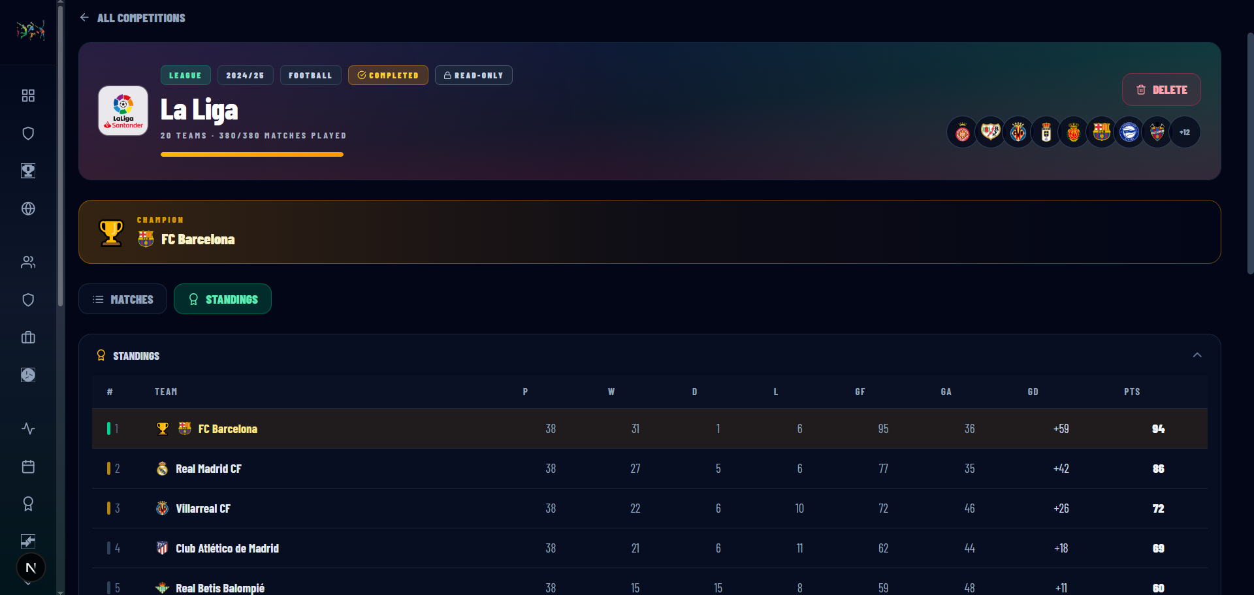
📷 Real Competitions
fig-laliga.png
Sportify · MSCMS
18

Slide 19
⚽ Live-Match Engine
A broadcast-style match-day cockpit, run minute by minute.
⏱️
Phase State Machine — Walks every match through scheduled → first half → half time → second half → full time, auto-going-live at kickoff.
📋
Phase-Bound Events — Records goals, cards, subs and injuries against a live clock, clamping each event's minute to the phase in play.
🥅
Knockout Decider — Triggers two extra-time periods and an alternating penalty shoot-out only when a true knockout tie is still level.
💾
Live Persistence — Streams every score change, event and status flip to the training-match service so the timeline survives a reload.
Sportify · MSCMS
19

Slide 20
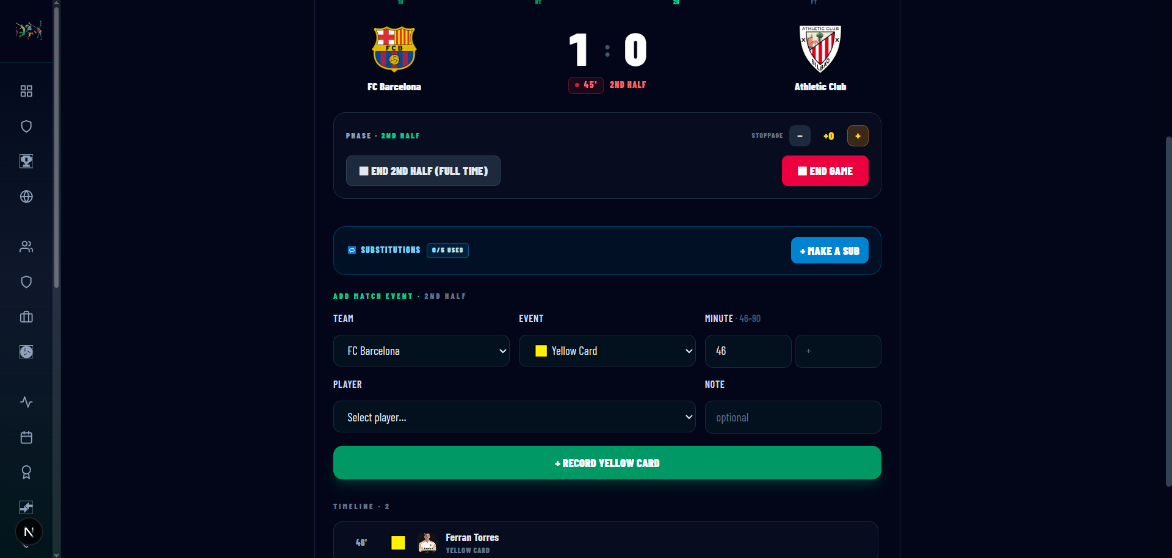
📷 Live-Match Engine
fig-live-match.png
Sportify · MSCMS
20

Slide 21
🩺 Advanced Injury Management
A medically-governed return-to-play pipeline.
🔁
Staged Injury Lifecycle — Drives every injury through REPORTED → DIAGNOSED → TREATING → RECOVERING → RECOVERED as the status that gates each next action.
🎯
Single Source of Truth — Makes the medical service the one authority on availability, so card, stepper and squad all read the same status.
🚫
Auto-Removal When Injured — Pulls an injured player out of match line-ups, training and attendance the moment the injury is logged, and notifies the team.
🏃
Mandatory Fitness Test — Requires a passing return-to-play fitness test before the player flips to RECOVERED and is restored as AVAILABLE.
Sportify · MSCMS
21

Slide 22
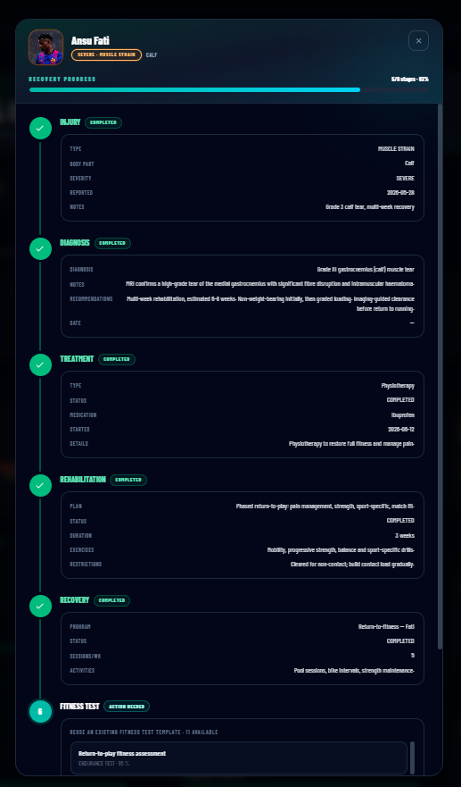
📷 Advanced Injury Management
new-medical-lifecycle.PNG
Sportify · MSCMS
22

Slide 23
🏃 Plan-Driven Training
From season plan to scored session, one squad at a time.
📝
Training Plans — Anchors one plan to a single team and sport, with a start-to-end date range, training type, goals and focus that every session inherits.
📅
Scheduled Sessions — Places each session at its own date and time inside the plan's range, then lists them in chronological order with a done count.
🎯
Ordered Drills — Stamps each drill with a category, duration and sequence, and rejects the session if the drills' total minutes reach the session length.
✅
Squad Attendance — Records a per-player status and offers only non-injured players who belong to that plan's team for call-up.
Sportify · MSCMS
23

Slide 24
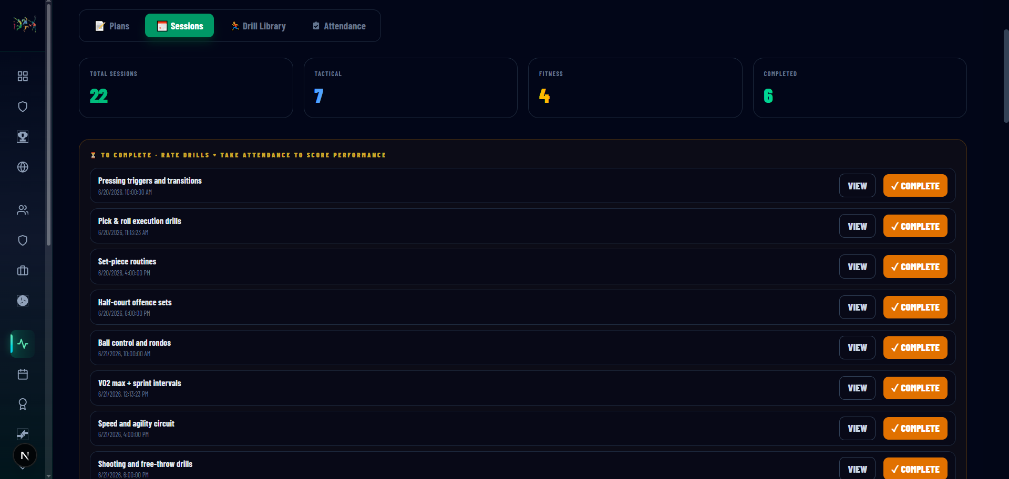
📷 Plan-Driven Training
fig-training.png
Sportify · MSCMS
24

Slide 25
🔍 Scouting & Sponsorship
Scout reports on prospects and sponsor-offer negotiation.
📝
Sign-or-pass reports — Scouts log structured reports on external prospects.
🤝
Sponsor negotiation — Offers move through pending, stale and accepted states.
🔗
Tied to fixtures — Reports attach to the players and matches they were scouted at.
Sportify · MSCMS
25

Slide 26
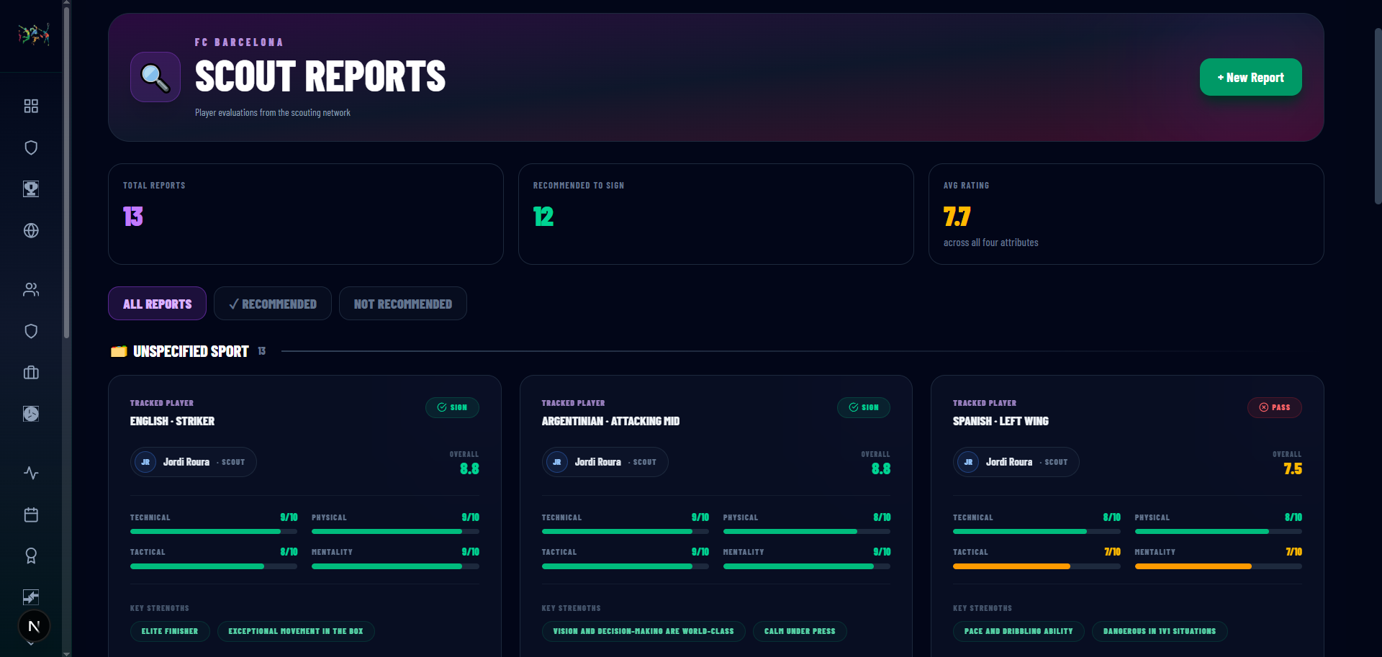
📷 Scouting & Sponsorship
fig-scouting.png
Sportify · MSCMS
26

Slide 27
💬 Real-Time Messaging
Club-wide group chat over a live socket.
⚡
Live WebSocket — Messages, reactions, replies and read receipts in real time.
🔁
Polling fallback — Falls back to polling when the socket is unavailable.
👥
Team-scoped — Staff and players only — fans stay on the spectator surface.
Sportify · MSCMS
27

Slide 28
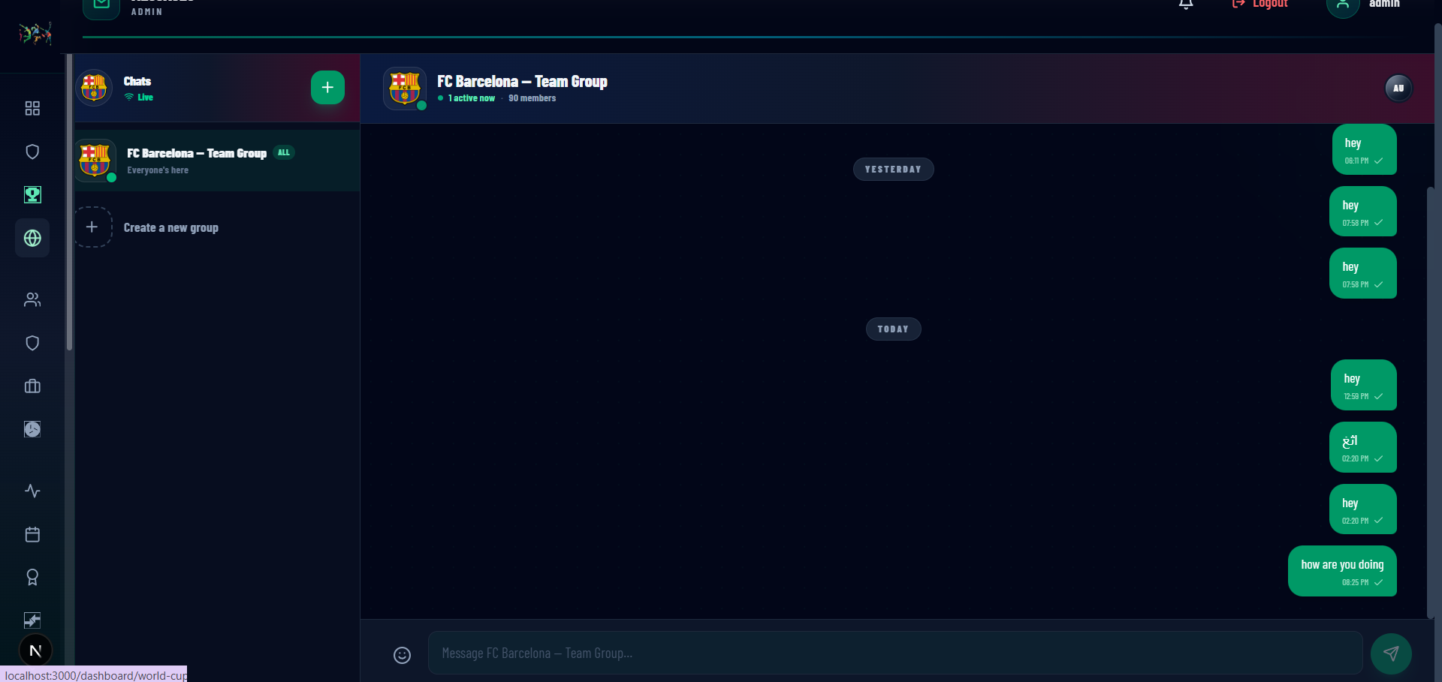
📷 Real-Time Messaging
fig-messages.png
Sportify · MSCMS
28

Slide 29
🤖 Analytics & ML Predictions
Match-outcome and player-rating predictions on real data.
📊
KPI dashboards — Aggregates team, player and training KPIs.
🔮
Match predictor — A Python/FastAPI service forecasts match outcomes.
⭐
Player ratings — ML 0–100 ratings inform selection and scouting.
Sportify · MSCMS
29

Slide 30
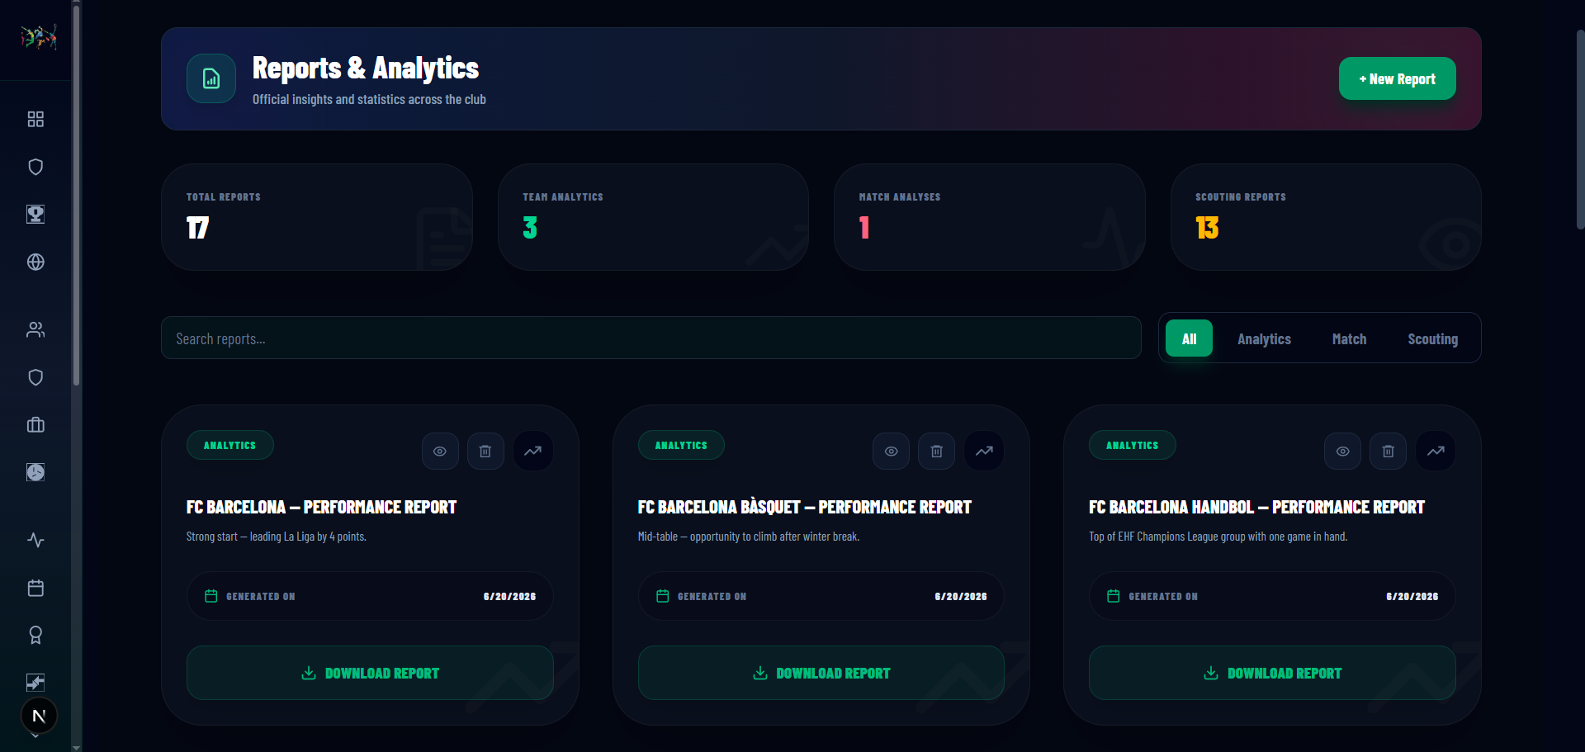
📷 Analytics & ML Predictions
fig-reports.png
Sportify · MSCMS
30

Slide 31
🔔 Live Notifications
The whole club, kept in the loop in real time.
🔔
Top-bar bell — Injuries, goals, transfers and report-ready events surface instantly.
📨
Event-driven — Kafka events fan out to the notification service.
🗂️
Alerts center — A full history of everything that happened.
Sportify · MSCMS
31

Slide 32
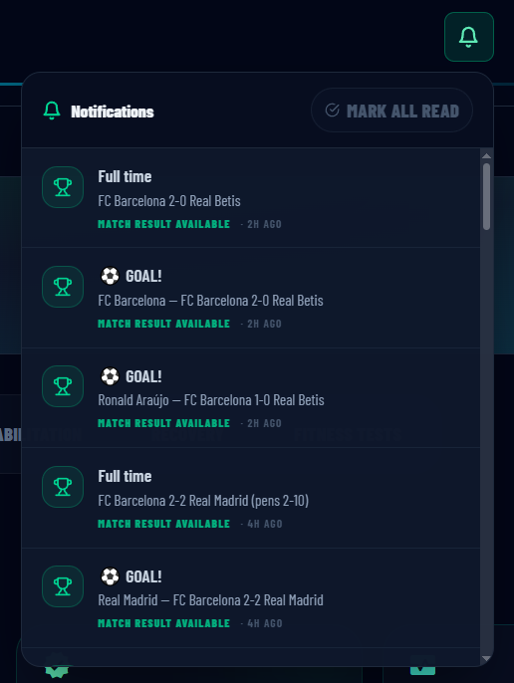
📷 Live Notifications
fig-notifications.png
Sportify · MSCMS
32

Slide 33
👁️
Role Views
The same platform, a different surface for every login.
Sportify · MSCMS
33

Slide 34
👑 Administrator — what they see
📷
Screenshot placeholder — drop shot-view-admin.png into documentation/screenshots/
Full access — every section, plus User Management.
shot-view-admin.png
Sportify · MSCMS
34

Slide 35
🏢 Sport Manager — what they see
📷
Screenshot placeholder — drop shot-view-sportmanager.png into documentation/screenshots/
Squad, staff, matches, scouting, contracts and sponsors.
shot-view-sportmanager.png
Sportify · MSCMS
35

Slide 36
🎯 Head Coach — what they see
📷
Screenshot placeholder — drop shot-view-headcoach.png into documentation/screenshots/
Training, line-ups, matches, medical and analytics.
shot-view-headcoach.png
Sportify · MSCMS
36

Slide 37
🩺 Team Doctor — what they see
📷
Screenshot placeholder — drop shot-view-doctor.png into documentation/screenshots/
The medical module, players and training availability.
shot-view-doctor.png
Sportify · MSCMS
37

Slide 38
🔍 Scout — what they see
📷
Screenshot placeholder — drop shot-view-scout.png into documentation/screenshots/
Scouting, prospects, matches and head-to-head.
shot-view-scout.png
Sportify · MSCMS
38

Slide 39
👤 Player — what they see
📷
Screenshot placeholder — drop shot-view-player.png into documentation/screenshots/
A read-only view of club, matches, training and own medical.
shot-view-player.png
Sportify · MSCMS
39

Slide 40
🎟️ Fan — what they see
📷
Screenshot placeholder — drop shot-view-fan.png into documentation/screenshots/
Spectator-only — club hub, trophies, competitions and matches.
shot-view-fan.png
Sportify · MSCMS
40

Slide 41

▶
🎬 LIVE DEMO
See Sportify in Action
A short walkthrough — login, the role dashboard, a live match, the medical room and team messaging.
Insert → Video here, or run the live app
Sportify · MSCMS
41

Slide 42
🚀 Future Work
Where Sportify goes next: mobile, ML and the wider sporting world
📱
Native Mobile Apps
🧠
Deeper ML Models
🏅
More Sports & Federations
Ships dedicated iOS and Android apps with push notifications so staff and players manage the club on the move.
Extends the Python ML service with richer predictions fed by live in-match features, not just pre-game stats.
Expands the multi-sport engine with new disciplines and official federation data feeds beyond football-data.org.
⌚
Wearables & Biometrics
🎥
Live Video & Streaming
Integrates wearables to stream training-load and biometric data straight into player medical and fitness profiles.
Attaches live video and clip streaming to the match timeline so every key event links to its footage.
Sportify · MSCMS
42

Slide 43
✅ Conclusion
Sportify turns a club's scattered, manual operations into one secure, real-time, data-driven platform.
🧱
A production-grade microservices architecture, deployed with Docker.
⚽
Real competitions, a live-match engine and a complete medical workflow.
🔐
Role-based security end to end, with analytics and ML predictions on top.
🚀
An extensible foundation ready for mobile, more sports and richer models.
Sportify · MSCMS
43

Slide 44
👥 Team Members
Supervised by Dr. Shaimaa Saber
👤
👤
👤
Mariam Mohamed Ahmed
Mohamed Abdellatief
Eman Ahmed Elboghdady
👤
👤
👤
Khaled Mohamed
Shahd Abdelaziz
Mohamed Salem
Menoufia University · Faculty of Computers and Information · Graduation Project 2025 – 2026
Sportify · MSCMS
44

Slide 45
🙌
Thanks for your attention!
Questions & discussion welcome
Sportify · MSCMS — a cloud-native multi-sport club management platform

