Slide 1
Video Subtitles Detector
Team Members
Mostafa Mohammed Nabil 20200548
Osama Ibrahim Marzouk 20200069
Joeshowa George 20200131
Sameh Raouf Helmy 20200218

Slide 2
Outline
Introduction
Methodology
- Reading and Processing Video
- Preprocessing and Noise Removal
- Segmentation
- Bounding Box Calculation
- Results
Conclusion

Slide 3
Introduction
Objective: Detect and visualize subtitles and individual words in a video.
Approach: Utilize traditional image processing techniques.
Tools: OpenCV, Python

Slide 4
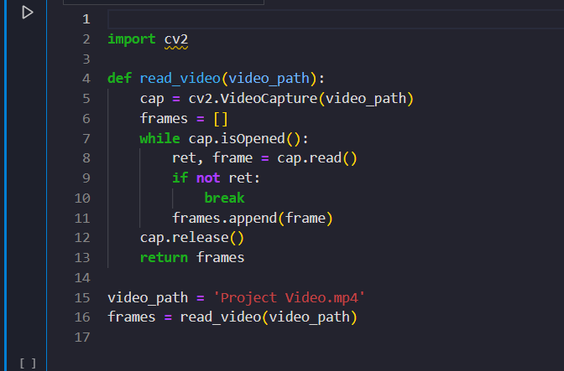
Reading and Processing Video
Used OpenCV to read the video and extract frames.
Code snippet:

Slide 5
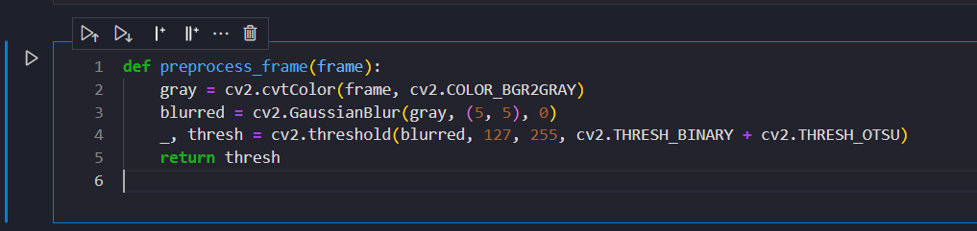
Preprocessing and Noise Removal
Steps: Convert to grayscale, apply Gaussian blur, and thresholding.
Code snippet:

Slide 6
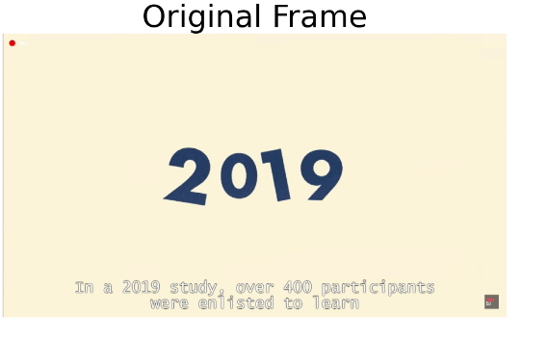
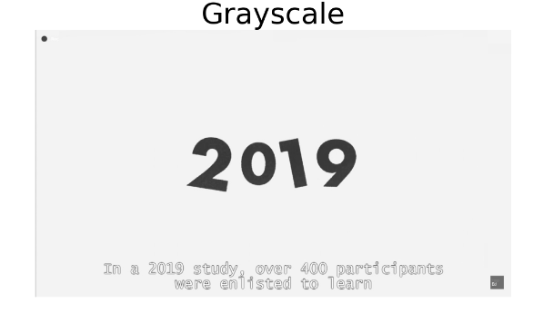
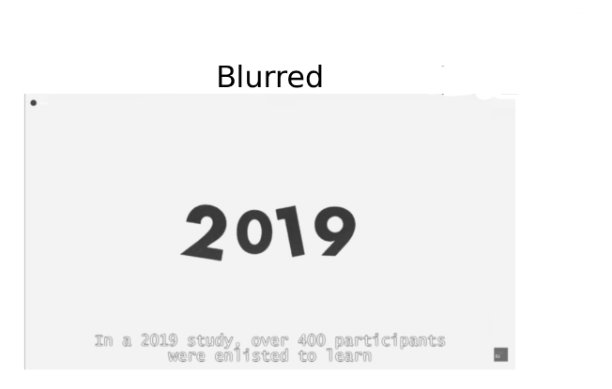
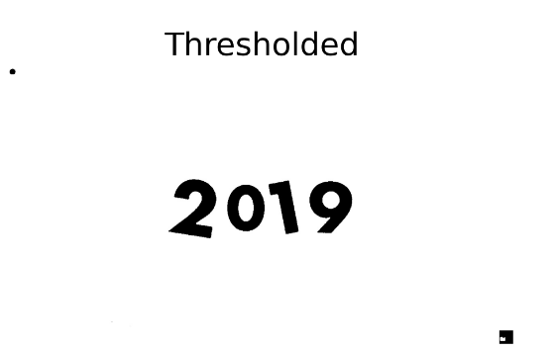
Preprocessing and Noise Removal

Slide 7
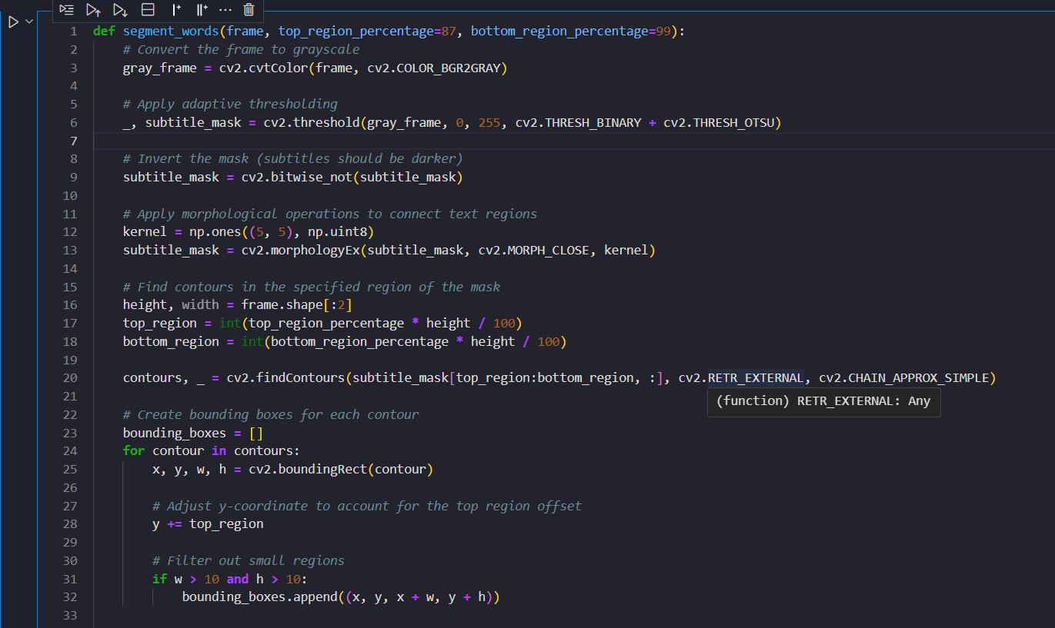
Segmentation
Detected subtitle regions using contours and morphological operations.
Code snippet:

Slide 8
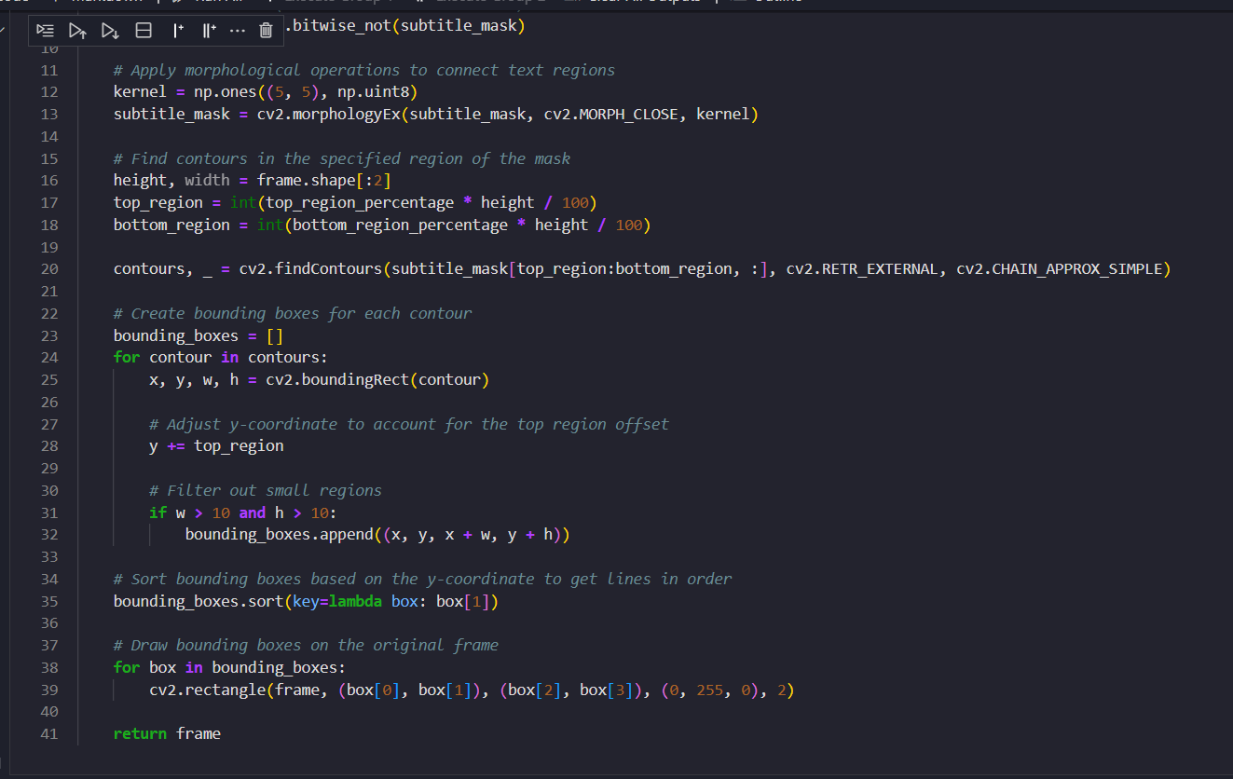
Segmentation

Slide 9
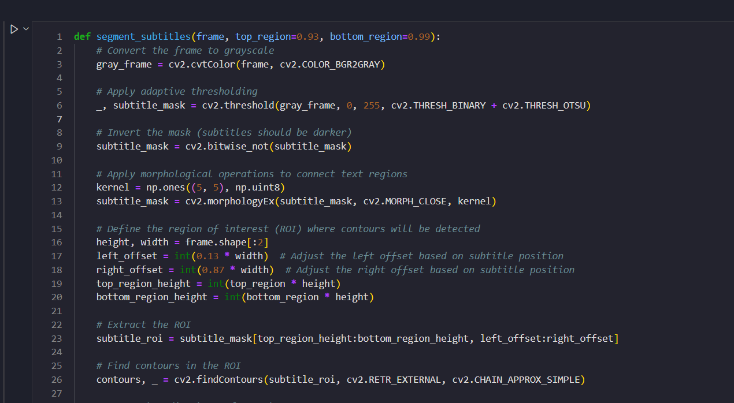
Segmentation

Slide 10
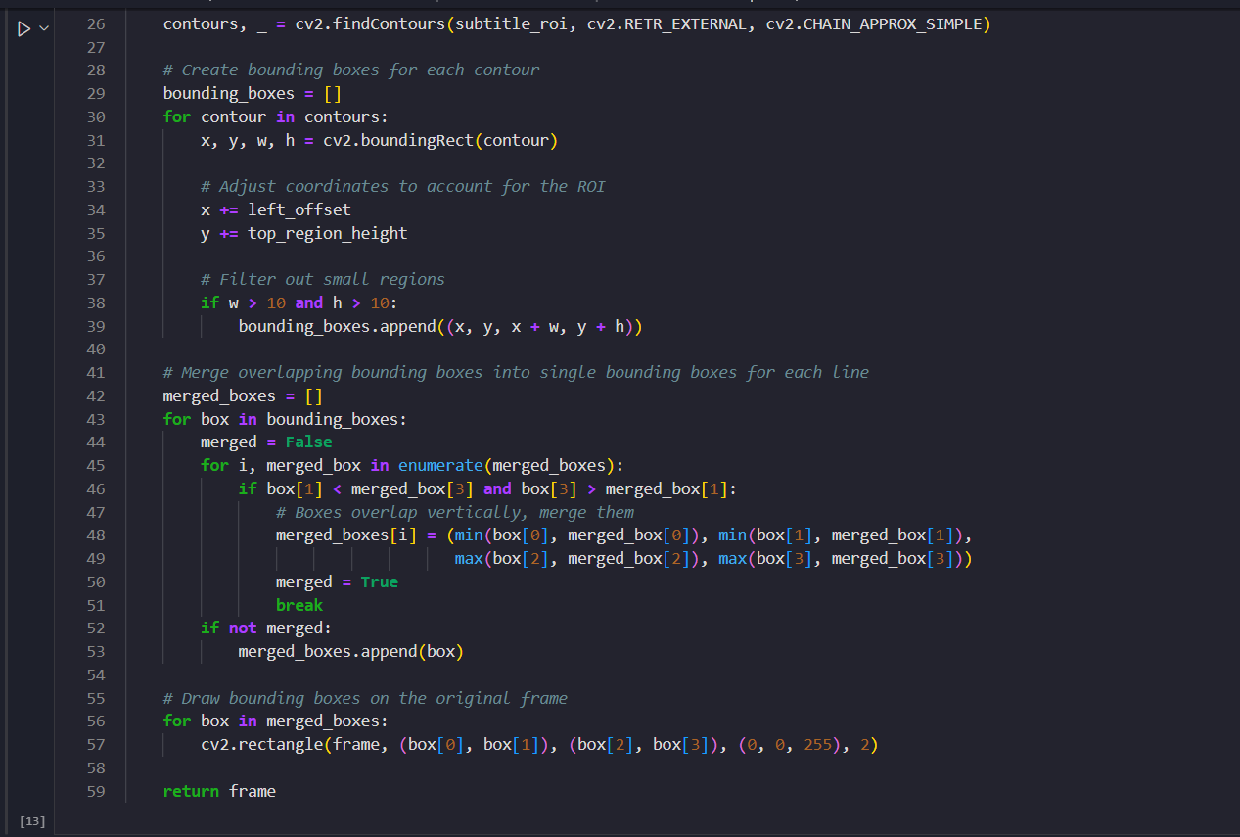
Segmentation

Slide 11
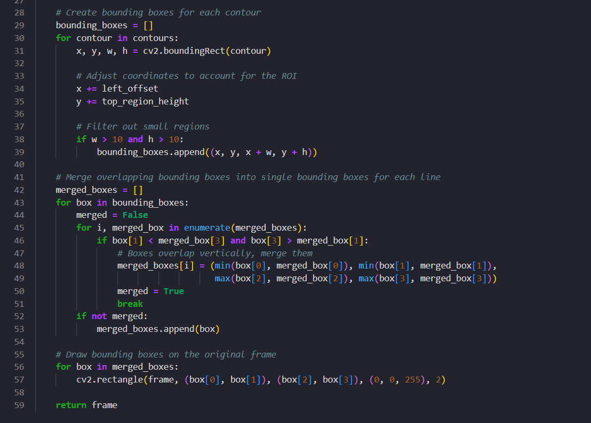
Bounding Box Calculation
Detected subtitle regions using contours and morphological operations.
Code snippet:

Slide 12
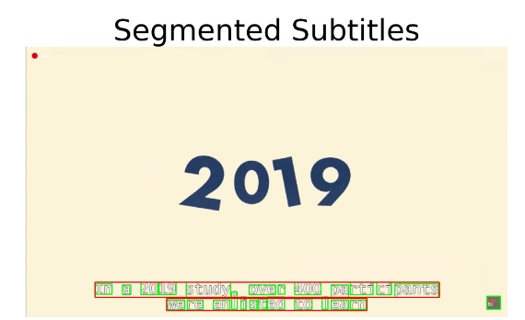
Results
Screenshots of frame with bounding boxes around subtitles and words.

Slide 13
Conclusion
Successfully detected and visualized subtitles and words.
Used traditional image processing techniques.
Future improvements: Enhance OCR accuracy, handle various subtitle styles.

Slide 14
Thank You

