Slide 1

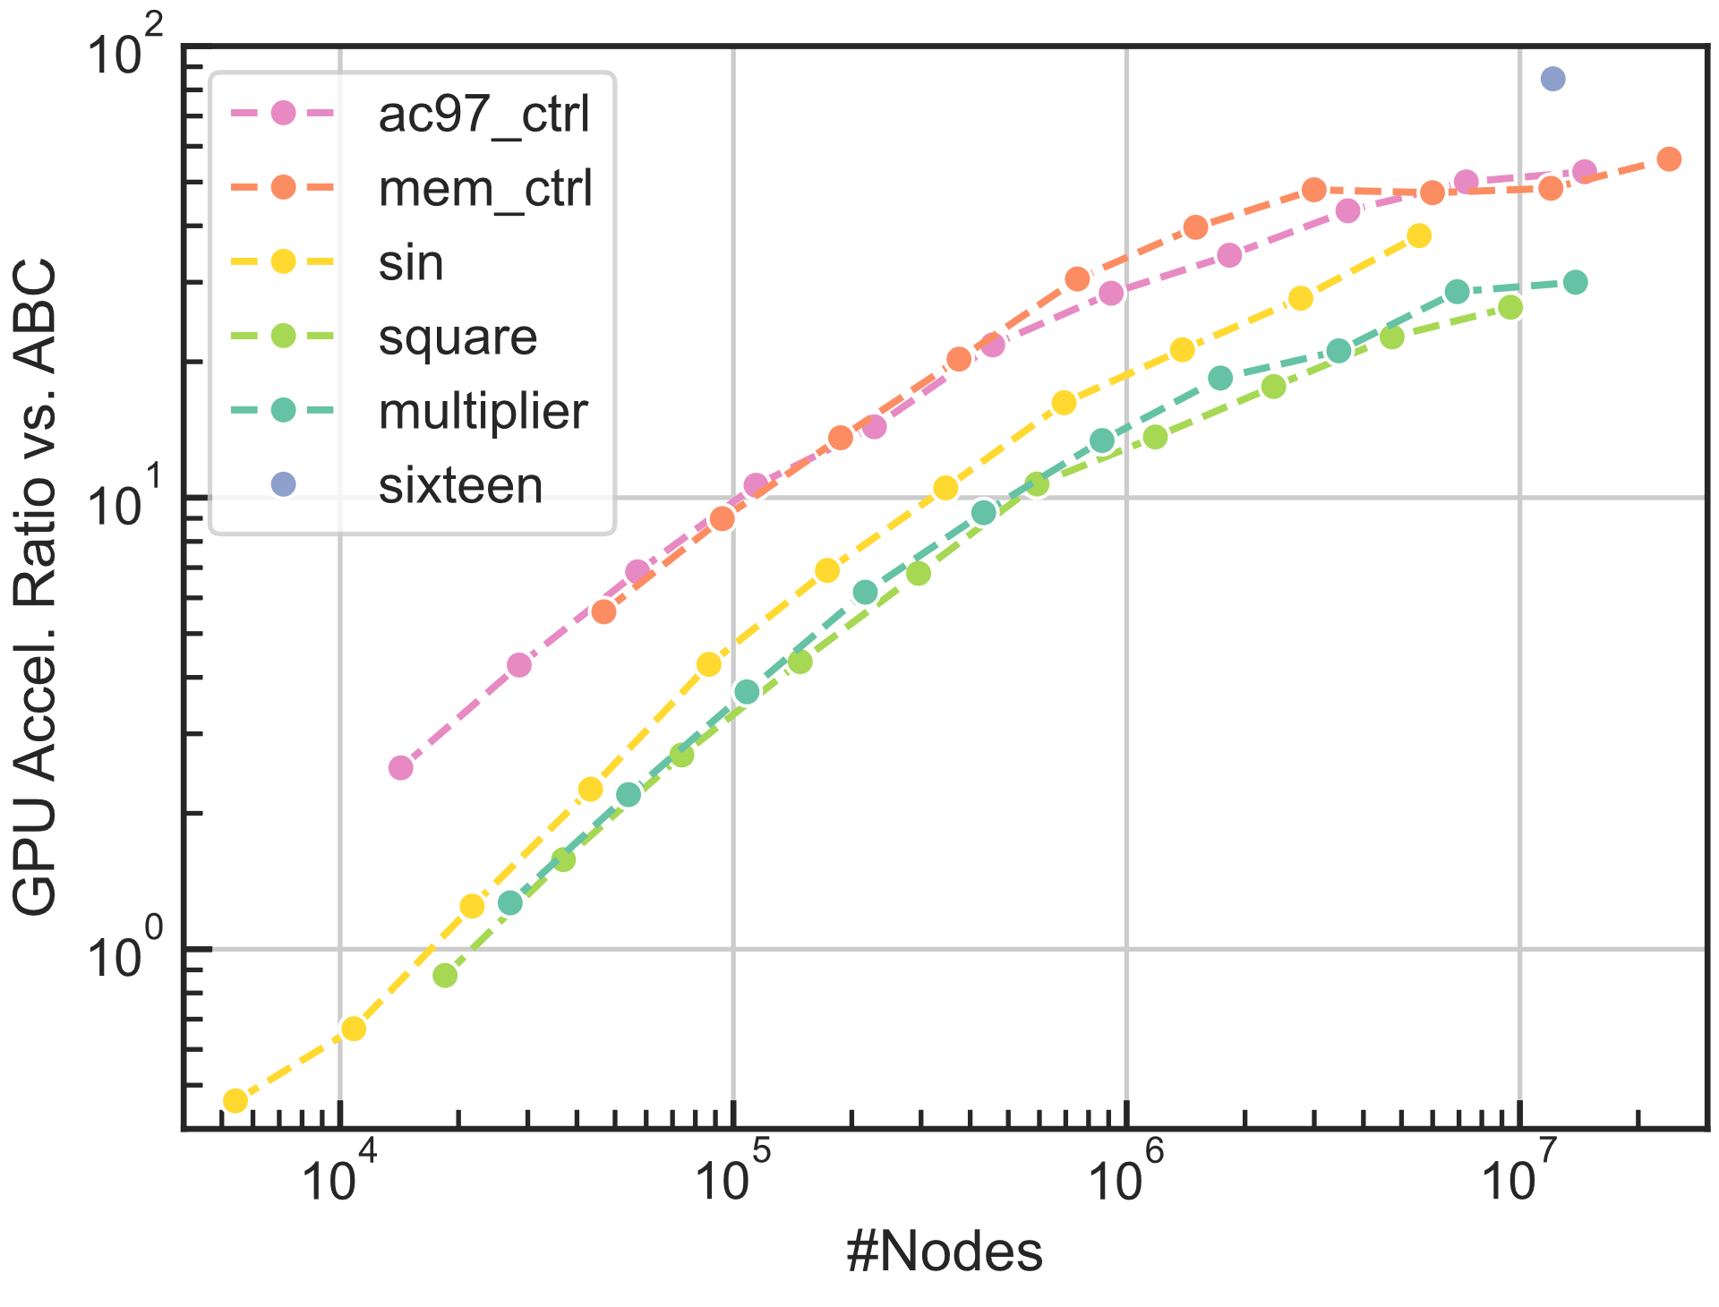

Rethinking AIG Resynthesis
in Parallel
Tianji Liu and Evangeline F.Y. Young
The Chinese University of Hong Kong
Introduction
Parallel Refactoring (cont’d)
AIG resynthesis applies different algorithms repeatedly
A commonly used script resyn2 consists of
rewrite (rw), refactor (rf), (AND-)balance (b)
Previous work of GPU-accelerated rewrite [1]
This work proposes parallel AIG refactor and balance for fully accelerating resyn2
Stage 2: resynthesize all local functions in parallel
Stage 3: replace cones in parallel
Background
AIG refactoring
Resynthesis large cones by algebraic factoring
AIG balancing
Reorder the inputs of AND gates to reduce delay
Parallel Balancing
Stage 1: identify n-input AND gates
Level-wise parallel from POs to PIs
Stage 2: reconstruct n-input AND gates
Level-wise parallel from PIs to POs
Results
Comparison with ABC
rf_resyn: b; rf; rf -z; b; rf -z; b
Similar or slightly better QoR
Speedup with different AIG sizes
Parallel Refactoring
Stage 1: identify (M)FFCs covering the AIG
(M)FFC: a logic cone whose nodes are dedicated to driving the root
Level-wise parallel from POs to PIs
Theoretical result
The identified (M)FFCs in stage 1 are disjoint
Summary
14.8x (balance), 42.7x (refactor), 45.9x (resyn2) acceleration over ABC with comparable QoR
References
[1] S. Lin et al., "NovelRewrite: node-level parallel AIG rewriting," DAC 2022.

