Slide 2
Automotive Mechatronics Laboratory
Topic:
Control PMSM Loaded with Dual Motor (Dyno) Using C2000 Processors
Presenter : - TaiND
2025-02-06
aml.edu.vn

Slide 3
Agenda

Slide 4
Introduction

Slide 5
Introduction
Use field-oriented control (FOC) to control two three-phase permanent magnet synchronous motors (PMSM) coupled in a dyno setup
Motor 1 runs in the closed-loop speed control mode.
Motor 2 runs in the torque control mode and loads Motor 1 because they are mechanically coupled.
Use to test a motor in different load conditions.
2 model options:
Single CPU control 2 PMSM: for both simulation and code generation.
Dual CPU: does not support simulation.

Slide 6
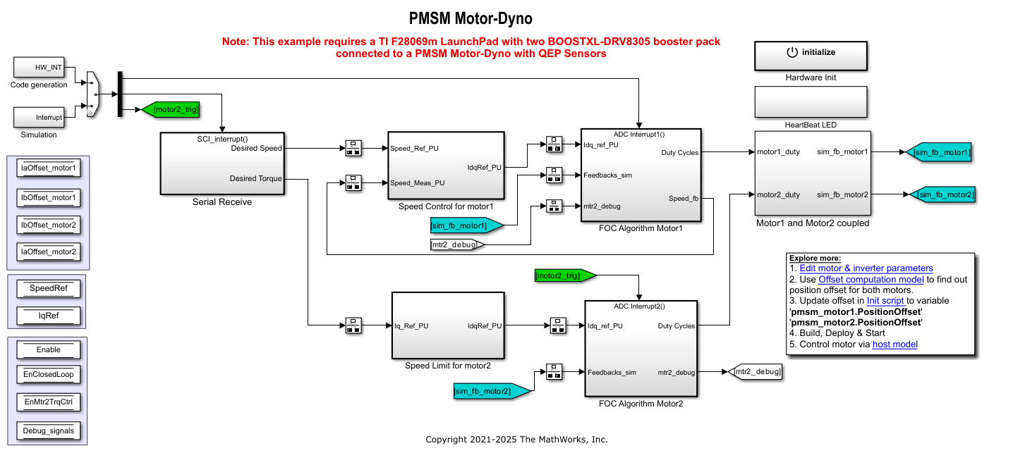
Introduction
Single CPU Dyno Models

Slide 7
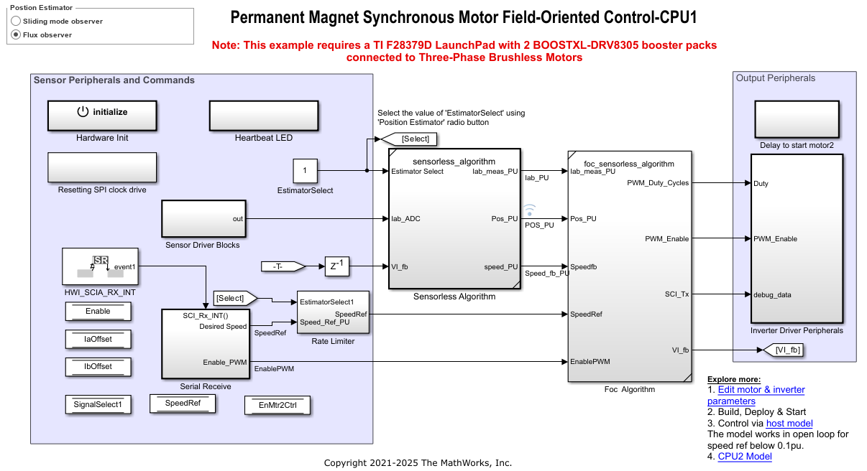
Introduction
Dual CPU Dyno Models: CPU1

Slide 8
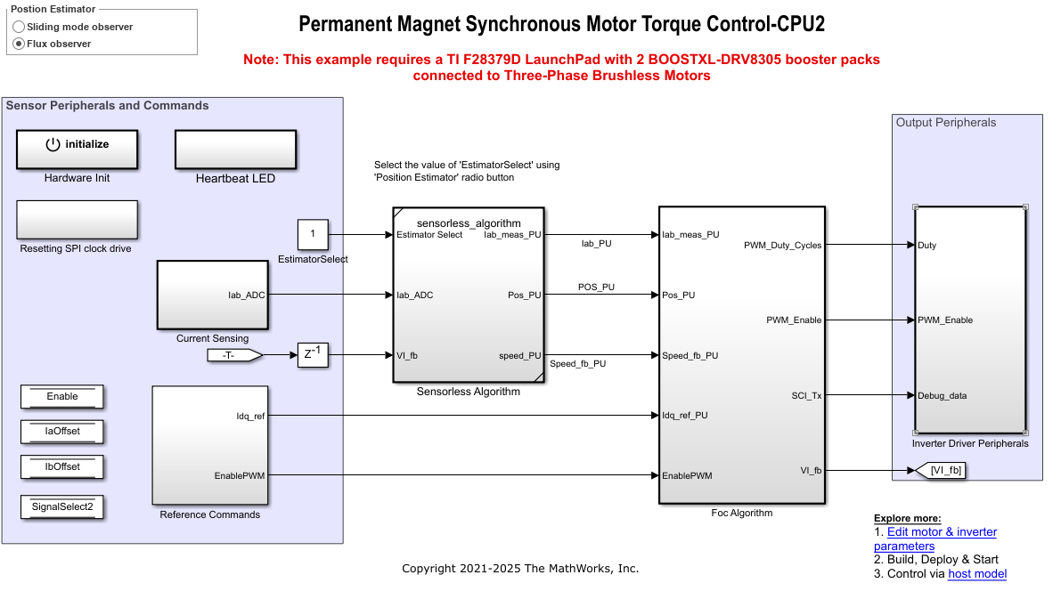
Introduction
Dual CPU Dyno Models: CPU2

Slide 9
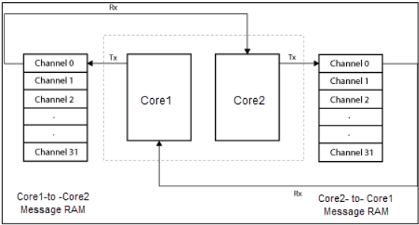
Introduction
Dual CPU Dyno Models: The CPU1 transmits the following data to CPU2 through IPC channels:
Torque reference
Signal select
Enable Motor2(EnMtr2Ctrl)
The CPU2 transmits the debug signal according to the signal select of CPU1.

Slide 10
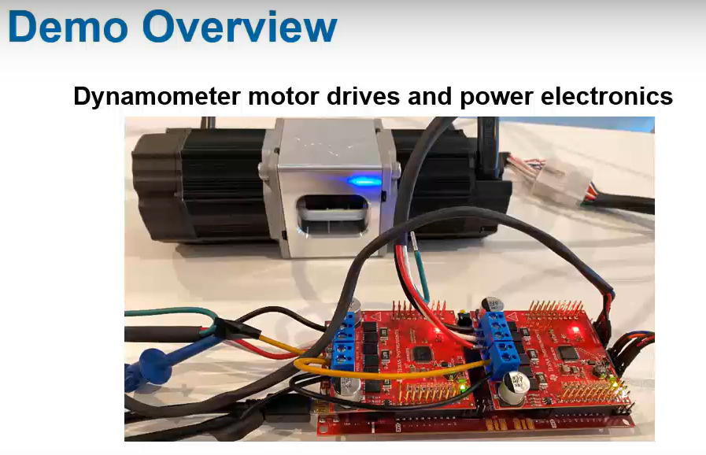
Demo overview
Souce: MATLAB, How to Simulate and Implement FOC Motor Controllers on TI C2000 Dual-Core Motor Control Units

