Slide 1
AOL Messenger
An Obviously Limited Messenger
By
Chandler, Nick, Julian, Kevin
Team AwesomeO

Slide 2
Sockets are Life
Sockets are the core of this project, without the sockets, this project would have been really hard.
Sockets create two-way communication between two programs.
Sockets are bounded by port numbers and ip address.

Slide 3
Bugs & bug spray
So the original idea was to use a ton of frames. However, this created thread locks and null pointers
The fix for that was to simply use dialog boxes
The User list was being stubborn and not updating. Then we realized a for loop was needed to go through the ArrayList. Duh
Panel would not take new color. So we just made a sub panel that would take the color.
Logging in and out. Actually kind of troubling. Fix was to create a new class that would handle exits

Slide 4
Team Issues
Due to our crazy schedules, team meetings were done mostly on-line through Google hangouts
Git. Caused us a lot more issues than we would have liked to experience

Slide 5
GUI/View
Interesting classes:
FileMenu
Sets up complex file menu which talks back to serverController/clientController
MessageFrame
called by main, implements controllers for server and client based on user input
DebugFrame
runs debugging information in separate console instead of Standard.out

Slide 6
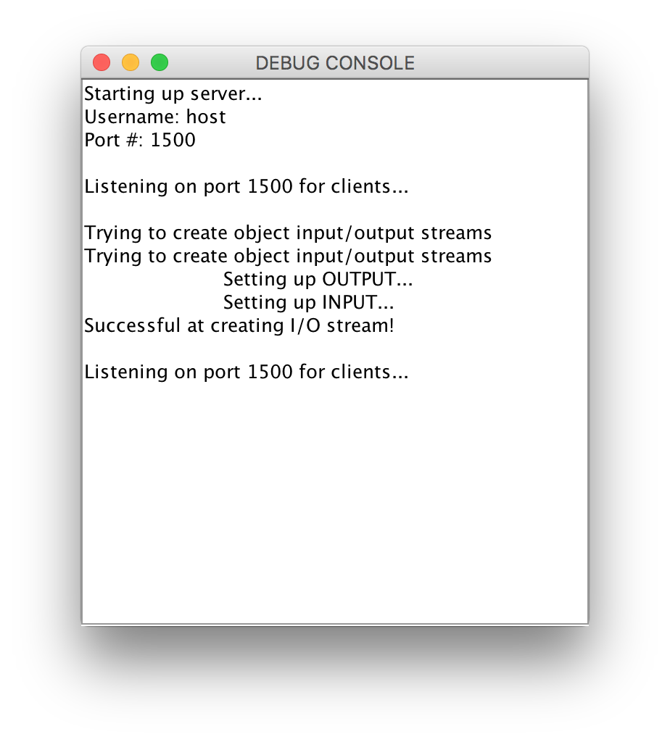
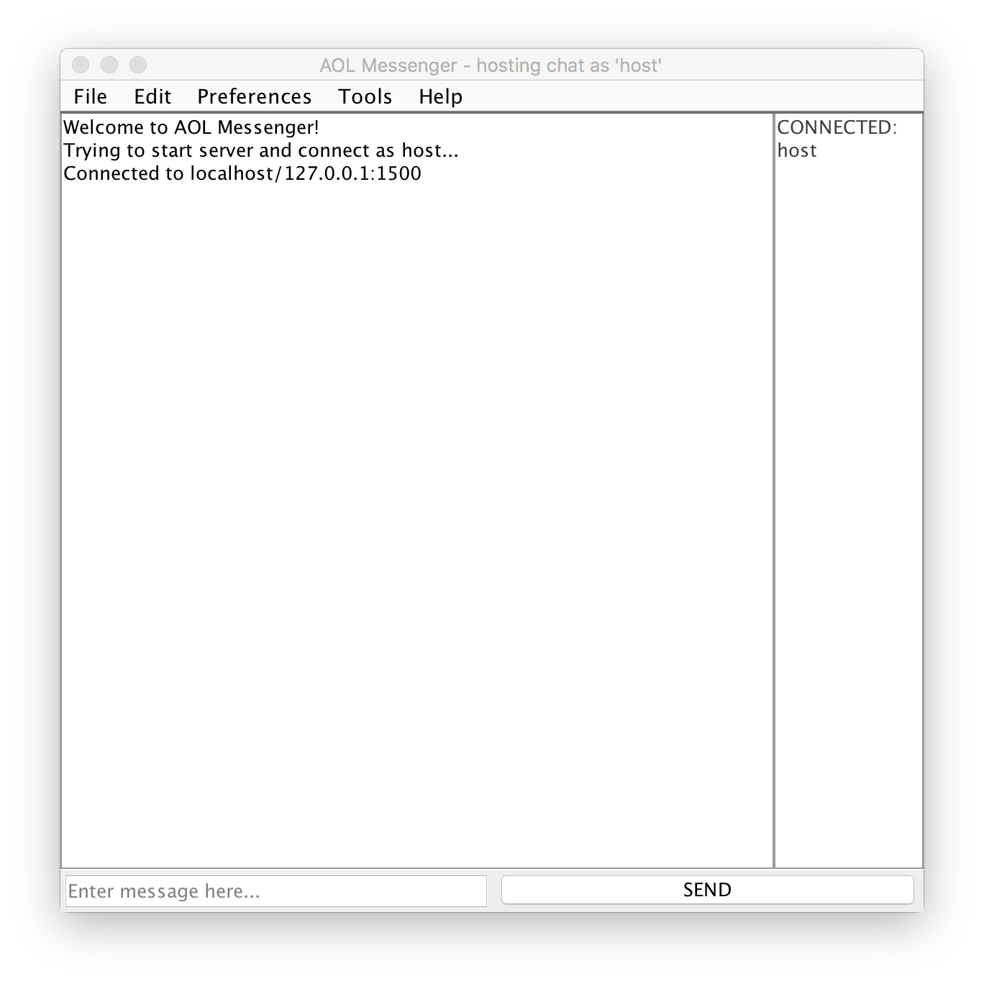
Debug console to trace server

Slide 7
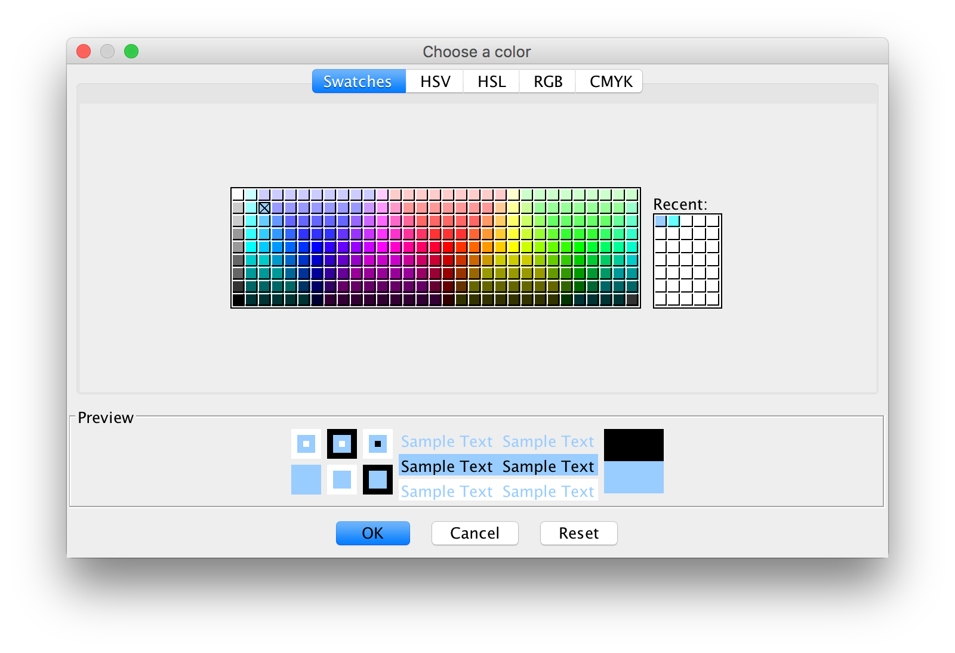
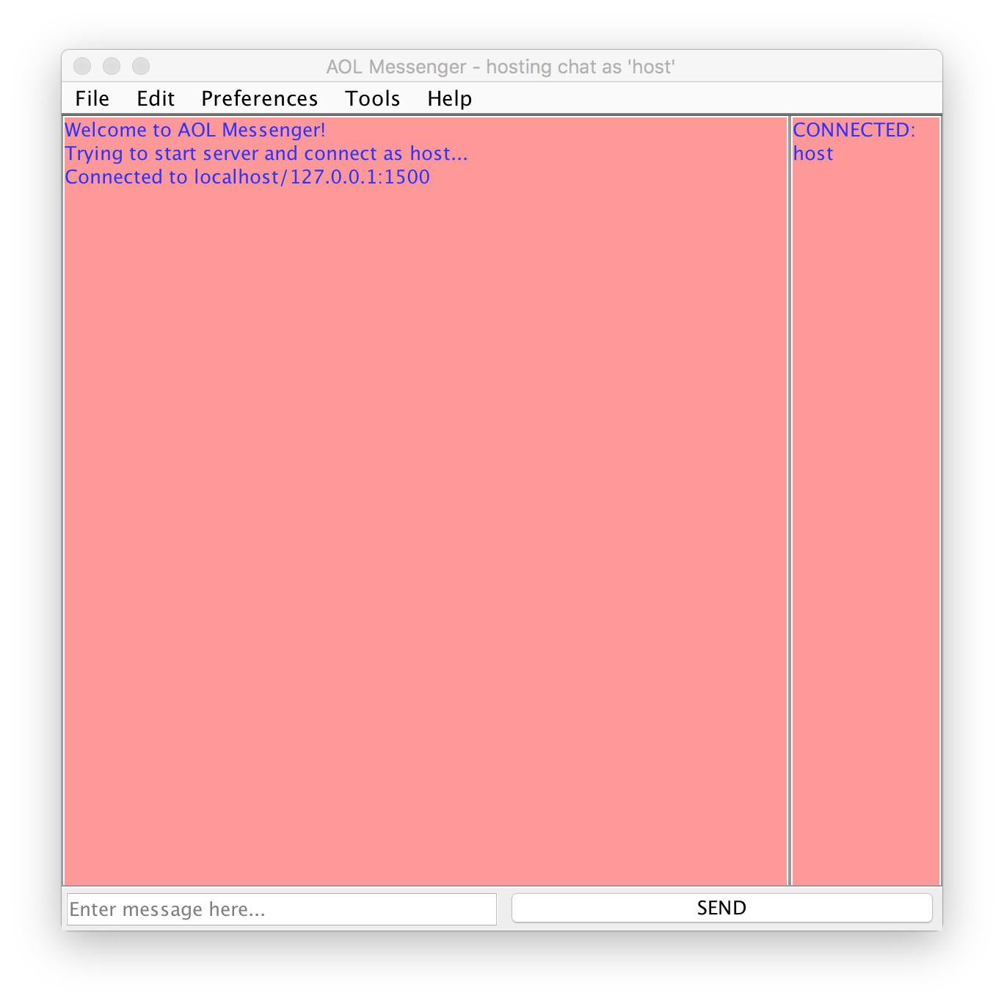
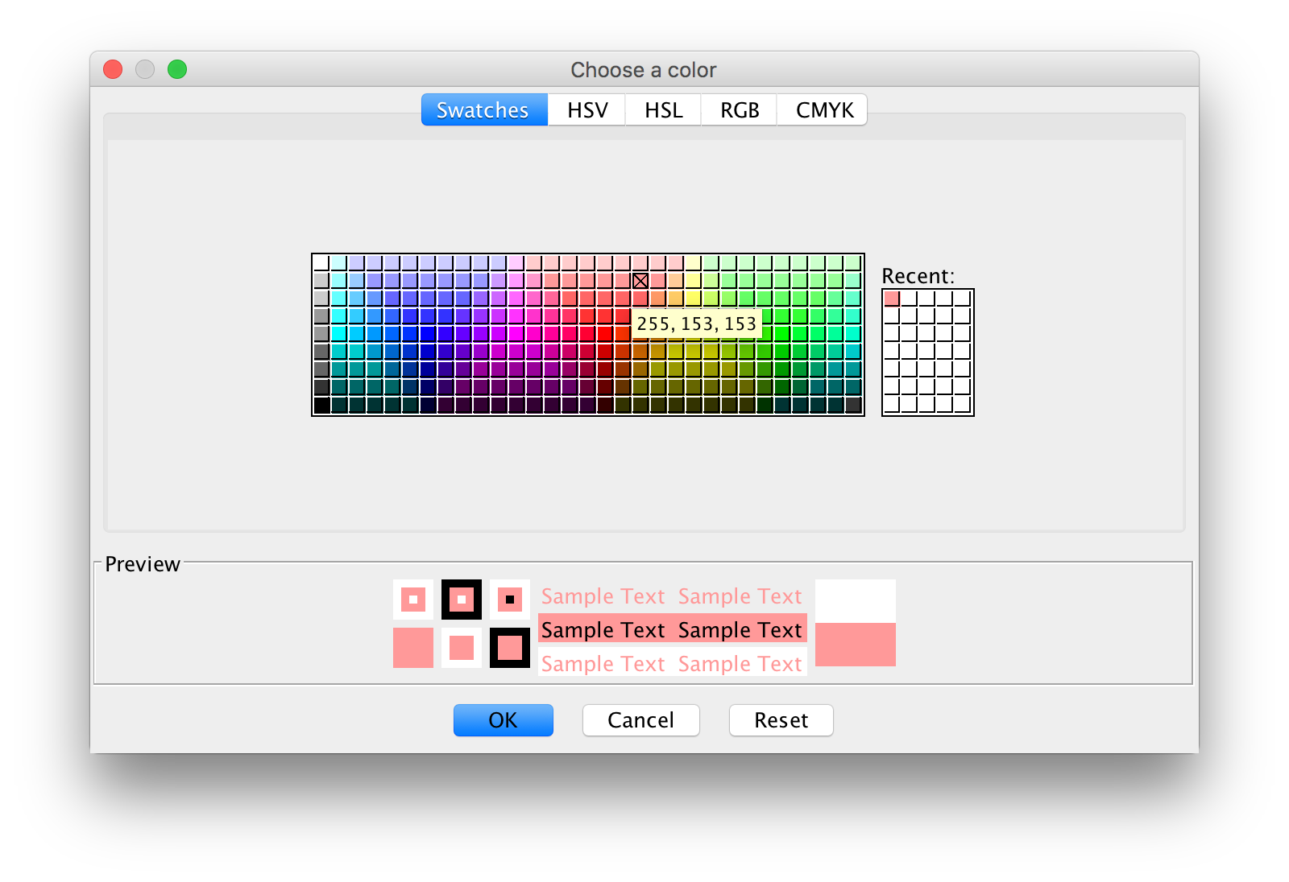
Preferences

Slide 8
Controller bits
One view for both clients and users, sets up necessary controllers
Logging in as client:
ClientController, ClientRunning, ListenFromServer
Logging in as server:
ServerController, ServerRunning, as well as client controllers

Slide 9
Model
Server’s models:
ServerModel, ClientInstance (thread running for each connected client talking to ServerModel), sends strings through socket to clients
Client’s models:
ClientModel, sends Message objects to server
Message model
Consists of integer defining the message type (login/logout, message), and string containing message

Slide 10
Take-aways on git…
It’s difficult
Had to coordinate who would work on what and when to avoid merge-conflicts
Working on a large piece of software has its challenges
Can’t think of a better solution…
Checkout code? Limits who can work on what

Slide 11
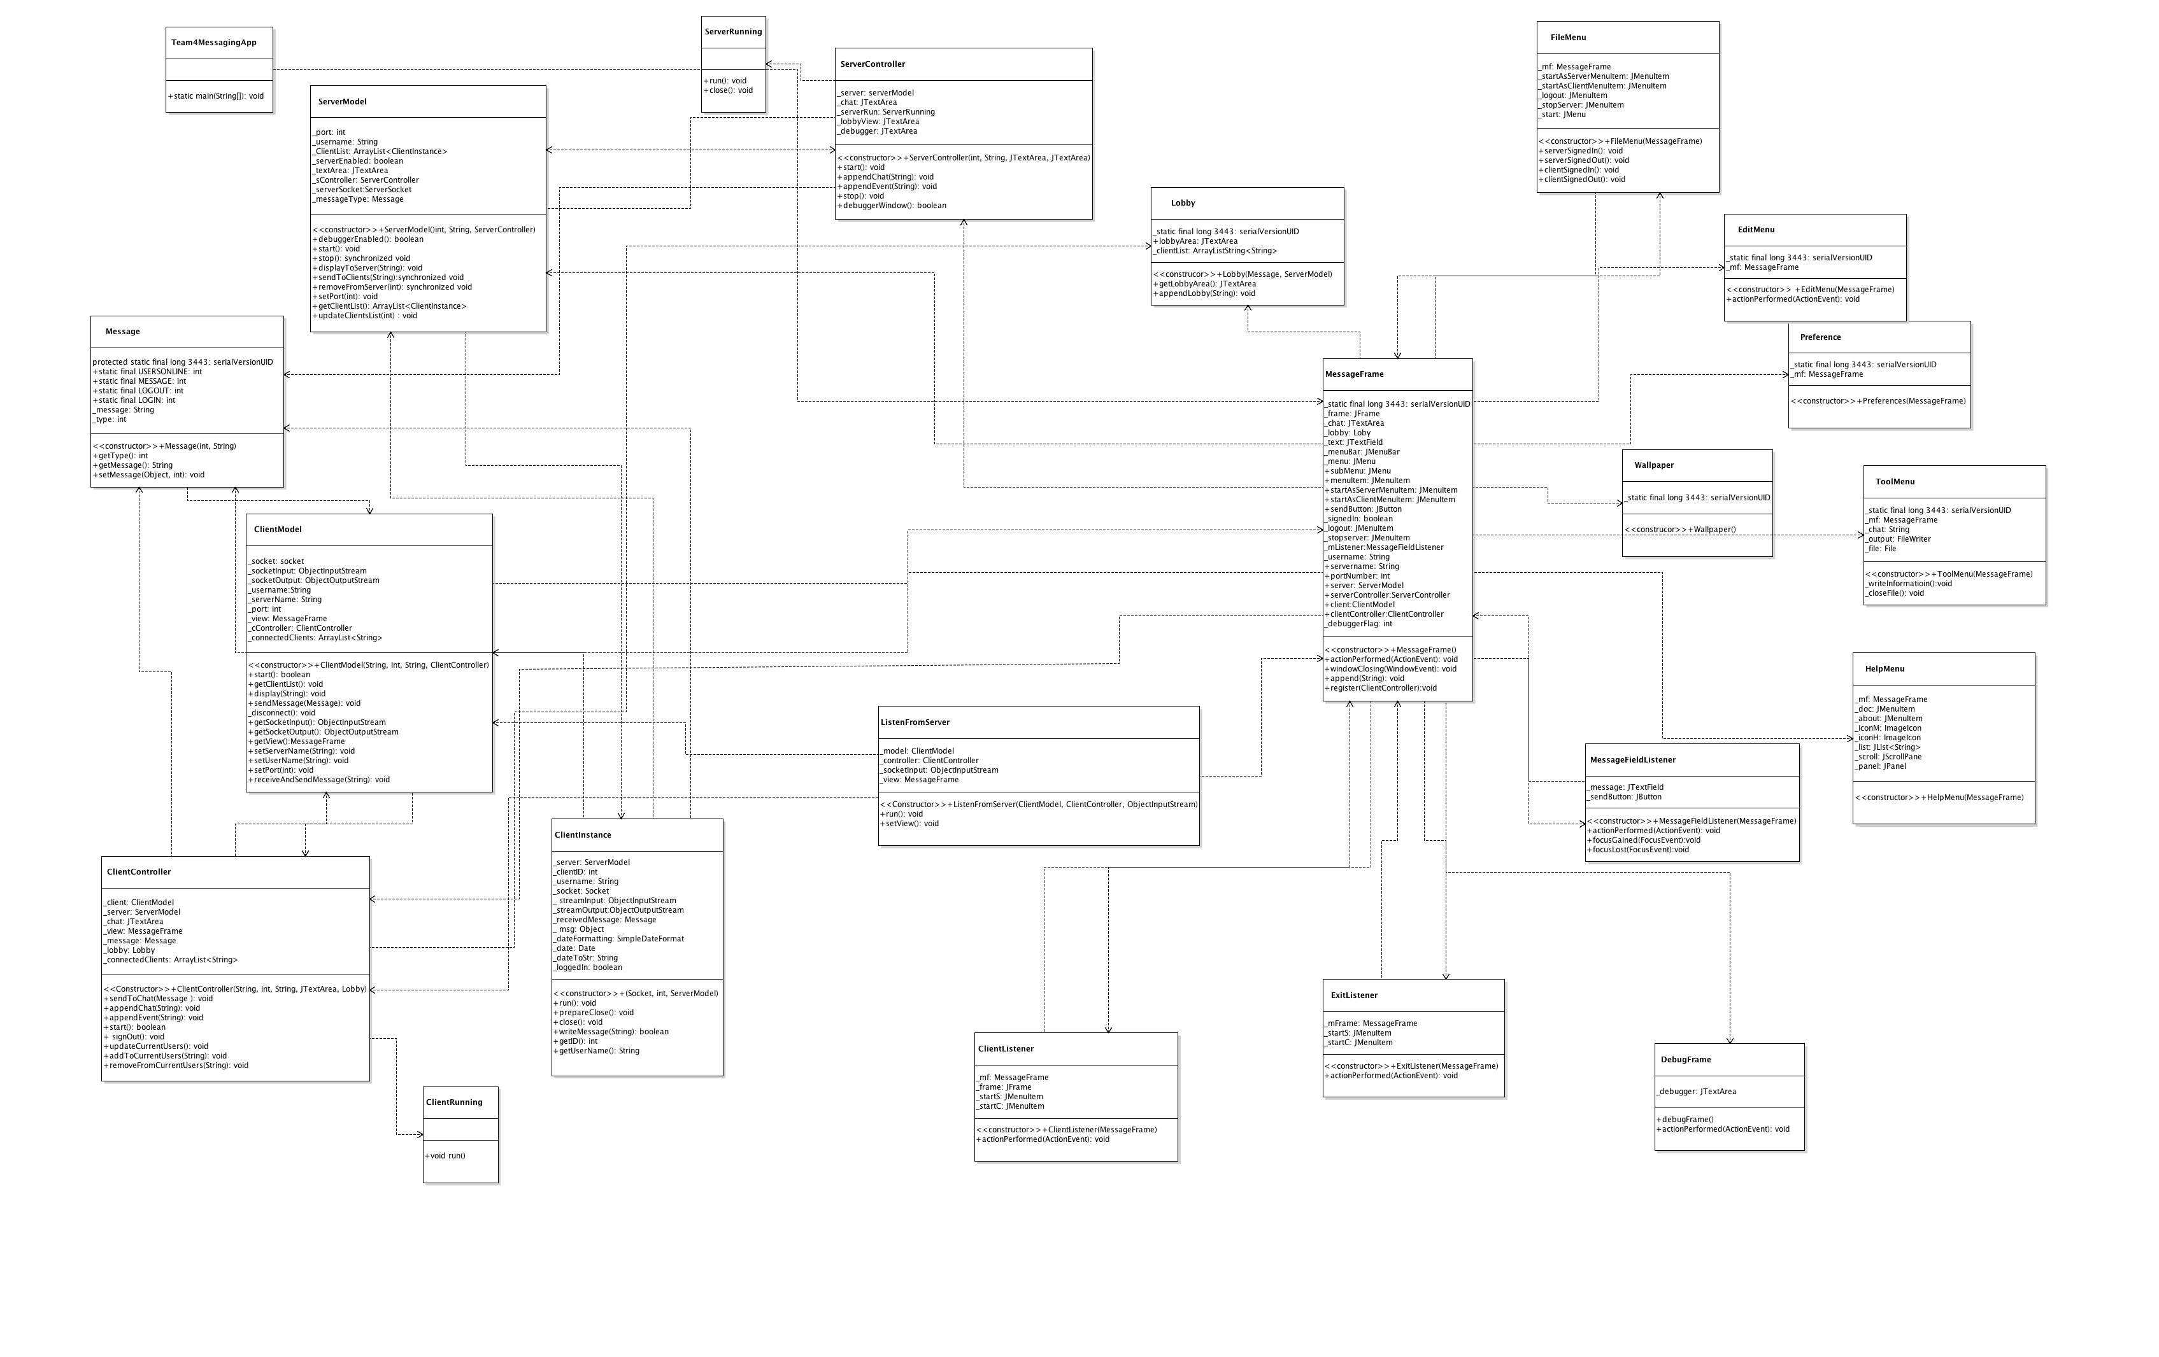
UML

Slide 12
UML detail (server implementation)

