Slide 1
Chronic Circuit Report
March - May 2025

Slide 2
Key Metrics Overview
64 Total Circuits Tracked | 599 Total Tickets Logged | 83.5% Average Availability | 15.3 Average MTBF (Days)

Slide 3
Executive Summary
Key Takeaways
• 1 new circuit(s) identified as chronic this month, requiring immediate attention and classification.
• Lowest performing circuit shows 1.8 days MTBF and 80.0% availability, indicating significant reliability issues.
• Highest impact circuit generated $26,324 in cost to serve, representing major operational expense.
Recommendations
• Review the top 5 circuits by lowest MTBF and investigate root causes for frequent failures.
• Prioritize vendor engagement for circuits showing consistent availability degradation.
• Implement proactive monitoring for new chronic circuits to prevent escalation.

Slide 4
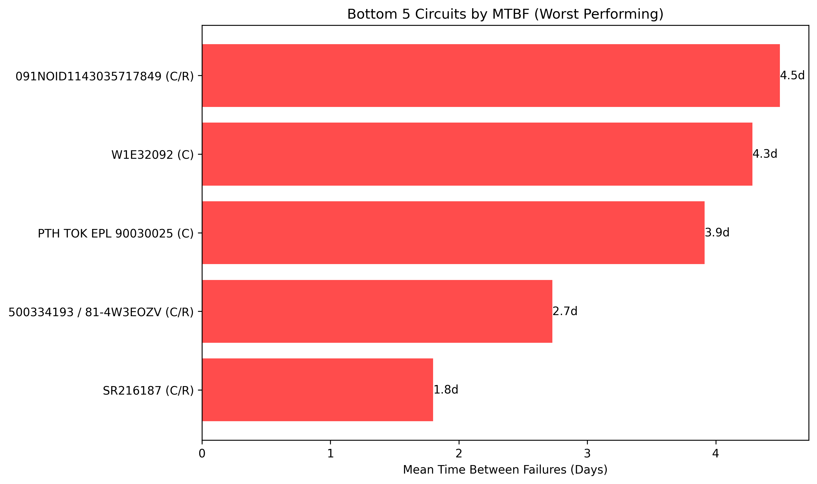
Bottom 5 Circuits by MTBF (Worst Performing)

