Slide 1

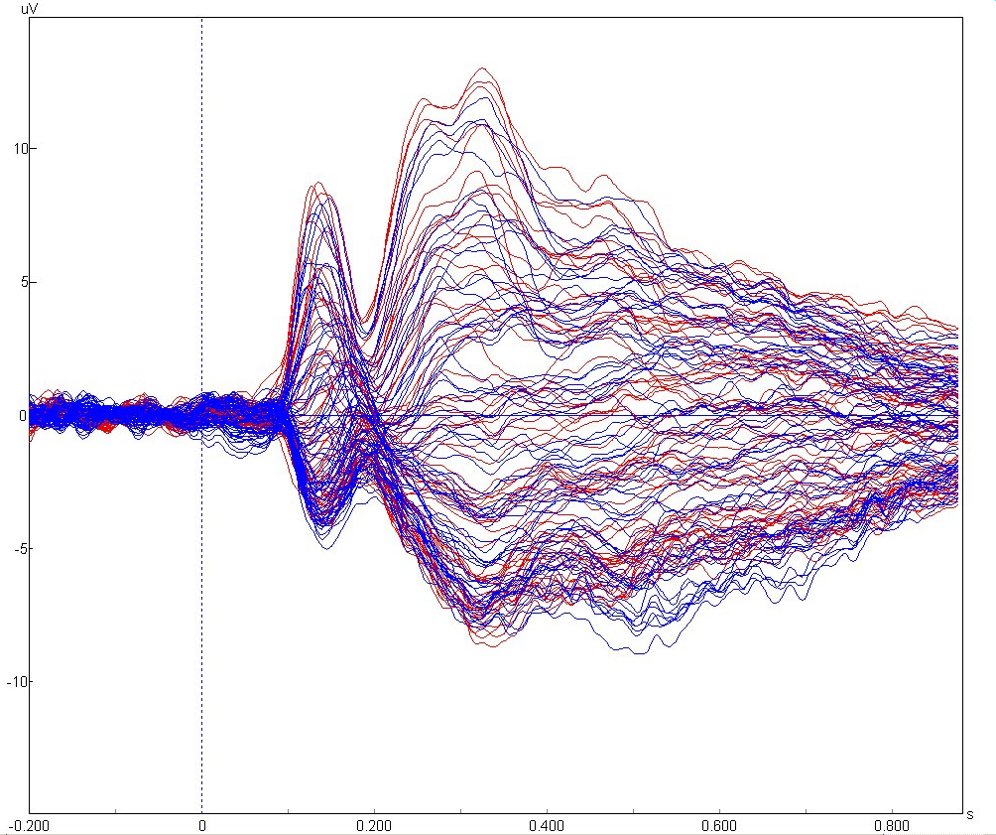
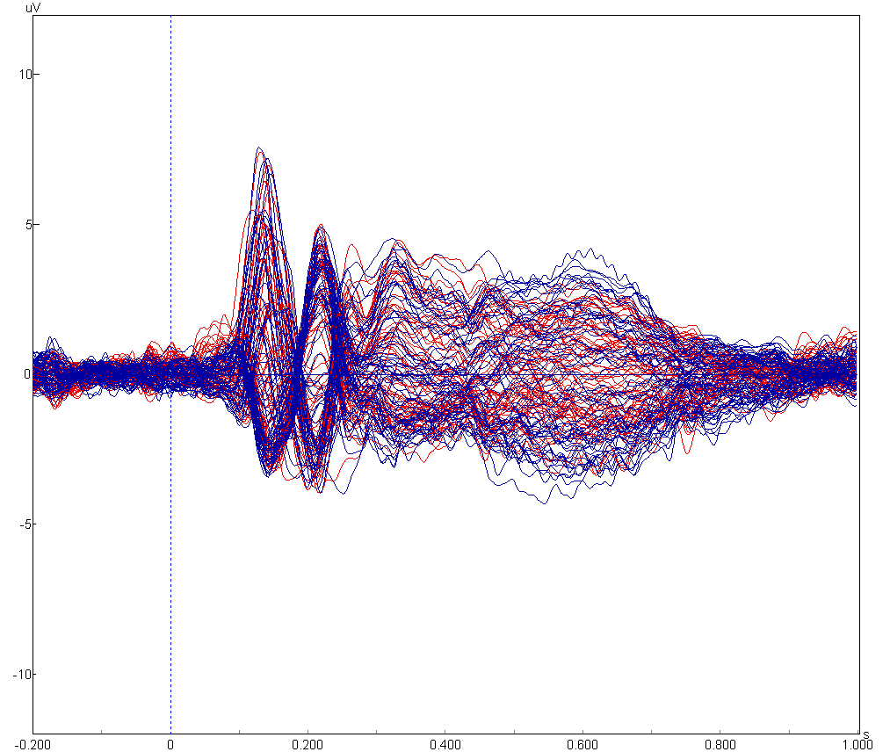
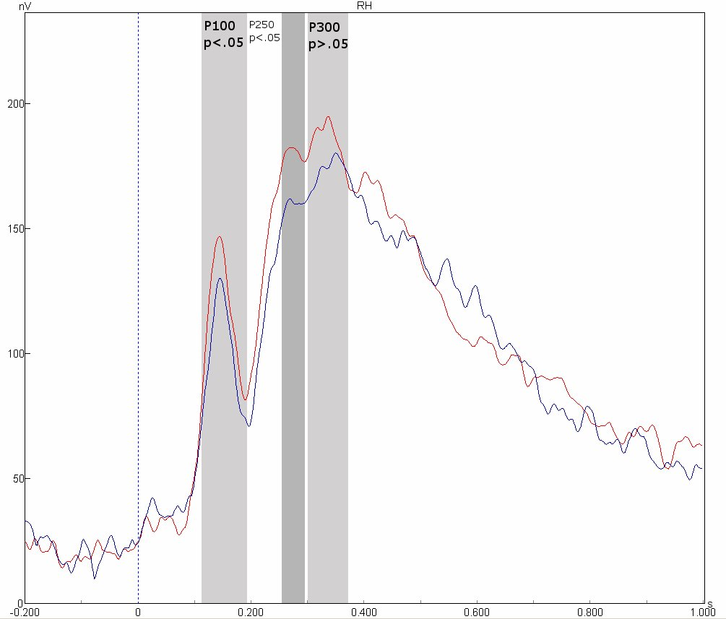
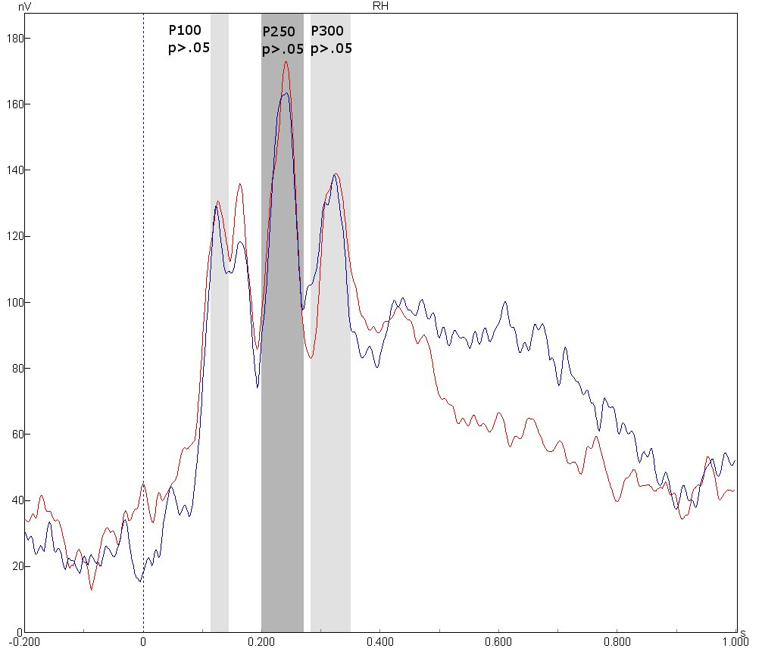
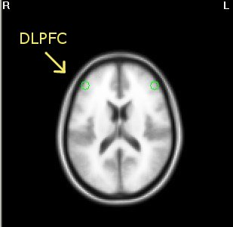
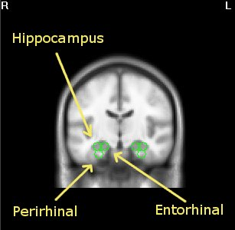
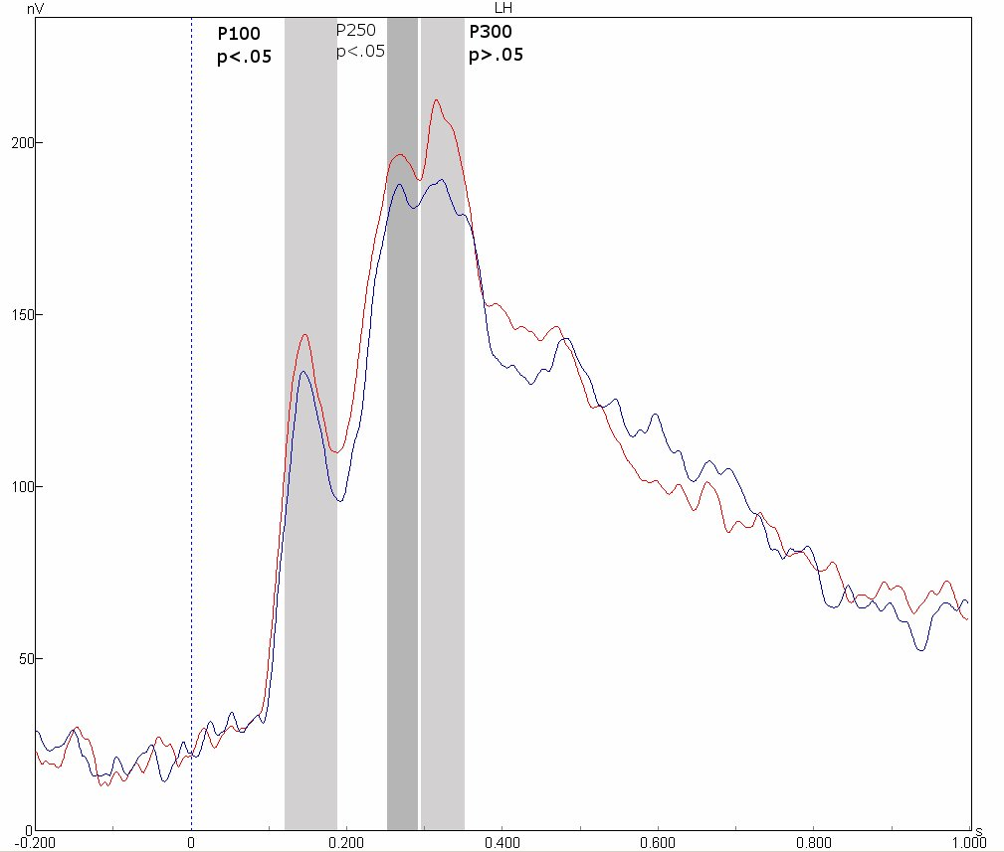
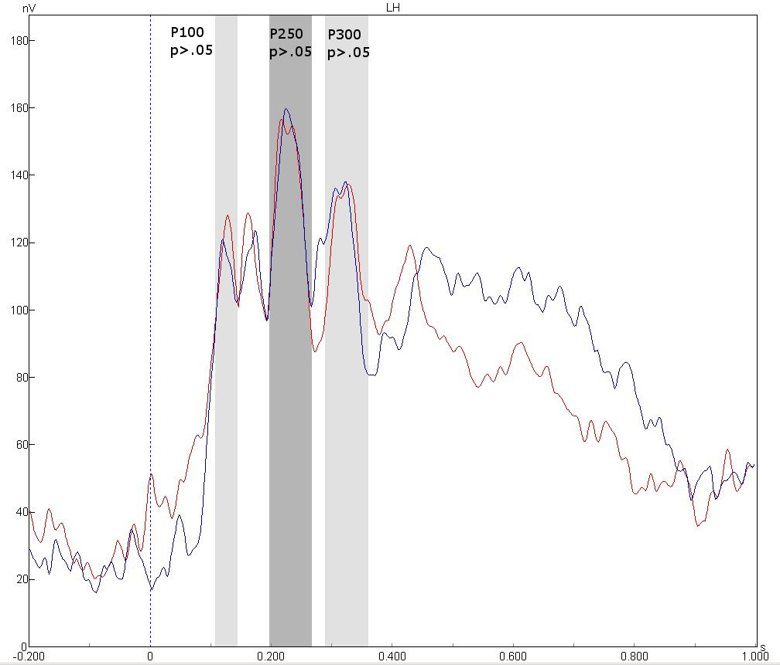
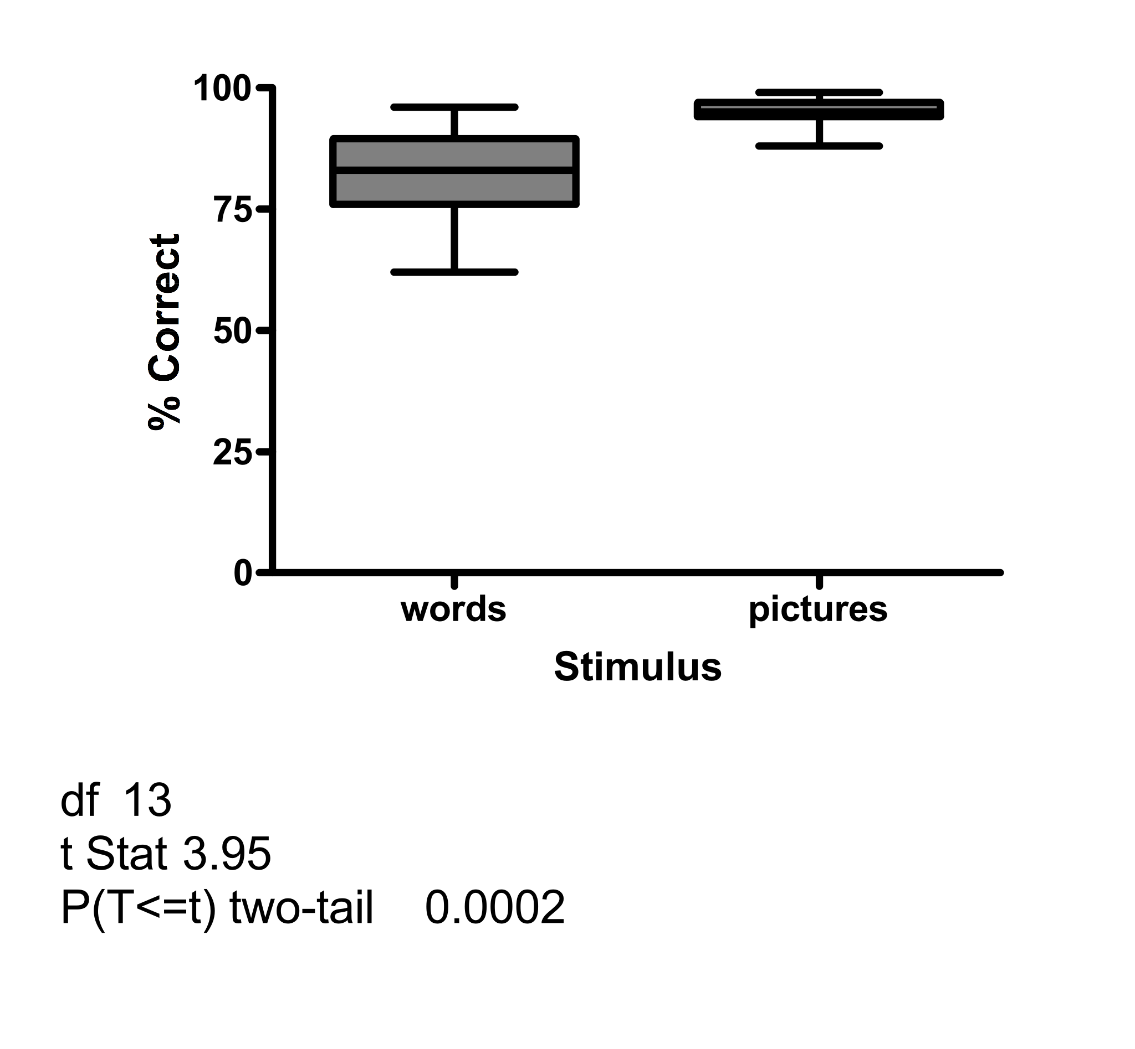
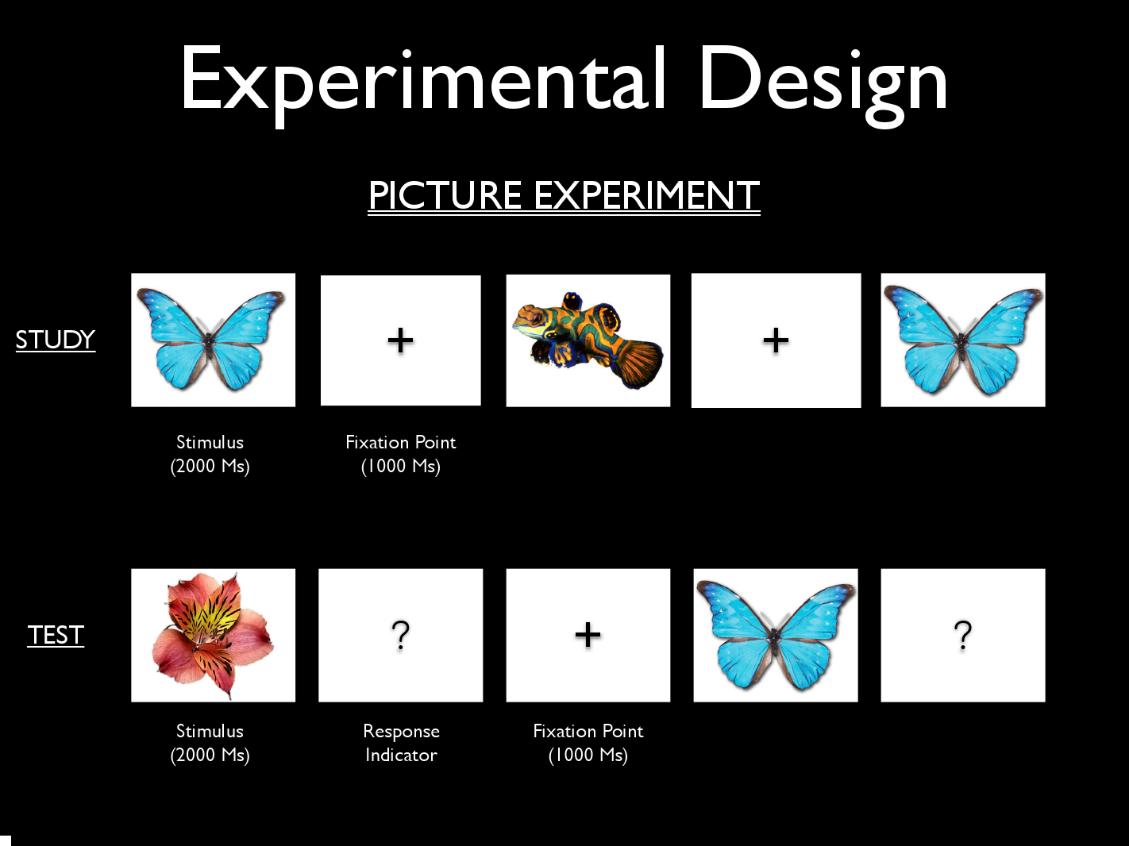
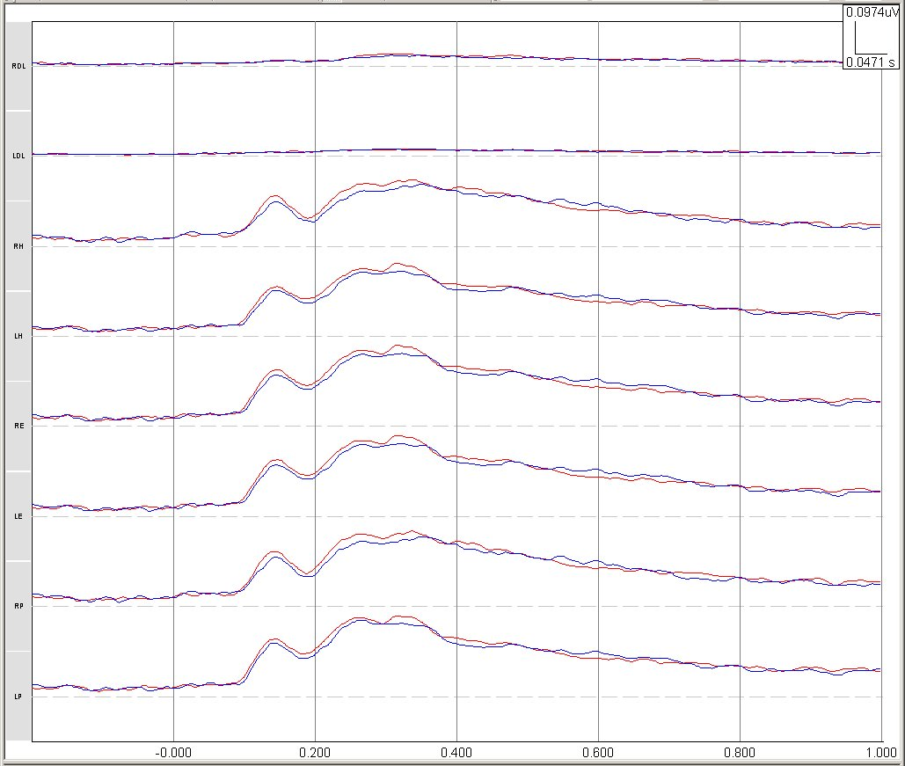
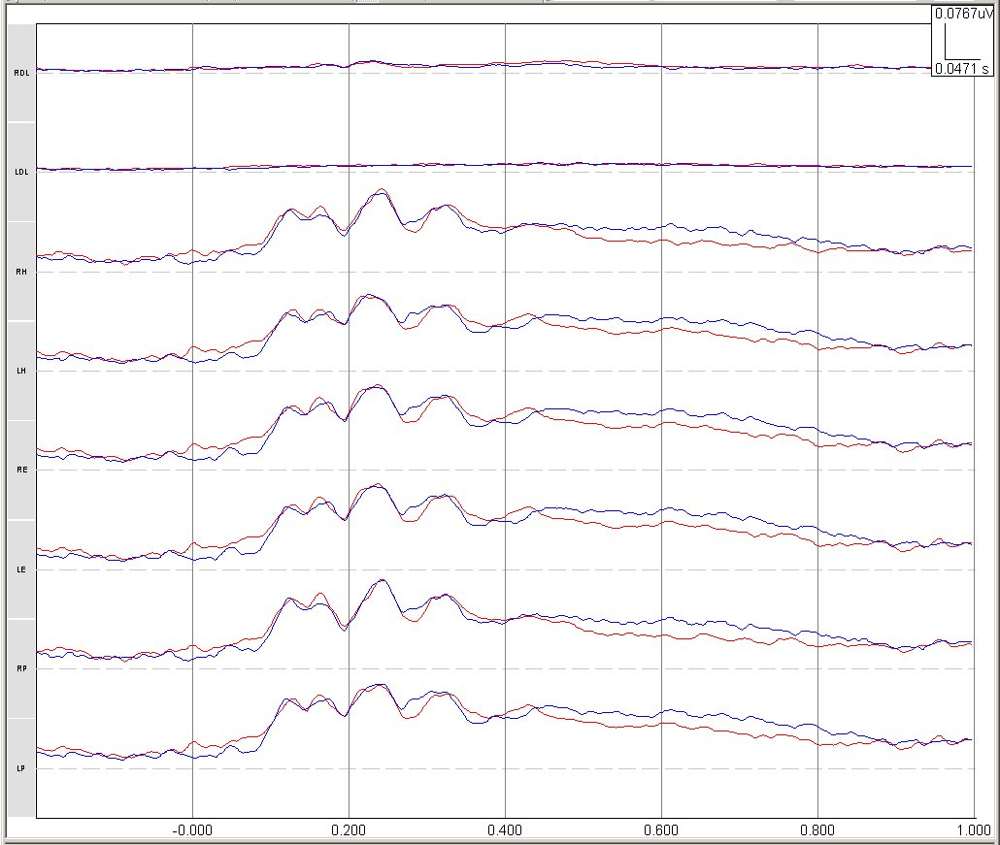
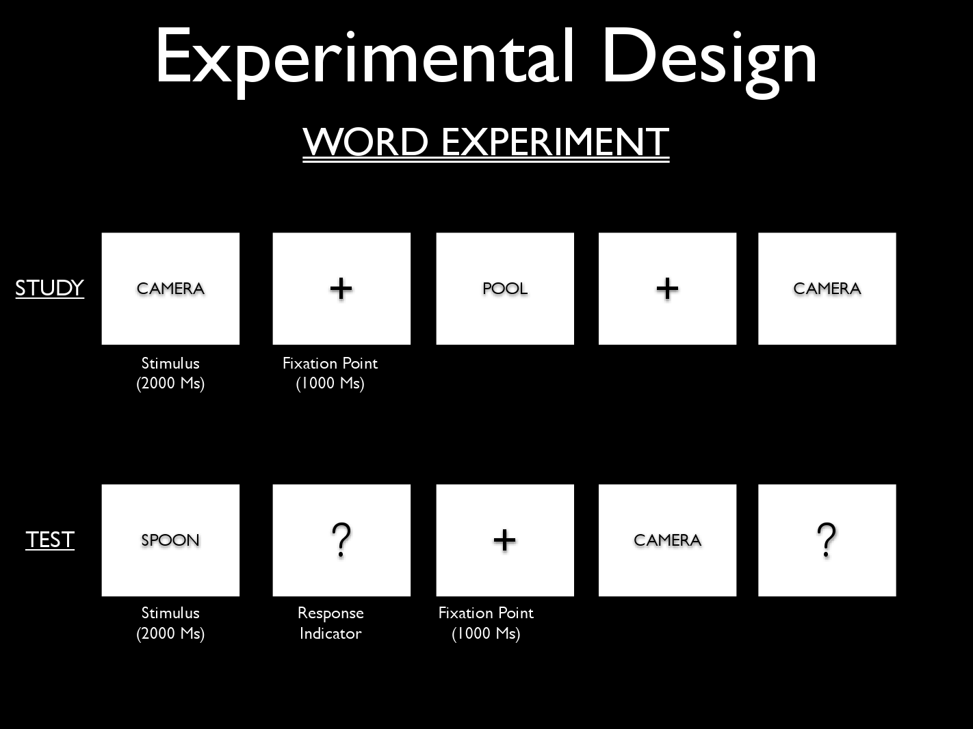
Recognition Memory: event related potentials with source localization
Julian Keith1,3 J. L. Sanguinetti¹, Kelly Psilos, Jon Flynn, Bridget Byrd, Lloyd Smith², 1. University of North Carolina,Wilmington, Psychology 2. Cortech Solutions, Inc. 3. Memory Assessment and Research Services, LLC.
870.15
Introduction
EEG Source Analysis
Repetition Suppression in MTL
Structures within the medial temporal lobes (MTL) are important for recognition memory.
Stimulus repetition systematically improves recognition performance accuracy and speed.
In non-human primates, individual neurons located in MTL structures, including the hippocampus, perirhinal and entorhinal cortices, reduce their firing rates in response to repeated presentations of visual stimuli (Brown & Xiang,1998). Evidence for such a MTL “repetition suppression” effect also has been observed in fMRI studies with human participants (Brozinsky, 2005).
EEG Source analysis techniques can be used to estimate electrical activity in of regions of interest (ROIs) in the brain based on scalp recorded event related potentials (ERPs). Although controversial and in need of more empirical evaluation, studies with implanted electrodes used to generate artificial dipoles have shown estimation error to 1 cm (see Slottnick, 2004 for review).
The current study used beamforming source estimation on scalp recorded EEG data to estimate activity of ROIs related to recognition memory for old vs. new stimuli.
Source estimation was performed on individual subjects using scalp recorded event-related potentials (ERPs). ERP grand averages for all subjects shown on the right. Novel condition in red and old condition in blue.
Picture
Word
Picture Experiment
Word Experiment
NEW
OLD
A local estimator beamformer model was created for user defined ROIs in averaged brain MRI slices (MNI 152). ROIs were located in Talariach space using the Talariach Applet (Lancaster et. al. 2000). A 3-sphere head model was used.
Hypothesis Stimulus repetition will suppress electrophysiological potentials generated in medial temporal lobe structures, including hippocampus, entorhinal cortex, and perirhinal cortex.
Spatially constrained source activity was derived for three ROIs (bilaterally): the hippocampus, entorhinal and perirhinal cortex. Source activity was also estimated for the dorsolateral prefrontal cortex (DLPFC)—an area that might be implicated in recognition memory. ANOVA was performed on individual subject’s source waveforms for each ROI for (see below).
Results
The figure above represents grand averages of source waveforms in the hippocampus. Waveforms from all MTL regions were similar to the ones shown above. The shaded zones signify the regions used to analyze the area under the curve.
Methods
Behavioral
Summary
Design
Two separate “old/new” recognition experiments were performed. One using real world pictures and the other using common nouns. A within-subjects design was used and the order in which the experiments were conducted was counterbalanced.
Picture stimuli were color images of common plants and animals presented against a white background: word stimuli were common nouns; the font was black
Study: Subjects passively viewed 60 stimuli that were randomly presented three times each.
Test: Old stimuli were randomly presented with 60 novel stimuli. Subjects were instructed to respond to old or new stimuli on a standard computer keyboard.
Recognition accuracy for both pictures and words. The accuracy (both hits and correct rejections) for the picture experiment was significantly higher (t=3.95, p<.01) than for the word experiment. The mean accuracy for experiment 1 (pictures) was 90.2% and the mean accuracy for experiment 2 (word) was 78.3%.
Beamformer source estimation revealed repetition suppression effects in medial temporal lobe (MTL) for pictures but not words.
This effect is significant 100 and 250 ms after stimulus presentations.
Minimal signal detected in dorsolateral prefrontal cortex compared to MTL with no repetition suppression effect.
Source waveforms for all MTL areas (hippocampus, entorhinal and perirhinal cortex) are similar in morphology and amplitude.
EEG Recording
Electrophysiological data was recorded with a 64-channel active-electrode EEG system with ActiView software (Biosemi).
  All electrode offsets were below 25kΩ.
  Sampling rate: 512 Hz.
  Filter: off-line digital band-pass 0.5 to 45 Hz.
Source Waveforms
Discussion
When the picture stimulus is repeated, electrophysiological potentials in the MTL show suppression in peak amplitude relative to novel.
Why were similar waveforms observed throughout the MTL?
  Hippocampus, PC and EC may all respond similarly to stimulus repetition.
  The beamforming model used in the present study may not provide the spatial resolution needed to permit the discrimination of activity arising from closely neighboring structures.
Your insights and feedback are welcome.
Picture
Word
Data Analysis
Off-line, the raw EEG data was referenced to a common mode average using EMSE software (Source Signal Imaging, Inc.). Eye movements and artifacts were removed. Artifact free data was segmented beginning 200 ms prior to the onset of the visual stimulus to 1 second following, creating stimulus locked ERPs. ERPs were extracted for correct trials only; subjects with poorer than 70% discrimination accuracy were rejected.
References
Brown M.W., Xiang J.Z. 1998. Recognition memory: neuronal substrates of the judgement of prior occurrence. Prog Neurobiol 55:149-189.
Brozinsky C.J., Yonelinas A.P., Kroll NE, Ranganath C. 2005. Lag-sensitive repetition suppression effects in the anterior parahippocampal gyrus. Hippocampus 15(5):557–61
Henson R.N., Cansino S, Herron J.E., Robb E.G., Rugg M.D. 2003. A familiarity signal in human anterior medial temporal cortex? Hippocampus. 13: 301-304.
Lancaster J.L., Woldorff M.G., Parsons L.M., Liotti M, Freitas C.S. Rainey L, Kochunov P.V., Nickerson D, Mikiten S.A., Fox P.T., "Automated Talairach Atlas labels for functional brain mapping". Human Brain Mapping 10:120-131, 2000
Rugg M.D. and Yonelinas A.P., Human recognition memory: a cognitive neuroscience perspective, Trends Cogn. Sci. 7 (2003), pp. 313–319
Slotnick S.D. (2004), Source localization of ERP Generators. In T. Handy (Ed.)
Event-Related Potentials: A Methods Handbook, (pp.149-166). MIT Press.
Grand average source waveforms for new (red) vs. old (blue) stimuli reveals suppressed waveforms for repeated stimuli (~230 nV peak signal) in the picture experiment only. No significant suppression effect was found for words.
DLPFC was analyzed and served as a control area. DLPFC showed little activation compared to MTL, with no suppression effect (~20 nV peak signal)
Waveforms in MTL regions that were generated by pictures were different in shape from those generated by words.
Waveforms did not differ significantly within the regions of the MTL.
Participants
18 right-handed volunteers enrolled at UNC, Wilmington (11 female; 7male, Mean Age=19 years).

