Slide 1
RESEARCH PROJECT · IN PROGRESS
Physics-guided ML for PV under partial shading
Where simplified photovoltaic physics models fail — and whether residual learning can correct those errors.
AI + Energy Systems · Anshu · Teghvir Singh · Aishaan
Notes:
This project studies whether machine learning can correct systematic error in simplified photovoltaic physics models without replacing the physics model.

Slide 2
PROBLEM FRAME
Partial shading exposes the limits of simplified PV models
1
2
3
Many coupled conditions
Two imperfect defaults
Core question
Can ML correct systematic physics error without replacing the physics model?
PV performance depends on irradiance, temperature, shading, electrical mismatch, and panel-level operating conditions.
Physics models are interpretable and efficient; pure ML captures nonlinearities but can be opaque and weak outside the training distribution.
Notes:
Partial shading creates coupled behavior that simplified models may not represent well. The research question is not physics versus ML; it is whether ML can correct systematic physics error while preserving the physics model.

Slide 3
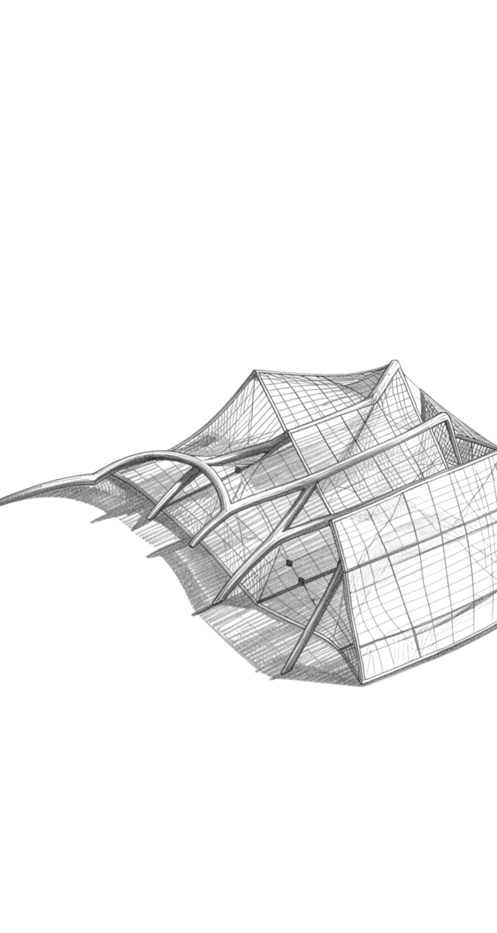
RESEARCH GAP
The research gap is the structure of model error
Physics-based PV models offer interpretability but can struggle with complex mismatch and shading. Pure ML offers nonlinear approximation but raises black-box and generalization concerns.
Investigation focus: analyze simplified-model error across shading and temperature regimes, then test residual learning in-distribution and on deliberately held-out operating regimes. Literature areas: single-diode modeling, partial-shading modeling, ML prediction, physics-guided ML, residual learning, and OOD generalization.
Notes:
The gap is not simply that one model is better. The investigation asks whether the error of a simplified model has structure across shading and temperature regimes, and whether that structure can be learned.

Slide 4
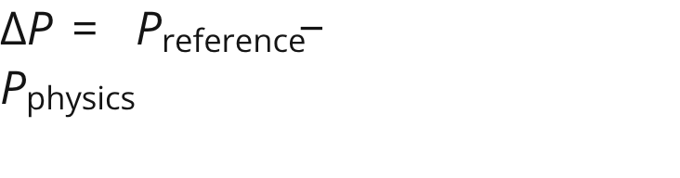
EXPERIMENTAL QUESTIONS
Four questions define the experiment
01
02
03
04
Model deviation
Pure ML
Residual ML
OOD behavior
Where does the simplified physics model deviate from a higher-fidelity reference?
Can pure ML predict PV maximum power accurately?
Can ML learn the residual ?
How do physics, pure ML, and hybrid models behave under OOD conditions?
Hypothesis to test: physics-model discrepancy contains structured information that residual ML can learn. This is an experimental hypothesis, not a predetermined result.
Notes:
These four questions define the experiment. The central hypothesis is explicitly unproven: physics-model discrepancy may contain structured information that residual ML can learn.

Slide 5


METHOD · HYBRID PIPELINE
Keep the physics model; learn what it misses
Operating conditions
Two model paths
Residual correction
pvlib / single-diode physics model
High-fidelity reference model
G · T · S₁–S₁₂
Irradiance, temperature, shading state
Compare three paths: Physics · Pure ML · Physics + Residual ML
Notes:
The hybrid pipeline keeps the physics model in the loop. Conditions feed both models; their outputs define the residual; an MLP learns that residual; the correction is added back to the physics estimate.

Slide 6
INPUT SPACE
A 12-panel array makes shading configuration explicit
Irradiance: 100–1200 W/m²
Temperature: 0–60°C
Shaded panels: 1–4
Shading severity: 20–80%
P1
P2
P3
P4
S₁
S₂
S₃
S₄
P5
P6
P7
P8
Two cases with the same number of shaded panels can behave differently depending on which panels are shaded.
S₅
S₆
S₇
S₈
P9
P10
P11
P12
S₉
S₁₀
S₁₁
S₁₂
Notes:
The shading mask is explicit at panel level. Two cases with the same number of shaded panels can behave differently when the shaded panels occupy different positions in the 3 × 4 array.

Slide 7

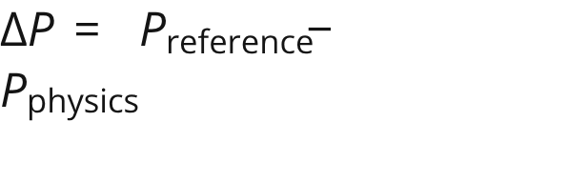

DATA GENERATION · PLANNED
Each simulation produces a reference, a physics estimate, and a residual
1
2
3
4
5
Generate
Simulate
Record
Calculate
Store
Operating conditions and a shading mask.
12-panel system with high-fidelity and simplified physics models.
and .
.
Feature vector and target for the chosen experiment.
Features: G, T, S₁–S₁₂, number shaded, shading severity, Pphysics · Targets: Preference or ΔP
Notes:
This is the planned simulation record. Every sample retains both model outputs, the residual, and the feature vector so the pure-ML and residual-ML experiments use the same generated cases.

Slide 8
BASELINE COMPARISON
The comparison separates ML value from physics value
01
PHYSICS
02
PURE ML
03
HYBRID
P = Pphysics
PML = f(X)
ΔPML = f(X)
No ML.
Predicting maximum power directly.
Then Phybrid = Pphysics + ΔPML.
The three-model comparison reveals whether ML helps, whether physics helps, and whether combining them helps most.
Notes:
The baselines isolate the sources of value. Physics provides the interpretable reference, pure ML tests direct approximation, and the hybrid tests whether learning the residual is more useful than replacing the physics model.

Slide 9
EVALUATION PROTOCOL · PLANNED BEFORE FINAL TEST
OOD evaluation is defined before the final test
Training domain example
IID: Inside the training distribution.
Temperature OOD: 0–10°C or 50–60°C.
Shading OOD: 60–80%.
Extreme OOD: Multiple extreme conditions together.
Irradiance 200–1000 W/m² · Temperature 10–50°C · Shading 20–60%
OOD regions will be defined before final model evaluation to prevent test-set selection bias.
Notes:
The OOD protocol is specified before final evaluation. This prevents choosing test regions after seeing model behavior and makes degradation comparisons more credible.

Slide 10
Planned Error(T, G) heatmap
MEASUREMENT PLAN · PLANNED
Measure accuracy, degradation, and residual structure
T ↓ / G → | 200 | 400 | 700 | 1000
10°C | · | · | · | ·
20°C | · | · | · | ·
35°C | · | · | · | ·
50°C | · | · | · | ·
Metrics: MAE, RMSE, NRMSE, and R².
Error maps: |ΔP| against irradiance, temperature, shading severity, and number of shaded panels.
Model behavior: residual distributions, I–V curves, P–V curves, feature ablation, SHAP / feature importance, and OOD degradation.
Illustrative layout only; cell values will be populated from simulation results.
Make Error(T, G) heatmaps a main visual so the audience can see where the simplified model fails.
Notes:
The measurement plan combines headline accuracy metrics with diagnostics that reveal where and why the models fail. Error(T, G) heatmaps are a main visual for the final results, but the shown grid is only the planned layout; values will come from simulation.

