Slide 1
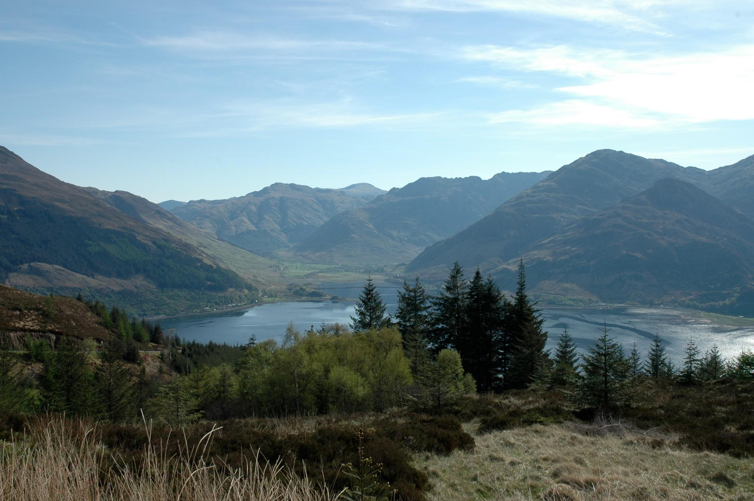
Tegola & HUBS: Rural Community Broadband
Peter Buneman & Michael Fourman
School of Informatics
University of Edinburgh
with:
Dr. Marwan Fayed, University of Stirling
Dr. Mahesh Marina, University of Edinburgh
Dr. Richard Simmons, University of Stirling
William Waites, University of Stirling & HUBS
and the residents of Loch Hourn and Knoydart
*
Notes:
*
*
*
*
*
*

Slide 2
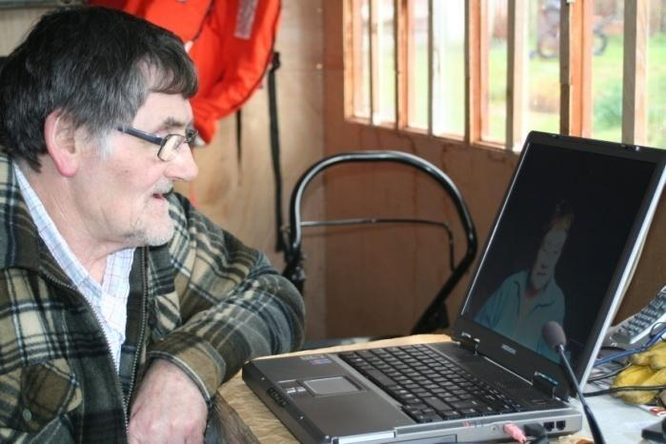
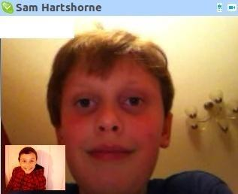
Rural Broadband
The need for fast broadband is higher in rural communities than urban ones, but they are the last to be connected.
Businesses: proportion of small businesses higher than in urban areas.
Online shopping: even for food.:
Other communications often don't work: telephone, radio, TV, mobiles
Alternative to libraries, cinemas, etc.
Education: children on Eigg can lose 3 weeks school a year due to bad weather.
“Distance” communications: vital social importance, especially for the oldies!
Telemedicine & telehealth.
Willie Sandaig “teleconferences” with his grandchildren in New Zealand
Finlay, in Arnisdale, keeps in touch with his pal Sam in Worcester
*

Slide 3
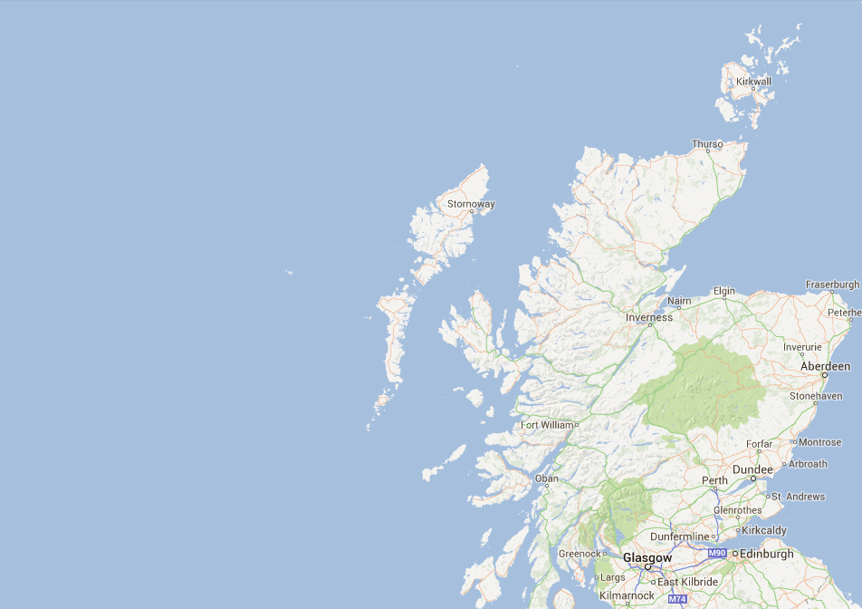
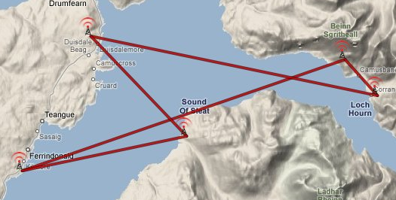
Tegola a network research testbed in the most remote part of the Scottish mainland.
Started in 2007, by the University of Edinburgh, Tegola demonstrated the importance of community participation in building distribution networks
HUBS an organisation that grew out of Tegola, is dedicated to providing advice, support and shared infrastructure for community broadband.
HUBS is a joint venture between University of Edinburgh, University of Stirling and the University of Highlands and Islands.
The original Tegola Network (2008)

Slide 4

Tegola successes
All but 3 families (octogenarians) in a community of 50+ have taken up broadband, including several in their 70's.
New businesses have moved into the community thanks to high-speed internet
Frequently in the news. Won the 2011 NextGen Broadband award
Has spawned other projects and small businesses that deliver broadband
Has been (by design) reliable
Delivered basic practical research into network planning, relay construction, power, network management, etc.
At least 1000 people in rural communities now have internet thanks to Tegola
In October 2011, lightning strikes knocked out the telephone lines to a wide area
Emergency health services were diverted through Tegola.

Slide 5
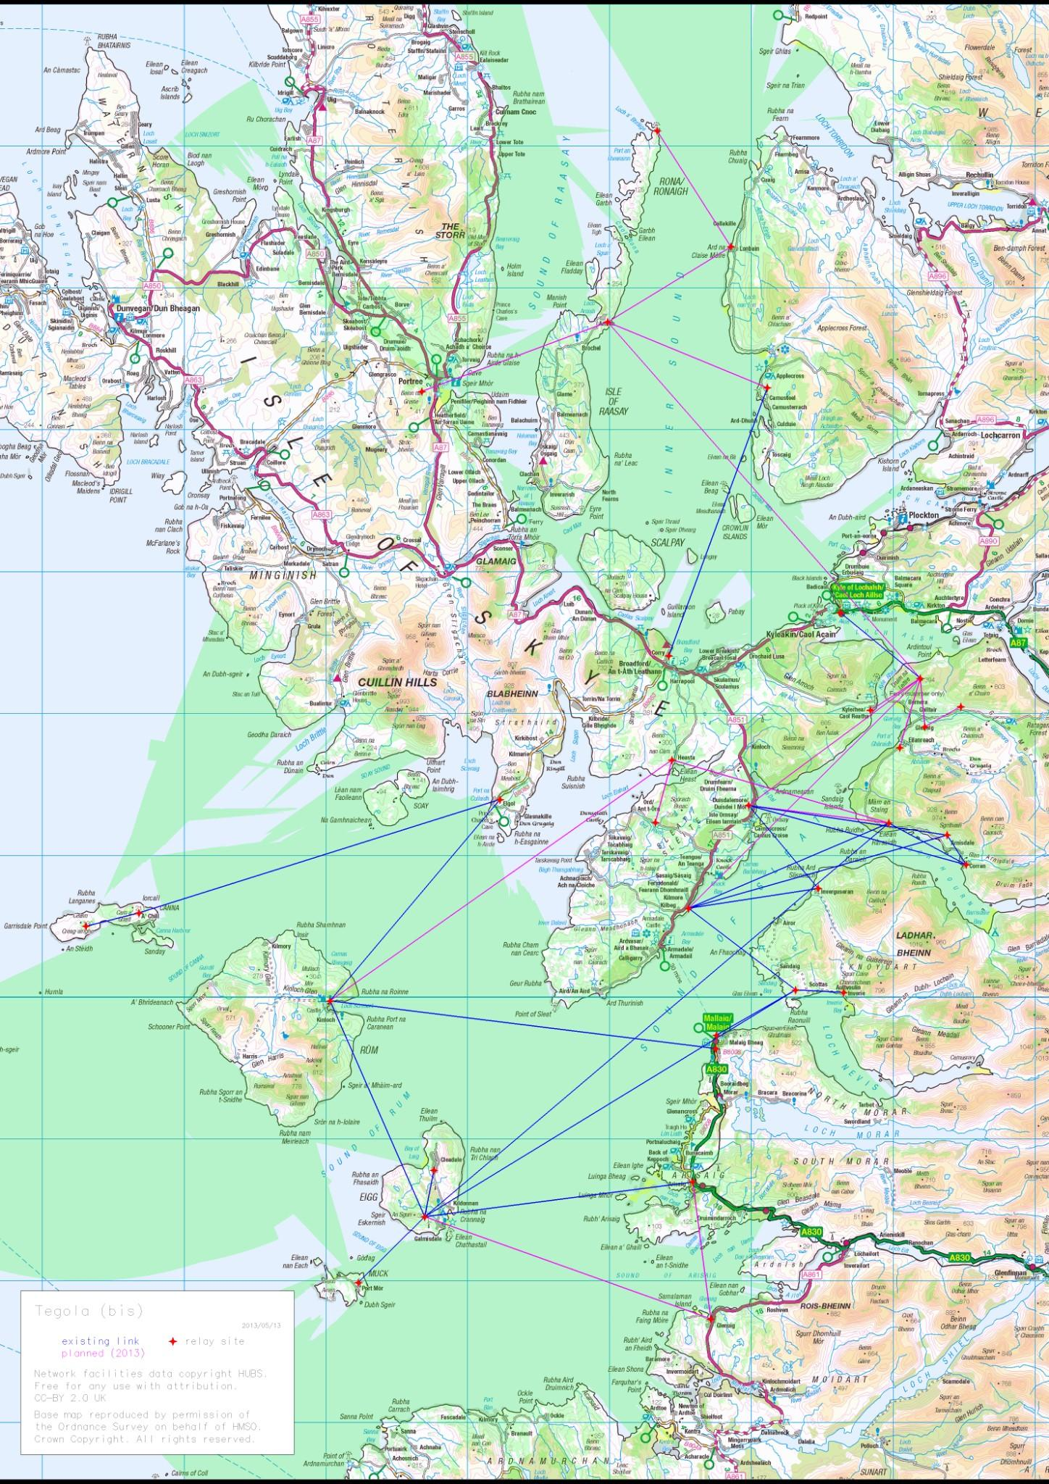

The extended Tegola network
(by autumn 2013)
A confederation of seven interconnected community networks created by HUBS
Sharing infrastructure & services for economies of scale and reliability.
Delivering speeds above 30Mb/s .
One of the largest remote community networks in Europe.

Slide 6
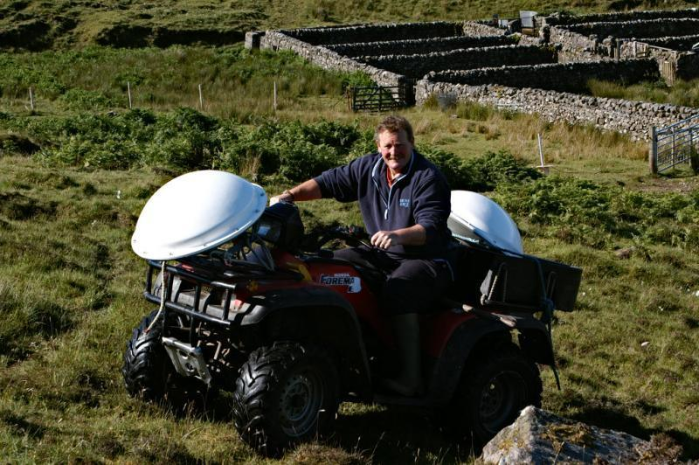
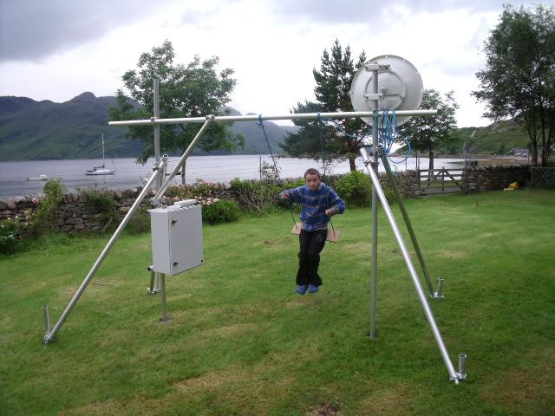
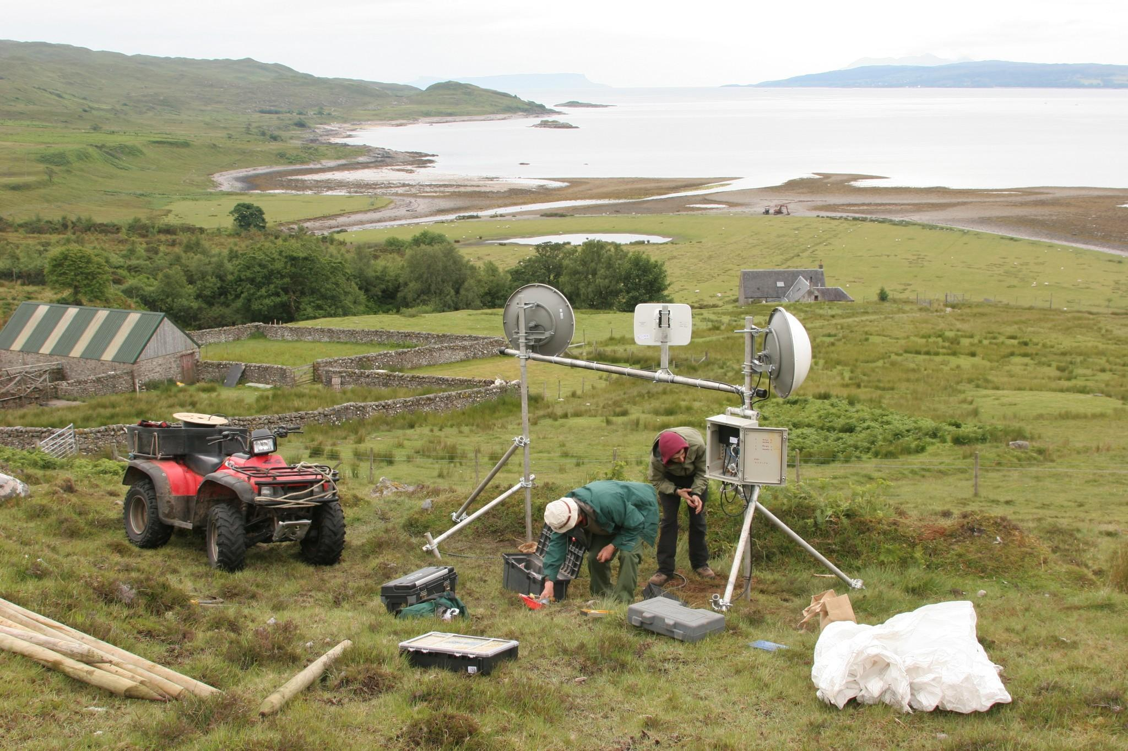
Reaching the last 15-30%
500k premises in Scotland > 1m people
Rural communities can build and maintain distribution networks at a fraction of the cost to centralised providers provided they have access to backhaul
Vastly lower civil & transportation costs
Infrastructure (relays, fibre) is locally owned. Fewer issues with licensing, wayleaves, rents, taxes etc.
Communities can adapt more quickly to changes in technology and connectivity
People in remote communities are resourceful (they must be to live there)
The burning question How can individual projects be aggregated in order to reach scale?
We must scale 500 x to reach the final fifth of Scotland's homes and businesses !
A new model:
Local action at national scale ...
Local transport
Stress testing
Construction

Slide 7
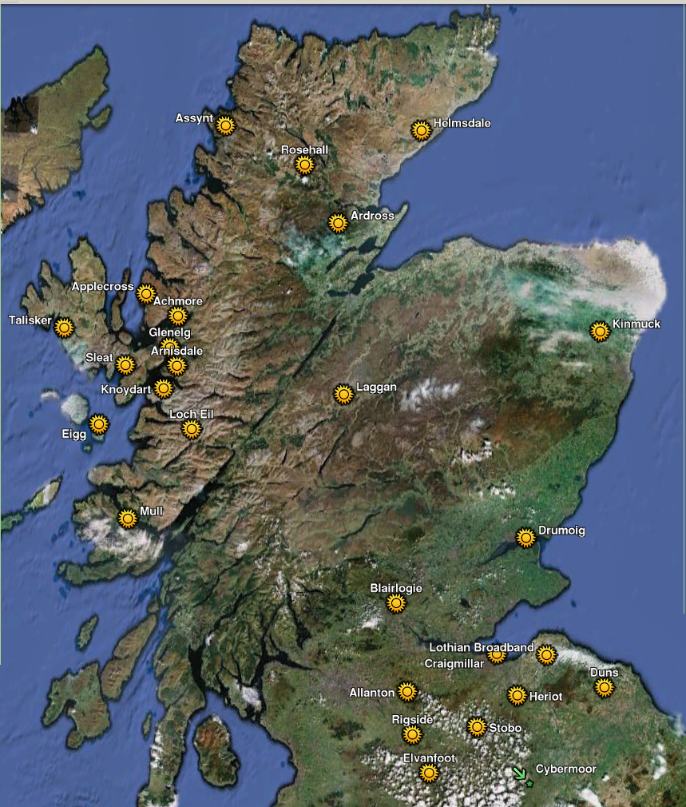
HUBS
Provides
Tegola know-how
Network planning and on-site help
Equipment loans to get projects off the ground
Educational materials
Aggregates backhaul bandwidth and other network services
Interconnects community networks
Develops tools for OMA – operations, administration and maintenance – to enable a new economic model for community broadband at national scale
With HUBS assistance, several interconnected community networks have been built without state funding
Since mid 2012, HUBS has assisted about 30 communities, 10 of which are now operational

Slide 8

What is needed
An open access fibre backbone
A light-touch and agile approach to community funding
Open source, open access community tools
Funding (Nominet application pending ...)
www.tegola.org.uk

