Slide 1

HebNet CIC
Fast, reliable and economic broadband for the Small Isles & Knoydart

Slide 2
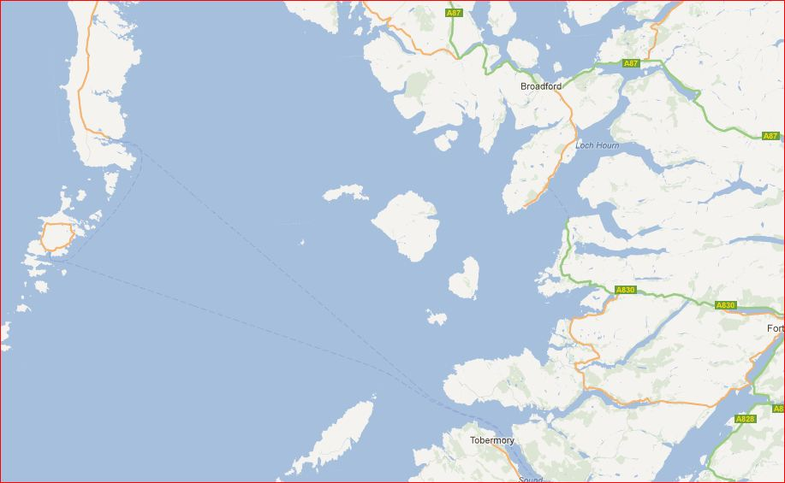

Slide 3
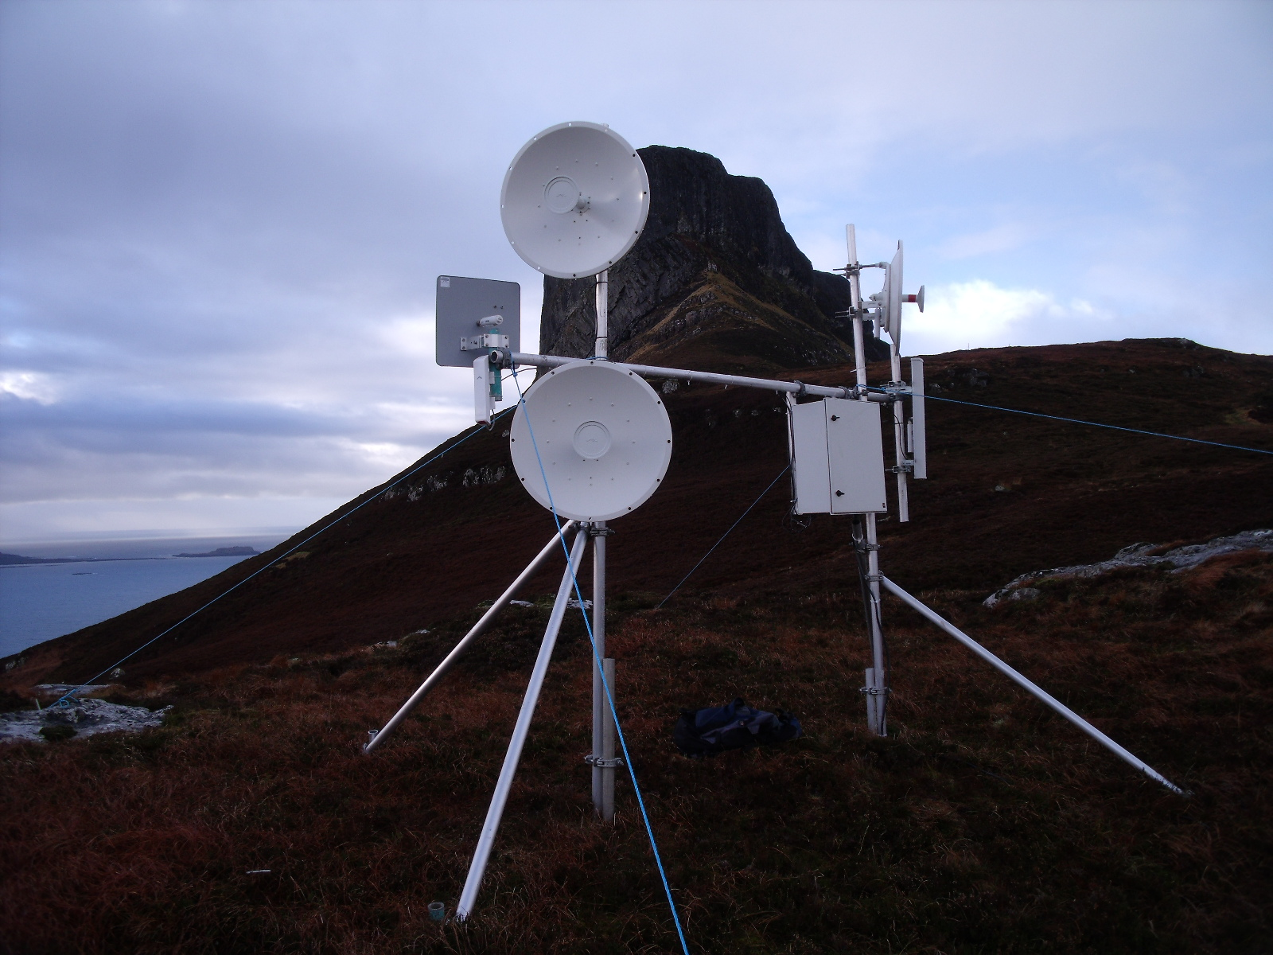

Slide 4
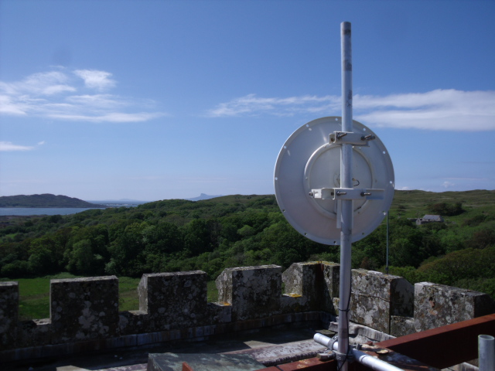

Slide 5
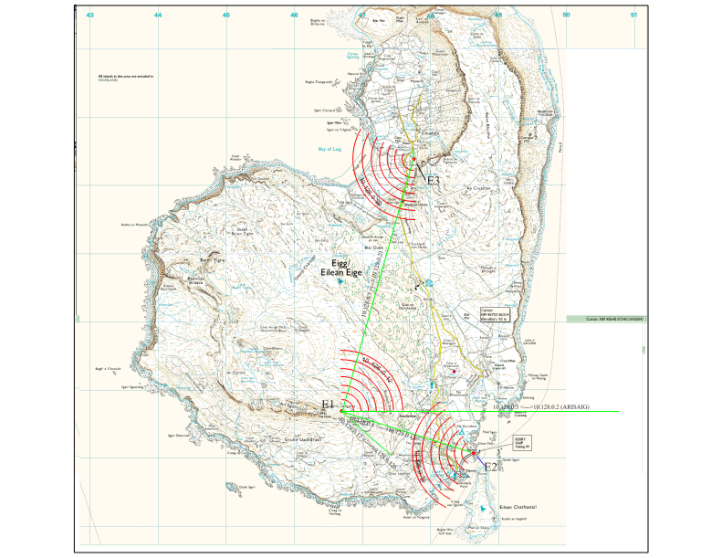

Slide 6
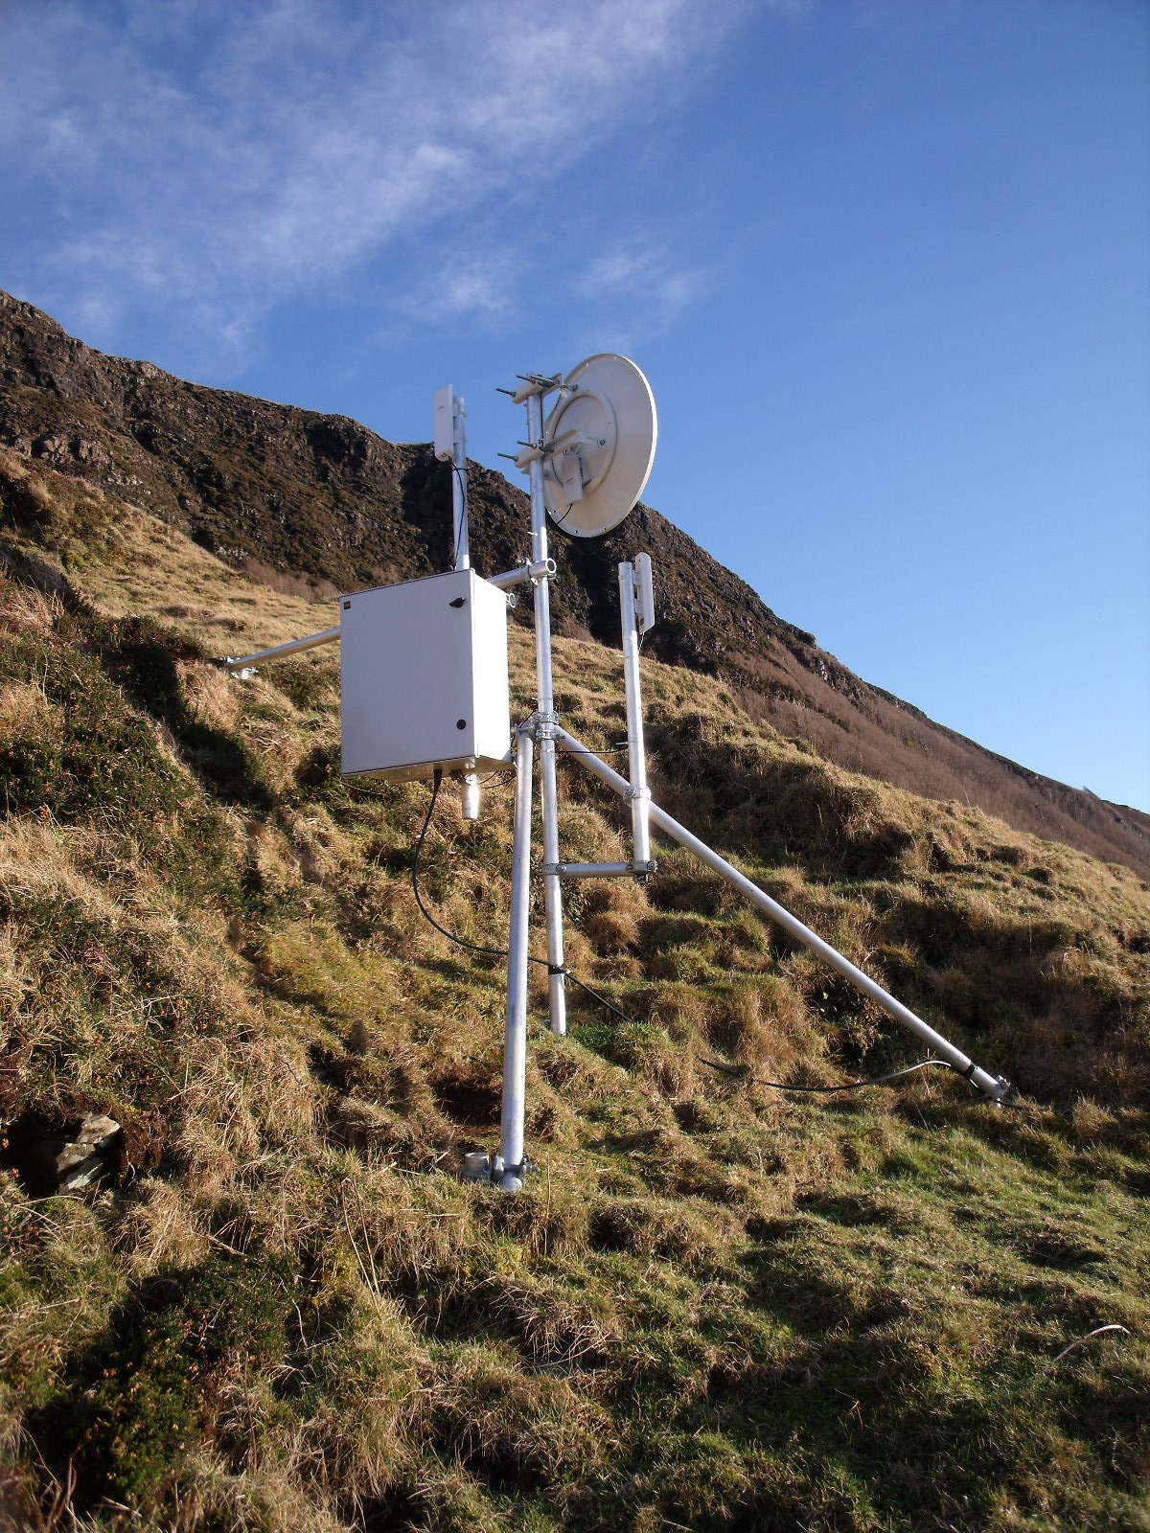

Slide 7
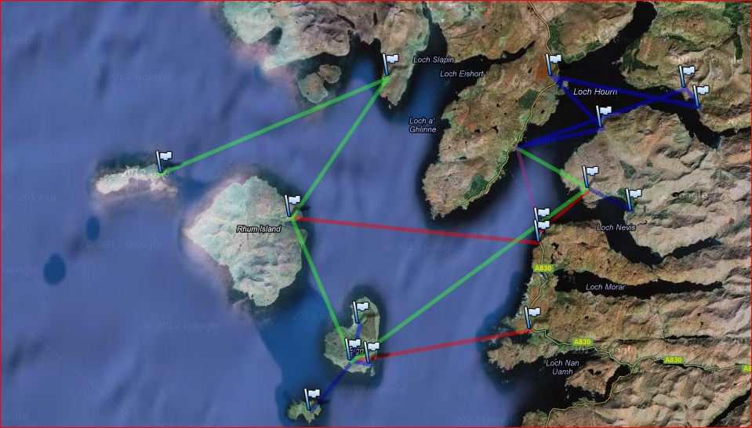

Slide 8
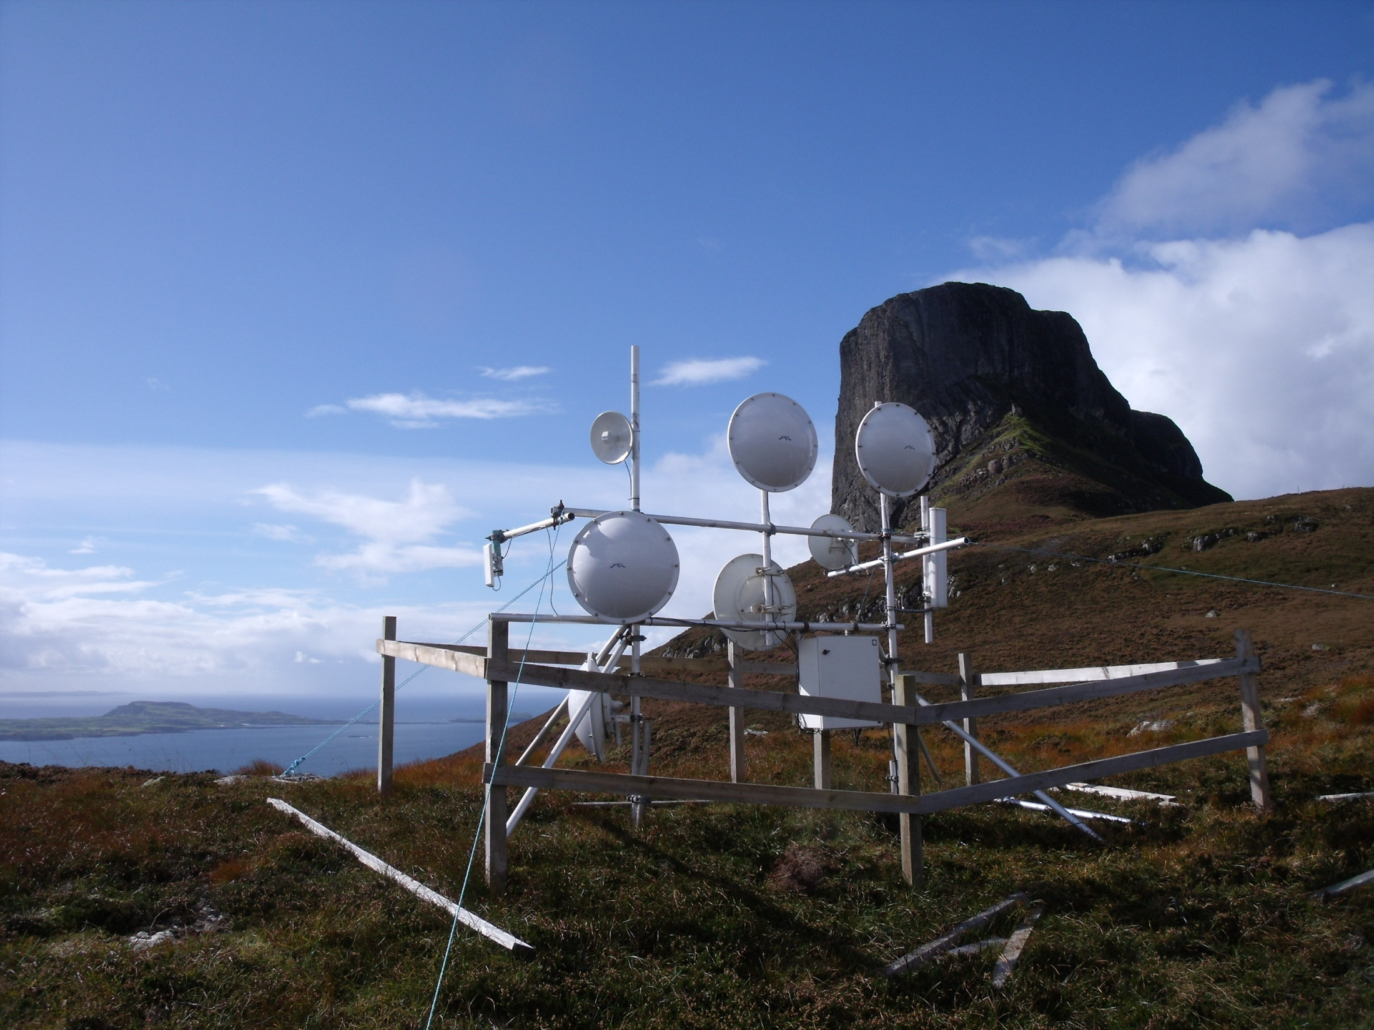

Slide 9
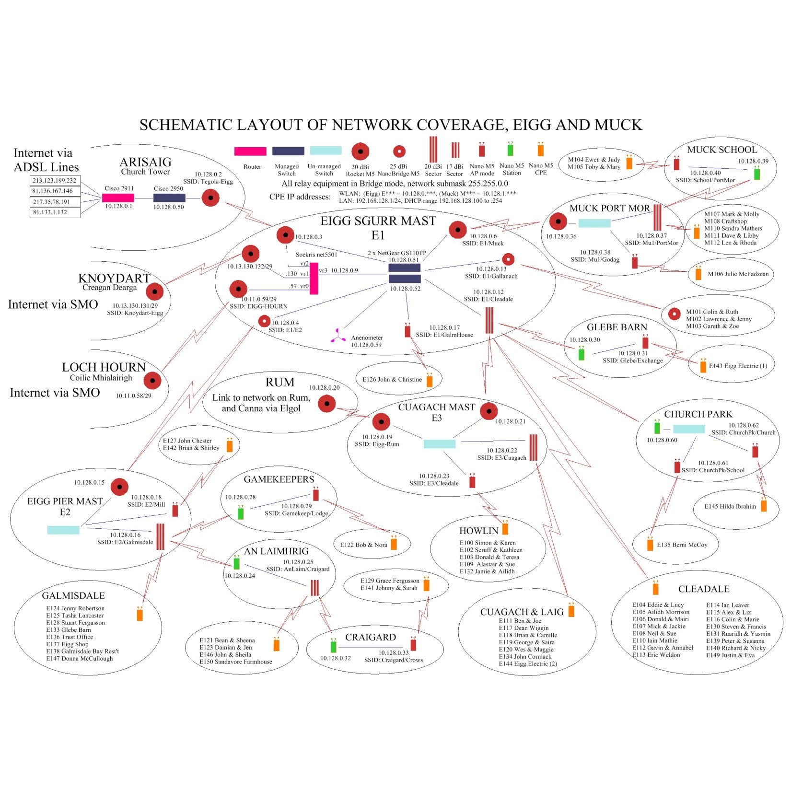

Slide 10
What impact has HebNet had?
Given all households decent broadband access (fast, economic & reliable)
Opened up possibilities for distance learning for adults (e.g. access to UHI!)
School pupils can log in from home – the GLOW project (Scottish schools national intranet) can be accessed
Local businesses are no longer disadvantaged
Social networking has become possible
Local government online services are now available
Potential for medical care has improved enormously
A simple model for rural community broadband has been developed that is replicable almost anywhere

Slide 11
What are the benefits of a community network?
Ability to set your own pricing – connection fee and monthly subscription
Ability to decide how much bandwidth you receive
For support you call a local resident, not a call centre
More money stays in the local economy
Opens up job opportunities and home based employment
New revenue streams can be generated from local wi-fi ‘hot-spots’ that visitors can access, after making a small payment to log into the network
Backhaul can be purchased on a commercial scale – not possible for individuals

Slide 12
How could Scottish Government help in establishing more community networks?
Set up a dedicated fund.
Require the operators of communication masts (BT etc) to allow affordable access by local communities for their own small antennae.

