Slide 1
The Role of Variability in Learning Generalization: A Computational Modeling Approach
Dissertation Defense Thomas Gorman

Slide 2
Introduction
Investigate effects of training variability on learning and generalization
Focus areas: visuomotor skill learning and function learning tasks

Slide 3
Background and Motivation
Importance of training variability
Research gaps in visuomotor skill learning
Previous research in category learning, language learning, and function learning

Slide 4
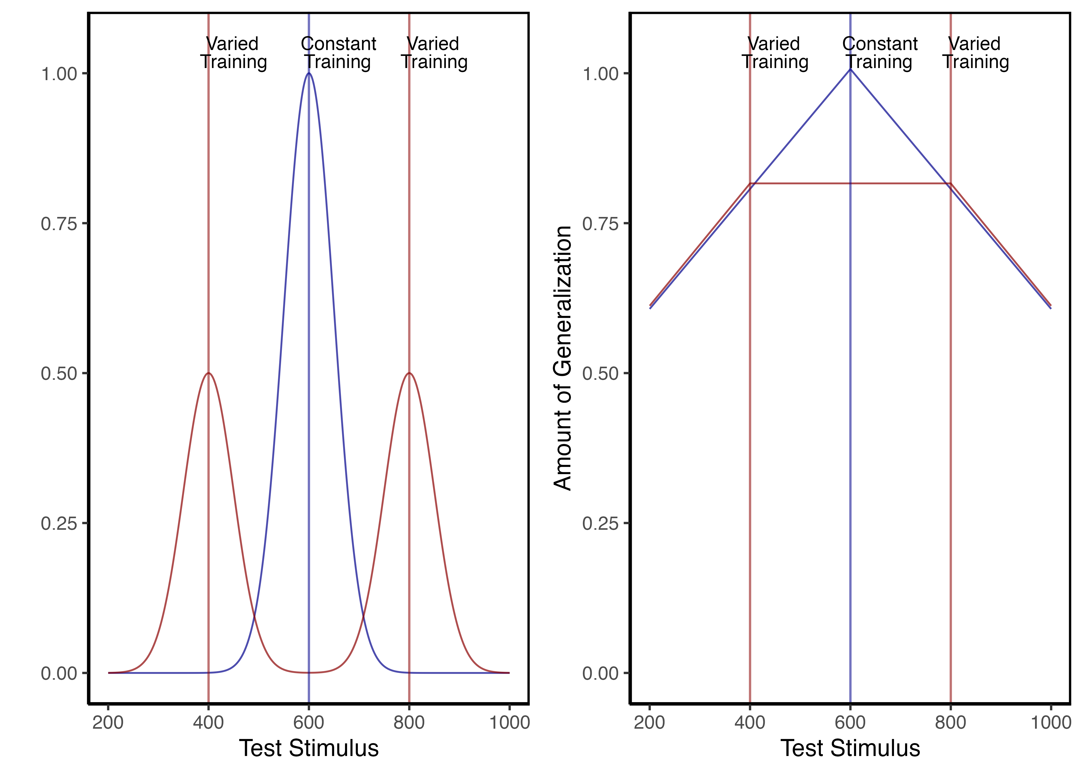
Theoretical Frameworks
Schema Theory (Schmidt, 1975)
Desirable Difficulties Framework (Bjork & Bjork, 2011)
Challenge Point Framework (Guadagnoli & Lee, 2004)

Slide 5
Overview of Current Work
Project 1: Visuomotor projectile launching task
Project 2: Visuomotor extrapolation task

Slide 6
Project 1 - Hit The Target (HTT)
Influence of varied practice in a projectile launching task
Experiments 1 & 2:
Constant vs. varied training groups
Performance metrics and transfer testing

Slide 7
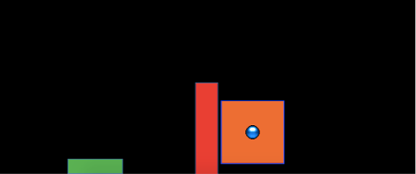
Project 1 - Methodology
Task description and experimental design
Participants and procedures
IGAS model introduction

Slide 8
Project 1 - Results and Discussion
Varied training group’s superior performance
Computational modeling results with IGAS
Theoretical implications

Slide 9
Project 2 - Hit The Wall (HTW)
Influence of varied practice in a function learning task
Experiments 1, 2, and 3:
Training regimes and testing conditions
Learning, discrimination, and extrapolation performance metrics

Slide 10
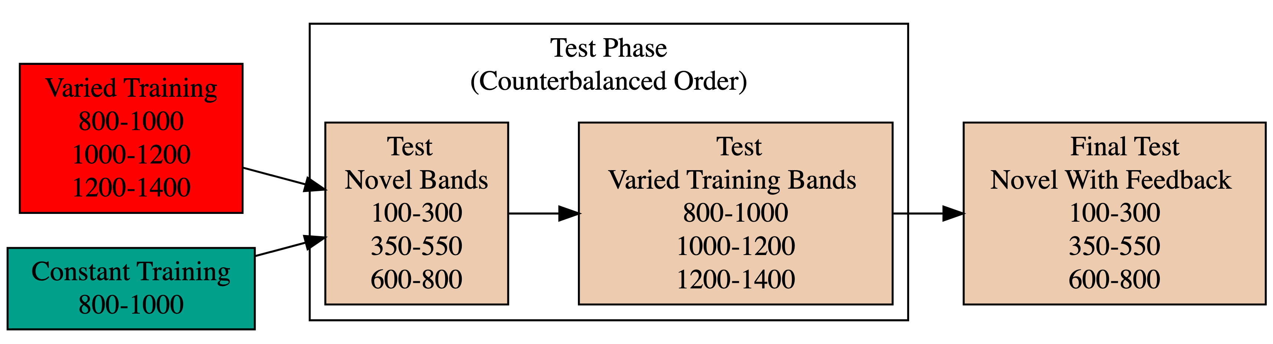
Project 2 - Methodology
Task description and experimental design
Participants and procedures
Application of ALM and EXAM models

Slide 11
Experiment 1 Design. Constant and Varied participants complete different training conditions.

Slide 12
Project 2 - Results and Discussion
Training variability’s mixed results
Modeling analysis with ALM and EXAM
Theoretical implications

Slide 13
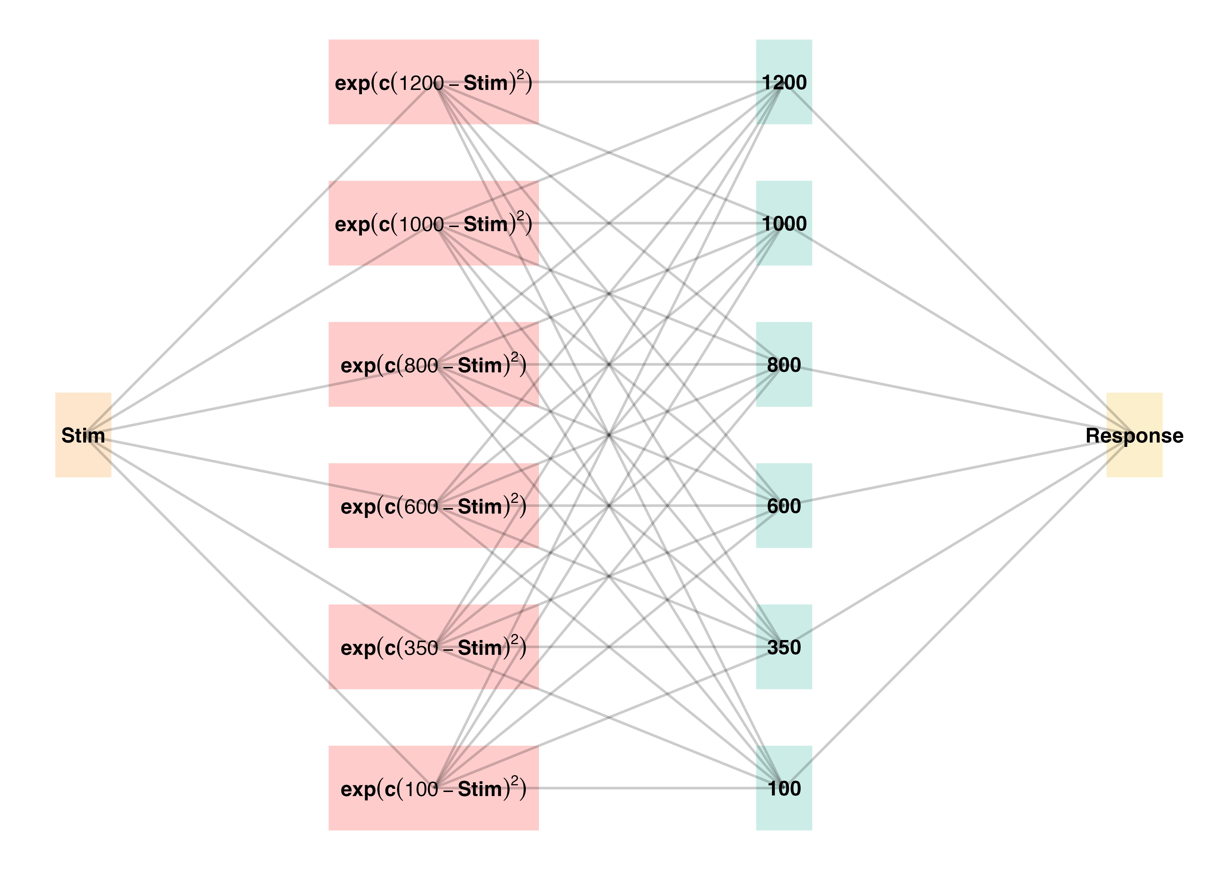
Project 2 - ALM

Slide 14
General Discussion
Compare HTT and HTW
Empirical findings summary
Computational modeling contributions

Slide 15
Theoretical Contributions
Insights into training variability effects on learning and generalization
Computational models applications

Slide 16
Practical Implications
Training programs design implications
Future research considerations

Slide 17
Limitations and Future Directions
Study limitations
Future research suggestions

Slide 18
Conclusion
Recap of key findings
Final thoughts on training variability’s role in learning

Slide 19
Questions and Discussion
Open floor for questions from the committee and audience

