Slide 1
The Role of Variability in Learning Generalization: A Computational Modeling Approach
Dissertation Defense Thomas Gorman

Slide 2
Introduction
Investigate effects of training variability on learning and generalization
Focus areas: visuomotor skill learning and function learning tasks

Slide 3
Background and Motivation
Importance of training variability
Research gaps in visuomotor skill learning
Previous research in category learning, language learning, and function learning

Slide 4
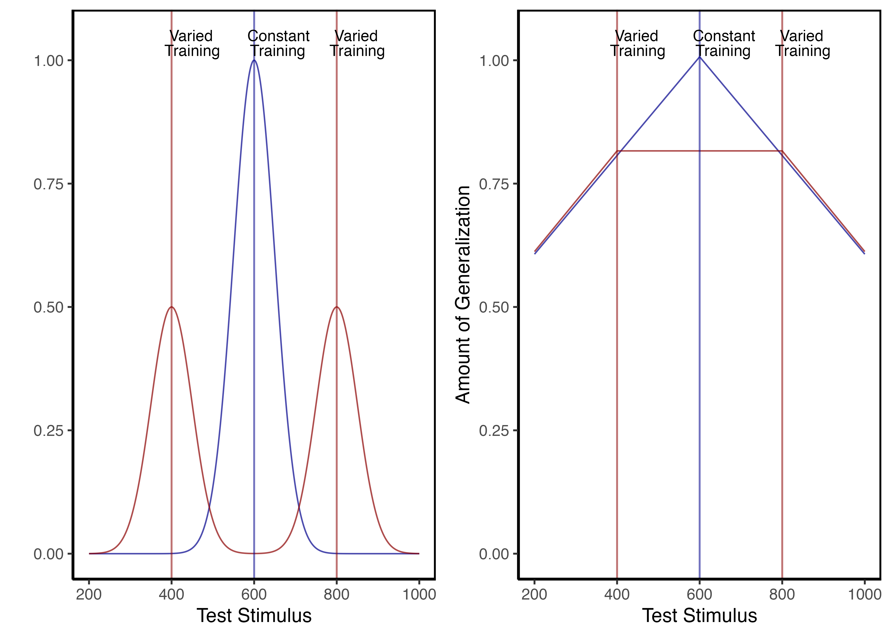
Theoretical Frameworks
Schema Theory (Schmidt, 1975)
Desirable Difficulties Framework (Bjork & Bjork, 2011)
Challenge Point Framework (Guadagnoli & Lee, 2004)

Slide 5
Overview of Current Work
Project 1: Visuomotor projectile launching task
Project 2: Visuomotor extrapolation task

Slide 6
Project 1 - Hit The Target (HTT)
Influence of varied practice in a projectile launching task
Experiments 1 & 2:
Constant vs. varied training groups
Performance metrics and transfer testing

Slide 7

Project 1 - Methodology
Task description and experimental design
Participants and procedures
IGAS model introduction

Slide 8
Project 1 - Results and Discussion
Varied training group’s superior performance
Computational modeling results with IGAS
Theoretical implications

Slide 9
Computational Model
Equation 1:
SimilarityI,J=i=I​j=J​e−c⋅di,jp
Equation 2:
$$d_{i,j}=\sqrt{{\left(x_{Train_{i}}−x_{Solution_{j}}\right)}^{2}+{\left(y_{Train_{i}}−y_{Solution_{j}}\right)}^{2}}$$

Slide 10
Project 2 - Hit The Wall (HTW)
Influence of varied practice in a function learning task
Experiments 1, 2, and 3:
Training regimes and testing conditions
Learning, discrimination, and extrapolation performance metrics

Slide 11
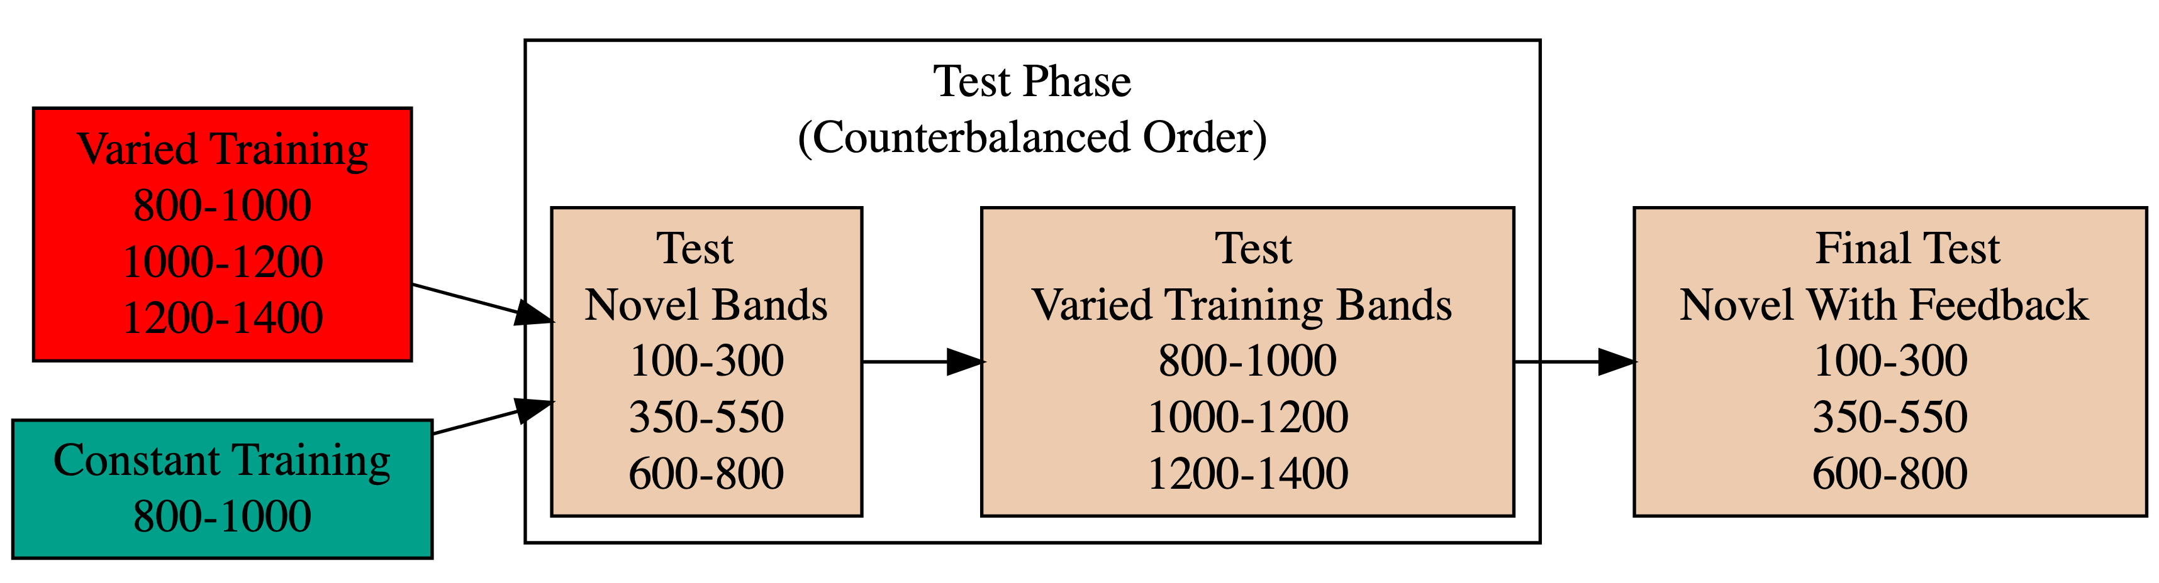
Project 2 - Methodology
Task description and experimental design
Participants and procedures
Application of ALM and EXAM models

Slide 12
Experiment 1 Design. Constant and Varied participants complete different training conditions.

Slide 13
Project 2 - Results and Discussion
Training variability’s mixed results
Modeling analysis with ALM and EXAM
Theoretical implications

Slide 14
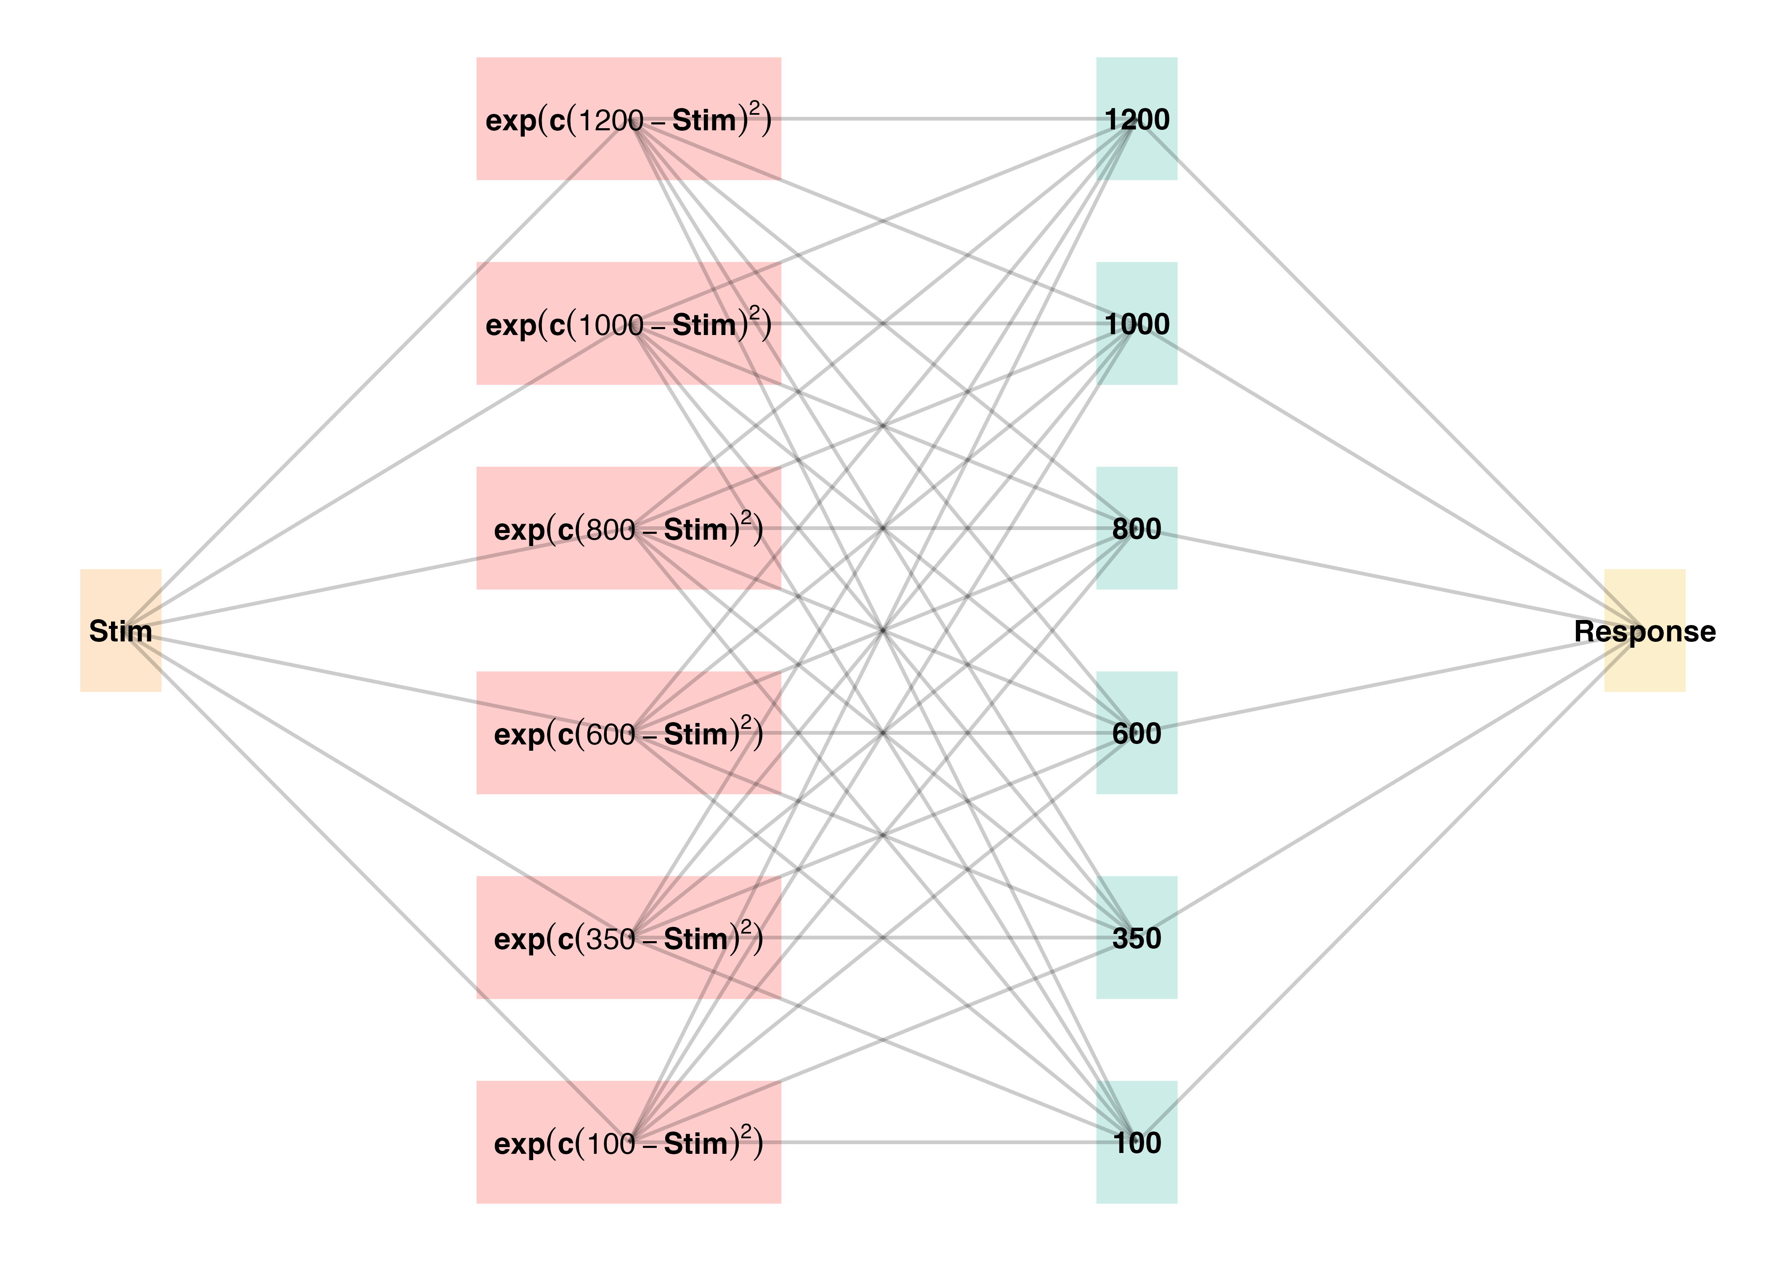
Project 2 - ALM

Slide 15
General Discussion
Compare HTT and HTW
Empirical findings summary
Computational modeling contributions

Slide 16
Comparison
Dimension | HTT (Project 1) | HTW (Project 2)
Task Description | Projectile launching to hit a target | Projectile launching to hit wall at a specific velocity
Task Complexity | More complex parabolic trajectory, both x and y velocities relevant to outcome | Simpler 1D mapping of force to outcome. Only x velocity is relevant.
Task Space | More complex: xy velocity combinations closer to the solution space may still result in worse feedback due to striking the barrier. | Simpler: smooth, linear mapping between velocity and feedback.
Perceptual salience of Varied Conditions | Varied conditions (# of throwing distances) are perceptually distinct, i.e. salient differences in distance between launching box and target. | Varied conditions (# of velocity bands) are less salient - only difference is the numeral displayed on screen.
Testing Feedback | Testing always included feedback | Primary testing stage had no feedback.
Potential for Learning during Testing | Limited potential for learning during testing due to feedback. | Some potential for learning during no-feedback testing by observing ball trajectory.
Training Experience | Varied group gets half as much experience on any one position as the constant group. | Varied group gets 1/3 as much experience on any one velocity band as the constant group.
Testing Structure | Random interleaving of trained/transfer testing distances. | Blocked structure, separately testing trained vs extrapolation testing bands.

Slide 17
Theoretical Contributions
Insights into training variability effects on learning and generalization
Computational models applications

Slide 18
Practical Implications
Training programs design implications
Future research considerations

Slide 19
Limitations and Future Directions
Study limitations
Future research suggestions

Slide 20
Conclusion
Recap of key findings
Final thoughts on training variability’s role in learning

Slide 21
Questions and Discussion
Open floor for questions from the committee and audience

