Slide 1
Calibrating Trust in an LLM Energy Advisor
The Impact of Linguistic Uncertainty on User Trust and Decision Making Thomas E. Gorman Torsten Reimer

Slide 3
Background
Energy Knowledge
LLM Uncertainty
Attari et al. (2010) Steyvers et al. (2025)

Slide 4
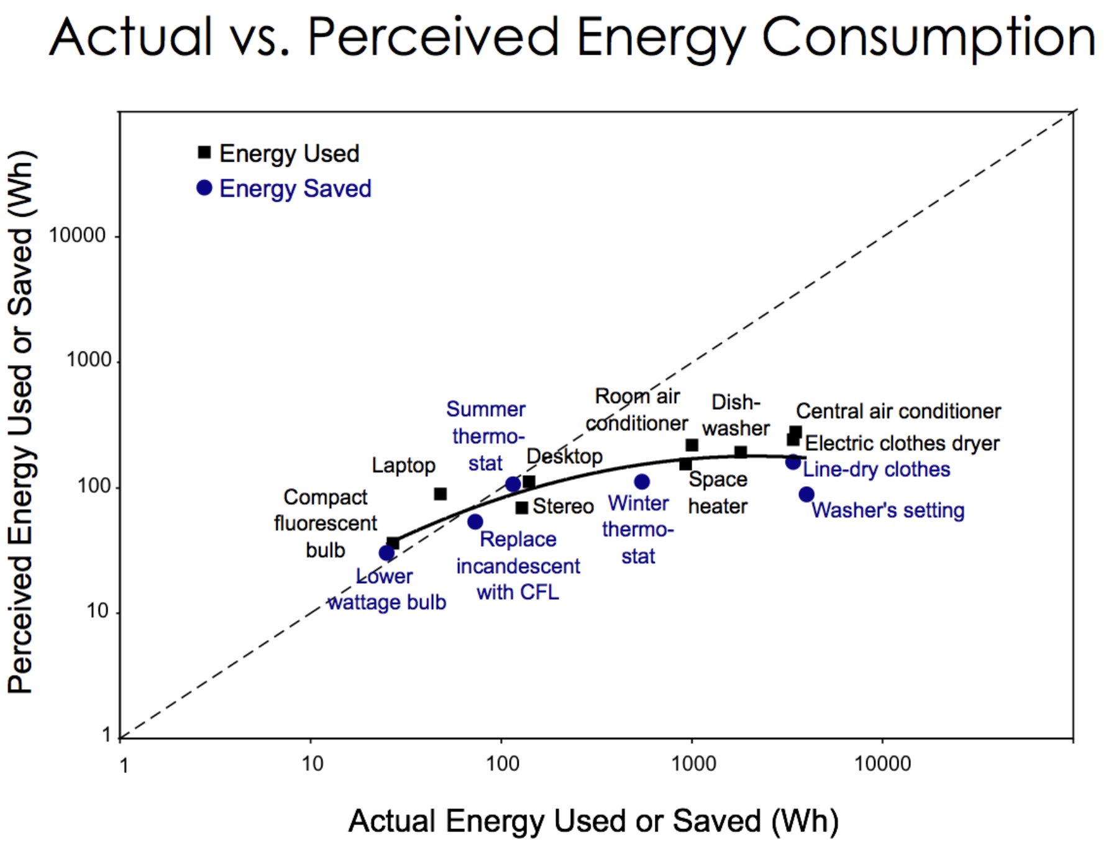
Attari et al. (2010)
Estimation Task
Compression pattern. Underestimation of high-energy appliances and overestimation of low-energy items.
Some evidence suggesting that the effect occurs due to people using unreliable heuristics when making estimates - e.g,. a size heuristic (thinking that larger appliances use more energy)
Attari et al. (2010)
Attari 2010 pattern

Slide 5
Estimation Task
Participants given a reference point (100 W lightbulb) and asked to estimate the energy use of various household appliances.

Slide 6
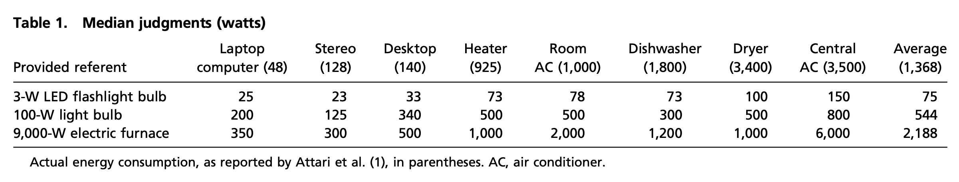
Anchor Influence
Results can vary depending on the anchor used.
Frederick et al. (2011) used the original Attari et al. (2010) anchor (100 W lightbulb), along with smaller flashlight bulb, and larger electric furnace

Slide 7
Cues and Heuristics
Schille-Hudson et al. (2019) examined relationship between energy estimation ability, and reliance on various observable appliance features.

Slide 8
Cues and Heuristics
Novice Heuristics
Expert Heuristics (subset)
Kantenbacher & Attari (2021)

Slide 9
Steyvers et al. (2025)
LLM’s tend to use confident language, even when they are uncertain.
The expressed confidence of the LLM is not always aligned with the internal confidence of the model.

Slide 10
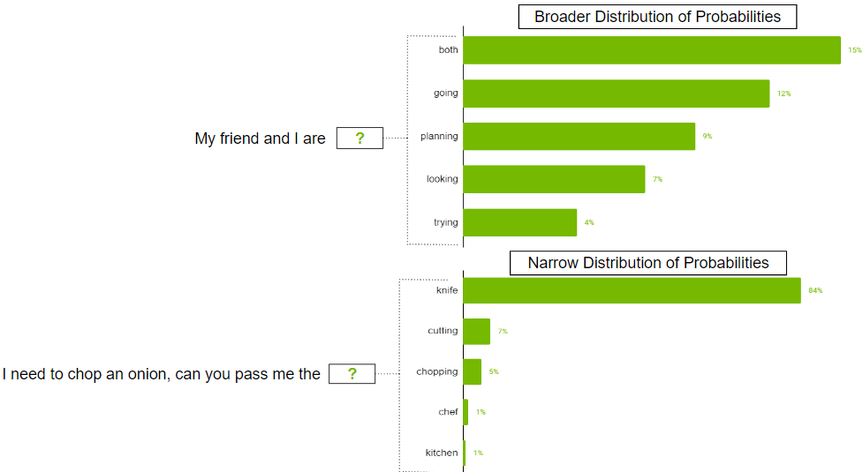
LLM confidence from output layer probabilities

Slide 11
Image from https://developer.nvidia.com/blog

Slide 12
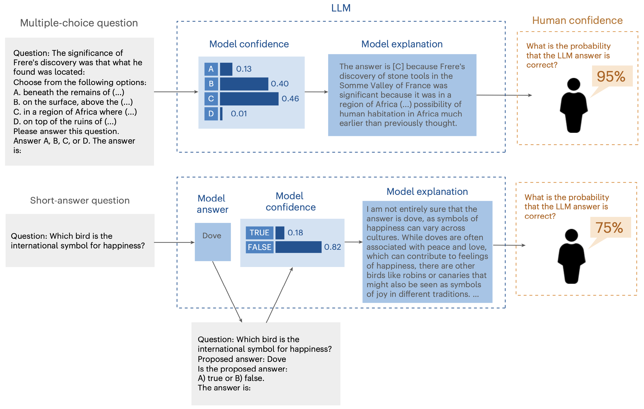
Steyvers et al. (2025)

Slide 13
Steyvers et al. (2025)

Slide 14
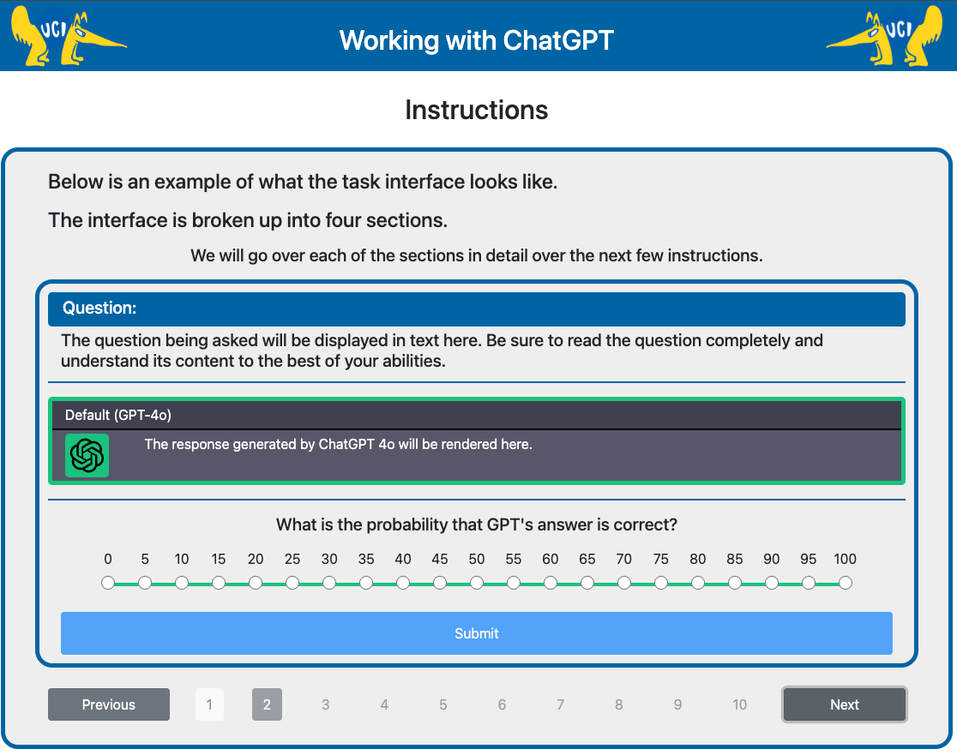
Steyvers Task

Slide 15
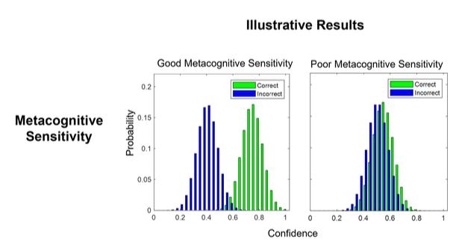
Confidence Calibration

Slide 16
Steyvers & Peters (2025)

Slide 17
Communicating Uncertainty
LLM’s also shown to map uncertainty terms to numeric probabilities in similar fashion to humans (Belem et al., 2024)

Slide 18
Energy AI Tasks
Task from Attari et al. (2010)
Estimate energy of each item
No AI Assistance
Procedure choices
See all items at once, or one at a time
Anchor
Feedback

Slide 19
Energy AI Tasks
Procedure choices
AI Portrayal
Energy Advisor?
ChatGPT response?
Another human participant?

Slide 20
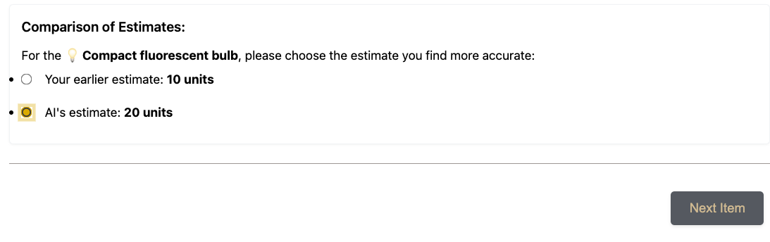
Energy AI Tasks

Slide 21
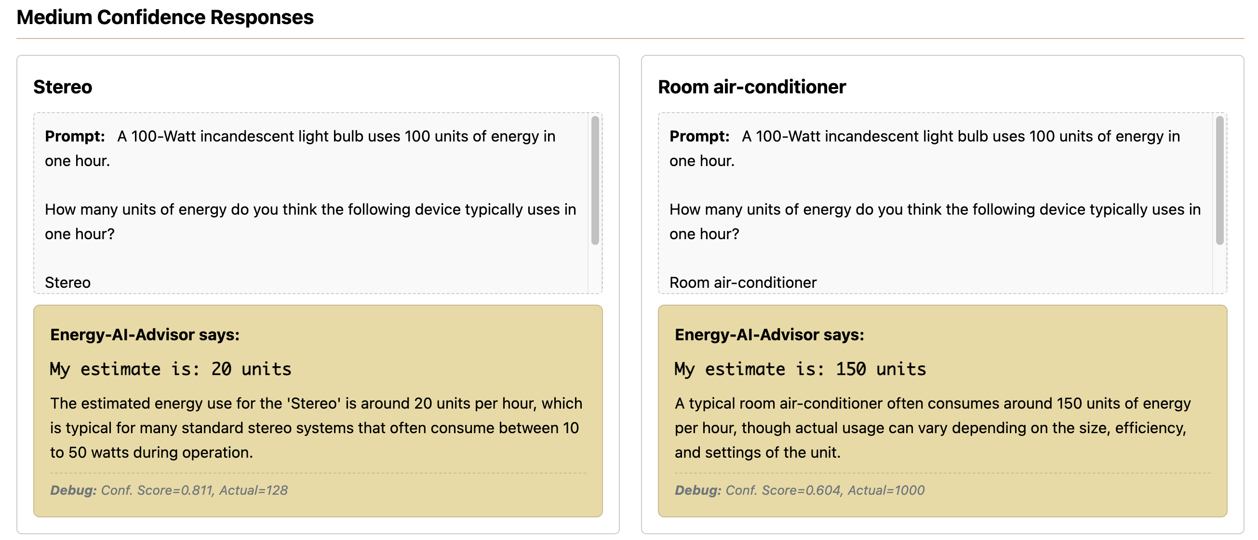
Energy AI Task LLM Explanations

Slide 22
Energy AI Task LLM Explanations

Slide 23
References
Attari, S. Z., DeKay, M. L., Davidson, C. I., & Bruine De Bruin, W. (2010). Public perceptions of energy consumption and savings. Proceedings of the National Academy of Sciences, 107(37), 16054–16059. https://doi.org/10.1073/pnas.1001509107
Belem, C. G., Kelly, M., Steyvers, M., Singh, S., & Smyth, P. (2024). Perceptions of Linguistic Uncertainty by Language Models and Humans (arXiv:2407.15814). arXiv. https://arxiv.org/abs/2407.15814
Frederick, S. W., Meyer, A. B., & Mochon, D. (2011). Characterizing perceptions of energy consumption. Proceedings of the National Academy of Sciences, 108(8), E23–E23. https://doi.org/10.1073/pnas.1014806108
Kantenbacher, J., & Attari, S. Z. (2021). Better rules for judging joules: Exploring how experts make decisions about household energy use. Energy Research & Social Science, 73, 101911. https://doi.org/10.1016/j.erss.2021.101911
Schille-Hudson, E. B., Margehtis, T., Miniard, D., Landy, D., & Attari, S. Z. (2019). Big, hot, or bright? Integrating cues to perceive home energy use. Proceedings of the Annual Meeting of the Cognitive Science Society, 41.
Steyvers, M., & Peters, M. A. K. (2025). Metacognition and Uncertainty Communication in Humans and Large Language Models (arXiv:2504.14045). arXiv. https://doi.org/10.48550/arXiv.2504.14045
Steyvers, M., Tejeda, H., Kumar, A., Belem, C., Karny, S., Hu, X., Mayer, L., & Smyth, P. (2025). What large language models know and what people think they know. Nature Machine Intelligence, 1–11. https://doi.org/10.1038/s42256-024-00976-7

Slide 24
extra

Slide 25
Attari et al. (2010)
Attari 2010 pattern
Attari 2010 pattern
Notes:
higher or lower variability can of course vary greatly between domains
One common manipulation in visuomotor learning is to have a group train with the lowest possible variability - constant
This is a fairly common pattern, at least to my reading. But….,

