Slide 1
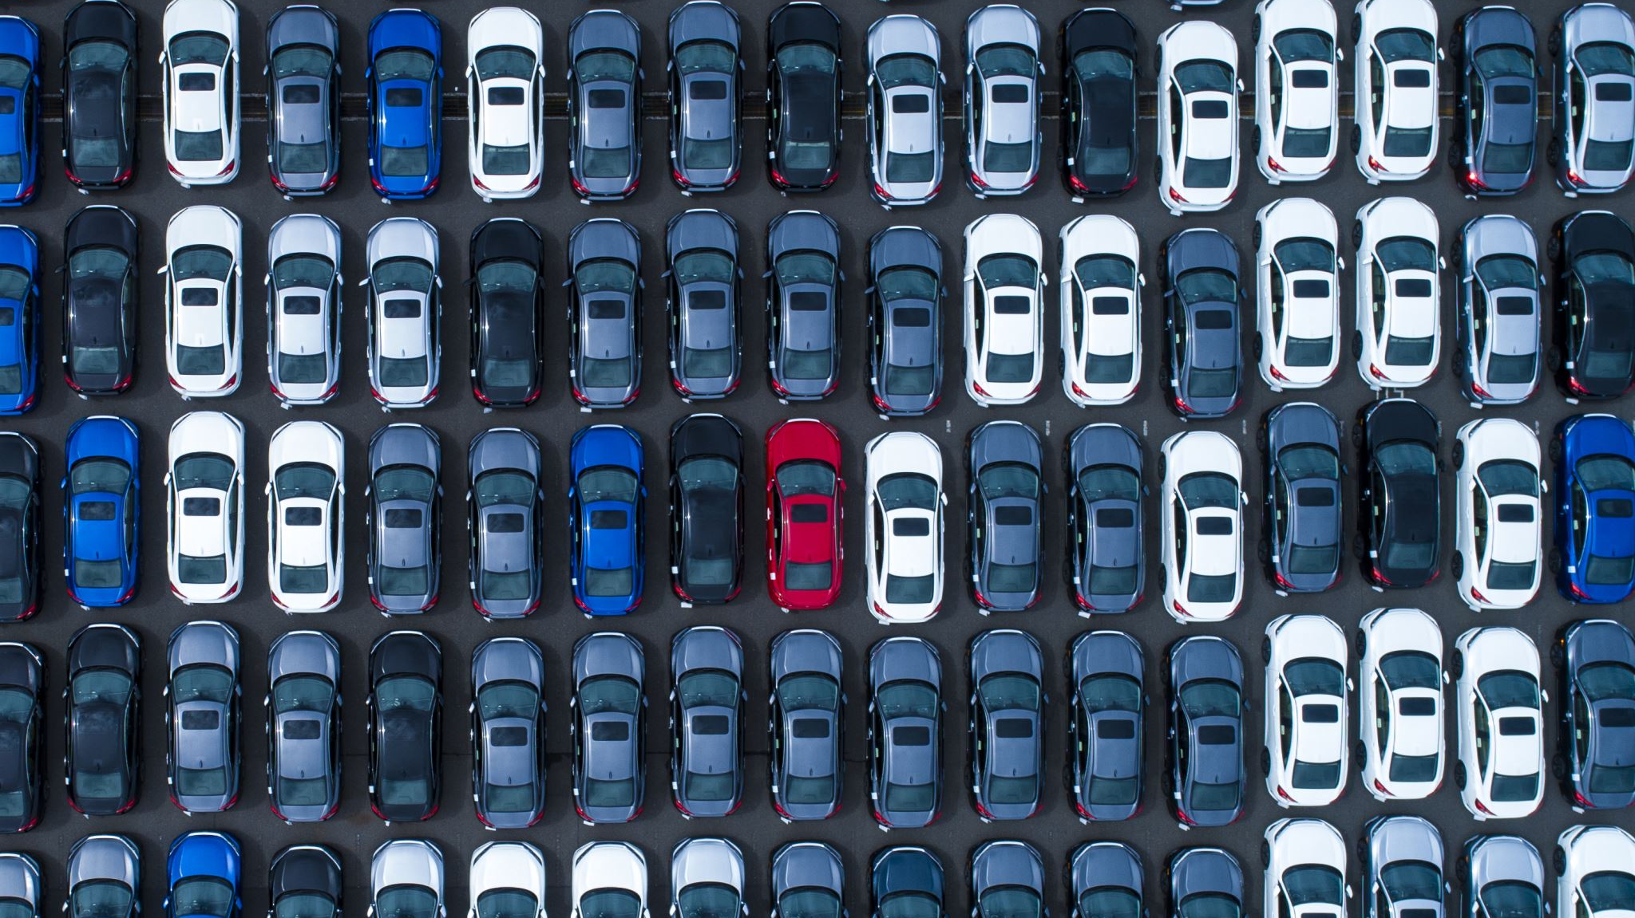
Car Rental System
By: Tegshbayar Ganbat 618066

Slide 2
Overview
Introduction
UML Diagram
Sequence Diagram
High Level Architecture

Slide 3
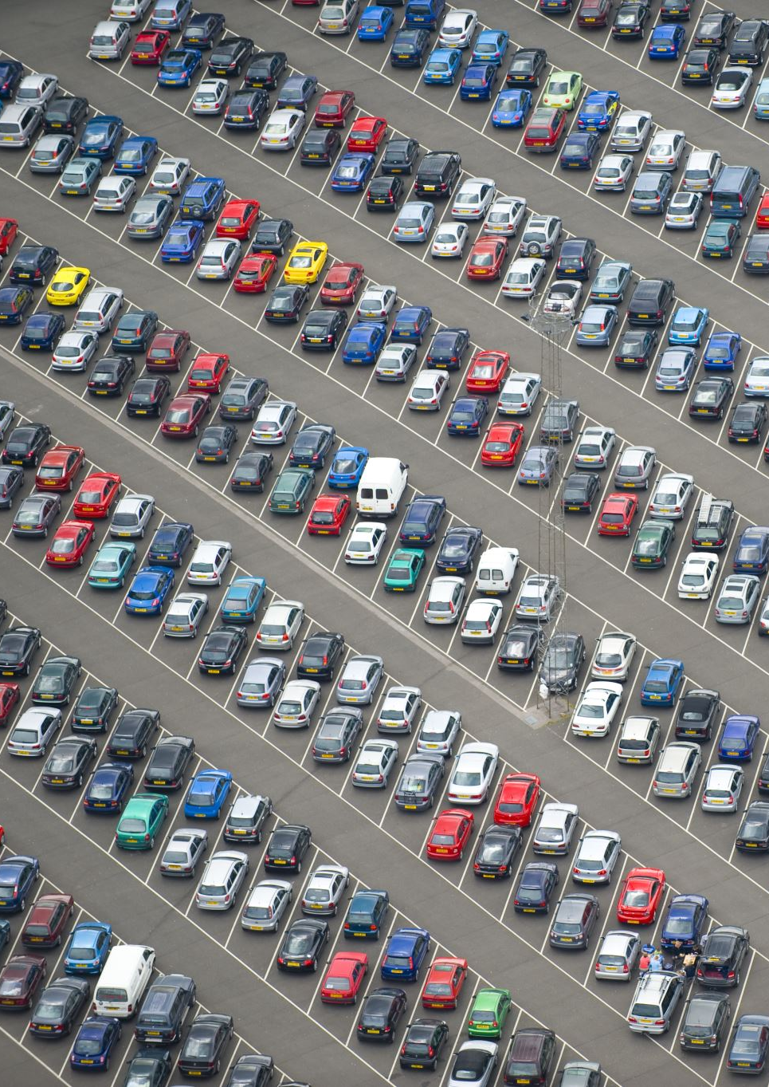
Introduction
The Rental Car Management System is designed to simplify and automate the vehicle rental process for customers and rental companies. It enables customers to search, reserve, rent, and return vehicles, while allowing administrators to efficiently manage vehicle inventory and reservations. The system improves operational efficiency, prevents booking conflicts, and enhances the overall customer experience through a scalable and object-oriented software design.

Slide 4
Actors
Admin
Customer

Slide 5
Admin
Add car
Update car
Remove car

Slide 6
Customer
Create User Account
1
Edit User Account
2
Browse Cars
3
Make Reservations
4
Edit Reservations
5
Cancel Reservations
6

Slide 7
USE CASE
Creating user Account
Make Reservation
Cancel Reservation

Slide 8
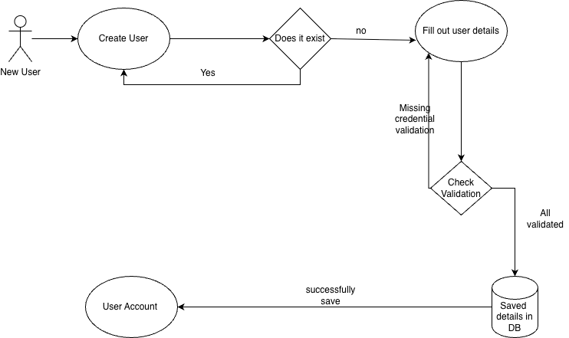
Create User Account

Slide 9
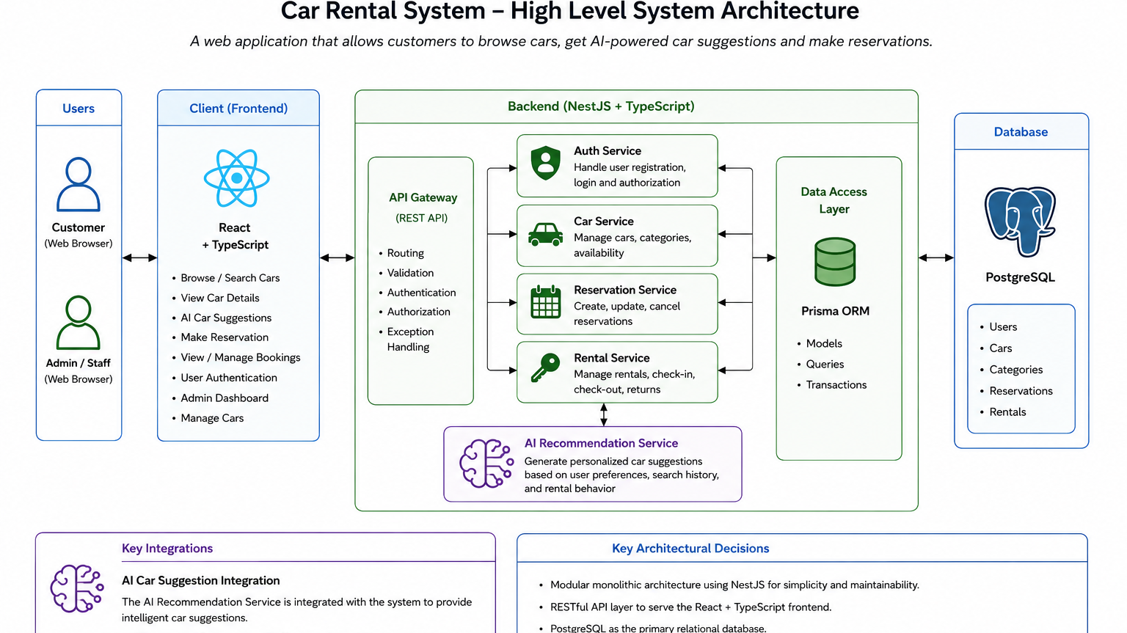

Slide 10
