Slide 1

Конкурентный анализ МИАС

Slide 2
SoftClinic
Who Uses This Software?
Physicians, Clinics, Hospital, Nursing Homes, Healtcare Professionals
SoftClinic is world best EHR & HMS (Hospital Management System) with all required features to run a practice or hospital smoothly and hassle free.
SoftClinic has become preferred choice for respective physicians, clinics, hospital and nursing homes. Currently there are more than a million patients registered on SoftClinic in over 30 countries.
Having various integrated modules like pharmacy, laboratory, human resources and financial accounting, it has everything a physician needs.
www.softclinicsoftware.com

Slide 3
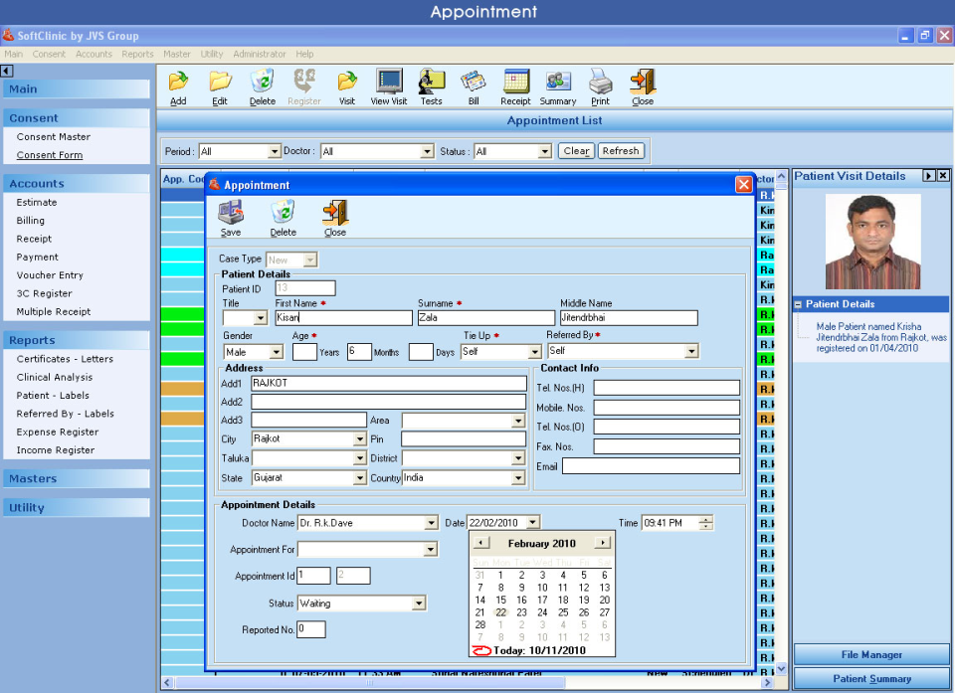
SoftClinic

Slide 4
eHospital Systems
Who Uses This Software?
EHR for Hospitals, Healthcare Facilities, Multi-Specialty Clinics and Medical Practitioners. Multi-Location facilities allows your Hospitals, Satellite Clinics, and Stores to be interconnected.
eHospital Systems is an Electronic Health Records System (EHR) designed to manage all aspects of a hospital operation.
This customizable healthcare solution includes OPD and IPD Management, Pharmacy, Laboratory, Radiology, Ward Management, Mobile Application, Online Appointments Scheduling, Secured Messaging, Doctor Portal, Patient and Family Portals, Billing, Accounting, HR/Payroll, Alert System and HL7/Integrated PACS System.
It is developed following the best practices around the world.
www.adroitinfosystems.com/

Slide 5
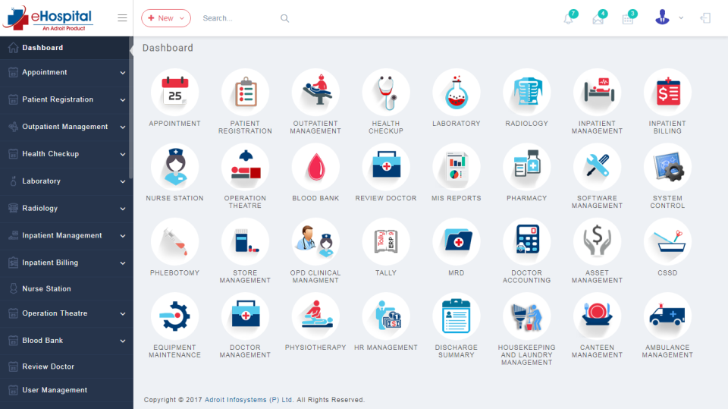
eHospital Systems

Slide 6
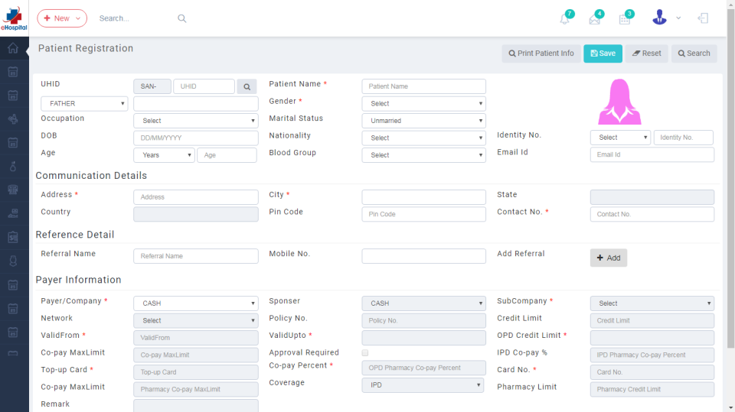
eHospital Systems

Slide 7
Medstar HIS
Who Uses This Software?
The main aim of MedStar HIS is to automate the hospital process and digitalize the date to make a paperless hospital. The system also provides excellent security of data at every level
Medstar HIS, one of the top Hospital Management Software, is a comprehensive Hospital Information & Management System, which can integrate all the HIS systems, processes and machines to an intelligent information system to derive operational efficiency and assist hospitals in making the right decisions quickly through MIS and Analytics.
www.medstarhis.com

Slide 8
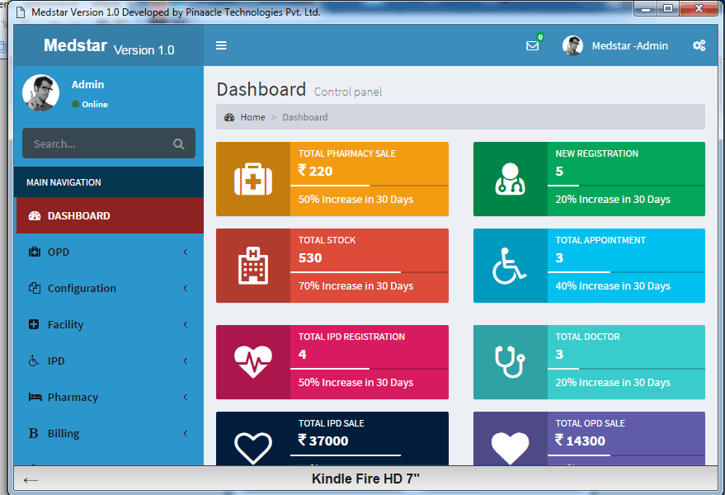
Medstar HIS

Slide 9
HIMS
Who Uses This Software?
HIMS Software is a complete hospital suite serving all functional areas of the hospital. Each of the department's work processes are in tandem with the system's business process. It is user friendly.
(HIMS) Software is a complete hospital suite serving all functional areas of the hospital. Each of the department's work processes are in tandem with the system's business process. It is user friendly software. It can take care of much complex #OPD operation; it covers complete cycle from Application, #Appointment, User Registration, Patient Registration, Patient History, Patient Case File, and #Doctor along with Prescription writing.
akshartechnosoft.blogspot.in

Slide 10
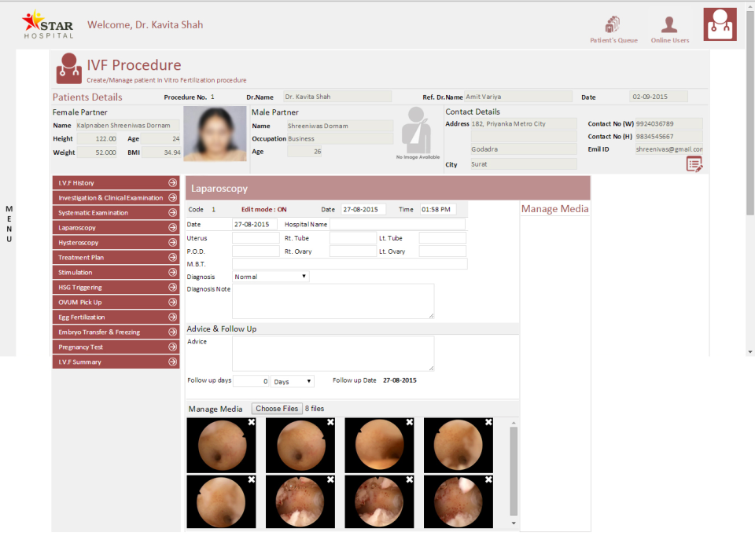
HIMS

Slide 11
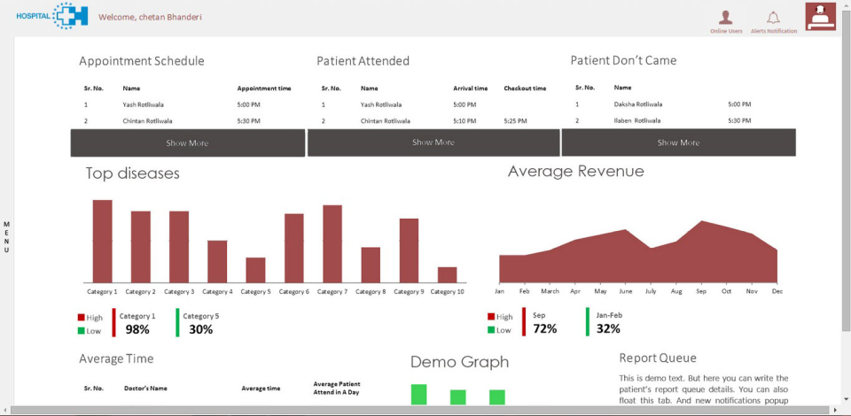
HIMS

Slide 12
Quanta WebHIMS
Who Uses This Software?
We serve clients from various areas including small or large scale hospitals, gynecologist, industrial health management, medical college management, ophthalmology, Insurance etc.
Web based Hospital Information Management System is an ERP suite of software modules to computerize any large scale hospital and connected clinics and its branches.
www.birlamedisoft.com

Slide 13
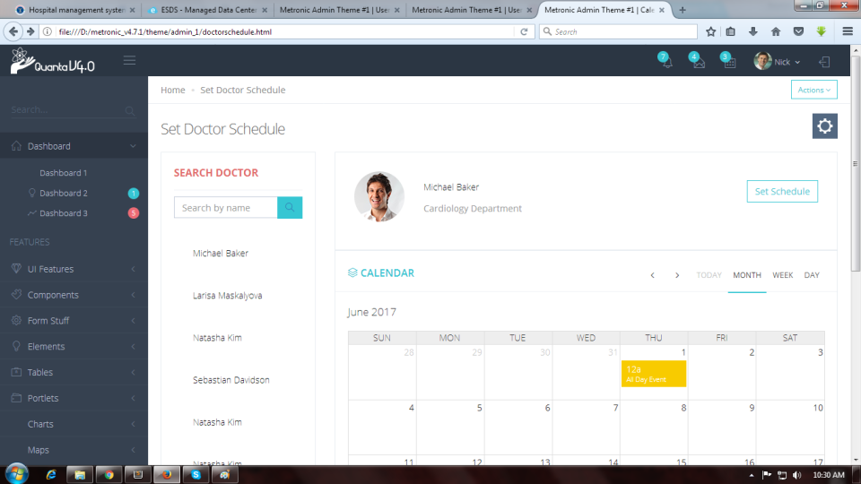
Quanta WebHIMS

Slide 14
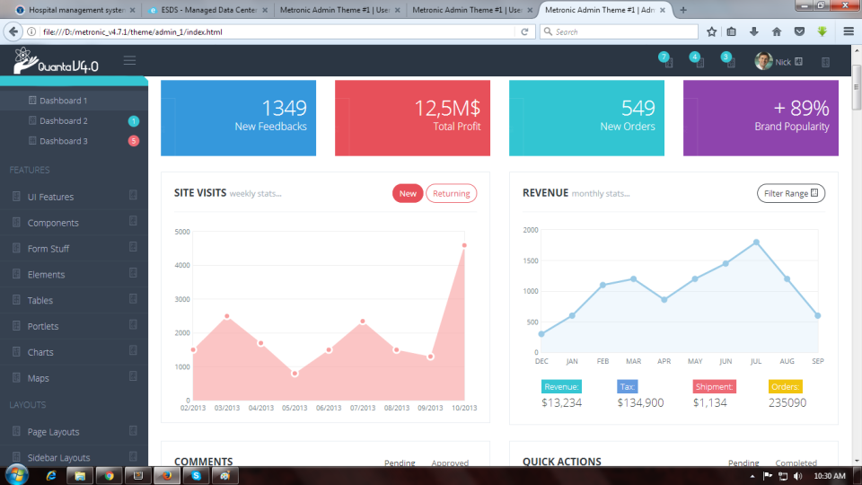
Quanta WebHIMS

Slide 15
Quanta WebHIMS

