Slide 1
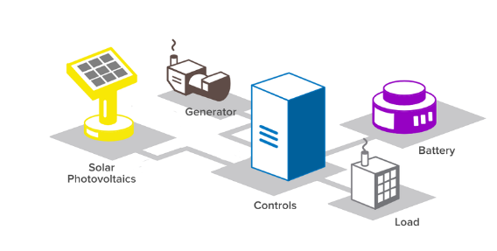

Model – System architecture
Market’s bids:
Overall power to be decreased and related unit benefit
LU’s emulation and AGG optimization problem
Initial states and model parameters
Prices and Reference values
Buildings
Microgrids
LU’s Objective functions

Slide 2
Optimization problem
Demand Response
EV
Charging
User Comfort
Usually on a particular time interval

Slide 3
Power Balance & Storage Constraints
Power balance
DATA
VAR
VAR
VAR
DATA
DATA
VAR
VAR
VAR
Storage
Bounds on min and max values

Slide 4
Electric Vehicles
Bounds on min and max values
Time at which the charging must be completed

Slide 5
Temperature model
Radiation and people
Internal temperature
fan coils
thermal fluxes exchanged between the building and the external environment
Bounds on min and max values
Thermal capacity

Slide 6
Project for the report

Slide 7
WE HAVE i=1,…,N local users
Change storage state equation
Add heat pump
Add EV
t=0,1,2…..T-1
i=1…..N

Slide 8
BOUNDS
Add all other bound constraints
Add Evs demand satisfaction
t=0,1,2…..T-1
i=1…..N

Slide 9
The objective function: case without demand response
Cost for energy taken from the grid
Cost for gas used in generation units
Cost for energy sold tothe grid
Add tracking comfort temperature
Add emissions

Slide 10
Three microgrids
Microgrid 1: photovoltaics, electrical storage, fossil fuel, connection to the external grid, fixed electrical demand, connected to Microgrid 2
Microgrid 2: electric vehicles (V2G), building with heat pump, wind power, electrical demand fixed and deferrable, connection to Microgrid 1 and Microgrid 3;
Microgrid 3: connection to microgrid 2 and to the external grid, storage system, fixed electrical demand
Objectives: minimize costs and emissions (30€ per tonns of CO2)
Find the pareto curve (costs (including those of emissions, tracking)
Eliminate tracking comfort temperature, insert bound constraints for temperature, find the pareto curve costs vs emissions

Slide 11
Temperature model
C^B = 0.8 kWh/K;
R^ext = 400; K/kW; EER^HP = 1.8;
Q_int = 0.1 kW (for each person at time t)
Tracking Temperature in the objective function: 21°C
Number of people: 25 from 8 to 13 and from 14 to 16, 0 otherwise
Maximum power from heat pump
Radiation and people
Internal temperature
fan coils
thermal fluxes exchanged between the building and the external environment
Thermal capacity

