Slide 1
rt | stimulus | response | trial_type | time_elapsed | internal_node_id | text | condition
1870 | Welcome to the experiment. Press any key to begin. |  | html-keyboard-response | 1871 | 0.0-0.0
119506 | ["img/circle_blue_1.png","img/circle_green_1.png"] | ["button_image-1"] | VoiceText | 121421 | 0.0-1.0-0.0 | ["No actually pass is a better word because what it does is that it creates a new strings yeah"] | diff
50914 | ["img/circle_blue_2.png","img/circle_green_2.png"] | ["button_image-1"] | VoiceText | 172339 | 0.0-1.0-1.0 | ["Asking you that with the prompt and the stimulus and then yeah and then you click on one of"] | easy
13769 | ["img/circle_blue_3.png","img/circle_green_3.png"] | ["button_image-2"] | VoiceText | 186112 | 0.0-1.0-2.0 | ["Again I was active know you say I don't know which one and then you say"] | easy

Slide 2
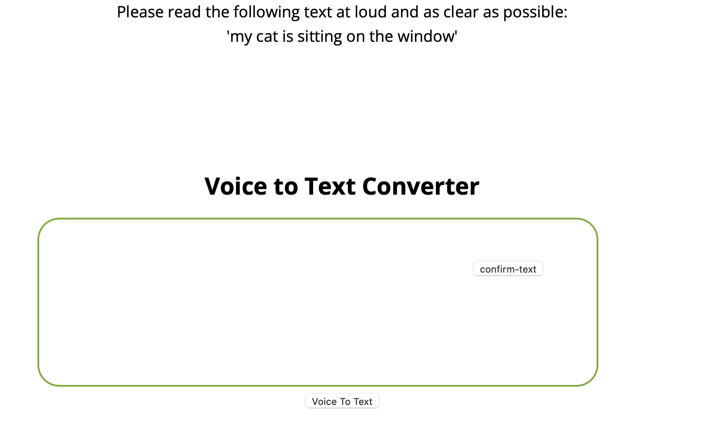
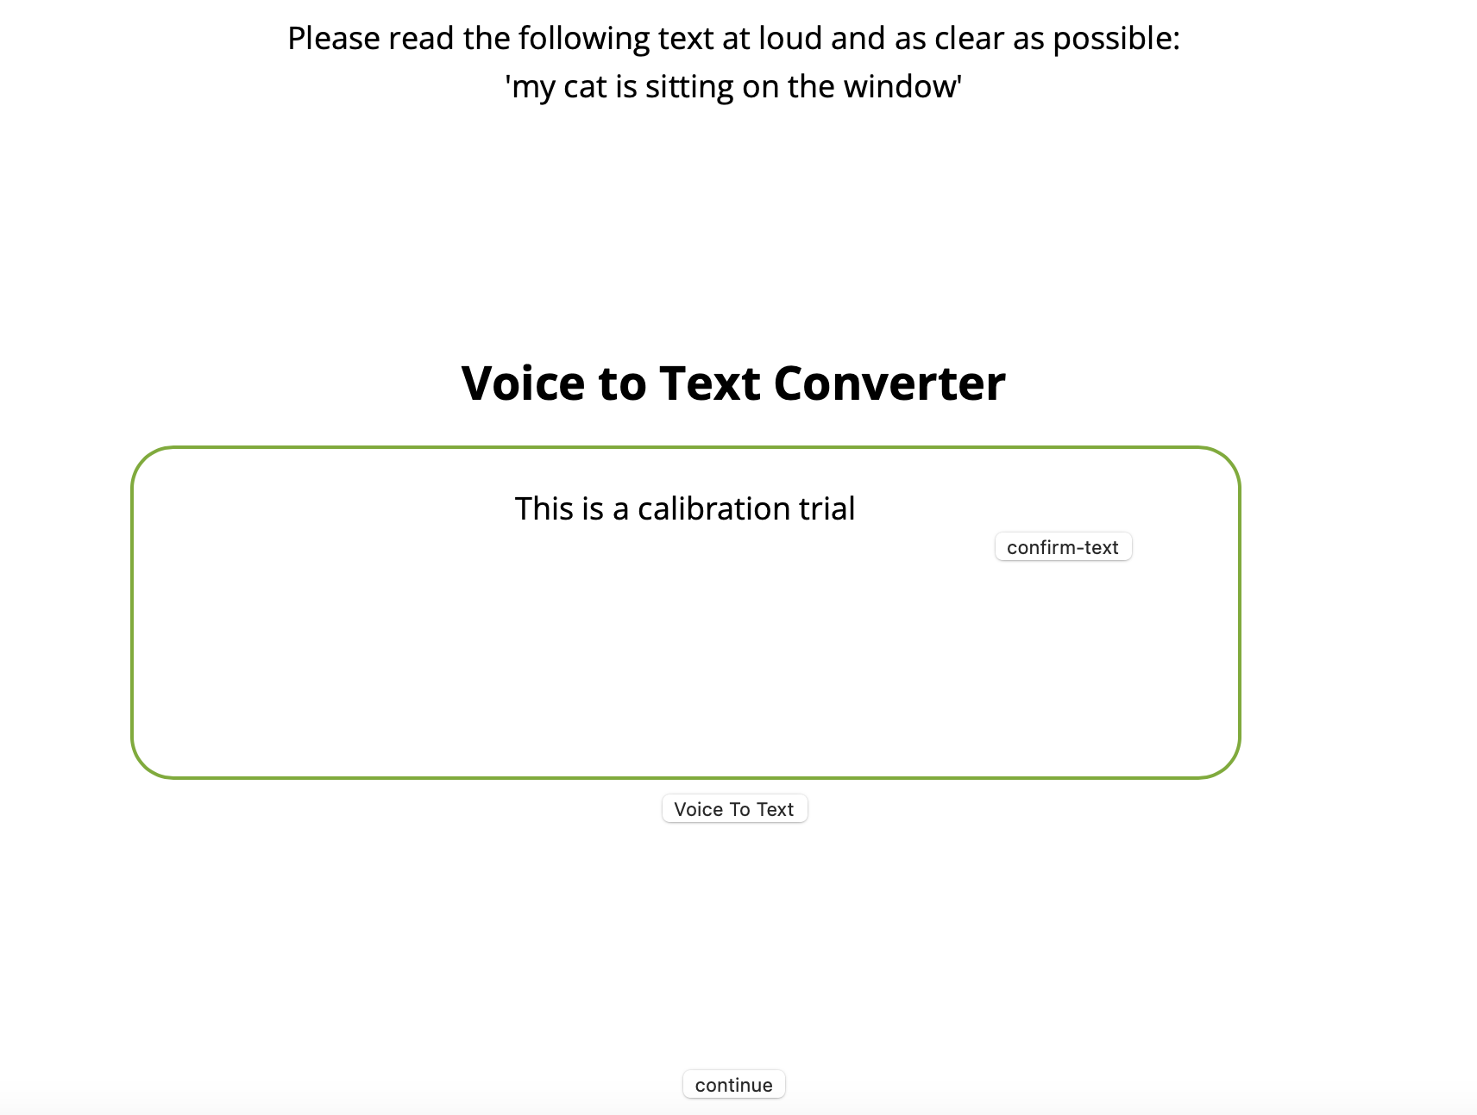
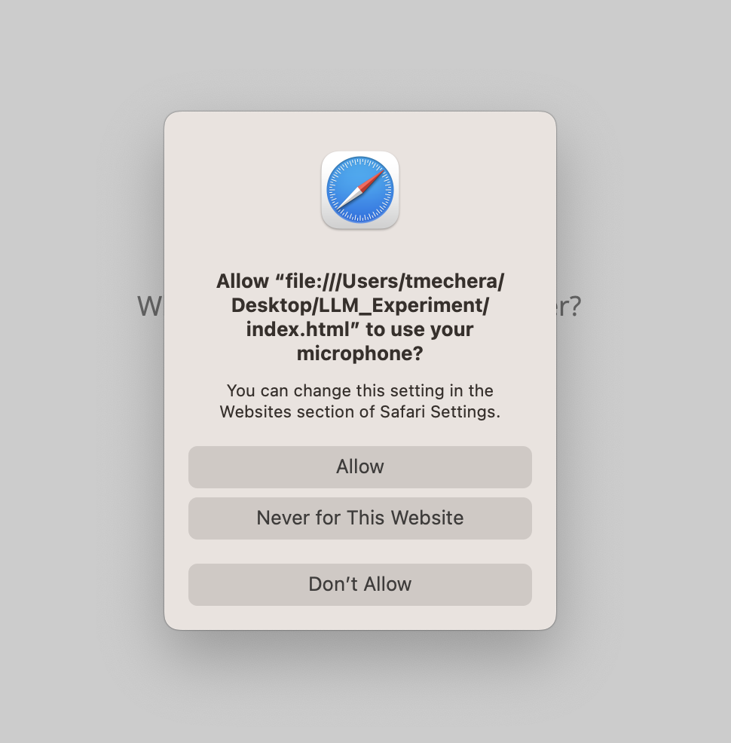
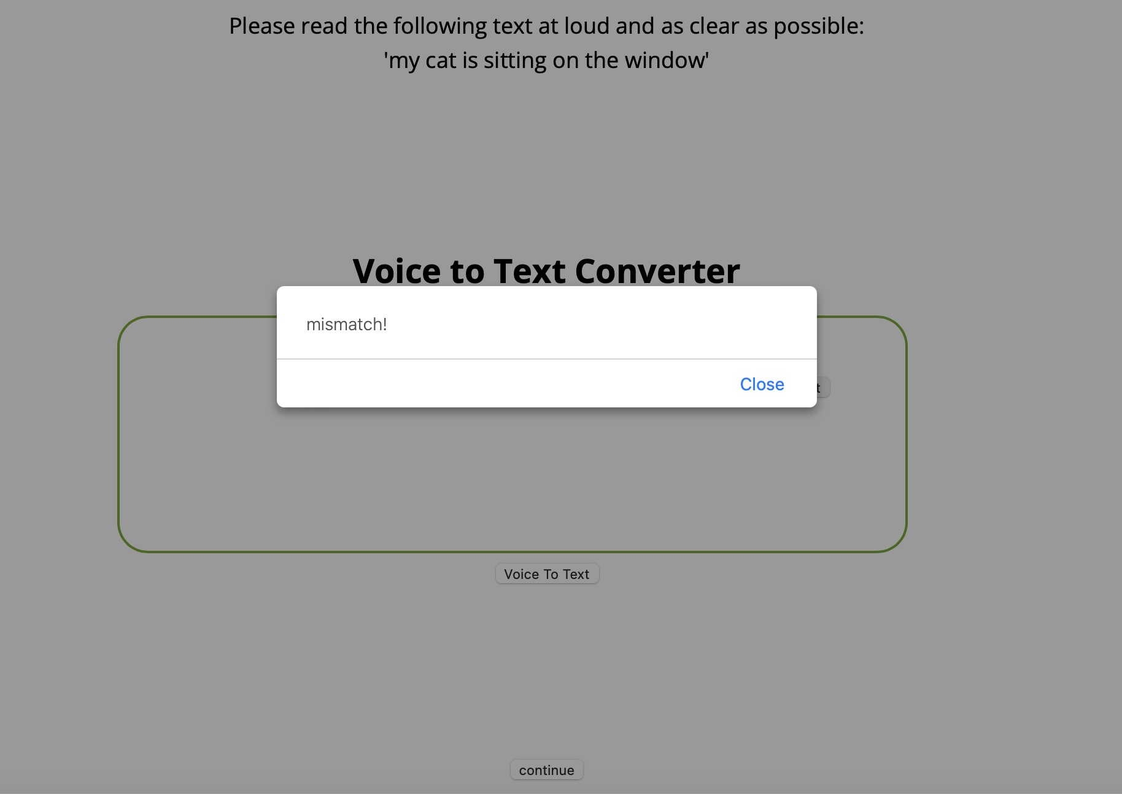
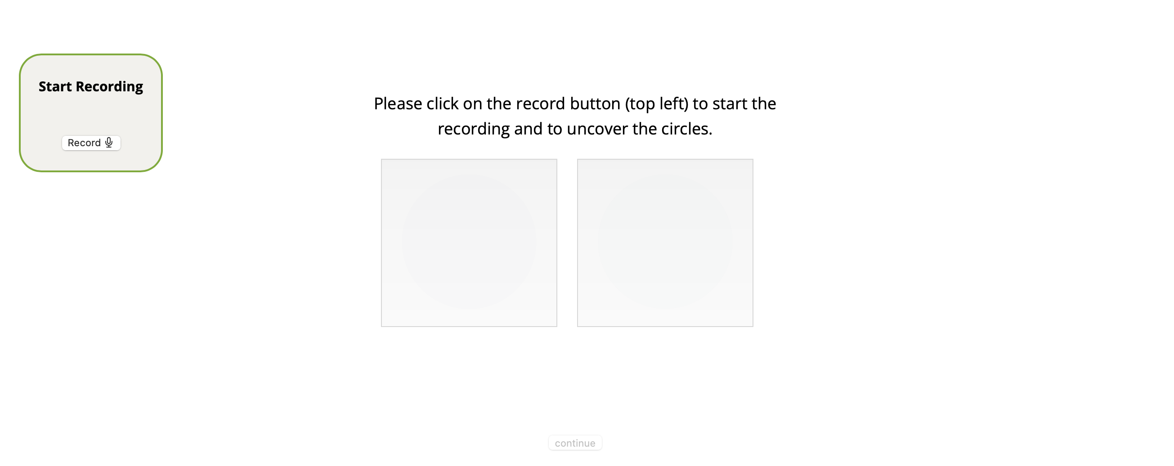
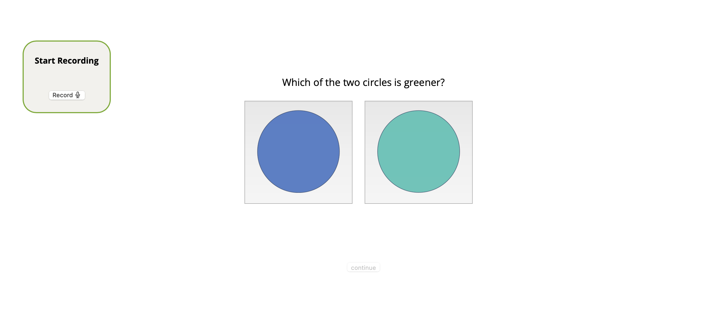
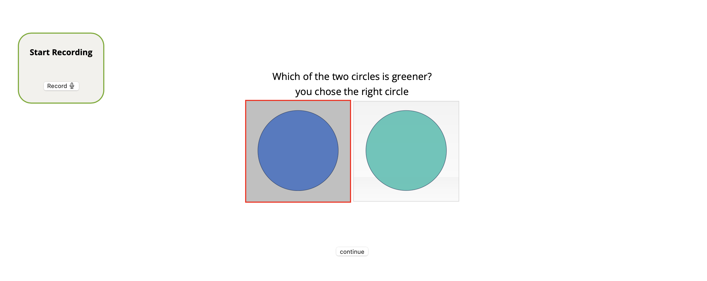
Output/Data
rt | stimulus | response | trial_type | time_elapsed | internal_node_id | text | condition
1870 | Welcome to the experiment. Press any key to begin. |  | html-keyboard-response | 1871 | 0.0-0.0
119506 | ["img/circle_blue_1.png","img/circle_green_1.png"] | ["button_image-1"] | VoiceText | 121421 | 0.0-1.0-0.0 | ["No actually pass is a better word because what it does is that it creates a new strings yeah"] | diff
50914 | ["img/circle_blue_2.png","img/circle_green_2.png"] | ["button_image-1"] | VoiceText | 172339 | 0.0-1.0-1.0 | ["Asking you that with the prompt and the stimulus and then yeah and then you click on one of"] | easy
13769 | ["img/circle_blue_3.png","img/circle_green_3.png"] | ["button_image-2"] | VoiceText | 186112 | 0.0-1.0-2.0 | ["Again I was active know you say I don't know which one and then you say"] | easy
Time-Line

