Slide 1
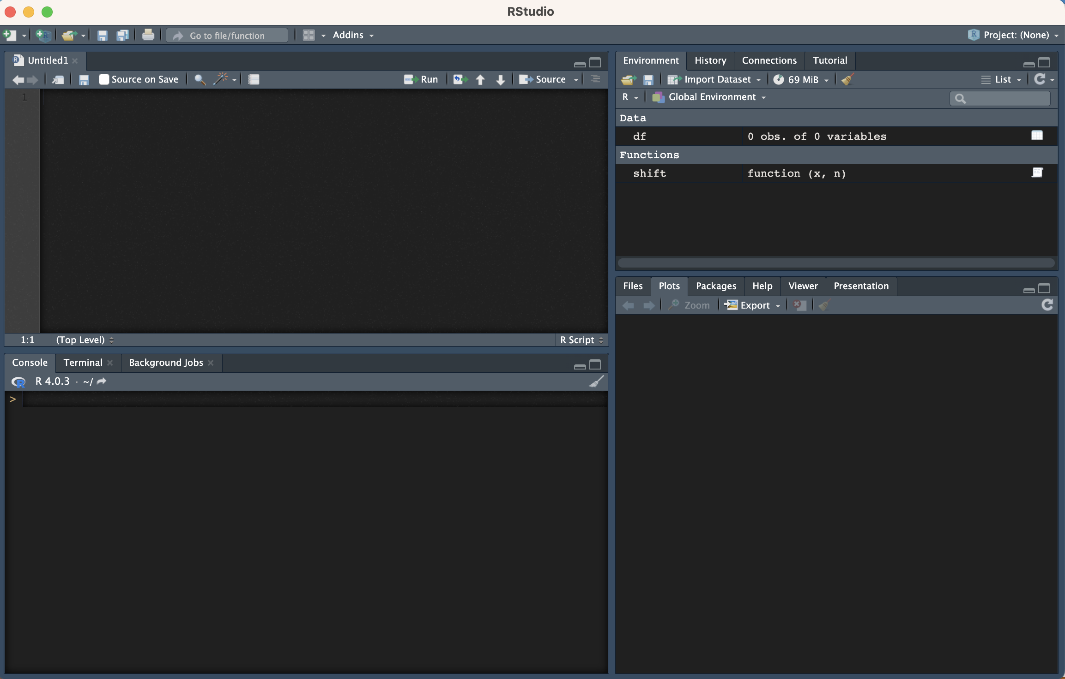
SCRIPT (OUR CODE)
ENVIRONMENT - SAVED VARIBALES VISIBLE
CONSOLE (OUR CODE’S EXECUSION)
HELP, FILES AND PLOTS

Slide 2
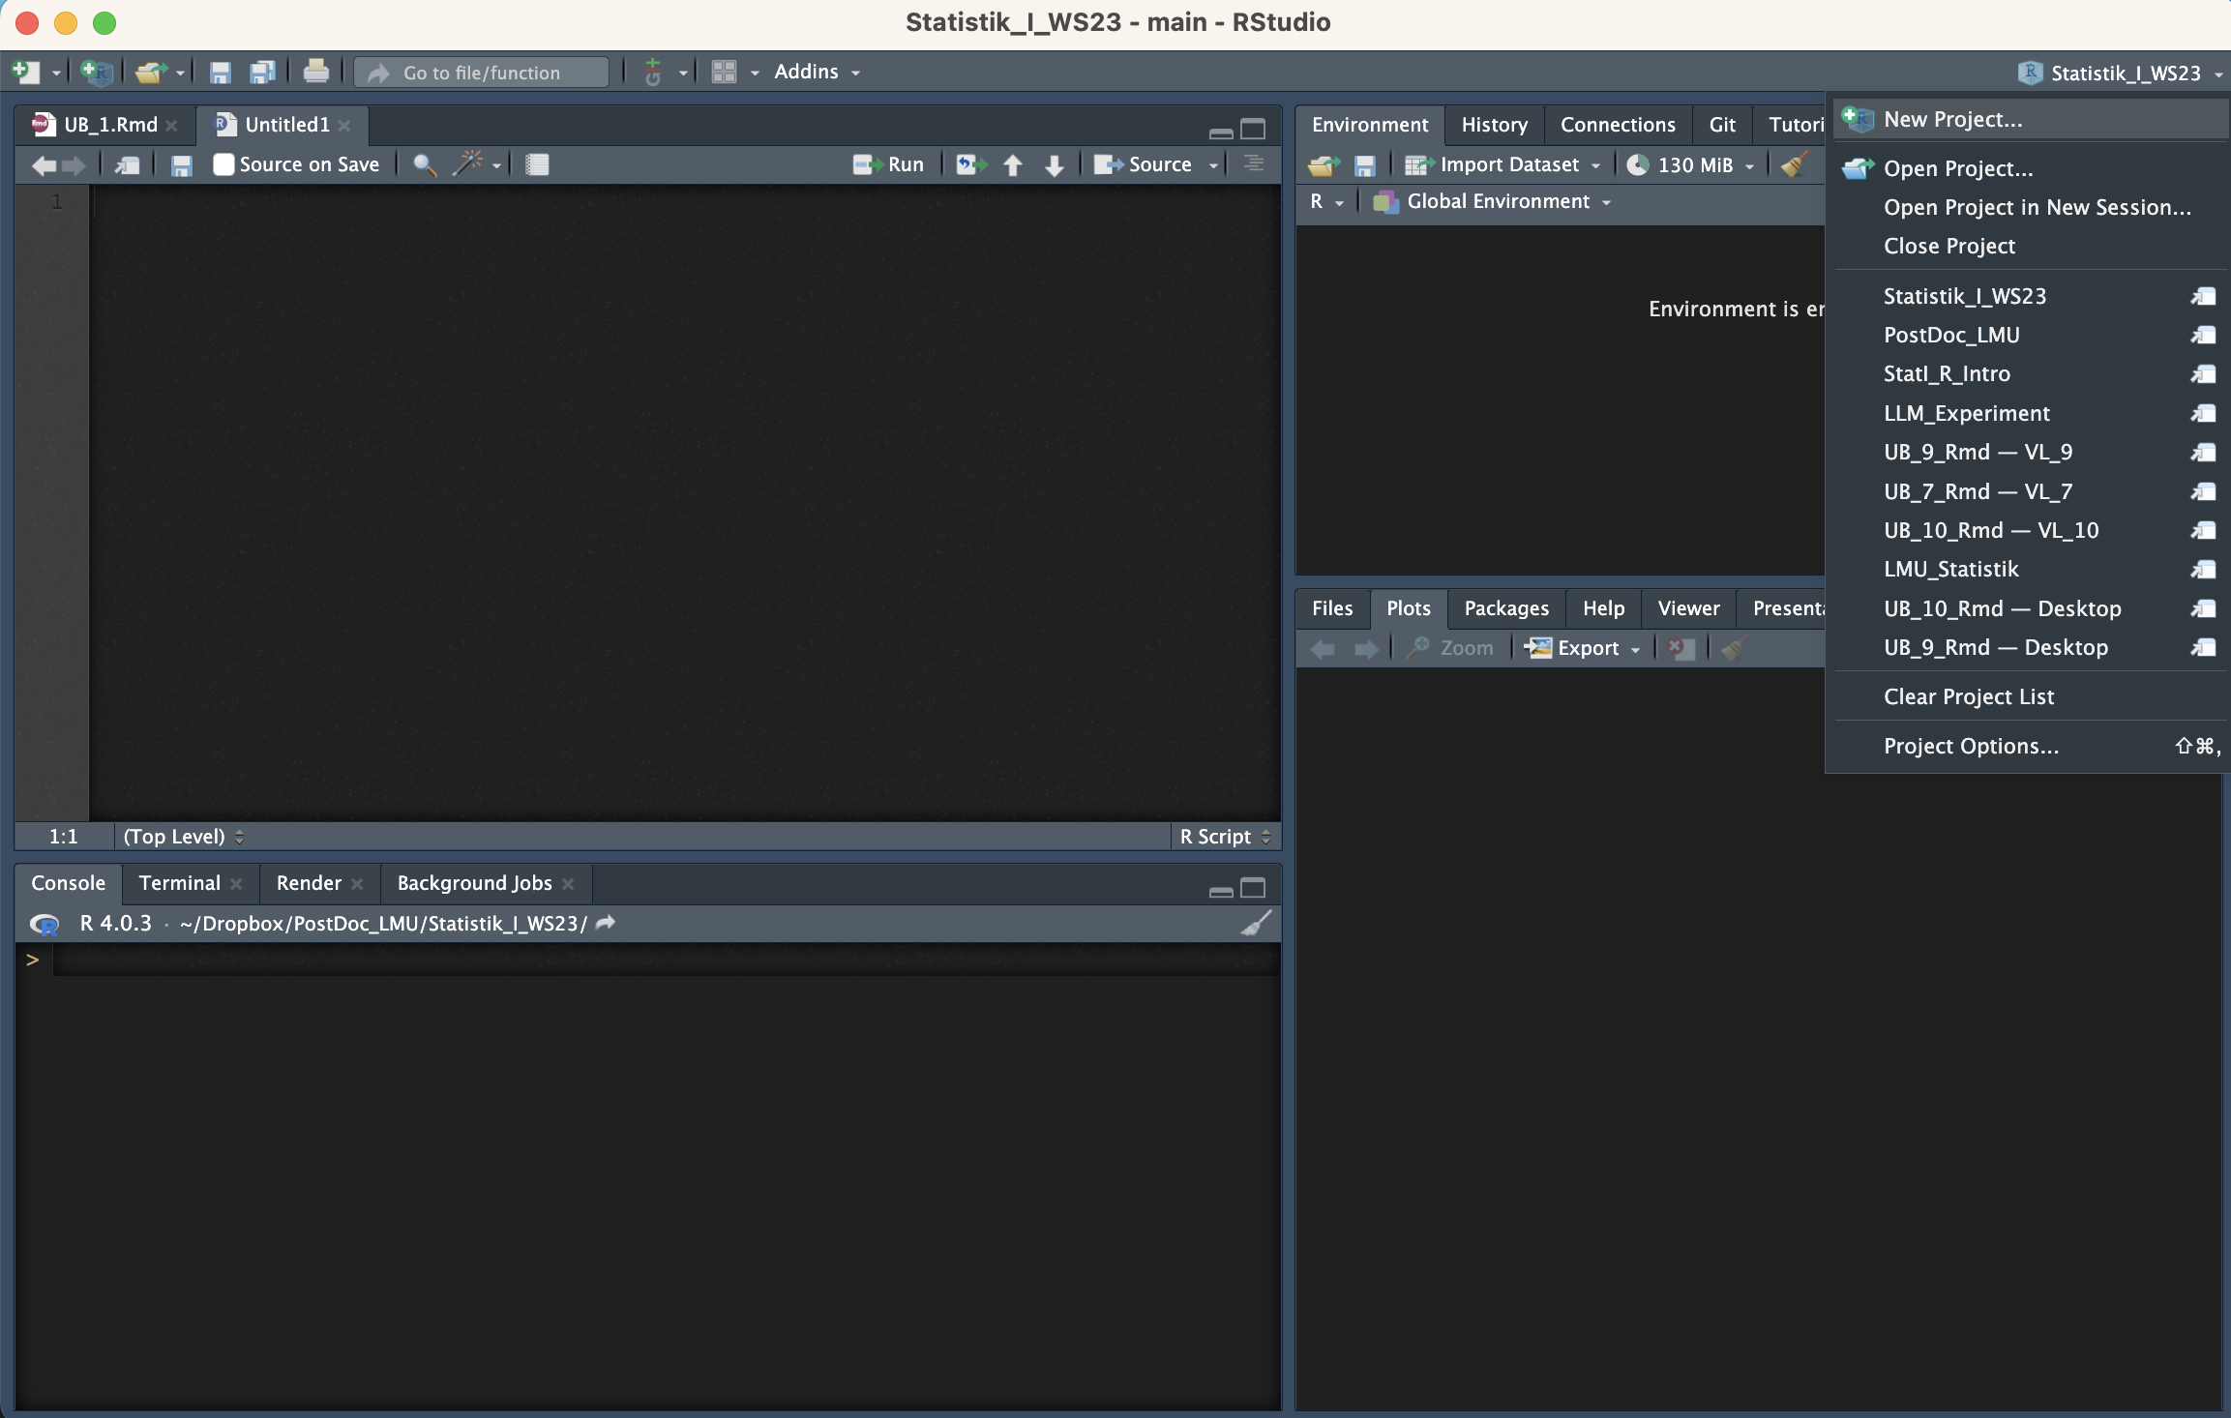

Slide 3
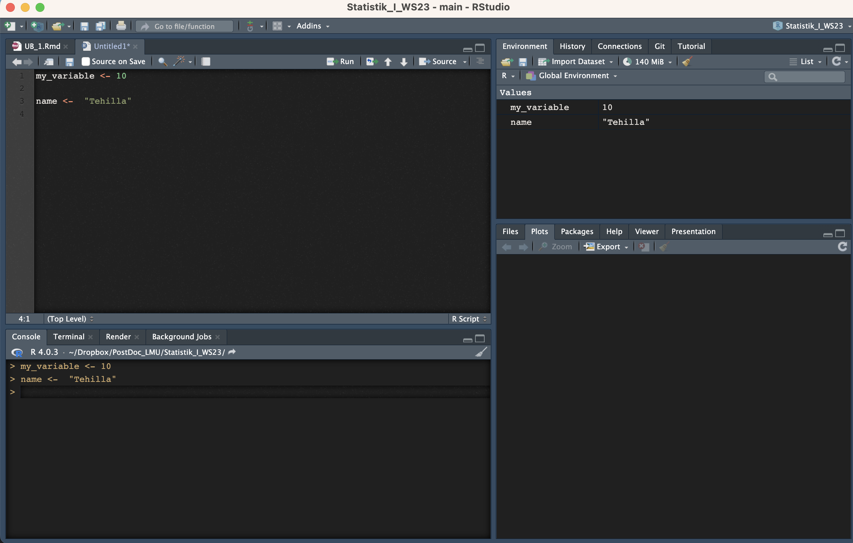

Slide 4
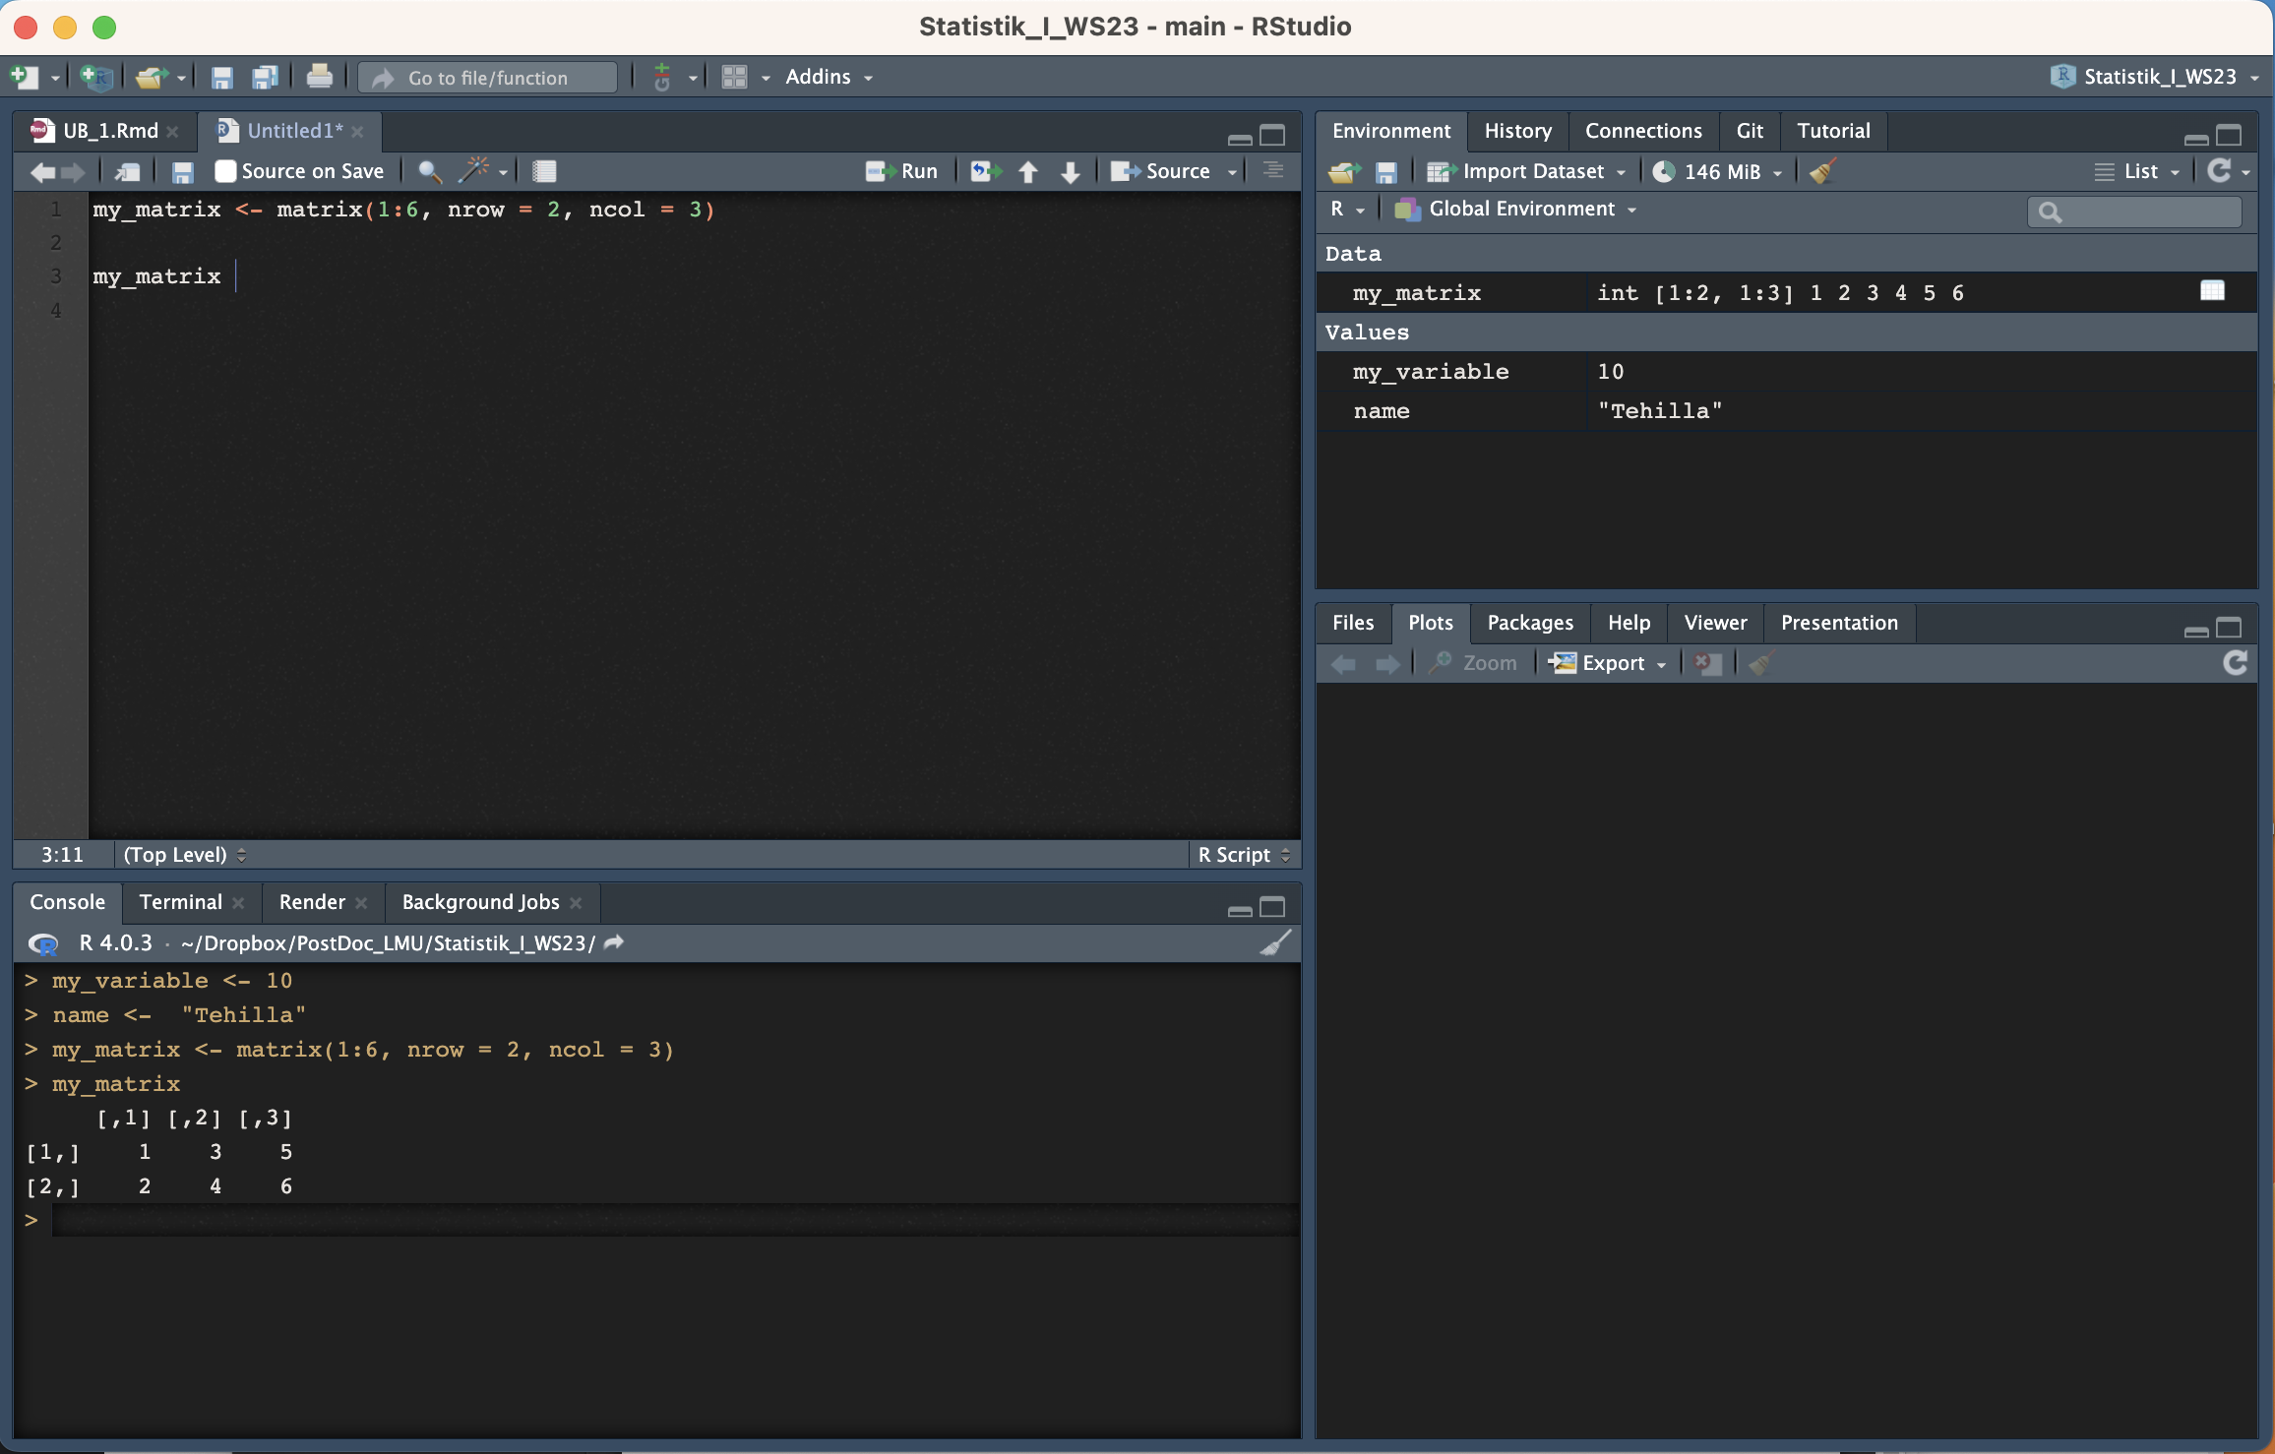

Slide 5
