Slide 1
Detecting breast cancer using convolutional neural networks
Erick Cobos Tandazo
March 2015
Notes:
Goal: I plan to use convolutional networks on x’ray mammograms for early detection and diagnosis of breast cancer.

Slide 2
Why breast cancer?
Breast cancer is one of the most commonly diagnosed cancer among women.
For women, death rates are the second highest of any cancer.
Survival rate when detected early is close to 100%
Notes:
Besides skin cancer, breast cancer is one of the most commonly diagnosed cancer among American women. Just under 30% of cancers in women are breast cancers.
About 1 in 8 U.S., UK women will develop invasive breast cancer.
higher than those for any other cancer, besides lung cancer.

Slide 3
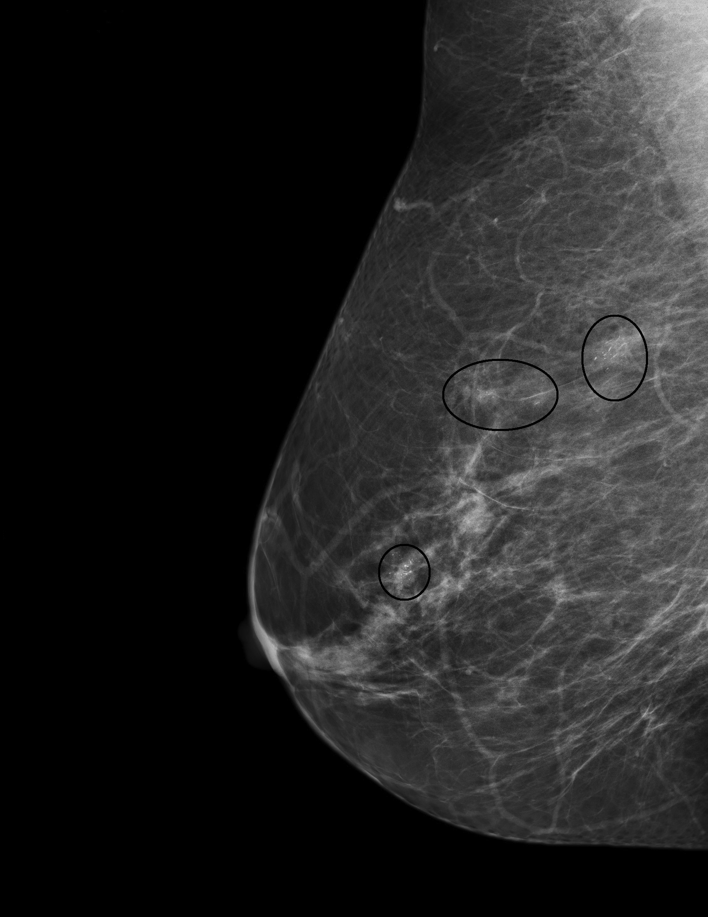
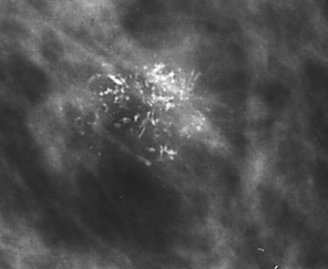
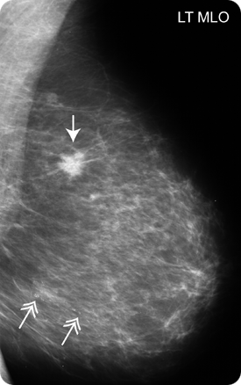
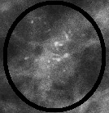
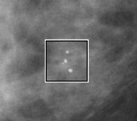
Breast cancer signs
Notes:
Mammography is the main tool to detect early breast cancer. Microcalcifications and masses.
Using mammography, an expert radiologist can detect 90% of positive cases.

Slide 4
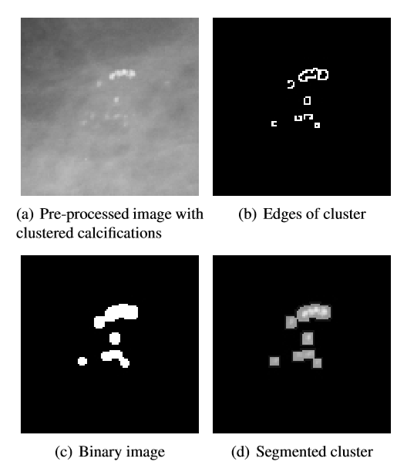
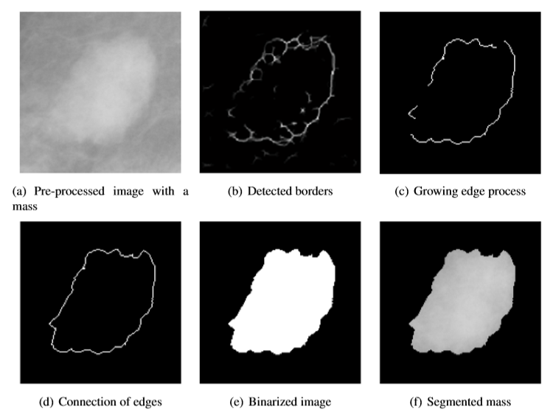
How do we detect them?
Notes:
Classical way. Image visión specialized techniques
Handcrafted features.

Slide 5
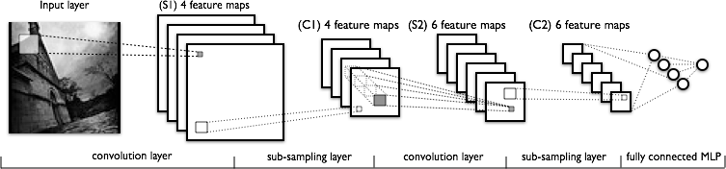


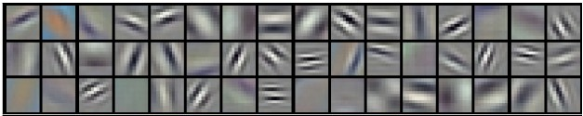
What do I plan to do?
Notes:
Not talk abouts specific
Point similarity with visual cortex.

Slide 6
Why convolutional networks?
Convnets have showed great results in image classification tasks.
Convnets learn which features are important for the classification.
We don’t need experts to carefully handcraft and select features.
Cons: Needs processing power, data.
Notes:
ImageNet, Google, … Standard in imaging processing

Slide 7

Thanks!

