Slide 1
  TehLUG
  Client/Server Repository Model
  SCM Softwares
  (Amir Mohammad Saied)
  November 7, 2007

Slide 2
Source Code Management
History
  1972: Original diff algorithm (Bell Labs)
  1972: SCCS (Bell Labs)
  Late 1970s: Revision Control System, RCS (Walter Tichy)
  Early 1980s: patch (Larry Wall)
  1986: Concurrent Version System, CVS
  Early 2000s: DVCS, BitKeeper and GNU arch.

Slide 3
Source Code Management
Common Vocabulary
  Trunk (Baseline or Mainline)
  Branch
  Check-out (co), Check-in (commit, ci)
  Change, Change list
  Import, Export
  Head
  Repository
  Tag (label)
  Update (sync)

Slide 4
Repository
Repository is a kind of file server that remembers every change ever written to it.
Client
Client
Write
Read
Client sees the latest version of tree,
but also has the ability to view previous states.

Slide 5
CVS
History
  Dick Grune, June 23, 1986
  Module:
  A single project managed by CVS is called a module. Modules stored in repository.
  $CVSROOT
  :protocol:user@host:path
  $CVS_RSH
  ssh (It's rsh by default)
  Don't have $CVSROOT?
  cvs -d repository

Slide 6
CVS
Check it out!
  cvs -z3 -d:pserver:amir@cvs.php.net:/repository checkout -P pear/Validate
  CVS/
  Entries
  Lists files and subdirectories this particular CVS co knows about.
  Repository
  Stores path to the corresponding directory in the repository.
  Root
  Contains the path to the repository (Overwrites $CVSROOT).

Slide 7
CVS
More Check-outs
  cvs checkout -r1.15 src/foo/bar.c
  cvs checkout -rRELEASE_0_5 pear/Net_SmartIRC
  cvs checkout -D "1 fortnight ago" ls

Slide 8
CVS
Update your wc
  cvs update
  cvs update -d
  U updated successfully
  A added but not yet committed
  R removed but not yet committed
  M modified in your working copy
  C conflict, requires human intervention
  ? file is not in repository

Slide 9
CVS
Let the world know what you did
  cvs commit
  $CVSEDITOR or $EDITOR
  Meaningful change notes (please!)
  cvs add filename
  cvs remove filename
  First remove it from fs, no actual remove though, just a move to Attic subdir in repo.
  CVS won't remove Directories. That's possible only by changing the repository.

Slide 10
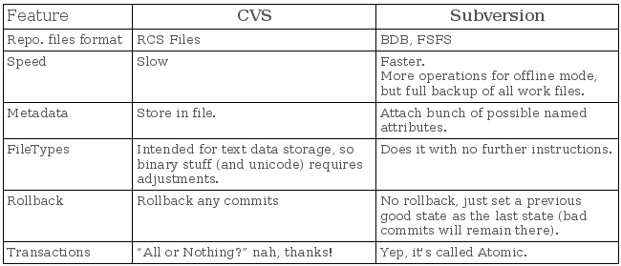

Slide 11
Subversion
History
  June 2000, Coding begins
  August 2001, Subversion becomes self-hosting
  2002, 1st release
  February 2004, Release 1.0.0
  2007, Release 1.4.5

Slide 12
Subversion
Versus CVS
  Most current CVS features.
  Directories, renames, and file meta-data are versioned.
  Commits are truly atomic (like a database transaction, technically there's no difference).
  Standalone server option.
  Versioning of symbolic links.
  Efficient handling of binary files.
  Parseable output.
  Localized messages.

Slide 13
Subversion
Network Protocols
  file://
  Direct repository access to local or network drive.
  http://
  Access via WebDAV protocol to Subversion aware Apache server.
  https://
  Same as http:// but with SSL encryption.
  svn://
  Unauthenticated TCP/IP access via custom protocol to an svnserve server.
  svn+ssh://
  Same as svn:// but Authenticated and Encrypted.

Slide 14
Subversion
How to check-out
  svn checkout svn://svn.osp.ir/svnroot/persism/trunk persism
Repository URL
Working Copy

Slide 15
Subversion
Status of working copy
  svn status
  A added but not yet committed.
  C conflict, require human intervention.
  D deleted but not yet committed.
  M modified.
  R replaced but not yet committed (object is first deleted but another object of the same name is added).
  X external.
  ? object is not under control.
  ~ the kind of object in wd and repo is different.
  I the object is not under version-control but Subversion is told to ignore it.
  ! object is under version-control but is missing.
  svn update will refetch 'em.
  svn revert <file> will restore a missing file.

Slide 16
Subversion
Send changes from working copy
  svn commit
  -m "- Log Message"

Slide 17
Subversion
The log messages
  svn log file(s)
  one or more files separated by spaces.
  svn log -r 5:10
  logs 5 through 10 in chronological order.
  svn log -r 10:5
  logs 5 through 10 in reverse order.
  svn log -r 7
  log for revision 7.

Slide 18
Subversion diff
  svn diff
  You'll see the difference between your working-copy and the cached copy in .svn.
  svn diff -r 4:5 foo.bar
  Two revisions would directly compared.
  svn diff -r {date}
  Revision at start of the date

Slide 19
Subversion
Revisions magic words!
  HEAD
  The latest revision in the repository.
  BASE
  The revision number of object in working copy.
  COMMITTED
  The most recent revision <= BASE which an item changed.
  PREV
  COMMITTED – 1
  svn diff -r PREV:COMMITTED foo.bar

Slide 20
Subversion
The Ultimate Resource (Free!)
  http://svnbook.red-bean.com/

