Slide 1

MapReduce & Hadoop
سید مجید عظیمی

Slide 2
Problem
How to process lots of data?
Short answer:
Distribute the processing on many machines

Slide 3
Challenges
We are not going to care WTF is going on the network.
Having faulty machine is normal.
How to store multiple peta bytes of data as input and output

Slide 4
MapReduce
Simple MapReduce job:
Input
Map
Reduce
Output
Shared File System

Slide 5
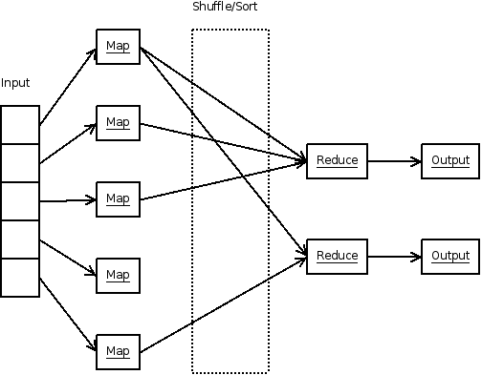
MapReduce

Slide 6
What Google does everyday
We have a web crawler that collects a copy of each web page: X1, X2, X3, …., Xn
The job:
Create Reverse Index

Slide 7
Mapper
Each mapper process one file. Output of Mapper is a list of Key/Value:
Key: keyword , Value: Web page address
Mapper1 |  | Mapper2 |  | Mapper3 |  | Mapper4
Key | Value | Key | Value | Key | Value | Key | Value
is | x1 | is | x2 | is | x3 | is | x4
driver | x1 | kernel | x2 | kernel | x3 | kernel | x4
Linux | x1 | me | x2 | hello | x3 | Apache | x4
me | x1 | glib | x2 | Apache | x3 | me | x4

Slide 8
Shuffle + Sort
1- This is done by framework.
2- Write list to mapper's local disk.
3- Called intermediate result.
Apache: [x3, x4]
driver: [x1]
glib: [x2]
hello: [x3]
is: [x1, x2, x3, x4]
kernel: [x2, x3, x4]
Linux: [x1]
me: [x1, x2, x4]

Slide 9
Reducer
Each partition will be sent to a separate reducer
Output of each reducer will be written to shared file system based on Key/Value
What can we do in Reducer:
Do nothing
Filter some web pages
Remove duplicates

Slide 10
What is Hadoop?
Best known MapReduce
implementation written in Java

Slide 11
What Hadoop provides
Different input readers(XML, CSV, …)
Different output writers(XML, CSV, …)
Distributed replicated file system called HDFS
Built in support for Avro
Compression(Gzip, Bzip2, ...)
Counters
Built in mechanism for detecting failed nodes

Slide 12
What Hadoop provides
Support streaming for using in shell pipeline
Different partitioning algorithms
Different job schedulers.
…

Slide 13
Hadoop Ecosystem
Scoop: Tools to transfer raw data from/to RDBMS
HBase: Hadoop columnar NoSQL database
Avro: Fast serialization framework(Java native serialization SUCKS)
Pig: SQL like language for MapReduce
Hive: Data warehouse solution based on Hadoop

Slide 14
Hadoop Ecosystem
Zookeeper: Cluster manager
Flume: Log aggregation framework
R: Data analytical language
Oozie: Workflow scheduler system

Slide 15
Learning resources
Hadoop: The Definitive Guide
Hadoop Operations
Hadoop in Action
Hadoop in Practice
HBase: The Definitive Guide
HBase in Action
MapReduce Design Patterns
Programming Hive
Programming Pig

Slide 16
Question & Answer
?

