Slide 1
UEFI
Unified Extensible Firmware Interface
© 2013, Mahdi Sadeghi. Licensed under the Creative Commons Attribution 3.0 license, http://creativecommons.org/licenses/by/3.0/

Slide 2
HISTORY: BIOS
Basic Input/Output System (BIOS):
  Invented by Gary Kildall in 1976 for CP/M OS
  Built into the PC
  First software run by a PC
Purposes:
  Initialize & test hardware components
  Run an OS or other program from mass memory
  MS-DOS used it for disk, keyboard & text display, others like linux does not rely on BIOS services
Modern BIOSes:
  Interactive UI, boot selection, password, and so on.

Slide 3
Motivations for a new specification
To overcome BIOS limitations in mid 1990:
  16-bit processor mode:
    Real mode, also called real address mode, is an operating mode of all x86-compatible CPUs. Real mode is characterized by a 20-bit segmented memory address space
  1 MB of addressable space based on IBM 5150 & Intel 8088 design
  The MBR limits on the number and size of disk partitions (up to 4 primary partitions per disk, up to 2 TiB* (2⁴⁰ bytes = Tebibyte) per disk)
  * Binary prefix for Terabyte (TB) = 10¹² bytes

Slide 4
What is UEFI
UEFI is a specification that defines a software interface between an operating system and platform firmware
Meant to replace BIOS
Legacy support for BIOS services
Remote diagnostics and repair of computers without any OS

Slide 5
History: UEFI
Original EFI invented by Intel for it's Itanium systems in mid-1990s
In 2005, UEFI deprecated EFI 1.10
UEFI is managed by the Unified EFI Forum
The current UEFI specification, version 2.3.1, was approved in April 2011.

Slide 6
UEFI Features
UEFI variables: provide a way to store data, in particular non-volatile data, that is shared between platform firmware and operating systems or UEFI applications
UEFI provides device-independent time services: include support for timezone & daylight saving
Graphics: rich preboot applications, localized strings, fonts, and forms
EFI shell: to execute other EFI apps

Slide 7
UEFI Features cont.
Extensions: can be loaded from any non-volatile storage. EFI partitions.
UEFI does not rely on a boot sector
  Boot variables: path to the loader
  OS loaders are a class of UEFI applications: e.g. \EFI\BOOT\BOOTx64.EFI
  Supported file systems include FAT32, FAT16 and FAT12 (accessible by firmware)
UEFI 2.1 specs:
  cryptography, network authentication and the User Interface Architecture

Slide 8
Features cont.
UEFI requires the firmware and operating system loader to be size-matched
  a 64-bit UEFI implementation can only load a 64-bit UEFI OS boot loader
EFI defines two types of services:
  Boot services: only when UEFI owns the platform
  Runtime services: accessible when OS is up
    Date, Time, NVRAM access
Compatibility Support Module (CSM): emulates a BIOS environment
Size-matched: a 64-bit UEFI implementation can only load a 64-bit UEFI OS boot loader

Slide 9
Secure Boot
UEFI 2.2 specification adds a protocol known as secure boot, it can prevents the loading of drivers or OS loaders that are not signed with an acceptable digital signature
it has 3 modes:
  Setup mode: to add initial platform key (PK) to firmware
  User mode: mode after initial setup
  Custom mode: to add incompatible PKs

Slide 10
Advantages over BIOS
Ability to boot from large disks (over 2 TiB) with a GUID Partition Table, GPT
CPU-independent architecture
CPU-independent drivers
Flexible pre-OS environment, including network capability
Modular design: extensions

Slide 11
Advantages over BIOS cont.
UEFI understands long mode:
  allows applications in the pre-boot execution environment to have direct access to all of the memory using 64-bit addressing
GPT instead of MBR
  GPT allows for a maximum disk and partition size of 8 ZiB (270 bytes)
  Linux supports GPT if compiled with CONFIG_EFI_PARTITION
  Fat32 for sys partitions & Fat12/16 for removable devices.

Slide 12
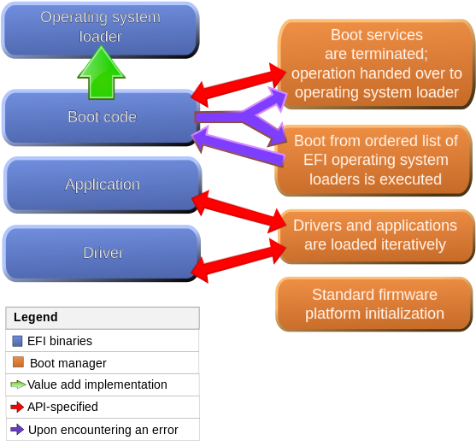

Slide 13
Microsoft & Windows 8
With the release of Windows 8 in October 2012, Microsoft's certification requirements now require that computers include firmware that implements the UEFI specification.
If the computer supports the "Connected Standby" feature of Windows 8, then the firmware is not permitted to contain a Compatibility Support Module (CSM)

Slide 14
Installation notes
If you have preinstalled OS in EFI mode you should install others in EFI mode too
Use ubuntu 64bit, 32bit versions will not detect EFI
Support for UEFI SecureBoot appeared in 12.10 and 12.04.2
With manual partitioning you should create an EFI partition

Slide 15
Installation notes cont.
UEFI-aware OS:
  the term booted from a (U)EFI means directly booting the system using a (U)EFI OS loader stored on any storage device
  If you want to disable/enable UEFI you will not be able to boot old installed OSes
Linux kernel has been able to use EFI at boot time since early 2000
Grub+Linux also supports booting from a GUID partition table without UEFI
Ubuntu added support for UEFI secure boot as of version 12.10

Slide 16
Ubuntu installation steps
Ubuntu-Secure-Remix 64bit or of Ubuntu (>=12.04.2) 64bit (contains boot repair tool) or latest release
Disable QuickBoot/FastBoot and Intel Smart Response Technology (SRT)
  In case of signature error disable SecureBoot
Install OS as always
If OS does not load afterwards use live disk and boot repair to fix boot (recommended repair)
Notes:
https://help.ubuntu.com/community/UEFI

Slide 17
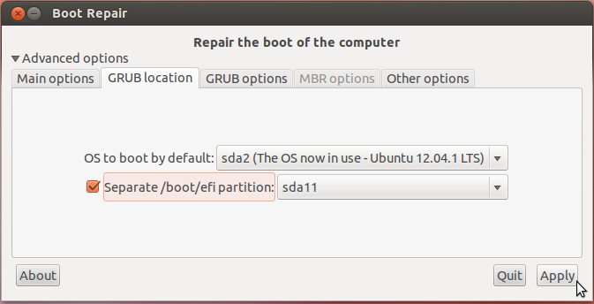
Boot Repair

Slide 18
Criticism: UEFI & Freedom
EFI as an attempt to remove the ability of the user to truly control the computer
Secure boot: Boot only signed bootloaders in ARM
More control for manufacturers and support teams and others?

Slide 19
Issues
In 2012, it was discovered that certain Lenovo computer models with secure boot had firmware that was hard-coded to only allow "Windows Boot Manager" or "Red Hat Enterprise Linux" to load
In January 2013, a bug surrounding the UEFI implementation on some Samsung laptops was publicized, which caused them to be bricked after installing a Linux distribution in UEFI mode

Slide 20
Which one is better?
For me BIOS still is enough
Manufacturers think UEFI is better for them

Slide 21
References
http://en.wikipedia.org/wiki/Unified_Extensible_Firmware_Interface
http://www.uefi.org/home/
https://help.ubuntu.com/community/UEFI
https://help.ubuntu.com/community/UEFIBooting
http://mjg59.dreamwidth.org/22855.html

Slide 22
Any questions?
Thank you

