Slide 1
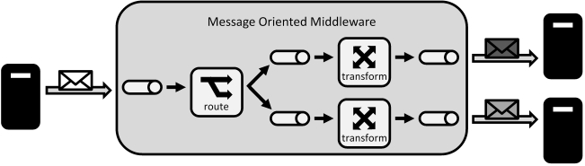
Message Oriented Middleware
سید مجید عظیمی

Slide 2
Message Oriented Middleware
MOM Is a software/hardware infrastructure supporting sending and receiving messages between nodes in a distributed system
What is a message?
Standalone unit of data that can be processed

Slide 3
Example of Messaging Systems
Remote Procedure Call
XML-RPC
Web Services(SOAP/Rest)
Object Request Broker(CORBA)
Common feature:
Synchronous Processing

Slide 4
Challenge
Biggest challenge in distributed computing?
Scale
Then how to scale?
Asynchronous Processing
Event Driven Programming

Slide 5
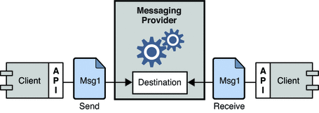
MOM and Asynchronous Processing

Slide 6
Topologies
Point to Point
  Pipeline (PUSH/PULL)
  Job Queue
  Routing
  Request / Reply
Publish / Subscribe

Slide 7

Point to Point: Pipeline
One way messaging
Usage:
  Logging
  Producer / Consumer

Slide 8
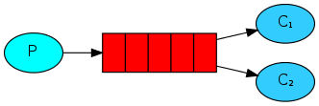
Point to Point: Job Queue
Distribute jobs to multiple nodes
Strategies:
  Round Rubin dispatching
  Weighted dispatching

Slide 9
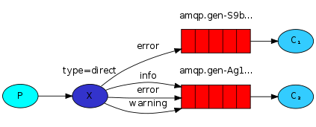
Point to Point: Routing
Route messages based on a routing key

Slide 10
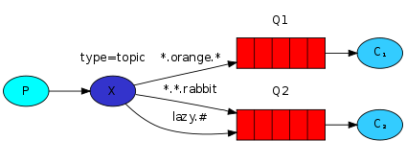
Point to Point: Routing
Route messages based on a routing key
key pattern: service.level.IP
example key:
httpd.*.192.168.1.2, *.error.192.168.1.2, httpd.*.*

Slide 11
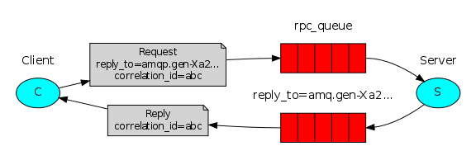
Point to Point: Request / Reply
Create temporary queue for reply
JMS has message selectors too

Slide 12
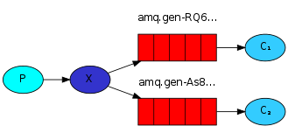
Publish / Subscribe
Usage:
  Social networking

Slide 13
Enterprise Extensions
Persistence
Transactions
Group Delivery
XA
Dead Letter Queue
Bridge Queue
Guaranteed Message Delivery

Slide 14
Technologies – Enterprise
JMS
  JBoss HornetQ
  Glassfish OpenAMQ
  Apache ActiveMQ
AMQP
  VMware RabbitMQ
  Apache Qpid
  OpenMQ

Slide 15
Technologies - Custom
Beanstalkd → Very fast queue
Kafka → Distributed Publish / Subscribe
ZeroMQ → Messaging library
Java Chronicle → Interprocess messaging
Ejabberd → XMPP implementation
MPI → mostly used in scientific applications

Slide 16
?

