Slide 1
Data Grid
سید مجید عظیمی
@majidazimi
majid.azimi@live.com
پاییز 1392

Slide 2
Grid Computing
Distribute high-volume of computations to computers separated by large geographical distances.

Slide 3
Cluster Computing
Distribute high-volume of computations to computers inside data center.

Slide 4
Data Grid
Hybrid Technology
It is mainly Cluster computing technology
Provides access pattern from different DCs

Slide 5
RAM
is becomming new hard disk

Slide 6
What is Data Grid
Data Grid is mainly a
Distributed Cache

Slide 7
Distributed in-memory RDBMS
Sharding is hard to achieve
Distributed Query Processing
  Cross node join
  Parrallel query processing

Slide 8
Distributed Key/Value DB
Too simple data model
No Parrallel data processing
  Map/Reduce

Slide 9
NoSQL Systems
Good Horizontal scalability
Fills gap between cache Key/Value and Relational DB
Offers storage vision
  Data grid offers processing vision

Slide 10
Data Grid: Concepts
In-Memory Database
In-Memory Streaming
In-Memory HPC

Slide 11
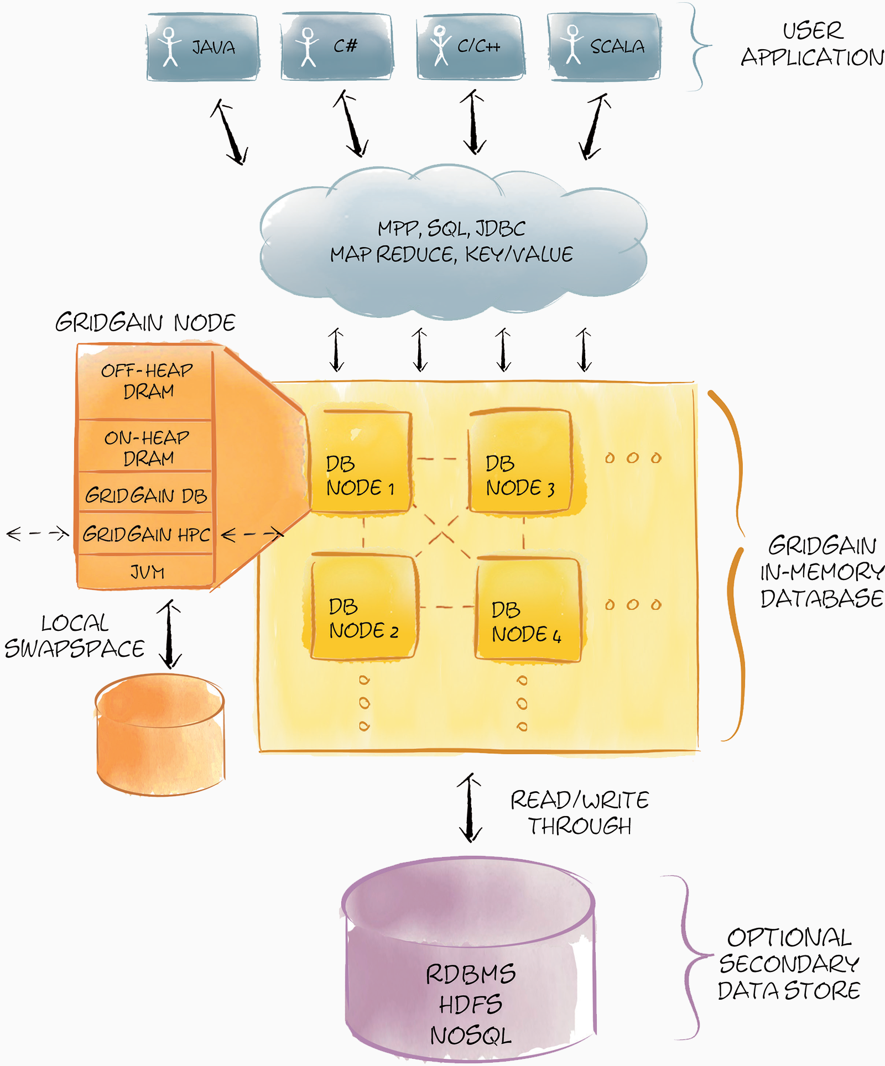
In-Memory Database

Slide 12
In-Memory Database
Local, Replicated, Partitioned
MVCC Based Concurrency
Off-Heap Memory
Write Behind Cache
Web Session Cashing
Continuous Query
ACID
Pluggable Persistency
REST Interface
Distributed Data Structures
SQL and Lucene Querying

Slide 13
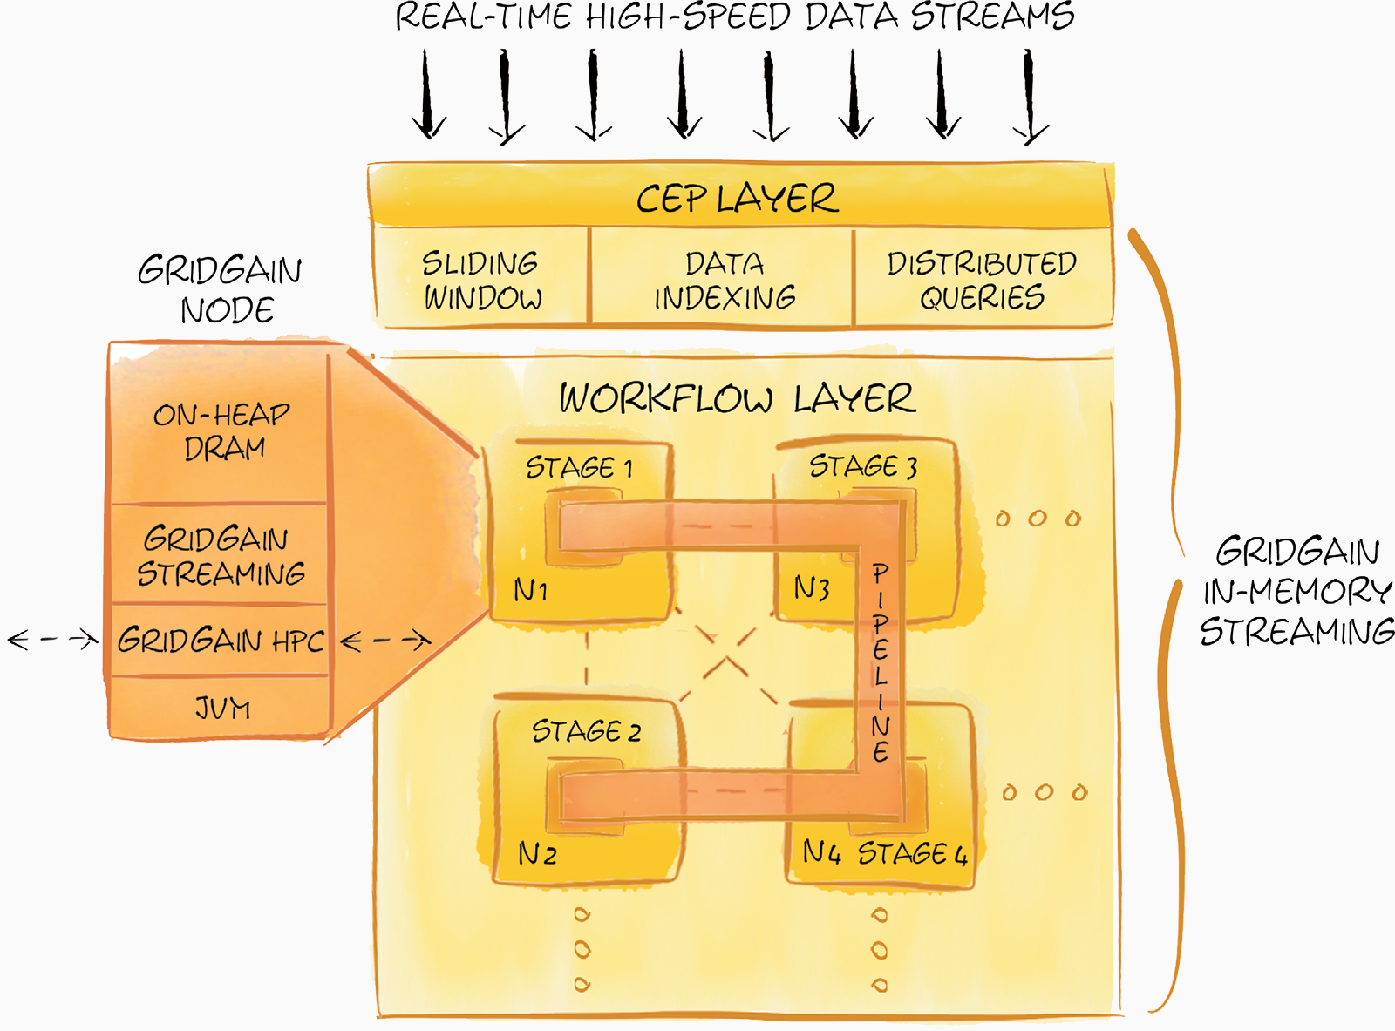
In-Memory Streaming

Slide 14
In-Memory Streaming
Event Pattern Detection
Grouping, aggregation, sorting, filtering, merging, splitting or duplicating
  Detection
  Aggregation

Slide 15
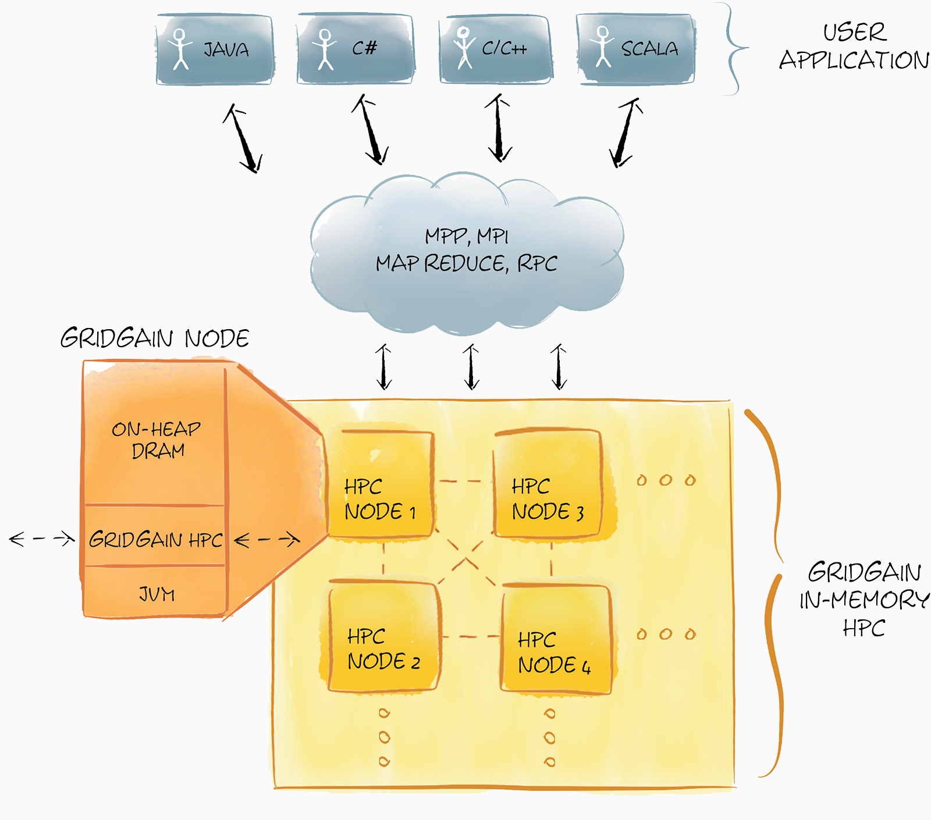
In-Memory HPC

Slide 16
In-Memory HPC
Map/Reduce
RPC Processing
MPI-Style Processing
Cron-Based Scheduling
Topology Resolution
Job Checkpointing

Slide 17
Implementation
GridGain
Jboss Infinispan
Hazelcast
Oracle Coherence

Slide 18
?

