Slide 1
حملات به شبکه های محلی و راه های مقابله
کوشا اسماعیل پور
Koosha.id.ir
Koosha.es@gmail.com

Slide 2
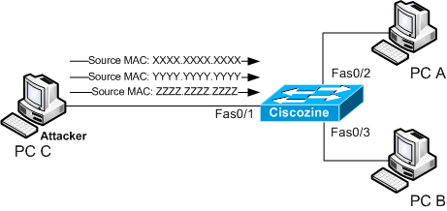
MAC Flood

Slide 3
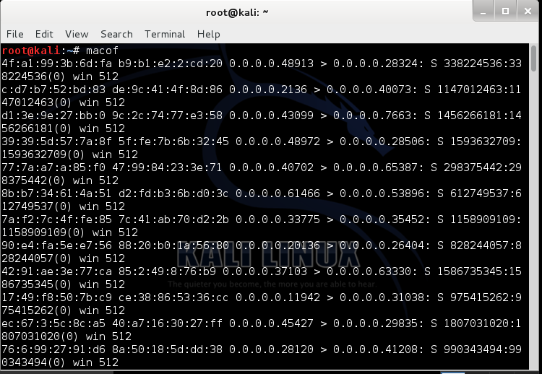
macof

Slide 4
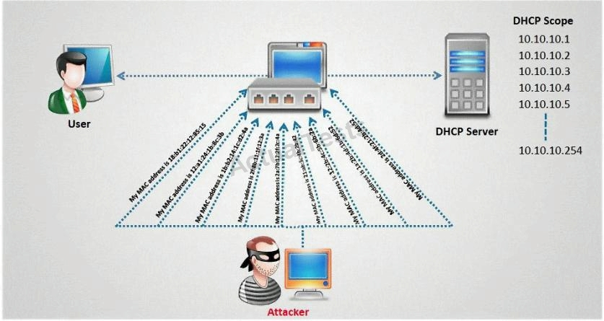
DHCP starvation

Slide 5
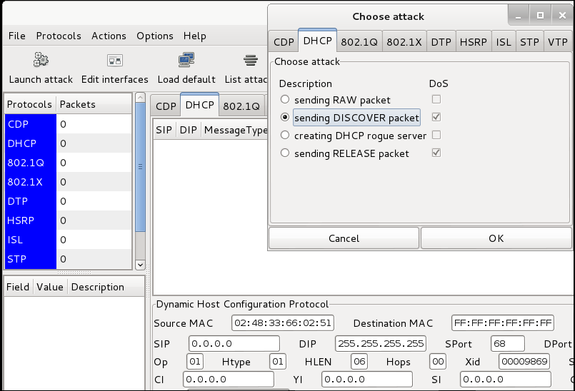
Sending DISCOVER packet

Slide 6
Port Security
Switch(config)# interface interface_id
Switch(config-if)# switchport mode access
Switch(config-if)# switchport port-security
Switch(config-if)# switchport port-security maximum value
Switch(config-if)# switchport port-security violation {protect | restrict | shutdown }

Slide 7
VLAN hopping
1-Switch spoofing
2-Double tagging

Slide 8
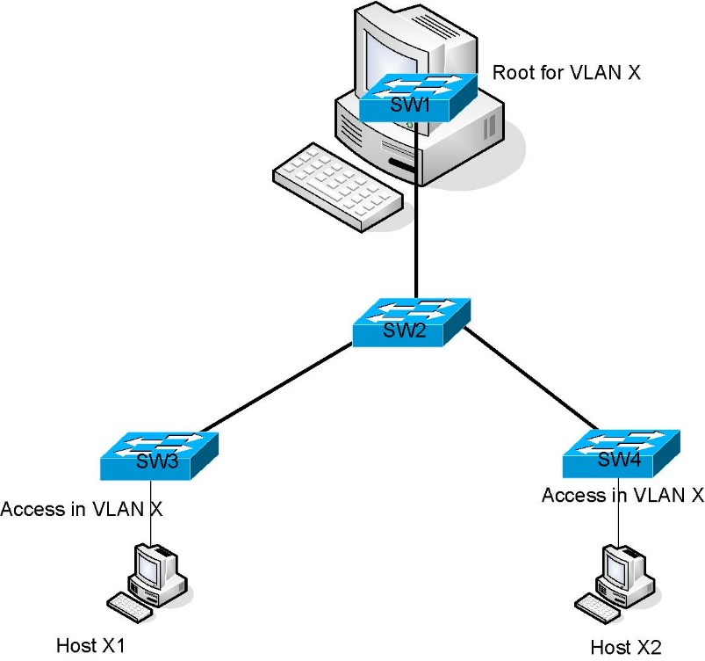
1-Switch spoofing

Slide 9
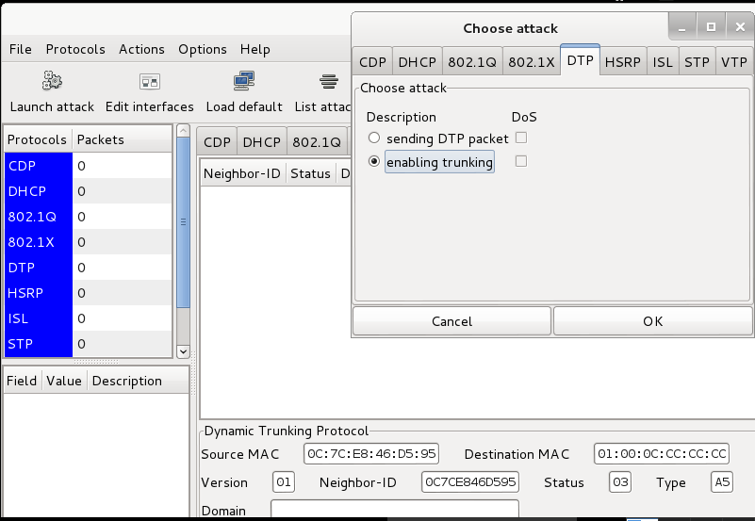
Enabling trunking

Slide 10
1. Ensure that ports are not set to negotiate trunks automatically :
Switch(config-if)# switchport nonegotiate
OR
2. Ensure that ports that are not meant to be trunks are explicitly configured as access ports
Switch(config-if)# switchport mode access

Slide 11
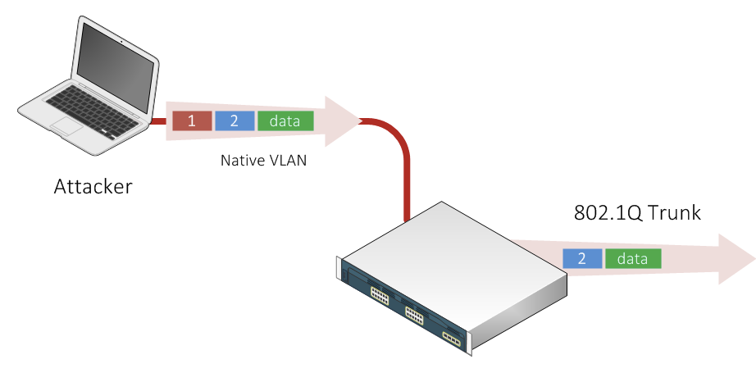
Double tagging

Slide 12
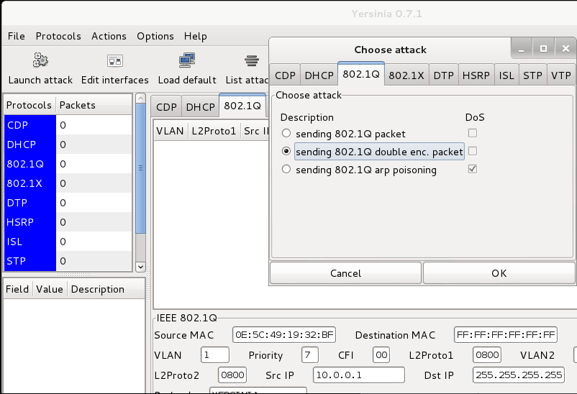
Sending .1Q double encapsulation

Slide 13
Simply do not put any hosts on VLAN 1
Switch(config-if)# switchport access vlan 2
OR
Change the native VLAN on all trunk ports to an unused VLAN ID.
Switch(config-if)# switchport trunk native vlan 999
OR
Explicit tagging of the native VLAN on all trunk ports.
switch(config)# vlan dot1q tag native

Slide 14
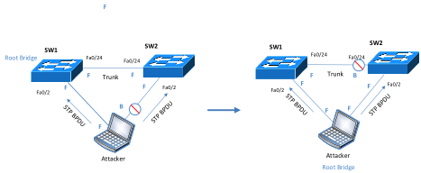
STP Attack

Slide 15
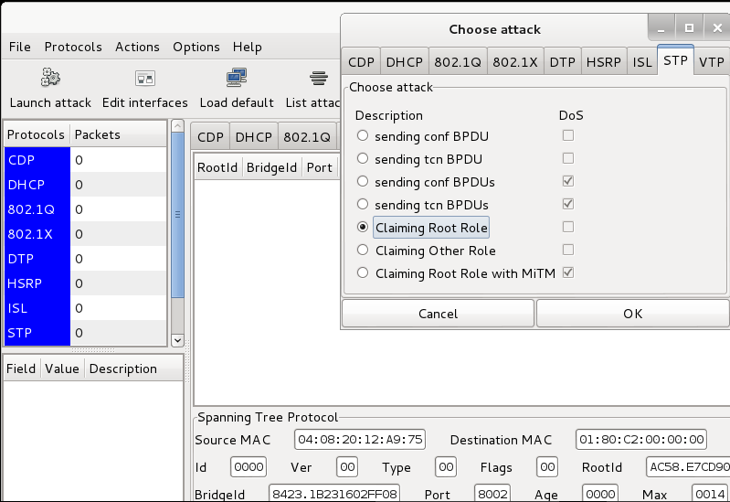
Claiming Root Role

Slide 16
BPDU guard OR Root guard
SW1(config)#interface interface_id
SW1(config-if)#spanning-tree bpduguard enable
OR
SW1(config)#interface interface_id
SW1(config-if)#spanning-tree guard root

Slide 17
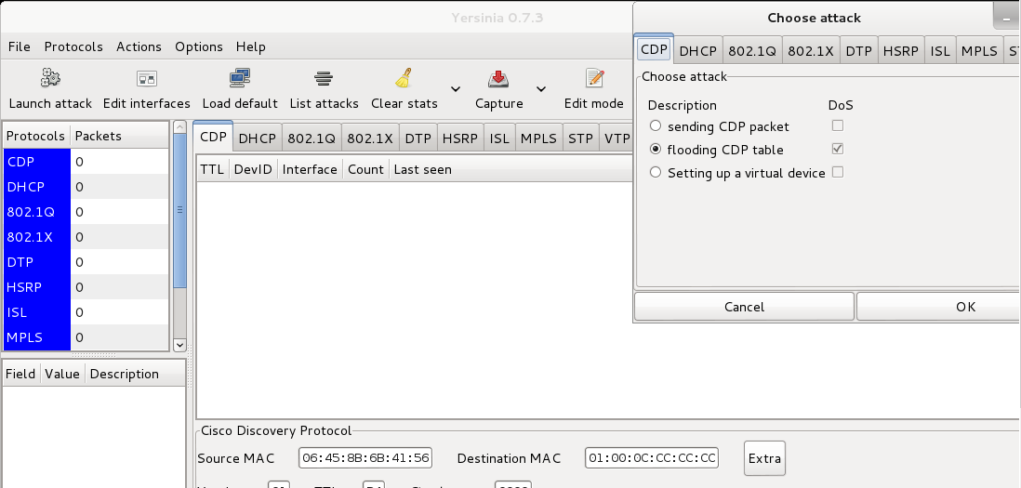
CDP Flood

Slide 18
Disable or Turn Off CDP on Cisco
Switches & Routers
Router(config)# no cdp run
OR
Router(config)# int interface_id
Router(config-if)# no cdp enable

Slide 19

سال نو مبارک

