Slide 1
DRAFT VERSION v0.1
First steps with Scrapy
@Francisco Sousa

Slide 2
WHAT IS SCRAPY?

Slide 3
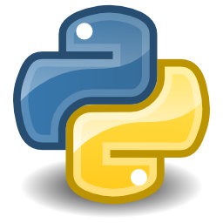
Scrapy is an open source and collaborative framework for extracting the data you need from websites.
It’s made in Python!

Slide 4
Who is it for?

Slide 5
Scrapy is for everyone that want to collect data from one or many websites.

Slide 6
“The advantage of scraping is that you can do it with virtually any web site - from weather forecasts to government spending, even if that site does not have an API for raw data access”
Friedrich Lindenberg

Slide 7
Alternatives?

Slide 8
There are many alternatives as:
        Lxml
        Beatiful Soup
        Mechanize
        Newspaper

Slide 9
Advantages of Scrapy?

Slide 10
    It’s free
    It’s cross platform (Windows, Linux, Mac OS and BSD)
    Fast and powerfull

Slide 11
Disadvantages of Scrapy?

Slide 12
    It’s only for python 2.7.+
    It’s has a bigger learnig curve that some other alternatives
    Installation it’s different according the operating system

Slide 13
Let’s start!

Slide 14
First of all you will have to install it so do:
Note: with this command will be installed scrapy and their dependencies.
On Windows you will have to install pywin32
pip install scrapy
or
sudo pip install scrapy

Slide 15
Create our first project

Slide 16
Before we starting scraping information, we will create an scrapy project, so go to directory where you want to create the project and write the follow command:
scrapy startproject demo

Slide 17
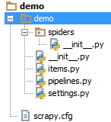
The command before will create the skeleton for your project, as you can see on the figure bellow:

Slide 18

The files created are the core of our project, so it’s important that you understand the basics:
scrapy.cfg: the project configuration file
demo/: the project’s python module, you’ll later import your code from here.
demo/items.py: the project’s items file.
demo/pipelines.py: the project’s pipelines file.
demo/settings.py: the project’s settings file.
demo/spiders/: a directory where you’ll later put your spiders.

Slide 19
Choose an Website to scrape

Slide 20
After we have the skeleton of the project, the next logical step is choose among the number of websites in the world, what is website that we want get information

Slide 21

I choose for this example scrape information from the website:
That is an important website of technology news

Slide 22
Because the verge is a giant website, I decide that I will only try to get information from the last reviews of The Verge.
So we have to follow the next steps:
1
See what is the url for reviews
2
Define how many pages we want to get of reviews
3
Define what information to scrape
4
Create a spider

Slide 23

See what is the url for reviews
http://www.theverge.com/reviews

Slide 24
Define how many pages we want to get of reviews. For simplicity we will choose scrape only the first 5 pages of The Verge
http://www.theverge.com/reviews/1
http://www.theverge.com/reviews/2
http://www.theverge.com/reviews/3
http://www.theverge.com/reviews/4
http://www.theverge.com/reviews/5

Slide 25
Define what information you want to scrape:

Slide 26
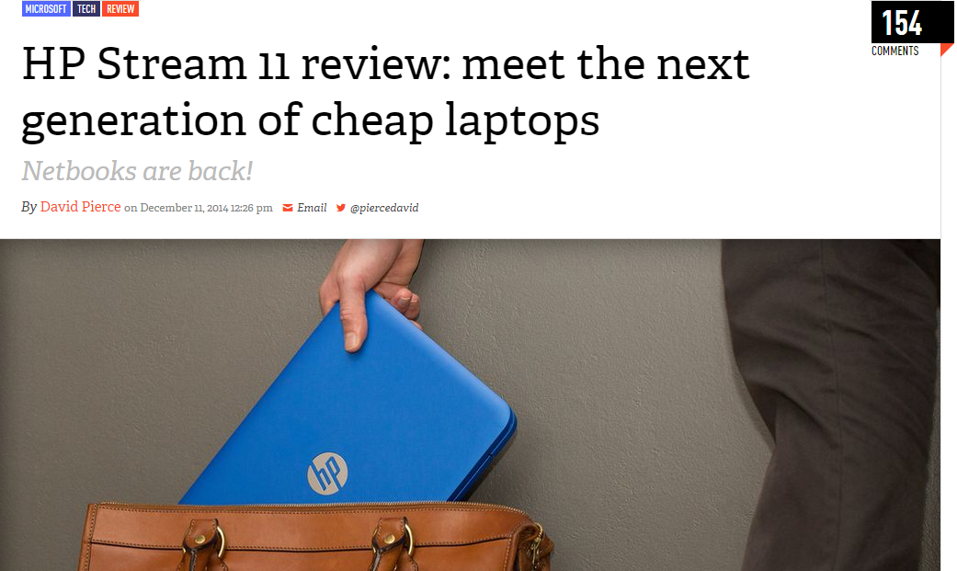
1
2
3
1
Title of the article
2
Number of comments
3
Author of the article
Notes:
Colocar em dois slides

Slide 27
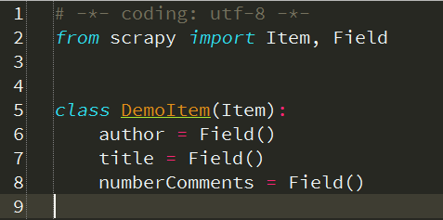

Create the fields for the information that you want to scrape on Python
Notes:
Colocar em dois slides

Slide 28
Create a spider

Slide 29
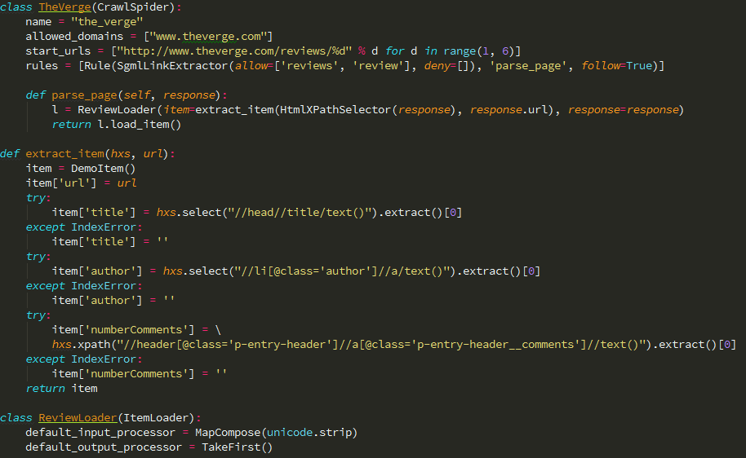

Slide 30
name: identifies the Spider. It must be unique!
start_urls: is a list of URLs where the Spider will begin to crawl from.
parse: is a method of the spider, which will be called with the downloaded Response object of each start URL..

Slide 31
How to run my spider?

Slide 32
This is the easy part, to run our spider we have to simple to the following command:
scrapy runspider <spider_file.py>
E.g: scrapy runspider the_verge.py

Slide 33
How to store information of my spider on a file?

Slide 34
To store the information of our spider we have to execute the following command:
scrapy runspider the_verge.py -o items.json

Slide 35
You have other formats like CSV and XML:
CSV:
scrapy runspider the_verge.py -o items.csv
XML:
scrapy runspider the_verge.py -o items.xml

Slide 36
Conclusion

Slide 37
In this presentation you learn the concepts key of scrapy and how to create a simple spider. Now is time to put hands to work and experiment other things :D

Slide 38
Thanks!

Slide 39
Appendix

Slide 40
Bibliography
http://datajournalismhandbook.org/1.0/en/getting_data_3.html
https://pypi.python.org/pypi/Scrapy
http://scrapy.org/
http://doc.scrapy.org/

Slide 41



Code available in:
Contact:
@Francisco Sousa
https://github.com/FranciscoSousaDeveloper/demo
pt.linkedin.com/pub/francisco-sousa/4a/921/6a3/

