Slide 1
Buildroot
سید مجید عظیمی
majid.azimi@live.com
@majidazimi
گروه کاربران لینوکس تهران
تابستان ۱۳۹۳

Slide 2
Buildroot
Buildroot is an embedded Linux build system to automate the process of building operating system from source

Slide 3
Cross Compilation
A cross compiler is a compiler capable of creating executable code for a platform other than the one on which the compiler is running.
        Wikipedia

Slide 4
x86 Booting Process
Power on the computer
CPU runs BIOS
BIOS does POST
BIOS founds boot loader
BIOS loads boot loader

Slide 5
x86 Booting Process
Bootloader loads Kernel and initrd/initramfs
Kernel does initilization(load drivers)
Kernel mounts main root file system
Kernel executes init

Slide 6

chiken-and-egg problem
Kernel needs root fs to load drivers
Root fs has not been mounted yet

Slide 7
initrd / initramfs
Temporary root file system that is loaded in to memory in boot process.

Slide 8
initrd / initramfs
  initrd
    Kernel run /linuxrc
    /linuxrc mounts main root file system
    /linuxrc executes init process
  initramfs
    Kernel directly runs init
    init process loads whatever is needed

Slide 9

ARM Boot Process
Where is God Damn BIOS?

Slide 10
ARM Boot Process
BootRom is an internal loader of BootStrap
BootStrap initializes external RAM and loads Bootloader
Bootloader loads Kernel and provides boot arguments
Kernel mounts RootFS
Kernel starts init process

Slide 11
Buildroot
Buildroot is an embedded Linux build system to automate the process of building operating system from source

Slide 12
Buildroot
Cross compile tool chain
Boot loader / Kernel / RootFS generator
User space libraries or applications
Completely written in make

Slide 13
OS Components
Boot loader
Kernel
Root File System
  C library
  Basic tools
  Libraries and applications

Slide 14
Kernel: Which board?
Official Kernel support
BSP (Board Support Package)
Patch
Custom vendor supplied Kernel

Slide 15
Board Support Package
Implementation of specfic support code for given motherboard, commonly built into bootloader

Slide 16
defconfig
A text file containing which feature has been selected:
CONFIG_64BIT=y
CONFIG_X86_64=y
CONFIG_X86=y
CONFIG_INSTRUCTION_DECODER=y
CONFIG_OUTPUT_FORMAT="elf64-x86-64"
CONFIG_ARCH_DEFCONFIG="arch/x86/configs/x86_64_defconfig"
CONFIG_LOCKDEP_SUPPORT=y
CONFIG_STACKTRACE_SUPPORT=y

Slide 17
C Library: glibc
Large binaries
  Smallest static C program is 662 KB
Stable
Maximum binary performance
Maximum POSIX compliance
Minimal configurable feature set
No atomic upgrade
Backward compatible

Slide 18
C Library: uClibc
Small binaries
  Smallest static C program is 7 KB
Medium binary performance
Normal POSIX compliance
Maximum configurable feature set
No atomic upgrade
NOT backward compatible

Slide 19
C Library: musllibc
Small binaries
  Smallest static C program is 1.8 KB
High binary performance
Normal POSIX compliance
No configurable feature set
Atomic upgrade
Backward / Forward compatible

Slide 20
C Library: dietlibc
Smallest binaries
  Smallest static C program is 0.2 KB
Worst binary performance
Worst POSIX compliance
Minimal configurable feature set
No Atomic upgrade
Not backward / forward compatible

Slide 21
BusyBox
BusyBox provides several stripped-down Unix tools in a single executable file
/bin/ls ---> /bin/busybox ls

Slide 22
BusyBox
basename, bbconfig, beep, blkid, blockdev, bootchartd, brctl, bunzip2, bzcat, bzip2, cal, cat, catv, chat, chattr, chgrp, chmod, chown, chpasswd, chpst, chroot, chrt, chvt, cksum, clear, cmp, comm, conspy, cp, cpio, crond, crontab, cryptpw, cttyhack, cut, date, dc, dd, deallocvt, delgroup, deluser, depmod, devfsd, devmem, df, dhcprelay, diff, dirname, dmesg, dnsd, dnsdomainname, dos2unix, dpkg, dpkg-deb, du, dumpkmap, dumpleases, echo, ed, egrep, eject, env, envdir, envuidgid, ether-wake, expand, expr, fakeidentd, false, fbset, fbsplash, fdflush, fdformat, fdisk, fgconsole, fgrep, find, findfs, flash_eraseall, flash_lock, flash_unlock, flashcp, flock, fold, free, freeramdisk, fsck, fsck.minix, fsync, ftpd, ft

Slide 23
BuildRoot
make menuconfig
make linux-menuconfig
make uclibc-menuconfig
make busybox-menuconfig
make

Slide 24
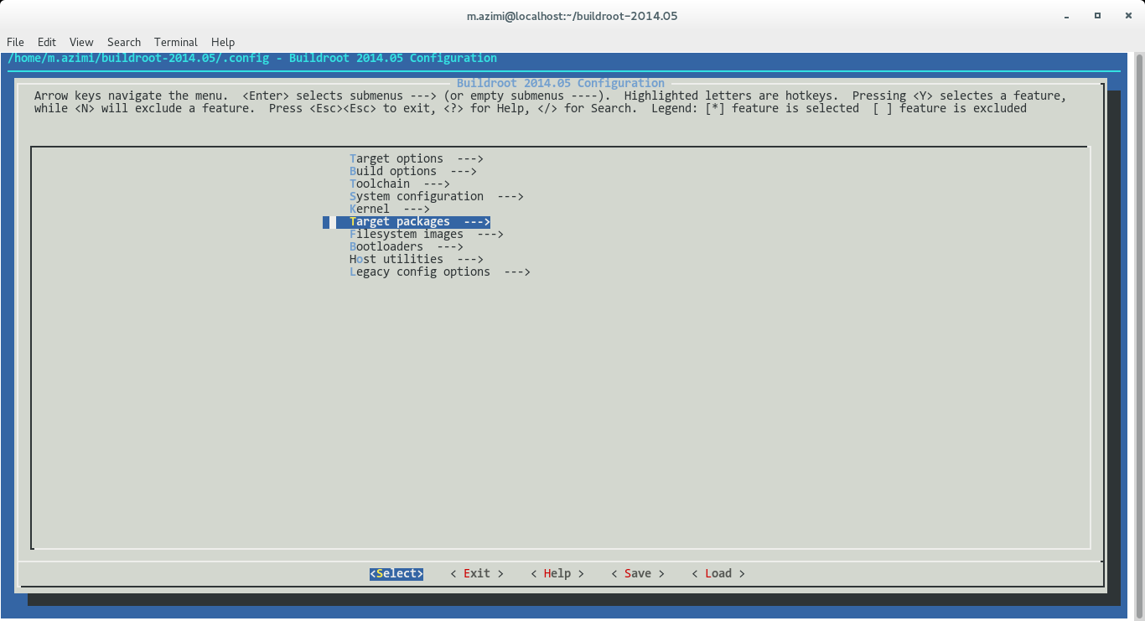
make menuconfig

Slide 25
?

