Slide 1
CoreOS
گروه کاربران لینوکس تهران
@majidazimi
majid.azimi@live.com

Slide 2

Problem
Design a PAAS Cloud

Slide 3
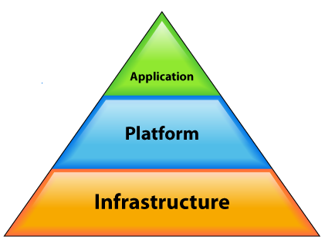
Cloud

Slide 4
Challenges
Minimal OS maintenance
  OS installation
  Upgrade management
  How many admin per n servers
Agility
Configuration management
  Nginx
  MySQL

Slide 5
Challenges
Financial management
  How much user should pay for a mysql instance?
Launch n instance of same application
Automation
  Every possible configuration should be programmable
HA

Slide 6
CoreOS
CoreOS is an open source lightweight operating system based on the Linux kernel, designed for providing infrastructure to clustered deployments
Wikipedia

Slide 7
CoreOS
Read-only rootfs
etcd
Docker
Systemd / Fleet
Locksmith

Slide 8
Read-only rootfs
Minimal OS (200MB)
Fork of ChromeOS
No package manager
PXE Boot
Automatic update
  Automatic updates are under control

Slide 9
etcd
A highly-available Key/Value store for shared configuration and service discovery inspired by Apache Zookeeper.

Slide 10
etcd
Data is stored as file system path
Each node contain Key/Value data
Atomic operation
Notification when path changes
Auto-Incrementing path generator
Ephemeral nodes
Rest interface
  Apache zookeeper uses native protocol

Slide 11
etcd
Data is stored as file system path
/master
/worker/worker-1

Slide 12
etcd
Each node contain Key/Value data
/master contains:
  IP: 192.168.1.12
  Port: 5487
/worker/worker-1:
  IP: 192.168.1.154
  Port: 1547

Slide 13
etcd
Atomic operation
When multiple clients want to create /master only one of them wins.
When multiple clients want to add Key/Value to /workers/worker-1 only one of them wins.

Slide 14
etcd
Notification when path attributes changes
Clients can set watches on a path
When a path deleted, notification will be pushed to all clients watching that path.
When a path data is changed, notification will be pushed to all clients watching that path.

Slide 15
etcd
Auto-Incrementing path generator
client-1 requests to create a child in /workers/
Server responds with /worker/worker-1
client-2 requests to create a child in /workers/
Server responds with /worker/worker-2

Slide 16
etcd
Ephemeral nodes
Client-1 registers /node
If client-1 is disconnected from etcd cluster then /node will be deleted.

Slide 17
Etcd: hot stand by master process
All clients try to create ephemeral /master with their IP/Port as data
Due to atomic operation only one of them wins
  The winner process becomes as master
All other process set a watch on /master
If master goes down /master will be deleted
All clients will be notified that /master is gone.
Goto 1

Slide 18
Apache Curator
Leader election
Shared Reentrant Lock
Shared Reentrant Read Write Lock
Shared Semaphore
Distributed Atomic Counter
Simple Distributed Queue
Distributed Priority Queue
Distributed Delay Queue

Slide 19
Systemd / Fleet
Distributed init System
Deploy a single container anywhere on the cluster
Deploy multiple copies of the same container
Ensure that containers are deployed together on the same machine
Maintain N containers of a service, re-deploying on failure
Deploy containers on machines matching specific metadata

Slide 20
Locksmith
Reboot manager for cluster
Control which mashine will be rebooted after update.
All coordination is done via etcd
  Shared semaphore

Slide 21
Docker
Light-weight virtualization
Application container using LXC
Use cgroups for isolation of processes

Slide 22
?

