Slide 1










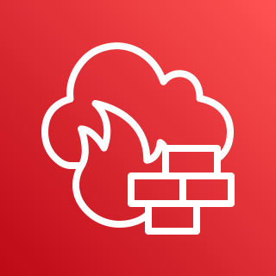
AWS Cloud
Region
Region
VPC
VPC
VPC
VPC
Segment
network
AWS Cloud WAN
EC2 instances
VPC endpoints
EC2 instances
VPC endpoints
EC2 instances
VPC endpoints
VPC endpoints
EC2 instances
Core network edge
nonprod
prod
sharedservices
legacy
Inspection VPC
Inspection VPC
Legacy VPC
Legacy VPC
Internet
AWS Network Firewall
AWS Network Firewall
Internet
EC2 instances
VPC endpoints
EC2 instances
VPC endpoints

