Slide 1
VITAMIN B5 & B6
TOPIC:
PRESENTED BY :
MAIDAH ASHFAQ
SUBJECT :
BIOCHEMISTRY

Slide 2


Slide 3
VITAMIN B5 (PANTOTHENIC ACID)
Vitamin B5, also called pantothenic acid, is one of the most important vitamins for human life
The word pantothenic comes from the Greek word "pantou," which means ‘everywhere’, as almost all foods contain small quantities of pantothenic acid in them..
It’s necessary for making blood cells, and it helps you convert the food you eat into energy.
.

Slide 4
ACTIVE FORMS
There are the two active Coenzymes forms of Pantothenic Acid.
Coenzyme-A(CoA – SH)
Acyl Carrier Protein (ACP)

Slide 5
VITAMIN B5 (PANTOTHENIC ACID)
B vitamins are also needed for:
Healthy skin, Hairs, Eyes
Proper functioning of the nervous system and liver
Healthy digestive tract
Making red blood cells, which carry oxygen throughout the body
Making sex and stress-related hormones in the adrenal glands

Slide 6
SOURCES OF VITAMIN B5
The best way to make sure you’re getting enough vitamin B5 is to eat a healthy, balanced diet every day.
Vitamin B5 is an easy vitamin to incorporate into a good diet. It’s found in most vegetables, including:
Broccoli, Members of the cabbage family
white and sweet potatoes, whole-grain cereals
Other Healthy sources of B5 include:
Mushrooms, Nuts, beans, peas
Lentils, meats, poultry, Dairy products, eggs

Slide 7
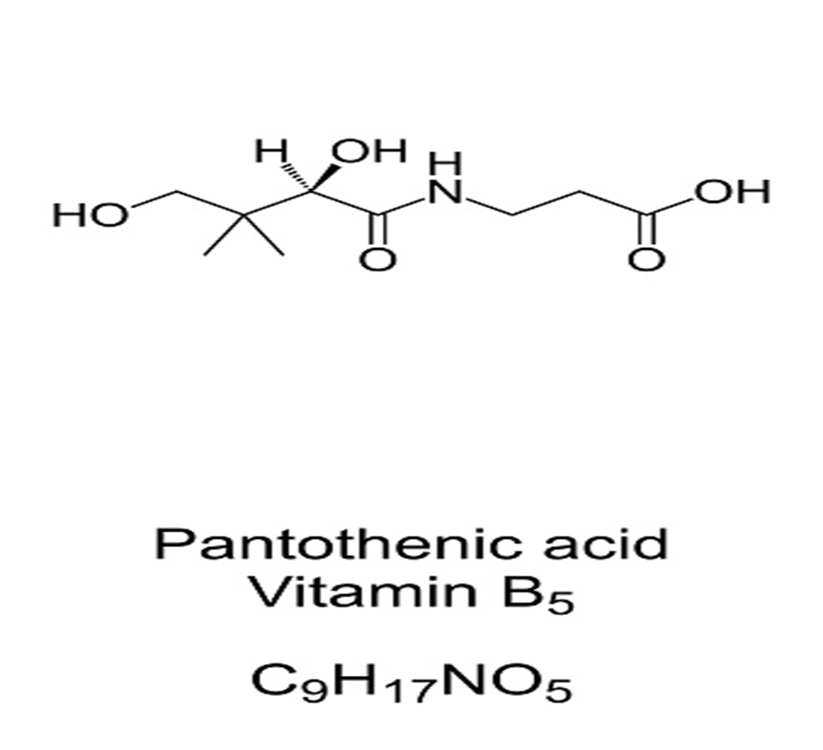
MOLECULAR STRUCTURE OF VITAMIN B5

Slide 8
How much vitamin B5 should we get?
As with most nutrients, the recommended intake of vitamin B5 varies by age. These are the recommended daily allowances :
Life Stage Group | Recommended Daily Intake of Vitamin B5
Infants 6 months and younger | 1.7 mg
Infants 7 to 12 months | 1.8 mg
Children 1-3 years | 2 mg
Children 4-8 years | 3 mg
Children 9-13 years | 4 mg
14 years or older | 5 mg
Pregnant or breast-feeding women | 7 mg

Slide 9
SYMPTOMS OF VITAMIN B5
Vitamin B5 deficiency is rare, but may include symptoms such as :
Insomnia, Depression
Vomiting, Stomach pains
Burning feet, Upper respiratory infections.
Fatigue, Irritability
impaired muscle coordination
gastrointestinal problems
Symptoms generally go away once you start getting enough vitamin B5.

Slide 10
COSMETIC USES OF B5
Vitamin B5 is often added to hair and skin products, as well as makeup.
Dexpanthenol, a chemical made from B5, is used in creams and lotions designed to moisturize the skin.
In Hair products, B5 can help add volume and sheen. It’s also said to improve the texture of hair that is damaged by styling or chemicals.
One studyTrusted Source found that the application of a compound containing panthenol, a form of vitamin B5, could help stop thinning hair.

Slide 11
B5 CHEMICALS
It can also be applied to the skin to relieve itchiness and promote healing from skin conditions, such as:
Eczema
Insect bites
Poison ivy
Diaper rash

Slide 12
VITAMIN B6 (PYRIDOXINE)
Vitamin B6, also known as pyridoxine, is a water-soluble vitamin that your body needs for several functions.
Vitamin B₆ is one of the B vitamins, and thus an essential nutrient. The term refers to a group of six chemically similar compounds, i.e., “Vitamers” which can be interconverted in biological systems.

Slide 13
VITAMIN B6 (PYRIDOXINE)
Vitamin B-6 (pyridoxine) is important for normal brain development and for keeping the nervous system and immune system healthy.
It’s significant to protein, fat and carbohydrate metabolism and the creation of red blood cells and neurotransmitters.

Slide 14
SOURCES OF VITAMIN B6
Food Sources:
Food Sources of Vitamin B6 is found in a variety of animal and plant foods.
Fish, Potatoes, Chickpeas,
Bananas and Fortified Cereals
Beef liver,Tuna
Salmon,Fortified cereals
Chickpeas Poultry
Some vegetables and fruits, especially Dark leafy greens, Banana, Papayas, Oranges.

Slide 15
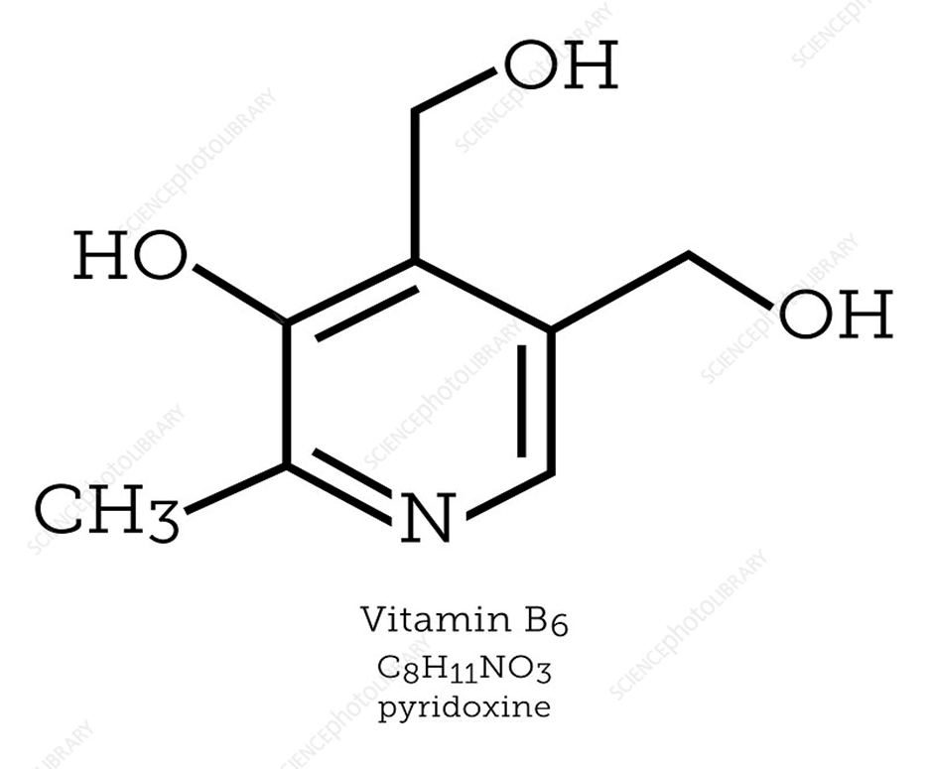
MOLECULAR STRUCTURE OF VITAMIN B6

Slide 16
SIGNS OF DEFICIENCY
DEFICIENCY :
A vitamin B6 deficiency most often occurs when other B vitamins in the body are low. A mild deficiency may have no symptoms, but a more severe or prolonged deficiency can exhibit the following:
Microcytic anemia
Skin conditions
Depression
Confusion
Lowered immunity

Slide 17
TOXICITY AND SYMPTOMS OF B6
Toxicity :
It is quite unlikely to reach a toxic level of vitamin B6 from food sources alone. Vitamin B6 is a water-soluble vitamin so that unused amounts will exit the body through the urine.
Symptoms:
Symptoms include:
Neuropathy in feet and hands
Ataxia (loss of control of body movements)
Nausea

Slide 18
STAY HEALTHY IN YOUR LIFE TAKES VITAMINS IN YOUR DIETS!
THANK YOU!

