Slide 1
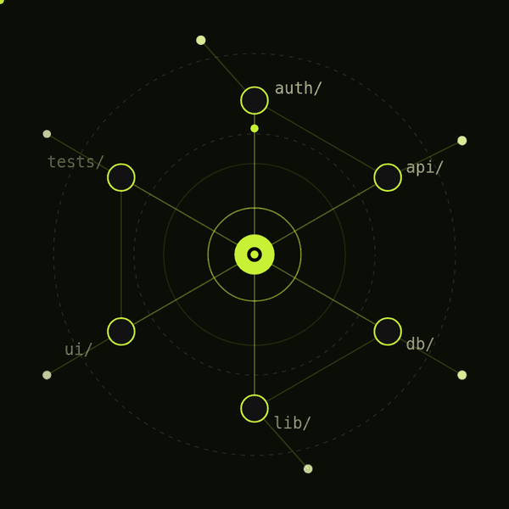
CODEBASE INTELLIGENCE · GEMMA 4
CodeBaseGPT
Understand any codebase.
Every answer cites its code.
Import a GitHub repository or ZIP, explore it as a live map, ask questions answered with file-and-line citations, and debug real code in a sandbox.
Atlas
Ask
Impact
Tutor
Notes:
CodeBaseGPT helps students and developers understand unfamiliar repositories. The animated graph is the Atlas idea: folders as nodes, imports as edges. Four tools: Atlas, Ask, Impact and the Code Tutor. Live at codebasegpt.vercel.app.

Slide 2



Reading someone else’s code is slow
THE PROBLEM
Where does it start?
What depends on what?
Can I trust the answer?
Entry points, routes and mains are scattered across folders you have never opened.
Changing one file can break code several imports away, and nothing tells you where.
A generic chatbot can describe code it never read. You need answers that point at real lines.
CodeBaseGPT answers all three from the repository itself.
Notes:
Three questions every newcomer to a codebase asks. The rest of the deck shows how CodeBaseGPT answers each one using the repository’s own code, not guesses.

Slide 3






Six tools, one indexed repository
WHAT IT DOES
Codebase Atlas
Ask
I’m stuck
An interactive map of folders, files, imports and calls.
Gemma 4 answers with file-and-line citations.
Your error, the related code and live web sources together.
Change impact
Learning path
Code Tutor
Every dependent, test and entry point a change can reach.
A cited codebase guide and a step-by-step route.
Run code in a sandbox, then explain, fix and verify.
Notes:
Everything works on one indexed copy of the repository. Atlas for structure, Ask for cited answers, I’m stuck for debugging with web research, Change impact before editing, the Guide and Learning path for onboarding, and the Code Tutor for running and fixing code.

Slide 4

From repository to map
HOW IT WORKS
Import
Parse
Index
Explore
A GitHub URL or a ZIP upload. Secrets, binaries and build output are filtered out.
Tree-sitter reads TypeScript, JavaScript, Python, Java, C and C++.
Files, symbols, imports and calls stored in Postgres with full-text search.
An Atlas graph, change impact, a cited guide and a learning path.
Notes:
Import from GitHub or a ZIP, with secrets and binaries filtered out. Tree-sitter parses six languages into files, symbols, imports and calls. Everything is indexed in Postgres with full-text search. Then you explore.

Slide 5
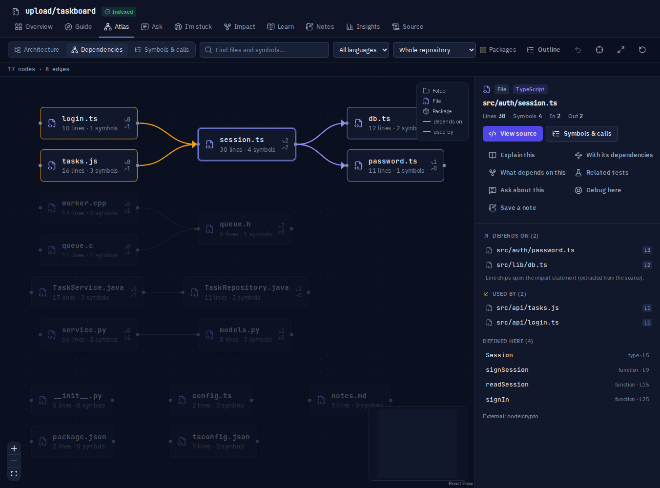
See the structure, then the evidence
CODEBASE ATLAS
Three views: architecture, file dependencies, and symbols & calls
Every connection shows its source: the import line or call site
Calls labelled static, via import, or unresolved
One click to explain, trace impact, debug or save a note
A keyboard-friendly outline of the same graph
Notes:
The Atlas is built from the index, not drawn by the AI. Selecting session.ts shows what it depends on and what uses it, each with the exact import line. Screenshot from a local build using the project’s test repository.

Slide 6
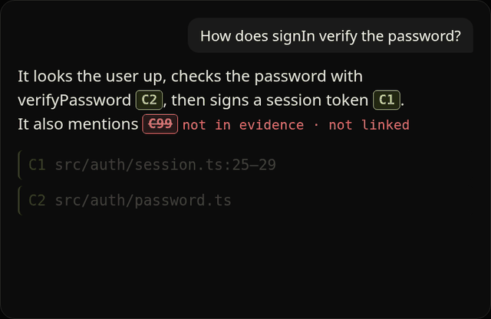
Answers that show their sources
ASK · I’M STUCK
Full-text retrieval finds the relevant code before the model writes
Gemma 4 26B A4B answers; Gemma 4 31B takes over if it fails
Citation labels are checked against the evidence the model saw
Claims the code doesn’t show are labelled Inference
I’m stuck adds live web results alongside your code
C99 was not in the evidence, so it is flagged and never linked.
Notes:
Ask retrieves code first, then Gemma answers only from that evidence. Every citation label is validated: real ones open the exact lines, invented ones are struck through. I’m stuck combines a stack trace, the related code and Tavily web search.

Slide 7
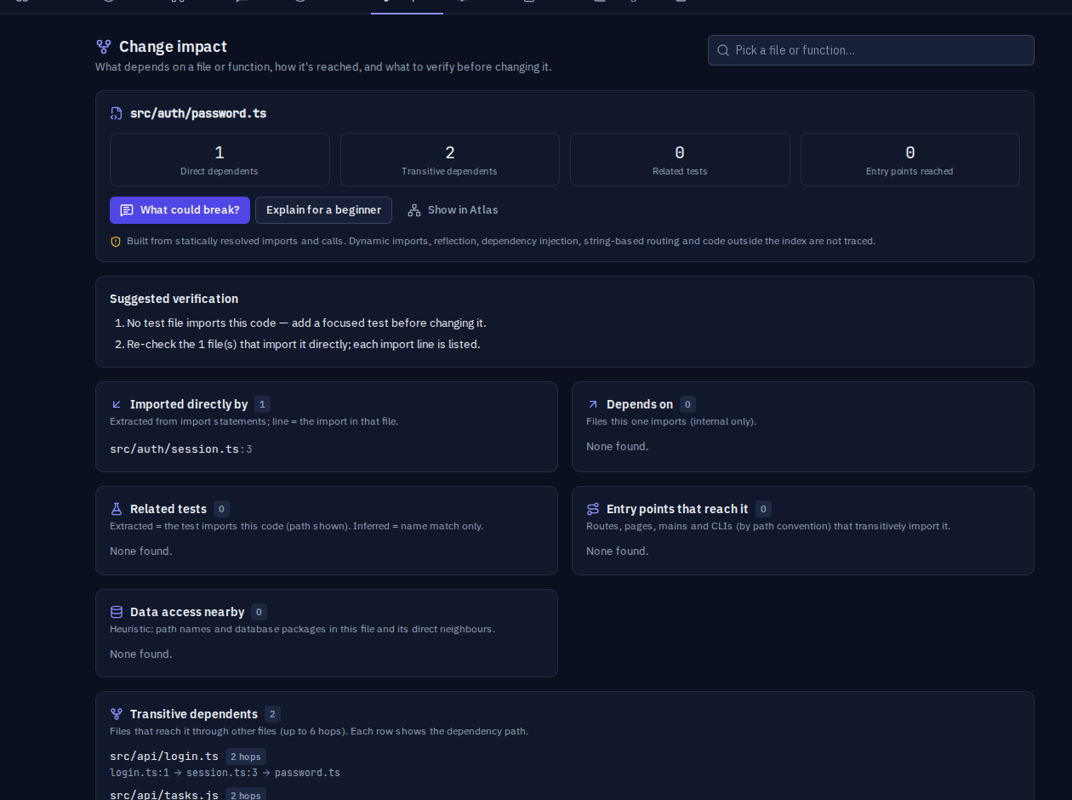
Know what breaks before you change it
CHANGE IMPACT
Direct and transitive dependents, each with its import path
Related tests marked extracted (imports it) or inferred (name match)
Entry points that reach it, and nearby data access
A suggested verification checklist
Says plainly what static analysis can’t see
Notes:
Pick any file or function. CodeBaseGPT walks the import graph backwards to find everything that depends on it, shows how each dependent reaches it, and separates evidence it extracted from guesses it inferred.

Slide 8
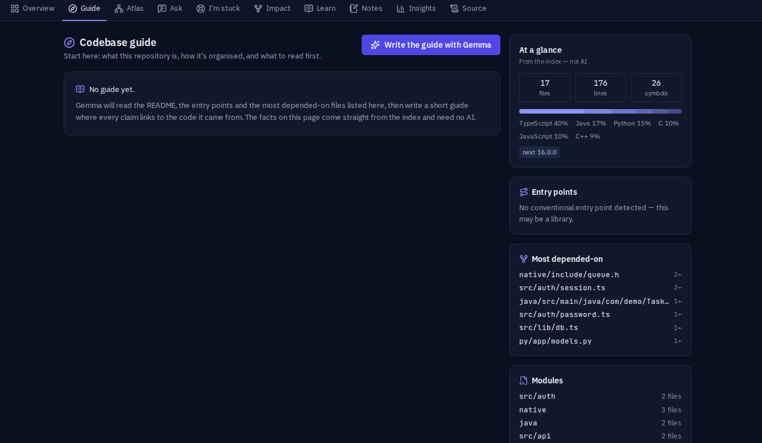


A guide, a route, and your own notes
ONBOARDING
Codebase guide
Facts from the index, plus a cited Gemma overview.
Learning path
README → entry points → core files → practice.
Notes
Private notes, flagged when their file changes.
Notes:
The guide’s side panel comes straight from the index: languages, entry points, most depended-on files. Gemma writes the narrative, with every claim cited. The learning path is built from the real dependency graph, and notes are flagged as possibly stale when their file changes on re-import.

Slide 9
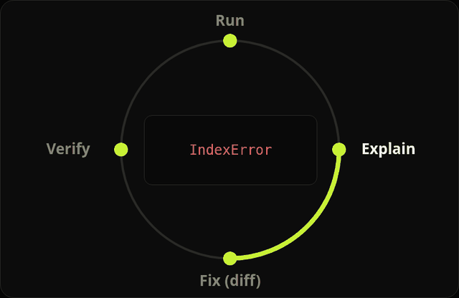
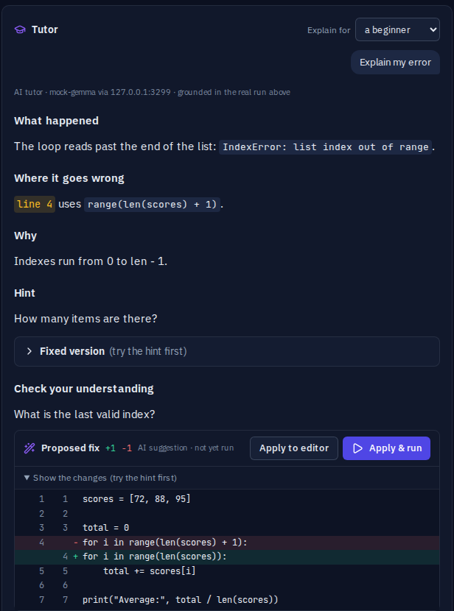
Run it, understand it, fix it, prove it
CODE TUTOR
Python, JavaScript, TypeScript, C, C++ and Java
Vercel Sandbox: no network, 10 s limit, 64 KB output
Explains the real output and exit code
Fix shown as a diff; nothing changes until you apply it
A re-run confirms Verified or Not fixed yet
The default Python example: IndexError, then Average: 85.0 after the fix.
Notes:
Students run code in an isolated Vercel Sandbox. The tutor reads the real compiler output and exit code, teaches with a hint first, then proposes a fix as a diff. Applying it and re-running shows Verified or Not fixed yet. Screenshots use a test stand-in model.

Slide 10
One app, managed services around it
ARCHITECTURE
Neon Postgres · Drizzle
Next.js 16 on Vercel
Better Auth · email, GitHub, Google
Gemma 4 · Google AI Studio
Browser
Tavily web search
API routes · ownership + rate limits
Vercel Sandbox
Indexer · tree-sitter, 6 languages
Resend email
Retrieval + citation checks
GitHub · import + sign-in
Notes:
A single Next.js 16 app on Vercel handles sign-in, the API and indexing. It talks to Neon Postgres through Drizzle, Gemma 4 through Google AI Studio, Tavily for web search, Vercel Sandbox for running code, Resend for email, and GitHub for imports and sign-in.

Slide 11






Private by default
SECURITY & PRIVACY
Owner-only data
Rate limits
Every API checks ownership; other users get a 404.
Postgres-backed limits on chat, search, imports, runs and sign-in.
Prompt-injection guards
Sandboxed code
Repository text is delimited and neutralized before Gemma sees it.
User code runs in a microVM with no network, never on the server.
Secrets stay server-side
Strong passwords
OAuth tokens encrypted at rest; .env and key files filtered at import.
Argon2id hashing and origin checks on every auth request.
Notes:
Isolation is enforced on the server for every request, not just in the UI. Rate limits live in Postgres so they hold across serverless instances. Repository content is treated as untrusted data in every prompt.

Slide 12
Built to be trusted
VERIFIED, NOT CLAIMED
104
14
0
6
unit and integration tests passing
browser tests, including a real sandbox run
WCAG 2.1 AA violations in the axe scan, both themes
languages the Code Tutor runs
Gemma 4 26B A4B with Gemma 4 31B as fallback · lint and type-check clean · measured 28–29 Oct 2026 on the shipped code
Notes:
Every number here was run, not estimated: 104 unit and integration tests, 14 Playwright browser tests including one that runs real code in Vercel Sandbox, and an axe WCAG 2.1 AA scan with zero violations on key pages in both light and dark themes.

Slide 13
TRY IT
codebasegpt.vercel.app
Sign in with email, GitHub or Google, import a repository, and ask your first question.
Next.js 16 · Better Auth · Drizzle · Neon · Gemma 4 · Vercel Sandbox · Resend
Notes:
Live at codebasegpt.vercel.app. Questions?

