Slide 1

Data Visualization and Analysis Tools
Teh Song Xuan

Slide 2
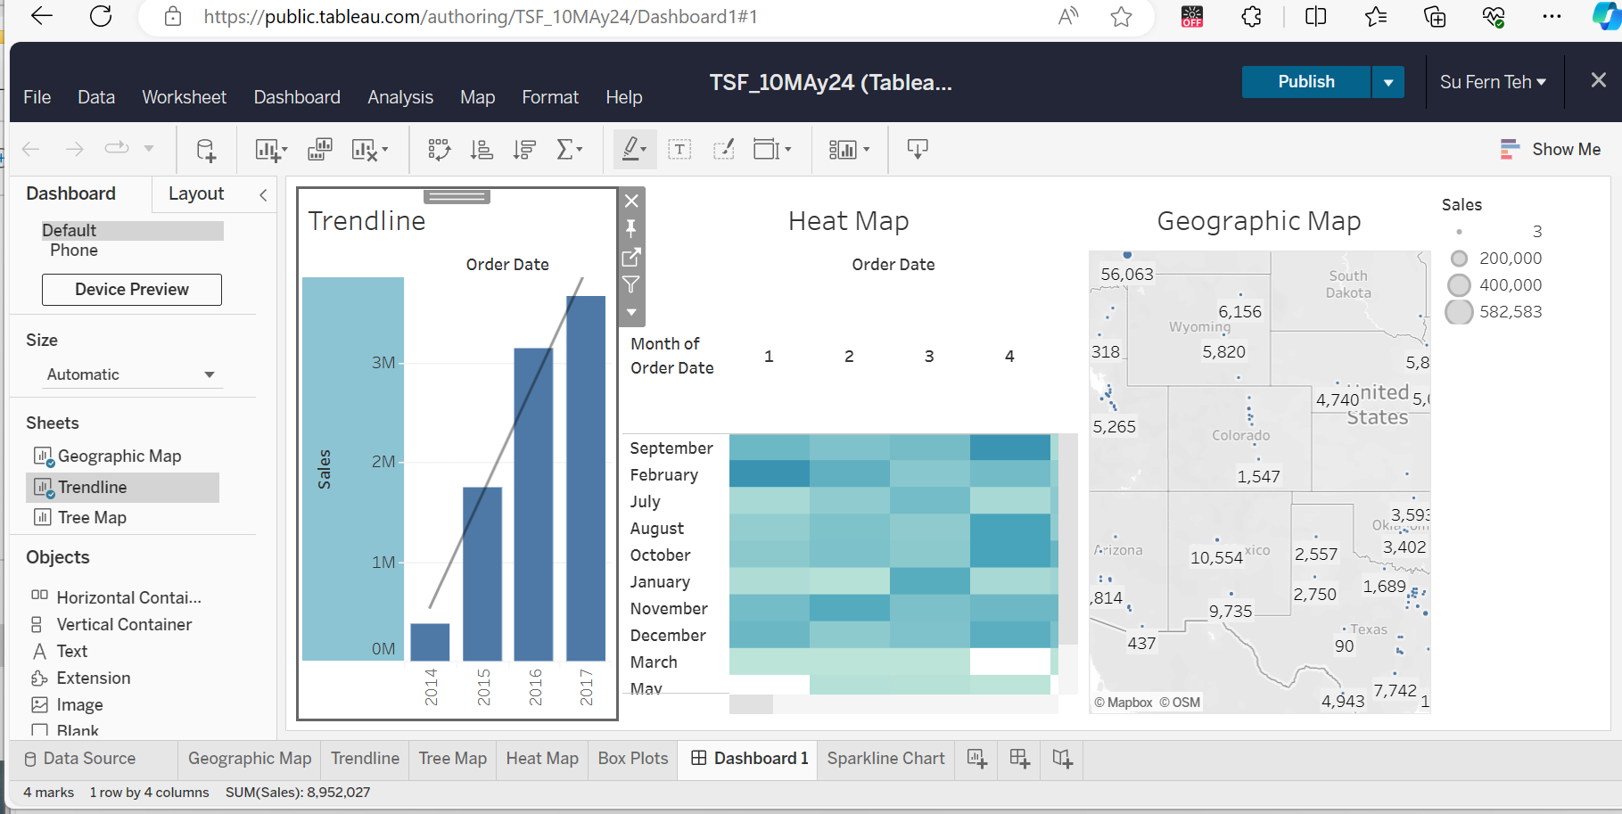
Tableau Public Desktop

Slide 3
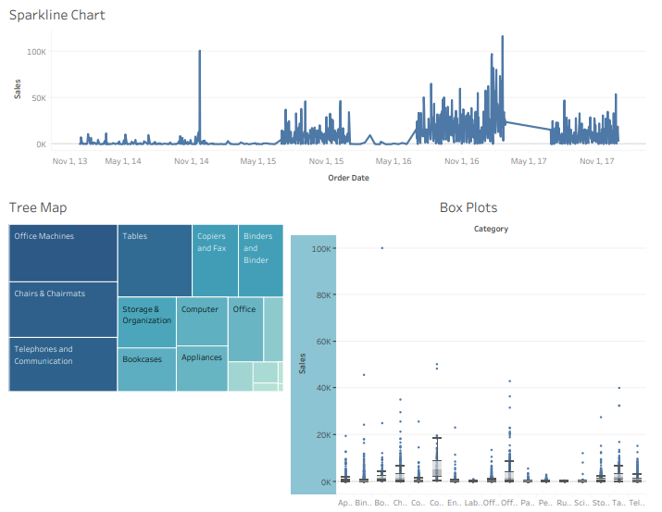
Tableau
Public
Desktop

Slide 4
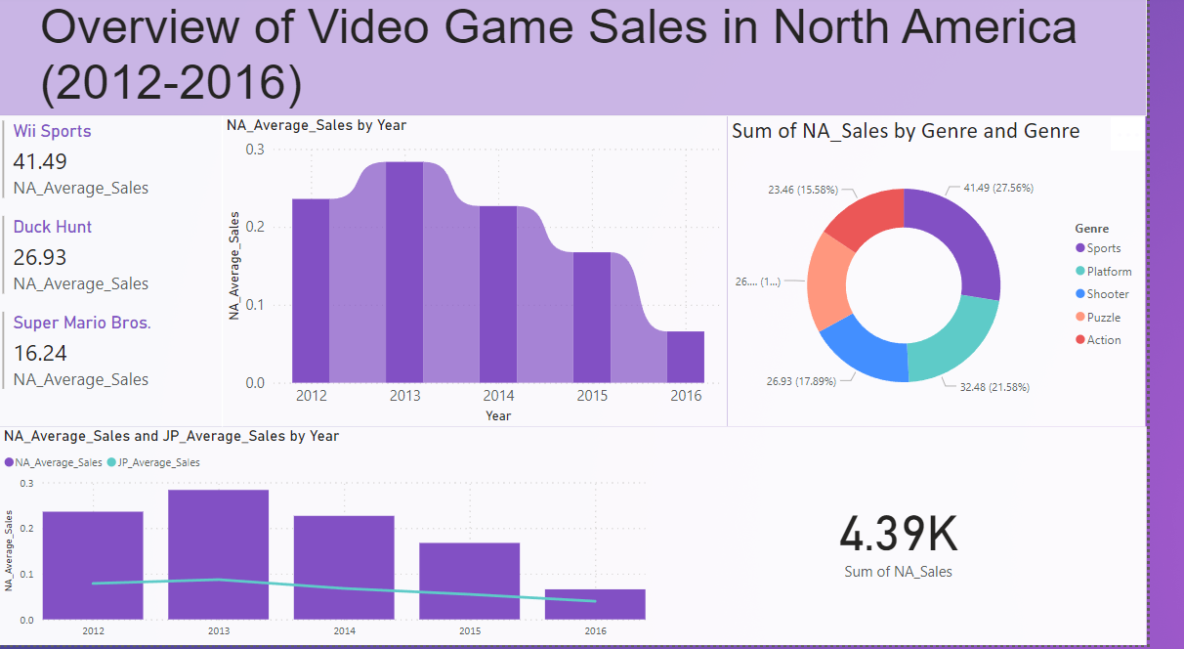
PowerBI

Slide 5
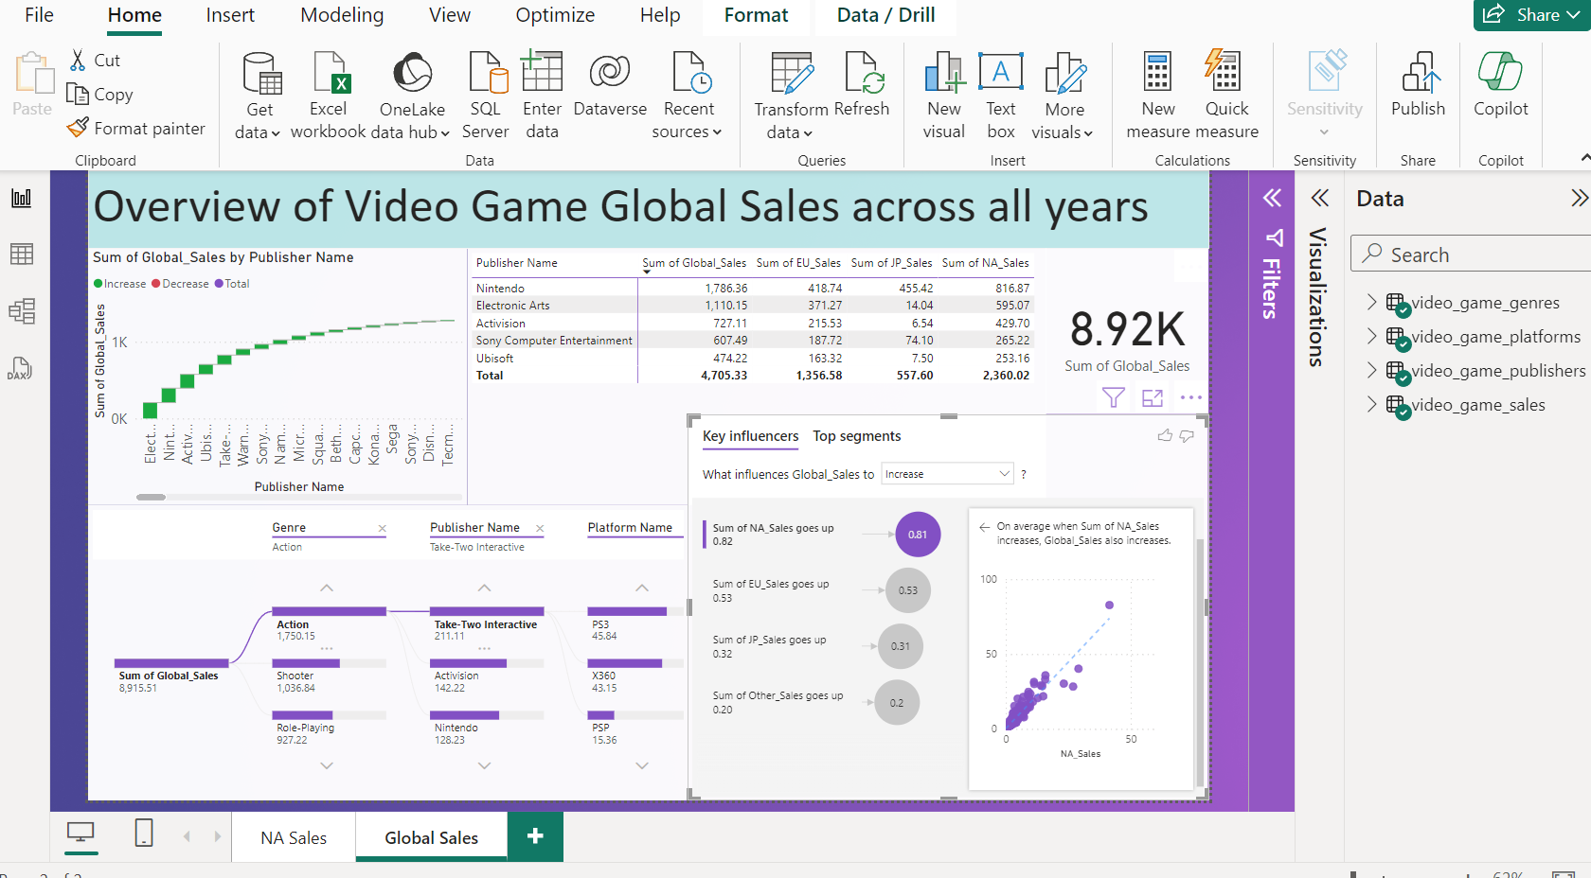
PowerBI

Slide 6
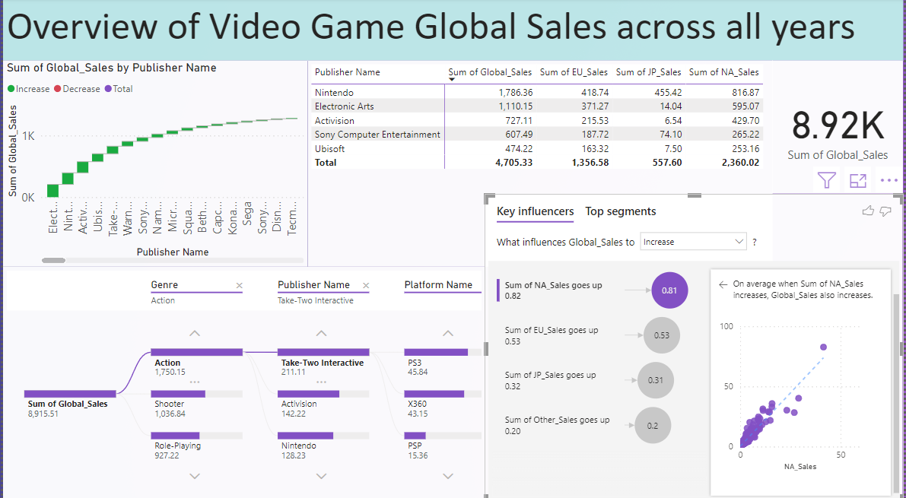

Slide 7
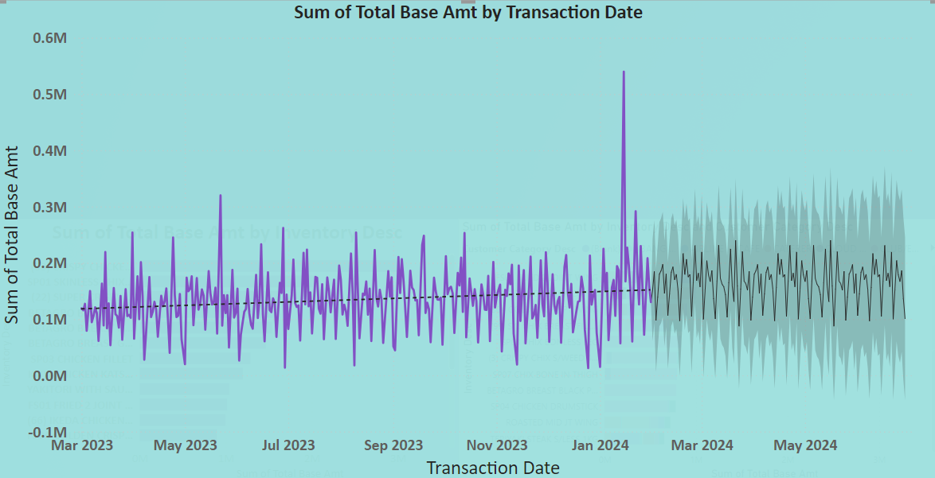

Slide 8
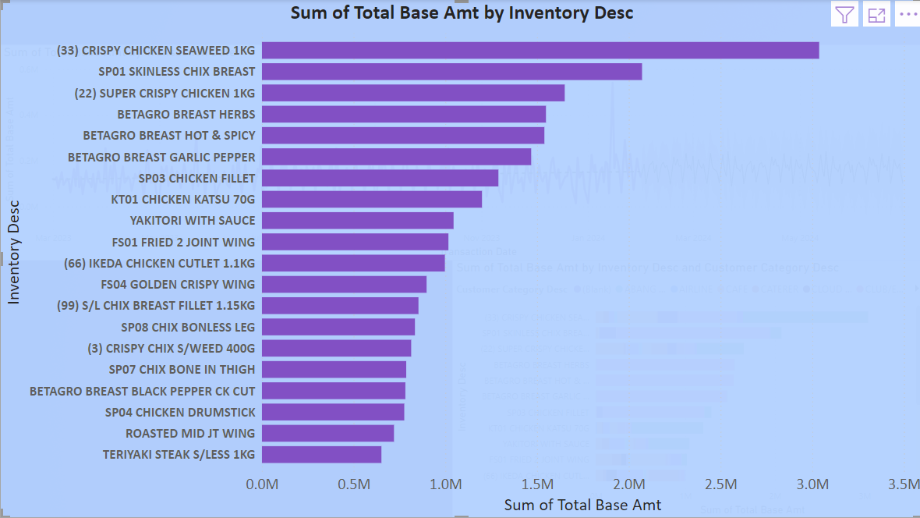

Slide 9
